Slide 1

Note: The data and information in this document is reflective of a hypothetical situation and client. This document is to be used for KPMG Virtual Internship purposes only.
Sprocket Central Pty Ltd
Data analytics approach
[Division Name] - [Engagement Manager], [Senior Consultant], [Junior Consultant]

Slide 2
Note: The data and information in this document is reflective of a hypothetical situation and client. This document is to be used for KPMG Virtual Internship purposes only.
Agenda
Introduction
Data Exploration
Model Development
Interpretation

Slide 3
Note: The data and information in this document is reflective of a hypothetical situation and client. This document is to be used for KPMG Virtual Internship purposes only.
Introduction
Customer Analysis
Age Wise distributions
Number of bike purchases in 3 years
Wealth Segments
Number of cars own on each states

Slide 4
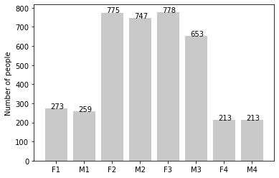
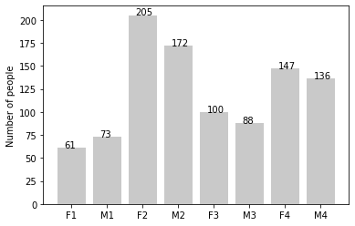
Note: The data and information in this document is reflective of a hypothetical situation and client. This document is to be used for KPMG Virtual Internship purposes only.
Data Exploration
Customer’s age distribution:
Old
As we can see, mostly our new customers are between 25 to 48 years old.
There is a slightly increase in number of customers over 59 years old in term of percentages
It looks like the percentages of under 25 years old not really change.
New

Slide 5
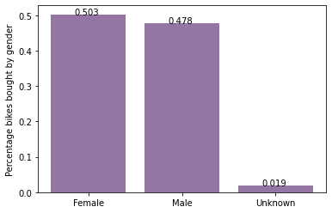
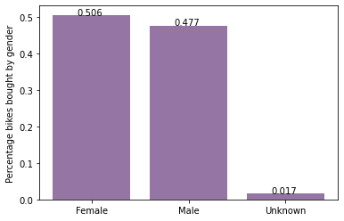
Note: The data and information in this document is reflective of a hypothetical situation and client. This document is to be used for KPMG Virtual Internship purposes only.
Model Development
Bike Purchase Last 3 Years
As we can see, our new customers mostly Female with 50.6%.
Male contributed to 47.7%.
So we should focus on advertises on Female customers than Male customers

Slide 6
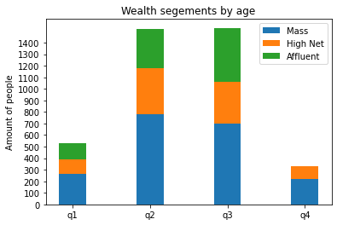
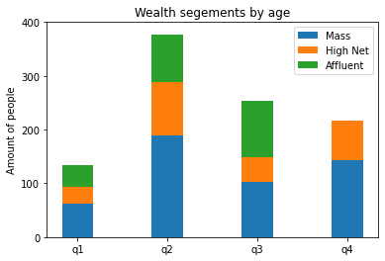
Note: The data and information in this document is reflective of a hypothetical situation and client. This document is to be used for KPMG Virtual Internship purposes only.
Interpretation
Wealth Segment:
In all ages, the number of Mass Customers is the highest so we should focus on this social class.
After that, we should focus on High Net Customer.
Then Affluent Customers but mostly second and third quadrant

Slide 7
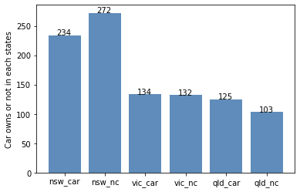
Note: The data and information in this document is reflective of a hypothetical situation and client. This document is to be used for KPMG Virtual Internship purposes only.
Interpretation
Number Of Cars Owned:
NSW should be considered the most since numbers of customers don’t own cars is significantly larger than that own.
VIC and QLD has more customers that own car that who don’t but we can try to have something so that those owns car will buy bikes.

Slide 8
Note: The data and information in this document is reflective of a hypothetical situation and client. This document is to be used for KPMG Virtual Internship purposes only.
Appendix

Slide 9
Note: The data and information in this document is reflective of a hypothetical situation and client. This document is to be used for KPMG Virtual Internship purposes only.
Appendix
Jupyter Notebook is attached as supporting items.

