Slide 1
Good Afternoon

Slide 2
Content
Introduction of OOPs
What is class and object
Encapsulation
Constructor
Inheritance
Type of inheritance
Aggregation
Overriding and Overloading.
Package
Keywords

Slide 3
Introduction of OOPs
Object-oriented programming (OOP) is a style of programming characterized by the identification of classes of objects closely linked with the methods with which they are associated.
OOP mainly focuses on the objects that are required to be manipulated instead of logic.

Slide 4
What is class and object
Class
Collection of similar objects is called class.
class contains properties/state and behaviour/methods of an object.
Object
Object means a real-world entity such as a pen, chair, table, computer, watch, etc.
Any entity that has state and behaviour is known as an object.

Slide 5
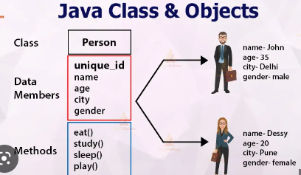
For e.g.
Car- This is class
Object is :-
Brand name
Model
Name
Car number
Behaviour is:-
Mileage()
Comfort()
Wheel drive ().

Slide 6

Encapsulation
Encapsulation in Java is the process by which data (variables) and the code that acts upon them (methods) are integrated as a single unit.

Slide 7
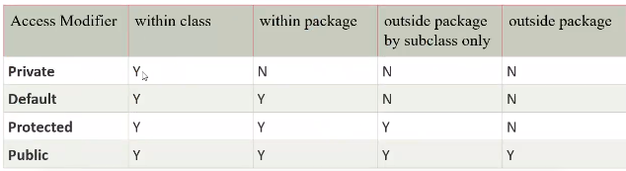
Four types of Java access modifiers
Private: The access level of a private modifier is only within the class. It cannot be accessed from outside the class.
Default: The access level of a default modifier is only within the package. It cannot be accessed from outside the package. If you do not specify any access level, it will be the default.
Protected: The access level of a protected modifier is within the package and outside the package through child class. If you do not make the child class, it cannot be accessed from outside the package.
Public: The access level of a public modifier is everywhere. It can be accessed from within the class, outside the class, within the package and outside the package.

Slide 8
Example of Encapsulation
class Student{
private int rollno;
private String name;
//setters are used to assign the value
void setRollno(int rollno){
this.rollno=rollno;
}
void setName(String name){
this.name=name;
}
//getters are used to print the data
int getRollno(){
return rollno;
}

Slide 9
String getName(){
return name;
}
}
class Sample{
public static void main(String args[]){
Student st=new Student();
st.setRollno(1234);
st.setName("laltha");
System.out.println(st.getRollno()+" "+st.getName());
}
}

Slide 10
Constructor
A constructor in Java is a special method that is used to initialize objects. The constructor is called when an object of a class is created.
Or
In Java a constructor is a block of codes similar to the method. It is called when an instance of the class is created.

Slide 11
Rules for creating Java constructor
There are two rules defined for the constructor.
Constructor name must be the same as its class name.
A Java constructor cannot be abstract, static, final, and synchronized.

Slide 12
Types of constructors
There are two types of constructors in Java:
No-arg constructor, (Default).
A constructor is called "Default Constructor" when it doesn't have any parameter.
Parameterized Constructor
A constructor which has a specific number of parameters is called a parameterized constructor.
The parameterized constructor is used to provide different values to distinct objects. However, you can provide the same values also.

Slide 13
Example of Constructor
class Product{ I
int id;
String name;
String description;
Product(int id,String name,String description){ // This is Constructor
this.id=id;
this.name=name;
this.description=description; }}

Slide 14
Inheritance
Inheritance in Java is a concept that acquires the properties from one class to other classes; for example, the relationship between father and son.
Inheritance in Java is a process of acquiring all the behaviours of a parent object.

Slide 15
Types
Single inheritance.
Multi-level inheritance.
Multiple inheritance.
Hierarchical Inheritance.
Hybrid Inheritance.

Slide 16
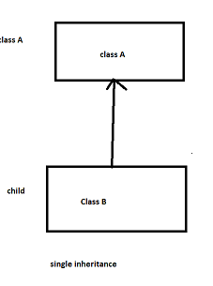
Single inheritance.

Slide 17
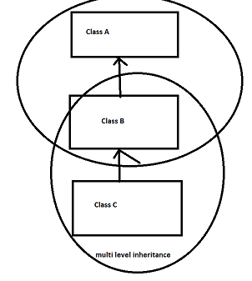
Multi-level inheritance.

Slide 18
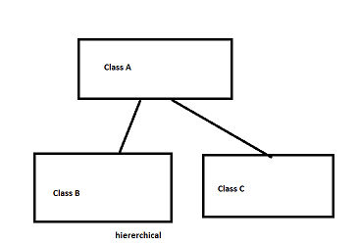
Hierarchical Inheritance.

Slide 19
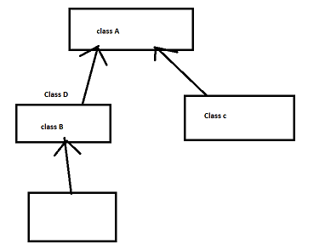
Hybrid Inheritance.

Slide 20
Aggregation
When an object A contains a reference to another object B or we can say Object A has a HAS-A relationship with Object B, then it is termed as Aggregation.

Slide 21
Example
class Address{​​
String state;
String city;
String streetname;
int drno;
Address(String state,String city,String streetname,int drno){​​
this.state=state;
this.city=city;
this.streetname=streetname;
this.drno=drno;
}​​
}​​

Slide 22
class Employee{​​
int eid;
String ename;
String edept;
int esalary;
Address address;(This is aggretation ) // the main benefit of using Aggregation is code re-usability.
Employee(int eid,String ename,String edept,int esalary,Address address){​​
this.eid=eid;
this.ename=ename;
this.edept=edept;
this.esalary=esalary;
this.address=address;
}​​
​​

Slide 23

Polymorphism
Polymorphism means having many forms. In simple words, we can define polymorphism as the ability of a message to be displayed in more than one form.
In Java polymorphism is mainly divided into two types:
Compile-time Polymorphism(Method overloading/Static binding)
Runtime Polymorphism(Method overriding/Dynamic binding)

Slide 24
Overriding and Overloading.
When there are multiple methods with the same name but different parameters then these methods are said to be overloaded. method can be overloaded by change in the number of arguments or/and a change in the type of arguments is called overloading
If subclass (child class) has the same method as declared in the parent class, it is known as method overriding in Java.

Slide 25
Overloading
class Student{
String name;
int age;
String address;
// constructor
Student(){
this.name="unknown";
this.age=0;
this.address="not aviable";
}
void setInfo(int age,String name){
this.age=age;
this.name=name;
}
void setInfo(String name,int age,String address){
this.name=name;
this.age=age;
this.address=address;
}
}

Slide 26
Overriding
class Vehicle{
void run(){
System.out.println("Vehicle is running");
}}
class Bike extends Vehicle{
//overriding
void run(){
System.out.println("Bike is running");
}}class Car{
public static void main(String args[]){
Bike b=new Bike();
b.run(); }}

Slide 27
What is package in java?
A java package is a group of similar types of classes, interfaces and sub-packages.
Package in java can be categorized in two form, built-in package and user-defined package.
There are many built-in packages such as java, lang, swing, net, io, util, sql etc.

Slide 28
Super keyword
The super keyword in Java is a reference variable which is used to refer immediate parent class object.
Usage of Java super Keyword
super can be used to refer immediate parent class instance variable.
super can be used to invoke immediate parent class method.
super() can be used to invoke immediate parent class constructor.

Slide 29
Final keyword
The final keyword in java is used to restrict the user. The java final keyword can be used in many context.
Final can be:
variable--if declare with a final keyword we cannot change value
method--if declare with a final keyword we cannot override
class--if declare with final keyword we cannot inherit

Slide 30
this keyword
It is used to refer current class instance variables
it is used to refer current class instance methods
it is used for refer current class constructor

Slide 31
Thanks

