Slide 1
Content
Introduction of OOPs
Advantages of OOPs
What is class and object
Static method
Instance method
Heap memory
Use of New keyword in java

Slide 2
Introduction of OOPs
Object-oriented programming (OOP) is a style of programming characterized by the identification of classes of objects closely linked with the methods with which they are associated.
OOP mainly focuses on the objects that are required to be manipulated instead of logic.

Slide 3
Advantages of OOPs
Solving problems.
We can reuse the code multiple times using class.
It is easy to maintain and modify.
Quicker improvement.

Slide 4
What is class and object
Class
Collection of similar objects is called class.
class contains properties/state and behaviour/methods of an object.
Object
Object means a real-world entity such as a pen, chair, table, computer, watch, etc.
Any entity that has state and behaviour is known as an object.

Slide 5
For e.g.
Car- This is class
Object is :-
Brand name
Model
Name
Car number
Behaviour is:-
Mileage()
Comfort()
Wheel drive ().

Slide 6
Static method
Static method is declared with static keyword.
Static methods are the methods in Java that can be called without creating an object of class.
Static method are referenced by the class name itself.

Slide 7
Instance method
Instance method can access the instance methods and instance variables directly.
Instance method are methods which require an object of its class to be created before it can be called.
Instance method is not with static keyword.
instance methods which are declared inside the class and outside the method, these we can access with help of instance/object only.

Slide 8
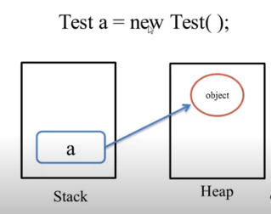
Heap memory
The Java heap is the area of memory used to store objects instantiated by applications running on the JVM.
New objects are always created in heap space, and the references to these objects are stored in stack memory.
Any object created in the heap space has global access and can be referenced from anywhere of the application.

Slide 9
Use of New keyword in java
To creates new objects.
To Call instance variable
To create a object in array then use the new keyword.
Car c=new car();

