Slide 1

Seasonal Agriculture Performance Analysis
Abhilash Pandey
College of Innovative Management and Sciences
AICTE STU ID : STU6a2ae770771891781196656

Slide 2

PROBLEM STATEMENT
Agricultural performance is influenced by seasonal variations in environmental conditions, farming practices, resource availability and market conditions.
Raw agricultural data does not clearly explain how performance changes across seasons or what patterns exist in different seasonal conditions.
The problem is to analyze the seasonal agriculture dataset and identify meaningful patterns, trends, relationships and variations in performance across Kharif, Rabi and Zaid seasons.

Slide 3
Project Description This project analyzes a dataset of 4,000 farm records across 8 Indian states, covering 8 crops and 3 seasons (Kharif, Rabi, Zaid). It examines how yield, production, environmental conditions, resource usage and economic performance (cost, revenue, profit) vary across seasons. The analysis includes data cleaning, exploratory data analysis, correlation study, and statistical testing (ANOVA), leading to evidence-based conclusions and recommendations for seasonal agricultural planning.

Slide 4

WHO ARE THE END USERS?
Farmers and agricultural planners deciding which crops and seasons to prioritize
State agriculture departments and policymakers designing seasonal support schemes
Agri-business and irrigation companies planning resource allocation by season
Researchers and data analysts studying seasonal patterns in agricultural performance

Slide 5

Technology Used
Python 3 (Google Colab / Jupyter Notebook)
Pandas and NumPy for data cleaning and preparation
Matplotlib and Seaborn for data visualization
SciPy for statistical testing (ANOVA)
GitHub for version control and project hosting

Slide 6
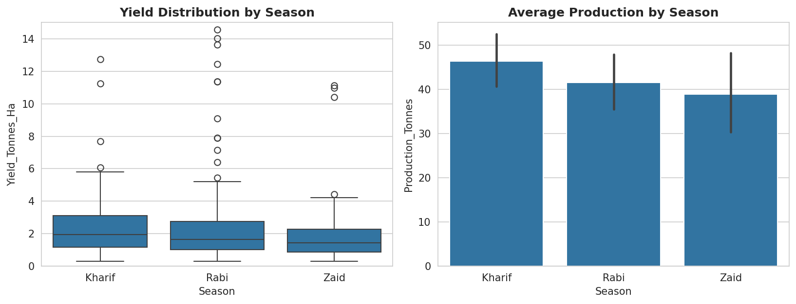
RESULTS
Yield and Production Comparison Across Seasons

Slide 7
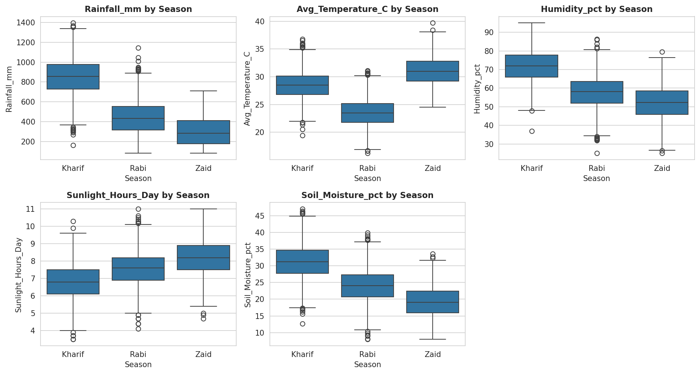
RESULTS
Environmental Conditions Across Seasons

Slide 8
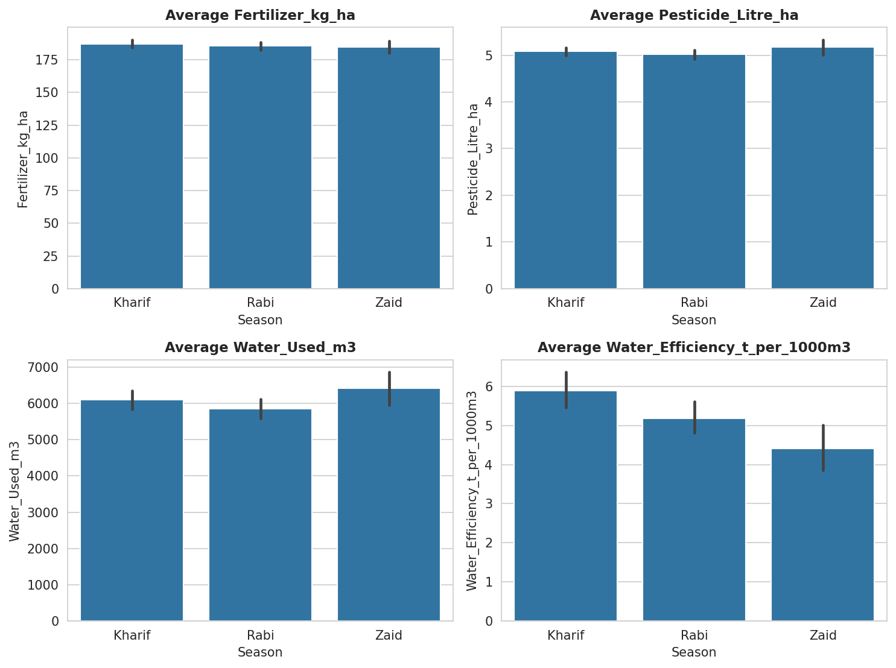
RESULTS
Resource Usage and Irrigation Across Seasons

Slide 9
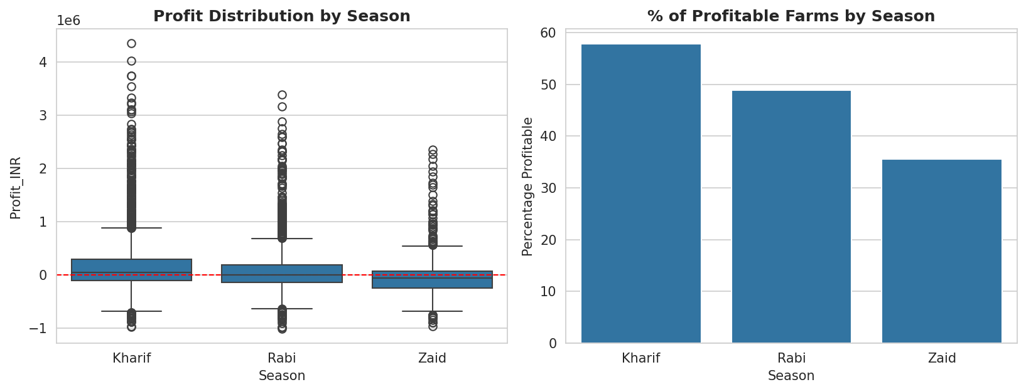
RESULTS
Economic Performance Across Seasons

Slide 10
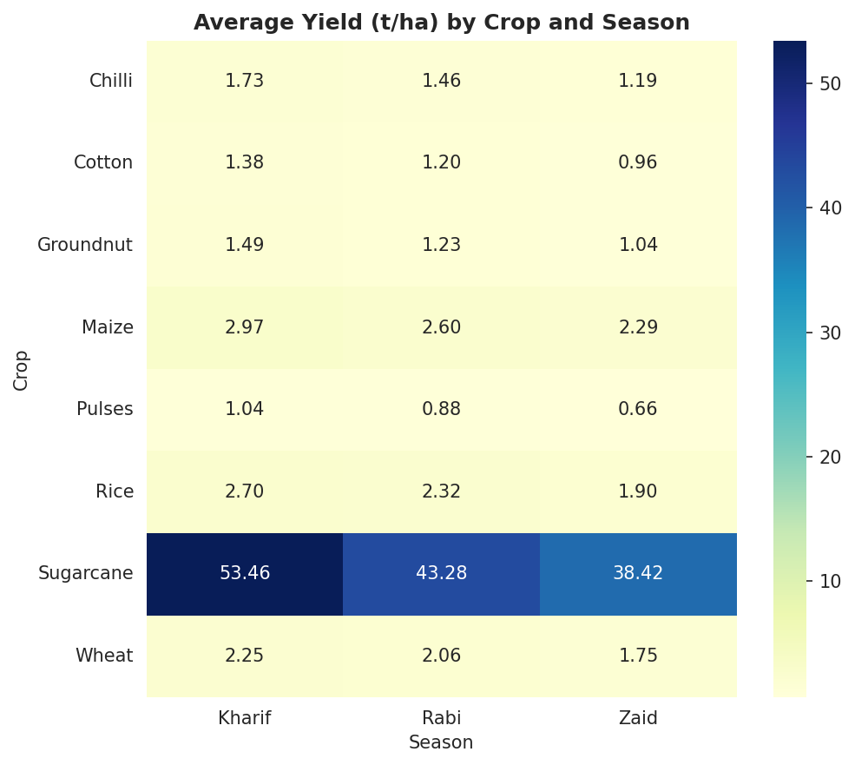
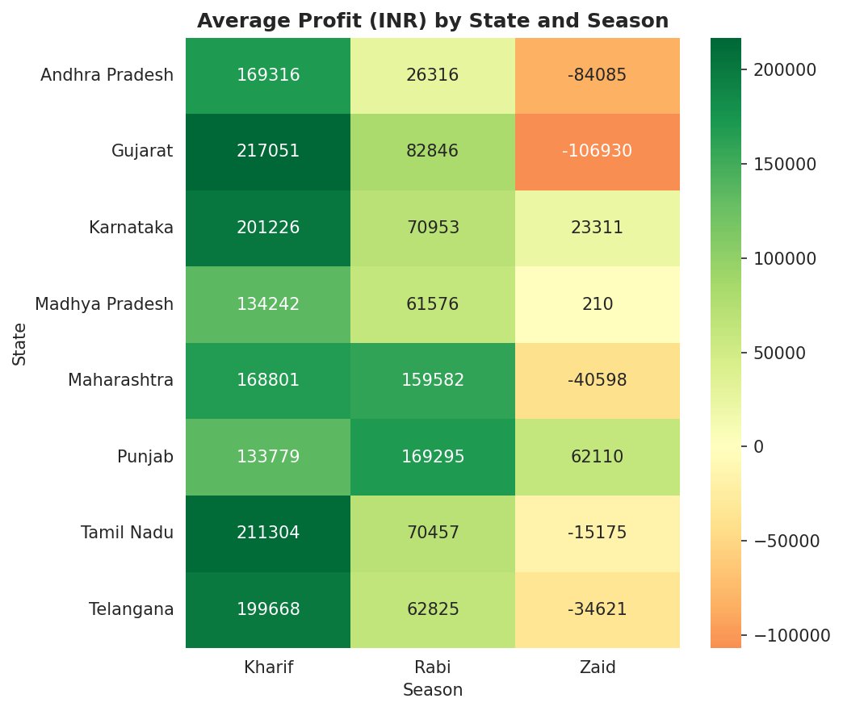
RESULTS
Yield by Crop and Profit by State, Across Seasons

Slide 11
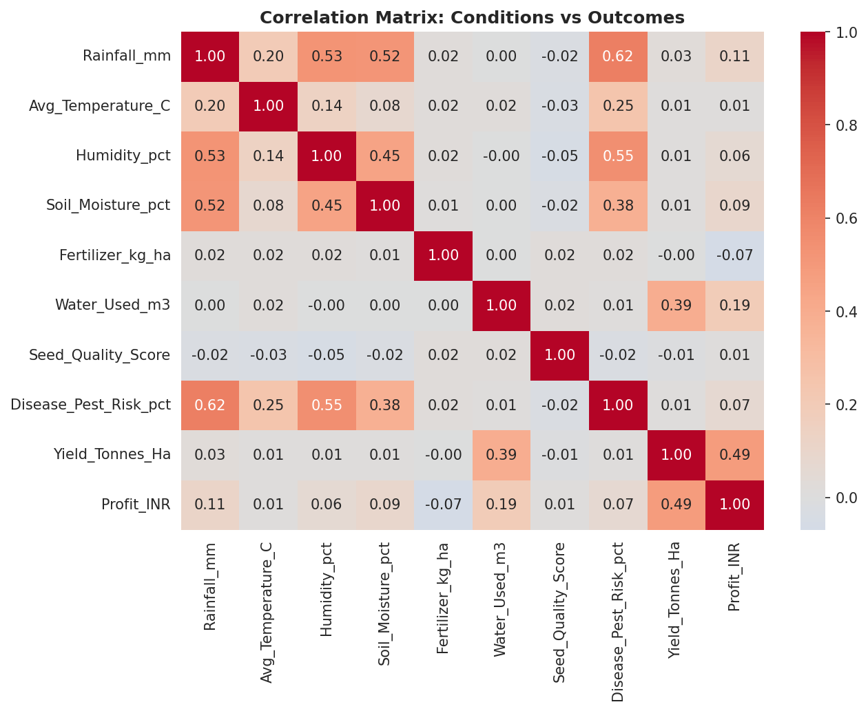
RESULTS
Correlation and ANOVA Testing
ANOVA Test Results
Yield across seasons: F = 1.554, p = 0.212 (not significant)
Profit across seasons: F = 34.292, p < 0.001 (statistically significant)
Key Correlations
Yield correlates with Water_Used (0.39) and Profit (0.49)
Disease/Pest Risk correlates with Rainfall (0.62) and Humidity (0.55)
Fertilizer use and Seed Quality Score show almost no correlation with yield or profit

Slide 12
Future scope
Extend the analysis to multi-year data to study year-over-year seasonal trends
Build a predictive model to forecast yield and profit for upcoming seasons
Develop an interactive dashboard for real-time seasonal monitoring by state
Incorporate satellite and weather-forecast data for early seasonal planning

Slide 13
GitHub Link
https://github.com/1234abhilashpandey-coder/Seasonal-Agriculture-Performance-Analysis
Repository includes the dataset, the full analysis notebook, and project documentation.

Slide 14

VOIS Course completion certificate - Course name- Data Visualization

Slide 15
Thank you
.
.

