Slide 1
THE CORRELATION BETWEEN HEALTH INSURANCE STATUS AND IN-HOSPITAL MORTALITY
PRESENTER: MANZOLO DENNIS MWENDWA
BASCC01/1043/2021
SUPERVISOR: DR. ARGAN WEKESA
THE CO-OPERATIVE UNIVERSITY OF KENYA
APRIL 2025

Slide 2
Declaration and Acknowledgement
Declaration
I hereby declare that this Project Proposal is my work and has, to the best of my knowledge, not been submitted to any other institution of higher learning for any award.
Acknowledgement
I express my deepest gratitude and thanks to the Almighty God for the grace, good health, and strength to have made it this far. I would also like to extend my sincere appreciation to my family and friends who gave their moral and financial support to see that the project is executed. I also thank my faculty supervisor, Dr. Wekesa, for his scholarly support and guidance in completing this project.

Slide 3
Presentation Outline
1. Introduction
Problem Statement
Objectives of the study
Justification
Scope of the study
2. Literature Review
3. Research Methodology
4. Data Analysis, Results, Findings, and Discussions
5. Conclusion and Recommendations

Slide 4
Background of the Study
Health insurance is widely seen as a key policy tool to improve health outcomes, reducing in-hospital mortality by enabling timely care and easing financial constraints.
Recent research indicates insurance expansions reduce adult mortality and improve healthcare access.
In Kenya, NHIF is the primary public insurer, covering almost 18% of the population, while primary insurers cover nearly 1%.
NHIF has challenges: limited access, inadequate coverage, and poor administration.
Most Kenyans rely on out-of-pocket healthcare payments.
Uninsured patients face higher risks of mortality.
Study examines the impact of insurance on in-hospital mortality in Kenya.

Slide 5
Statement of the Problem
High in-hospital mortality rates remain a concern in Kenya.
Lack of evidence on whether health insurance reduces these rates.
Multiple factors influence mortality outcomes: quality of healthcare services, socioeconomic disparities, and geographic inequalities.
There is a knowledge gap on the correlation between insurance status and in-hospital mortality.
This study aims to address this gap.

Slide 6
Objectives of the Study
General objective: Investigate the correlation between insurance status and in-hospital mortality.
Specific objectives :
-To assess the influence of key demographic and socioeconomic factors (age, gender, income, residence, education, and employment) on the likelihood of in-hospital death.
- To evaluate the predictive value of health insurance and other covariates using multivariable logistic regression models and classification metrics such as ROC curves and AUC.
-To address potential endogeneity in the insurance-mortality relationship by applying instrumental variable estimation (2SLS) and the control function approach.
To conduct diagnostic tests (e.g., Durbin-Wu-Hausman test, partial R², F-statistic) to validate the robustness and statistical integrity of the models used.

Slide 7
Justification and Scope of the Study
Provides insight into the relationship between health insurance and in-hospital mortality in Kenya.
Identifies gaps in insurance coverage and utilization that contribute to high in-hospital mortality.
Acts as a framework for identifying vulnerable populations affected by poor access to health insurance.
Scope: The study is Kenya-focused and aligns with the local health-care system and with the target population of hospital-admitted patients only.
Exclusion: Outpatients

Slide 8
Literature Review
Mugo et al. (2023): Insurance lowers mortality in Kenya; adverse selection noted.
Tarus et al. (2015): 54% lower mortality among insured patients in Kenya.
Fan et al. (2019): Higher ICU mortality in uninsured AKI patients (China).
Savadogo et al. (2015): Insurance linked to 46% lower child mortality (Burkina Faso).

Slide 9
Research Methodology Overview
Design: Used quantitative research methodology based on secondary data.
Data Source: KIHBS 2015/16, Kenya.
Techniques: Logistic regression, IV-2SLS, CFA, Chi-square tests.
Tools: All analyses were done using Python.

Slide 10
Data Description
Sample: The study utilizes a sample of 1,000 individuals, evenly split between insured and uninsured populations.
Variables:
Independent variable: Health insurance status. (1=Death, 0=Survival)-Binary
Dependent variable: In-hospital mortality. (1=insured, 0=uninsured)-Binary
Control variables: Age(Continuous), gender(Categorical), income(Categorical).

Slide 11
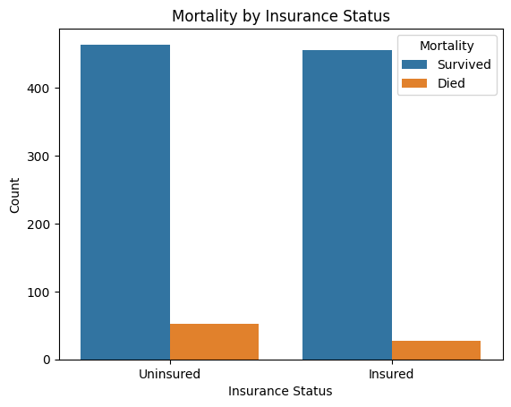
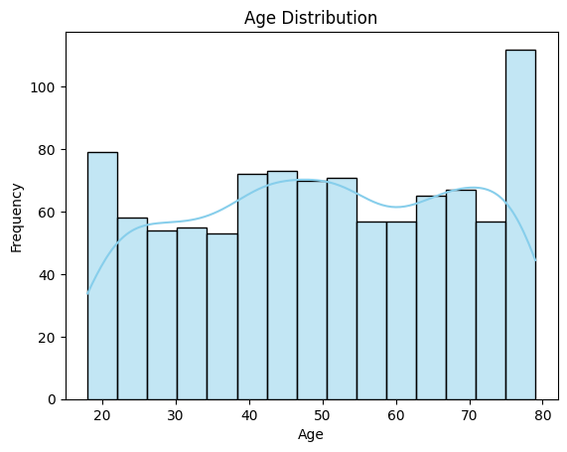
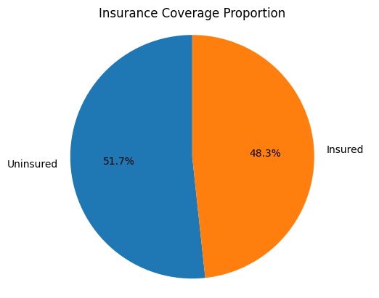
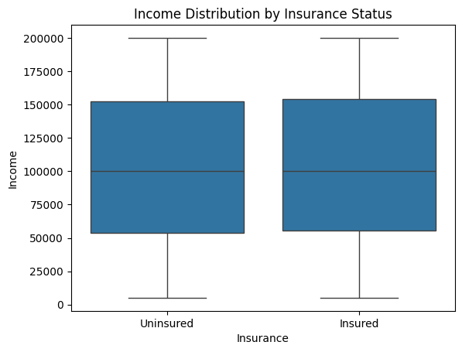
Descriptive analysis

Slide 12
Logistic Regression
The logistic regression estimates the probability of in-hospital mortality as a function of health insurance and other covariates.
Logit Regression Results ============================================================================== Dep. Variable: Mortality No. Observations: 1000 Model: Logit Df Residuals: 994 Method: MLE Df Model: 5 Pseudo R-squ: 0.06616 Log-Likelihood: -260.33 converged: True LL-Null: -278.77 Covariance Type: nonrobust LLR p-value: 6.318e-07 ============================================================================== coef std err z P>|z| [0.025 0.975] ------------------------------------------------------------------------------ const -3.8316 0.520 -7.374 0.000 -4.850 -2.813 Insurance -0.6495 0.249 -2.608 0.009 -1.138 -0.161 Age 0.0355 0.007 4.837 0.000 0.021 0.050 Gender -0.0950 0.240 -0.396 0.692 -0.566 0.376 Residence -0.3975 0.255 -1.561 0.119 -0.897 0.102 Income -8.786e-07 2.08e-06 -0.423 0.673 -4.95e-06 3.2e-06 ==============================================================================
Insurance significantly reduces mortality(β = -0.6495, p = 0.009).
Age is positively and significantly associated with mortality ( β = 0.0355, p = 0.000)
Age increases mortality risk.
Model is statistically significant.

Slide 13
Linear Regression
Linear Regression examined how demographic and socioeconomic characteristics influence household income.
Insurance is associated with higher income.
Urban residence increases income levels.
Linear Regression Coefficients: Age: 105.6887 Education: -1159.6810 Employment: -1533.4161 Insurance: 2662.9197 Residence: 4013.6840
Age has a positive relationship with income (β = 105.69), suggesting income increases with age.
Living in urban areas is associated with an increase in income of KES 4,013.68, while being insured is also associated with higher income (β = 2,662.92).

Slide 14
Instrumental Variable (IV-2SLS)
Adjusts for endogeneity using cluster-level insurance rate.
F-statistic = 17.45 (strong instrument).
IV-2SLS Estimation Summary ============================================================================== Dep. Variable: Mortality R-squared: -0.0138 Estimator: IV-2SLS Adj. R-squared: -0.0209 No. Observations: 1000 F-statistic: 78.112 P-value (F-stat) 0.0000 Distribution: chi2(7) Cov. Estimator: robust Parameter Estimates ============================================================================== Parameter Std. Err. T-stat P-value Lower CI Upper CI ------------------------------------------------------------------------------ Age 0.0021 0.0006 3.3766 0.0007 0.0009 0.0034 Gender -0.0170 0.0260 -0.6540 0.5131 -0.0679 0.0339 Residence -0.0385 0.0277 -1.3879 0.1652 -0.0928 0.0159 Education -0.0144 0.0293 -0.4926 0.6223 -0.0719 0.0430 Employment -0.0724 0.1148 -0.6303 0.5285 -0.2974 0.1527 Income -1.864e-07 3.008e-07 -0.6197 0.5355 -7.759e-07 4.032e-07 Insurance 0.1680 0.3727 0.4507 0.6522 -0.5625 0.8984 ============================================================================== Endogenous: Insurance Instruments: Cluster_Insurance_Rate Robust Covariance (Heteroskedastic) Debiased: False
The insurance effect is not statistically significant after adjustment.
The coefficient for insurance was not statistically significant (β = 0.1680, p = 0.6522), suggesting that once endogeneity is corrected, the protective effect of insurance on mortality may not be statistically distinguishable from zero in this model.

Slide 15
Control Function Approach
Test for further endogeneity and unobserved heterogeneity.
Adjusts using first-stage residuals.
OLS Regression Results ============================================================================== Dep. Variable: Mortality R-squared: 0.036 Model: OLS Adj. R-squared: 0.028 Method: Least Squares F-statistic: 4.578
Prob (F-statistic): 1.71e-05 Log-Likelihood: -96.240 No. Observations: 1000 AIC: 210.5 Df Residuals: 991 BIC: 254.6 Df Model: 8 Covariance Type: nonrobust ============================================================================== coef std err t P>|t| [0.025 0.975] ------------------------------------------------------------------------------ const 0.1372 0.214 0.641 0.521 -0.283 0.557 Age 0.0019 0.001 2.218 0.027 0.000 0.004 Gender -7.703e-05 0.021 -0.004 0.997 -0.041 0.041 Residence -0.0134 0.029 -0.470 0.639 -0.069 0.043 Education 0.0194 0.034 0.572 0.568 -0.047 0.086 Employment 0.1222 0.217 0.563 0.573 -0.304 0.548 Income 3.047e-08 2.13e-07 0.143 0.886 -3.87e-07 4.48e-07 Insurance -0.5162 0.780 -0.661 0.508 -2.048 1.015 Residuals 0.4753 0.781 0.609 0.543 -1.056 2.007 ============================================================================== Omnibus: 600.152 Durbin-Watson: 1.996 Prob(Omnibus): 0.000 Jarque-Bera (JB): 3466.093 Skew: 2.923 Prob(JB): 0.00 Kurtosis: 10.000 Cond. No. 1.59e+07 ============================================================================== Notes: [1] Standard Errors assume that the covariance matrix of the errors is correctly specified. [2] The condition number is large, 1.59e+07. This might indicate that there are strong multicollinearity or other numerical problems.
The insurance effect is not significant (β = -0.3666, p = 0.166) post-adjustment.
Age is consistently significant. (β = 0.0021, p < 0.001)

Slide 16
Chi-Square Test
Contingency Table:
Mortality Died Survived
Insurance
Insured 27 456
Uninsured 53 464
Chi-square Statistic: 6.7523
Degrees of Freedom: 1
P-value: 0.0094
Significant association between insurance and mortality (p = 0.0094).
The uninsured have a higher mortality rate.
Supports logistic regression findings.

Slide 17
Model Evaluation
Confusion Matrix: Good prediction accuracy.
ROC Curve: The Model can distinguish outcomes used for the accuracy of models.

Slide 18
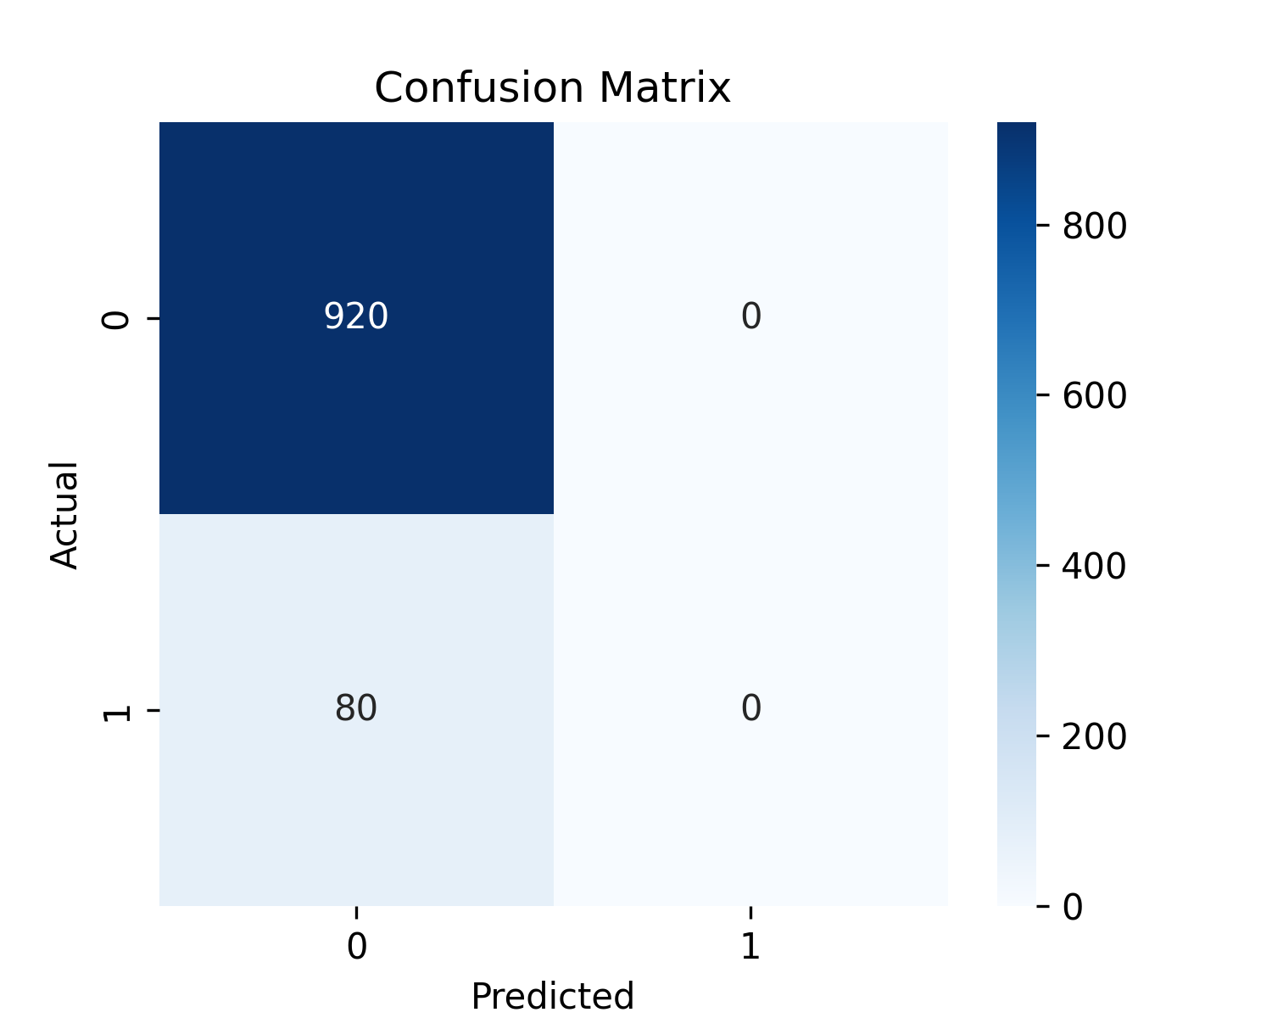
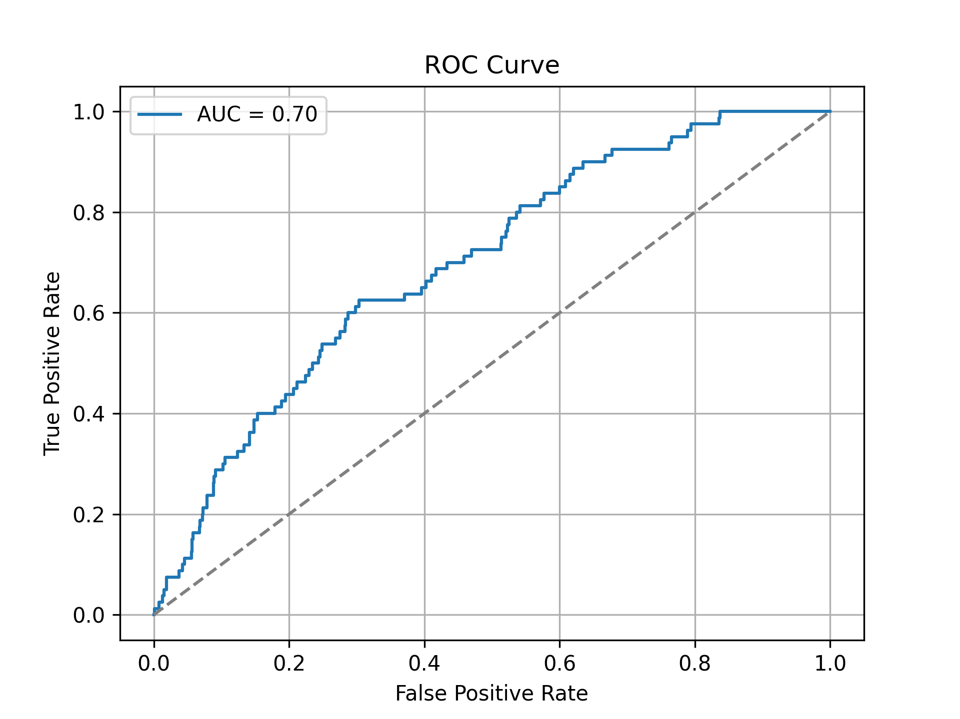

Slide 19
Conclusion
Insurance is linked to reduced in-hospital mortality.
Endogeneity weakens the insurance effect in some models.
Health insurance is significantly associated with reduced in-hospital mortality in the logistic regression model (β = -0.6495, p = 0.009).
Age is the strongest and most consistent predictor of in-hospital mortality across all models (positive and significant).
Gender, residence, and income were not statistically significant predictors of mortality in any model.
Health insurance is associated with higher income (β = 2,662.92), and urban residence also predicts higher income (β = 4,013.68).

Slide 20
Recommendations
Broaden NHIF and community insurance access.
Subsidize premiums for low-income groups.
Invest in rural health facilities and awareness campaigns.
Tailor insurance packages to cover critical and emergency services.

Slide 21
References
Mugo, M. G., et al. (2023) The impact of health insurance enrollment on health outcomes in Kenya.
A recent and Kenya-specific study showed reduced mortality and improved access among the insured.
Stone, G. S., et al. (2014) The association between insurance status and in-hospital mortality on the public medical wards of a Kenyan referral hospital.
Directly investigates in-hospital mortality and insurance coverage in Kenya. Found a 54% lower mortality among the insured.
Acharya, A., et al. (2013) The impact of health insurance schemes for the informal sector in low- and middle-income countries: A systematic review.
Broad LMIC context; highlights both benefits and challenges of insurance schemes.
Haushofer, J., et al. (2017) Peace of mind: Health insurance reduces stress and cortisol levels—Evidence from a randomized experiment in Kenya.
Supports the non-mortality-related benefits of insurance in Kenya.
Lu, C., et al. (2012) Towards universal health coverage: An evaluation of Rwanda Mutuelles in its first eight years.
Demonstrates how insurance expansion improved health outcomes and reduced mortality in a similar African context.
Bein, M. A., et al. (2017) Healthcare spending and health outcomes: Evidence from selected East African countries.
Provides regional evidence of how investments in healthcare relate to outcomes, relevant for policy implications.
Kimani, D. N., et al. (2016) An econometric analysis of health care utilization in Kenya.
Offers Kenyan-specific evidence on determinants of healthcare access and use, complementing mortality-focused studies.

Slide 22
THANK YOU!

