Slide 1
QUANTUM COMPUTING · FOUNDATIONS
|0⟩
Single Qubit
System
|ψ⟩
|+⟩
|−⟩
INSTRUCTOR
[Instructor Name]
COURSE
[Course / Programme]
|1⟩
INSTITUTION
[Institution]
A two-level quantum state,
visualized on the Bloch sphere.
DATE
[Date]

Slide 2
What is a qubit?
A qubit is a controllable two-level quantum system—not simply a smaller classical bit.
CLASSICAL BIT
QUANTUM BIT
0
1
|ψ⟩ = α|0⟩ + β|1⟩
OR
|α|² + |β|² = 1
BEFORE MEASUREMENT
AT MEASUREMENT
One definite value at a time
Amplitudes +
relative phase
→
One outcome:
0 or 1
Read without changing its logical value
Why it matters: controlling amplitudes and phase lets probability paths reinforce or cancel through interference.
Next: photon polarization gives us a physical qubit.

Slide 3
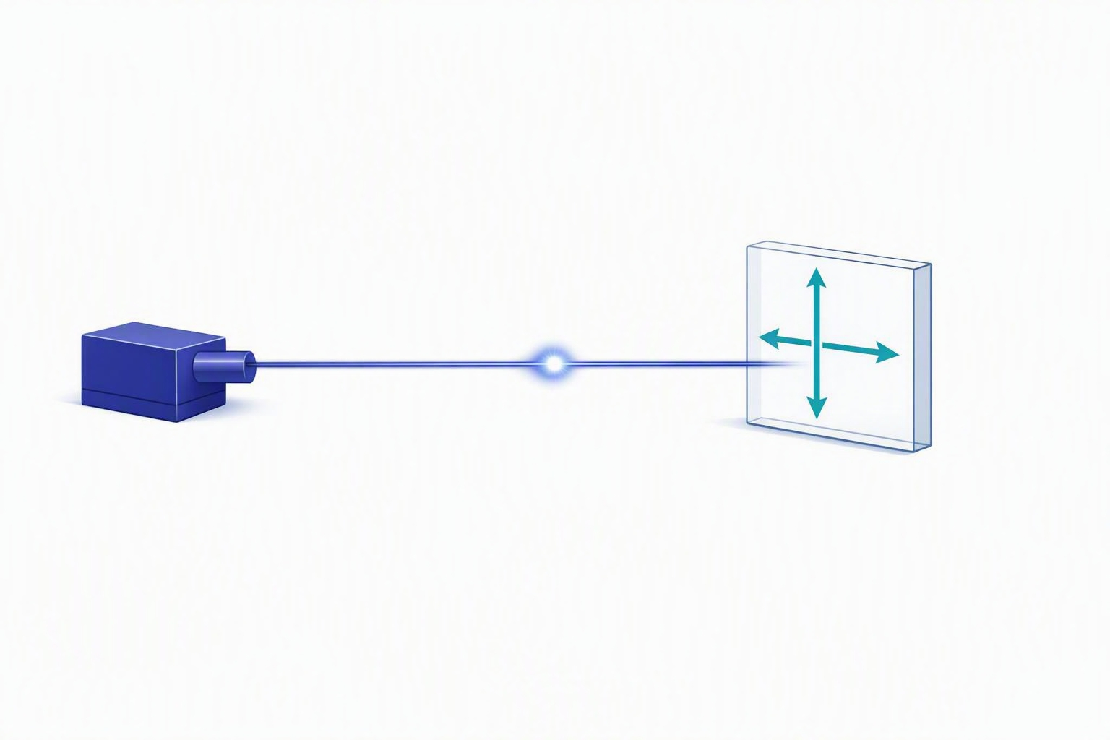
Photon Polarization as a Two-Level Quantum System
A qubit requires exactly two distinguishable states.
Polarization of a single photon naturally provides two orthogonal states.
We define:
  Vertical polarization → |0⟩
  Horizontal polarization → |1⟩
Every polarization state is a linear combination of these two basis states.
Laser source · Single photon · Vertical |0⟩ · Horizontal |1⟩
Photon polarization provides one of the most intuitive physical realizations of a qubit.
Notes:
Learning objective
Students should understand why photon polarization is chosen before introducing abstract mathematics.
Teaching sequence
Begin by asking: “When we say 'qubit', what is the actual physical object?” Most students immediately imagine a tiny particle or an atom.
Explain that a qubit is not a particular particle. A qubit is any physical system possessing exactly two distinguishable quantum states.
Introduce photon polarization. Take a marker, draw a vertical arrow, then draw a horizontal arrow. Explain that these are not merely arrows but represent two orthogonal polarization directions.
Note that this satisfies the requirement for a two-dimensional Hilbert space.
Important statement
“We are not studying light today. We are using light as a physical system to understand quantum information.”
Class discussion
Ask: “Can temperature be used as a qubit?” Allow discussion, then conclude: No, because temperature has infinitely many values.
Transition
“We now know that polarization provides two basis states. The next question is whether Nature behaves according to classical intuition.”

Slide 4
The Three-Polarizer Experiment
Laser
Vertical
polarizer
45° polarizer
Horizontal
polarizer
Screen
Question
“What should happen according to classical intuition?”
Notes:
Teaching approach
Do not reveal the answer immediately. Spend almost five minutes discussing predictions, then ask students to vote.
Common responses: zero intensity, half intensity, quarter intensity. Write all predictions on the board.
Then perform (or animate) the experiment.
Purpose
This slide is intended to create cognitive conflict before introducing quantum measurement.

Slide 5
Experimental Observation
Case A
Case B
Case C
Vertical polarizer only
Vertical + Horizontal
Vertical + 45° + Horizontal
Bright screen
Dark screen
Light reappears
Observation
Adding another filter unexpectedly allows light to pass.
Notes:
Teaching approach
Pause after revealing Case C. Let students react.
Then ask: “How can adding another obstacle increase the transmitted light?”
Explain that this single experiment historically motivated much of quantum mechanics.
Avoid giving the mathematical explanation yet.

Slide 6
Why Classical Physics Fails
Classical expectation | Experimental result
Every filter removes light | Extra filter increases transmission
Measurement only reveals pre-existing values | Measurement changes the state
Properties exist before measurement | Quantum state changes during measurement
Every mathematical idea in the chapter that follows exists to explain this experiment.
Notes:
Bridge to quantum theory
This is the bridge between classical intuition and quantum theory.
State that every mathematical idea in the remaining chapter exists solely to explain this experiment.

Slide 7
Mathematical Representation of Polarization
|0⟩ =
Vertical
Vertical and horizontal polarization are orthogonal, so they form a natural two-dimensional basis.
Any polarization state is a linear combination α|0⟩ + β|1⟩.
Writing states as vectors lets us describe polarization with the linear algebra we already know.
1
0
|1⟩ =
Horizontal
0
1
Nature tells us that polarization behaves exactly like a vector.
Notes:
Connect to Unit 1
Say: “We already know vector spaces. Now Nature is telling us that polarization behaves exactly like a vector.”
Do not re-teach vector spaces. Instead, remind students of orthogonality.

Slide 8
From Physical Polarization to Mathematical States
State vectors
Vertical polarization
→ |0⟩
|0⟩ =
1
0
Horizontal polarization
→ |1⟩
|1⟩ =
0
1
These vectors form the computational basis of a single qubit.
Notes:
Objective
Connect the physical experiment with linear algebra. Remind students that in Unit 1 they studied vector spaces.
Ask: “Why do physicists suddenly start using vectors to describe light?”
Explain that experiments show polarization behaves exactly like vectors: polarization can be added, polarization can be projected, and polarization has orthogonal directions. Therefore linear algebra naturally describes it.
Choice of basis
Explain that [1, 0] and [0, 1] are not chosen randomly — they are the simplest orthogonal basis. Draw coordinate axes, show the vertical and horizontal axes, and relate them to the x- and y-unit vectors.
Ask: “Could we instead choose diagonal polarization as the basis?” Expected answer: Yes — any orthonormal basis is acceptable. Do not explain the Hadamard basis yet; simply say “We'll return to this idea shortly.”
Transition
“Once we have basis vectors, we can describe every other polarization.”

Slide 9
Arbitrary Polarization State
|ψ⟩ = α|0⟩ + β|1⟩
|0⟩
Conditions
|ψ⟩
α, β ∈ ℂ
|α|² + |β|² = 1
|1⟩
Every pure qubit state is a superposition of basis states.
Notes:
Core idea
Tell students: “This equation is probably the most important equation in the entire chapter.” Spend time discussing every symbol.
Explain that α and β are NOT probabilities — they are probability amplitudes.
Ask: “If α = 0.6, is the probability 60%?” Most students answer yes. Correct them: probability = modulus squared.
Emphasize: quantum mechanics stores amplitudes; Nature reveals probabilities only after measurement.
Transition
“If amplitudes are not probabilities, why do we square them?” That naturally leads toward measurement later.

Slide 10
Normalization of a Quantum State
|α|² + |β|² = 1
Normalization
Why?
Total probability must equal one.
The quantum state must have unit length.
Notes:
Derive, don't memorize
Many students memorize normalization. Instead, derive it.
Suppose |ψ⟩ = 2|0⟩ + 3|1⟩. Ask: “Can this represent a physical qubit?” Students usually say yes.
Now calculate 4 + 9 = 13, and ask: “Can probability be thirteen?” Immediately they realize normalization is necessary.
Normalize step by step — do the calculation live.
Emphasize
Normalization is not merely a mathematical convention; it reflects conservation of total probability.
Transition: “Now let us examine one particularly important state.”

Slide 11
The 45° Polarization State
|+⟩ =
1
( |0⟩ + |1⟩ )
√2
|0⟩
|+⟩ (diagonal)
Equal probability
50% chance of |0⟩ and 50% chance of |1⟩
Different quantum state
Distinct from |0⟩ and |1⟩, not a classical mixture
45°
|1⟩
Notes:
Connect back
Connect back to the three-polarizer experiment: the middle filter prepares this state.
Ask: “What is the probability of measuring |0⟩?” Students should answer 50%. Similarly, |1⟩ is 50%.
Then ask: “Does that mean the photon is half vertical and half horizontal?” Explain carefully: No — it is entirely in one quantum state; the probabilities appear only when measured.
Common misconception
Students often equate 50% with classical randomness. Stress that the photon possesses a definite quantum state.
Transition: “We now understand the mathematical description. The next question is how physicists developed a notation that works for millions of qubits.”

Slide 12
Why Dirac Notation?
Column vectors | Dirac notation
Long | Compact
Coordinate dependent | Basis independent
Hard for multi-qubits | Naturally extends
Example
1
0
= |0⟩
Notes:
Opening
Start by saying: “We already know vectors. So why invent another notation?” Students often wonder this.
Historical motivation
Explain historically. Paul Dirac wanted a notation independent of coordinates.
For 20 qubits, column vectors become impossible to read, while Dirac notation remains elegant.
Looking ahead
Mention that tensor products will later become extremely simple in this notation.
Transition
“So what exactly is a ket?”

Slide 13
Ket Vectors
Definition
A ket represents a quantum state.
|ψ⟩
a
b
Examples
|0⟩
|1⟩
|ψ⟩
Column vector
Ket = Column vector
Notes:
Teaching approach
Keep this slide simple. Do not overwhelm students.
Terminology
Explain that “ket” is pronounced exactly like “ket,” not “kay-tee.”
Mention that Dirac called “bra-ket” a bracket. The second half became “ket” and the first half became “bra.” Students usually remember this story.
Transition
“If kets are vectors, what are bras?”

Slide 14
Bra Vectors
|ψ⟩ =
a
b
becomes
⟨ψ| =
[ a* b* ]
Column
Conjugate transpose
a
b
Transpose the column into a row.
Take the complex conjugate of each entry.
A bra is not merely a row vector.
[ a* b* ]
Row
Notes:
Teaching approach
Spend sufficient time explaining transpose and complex conjugation. Many students forget one of them.
Take a numerical example, for instance a column with entries 1 + i and 2, and convert it to a bra step by step.
Emphasize
Stress that a bra is not merely a row vector — it is the conjugate transpose.
Transition
“Once we have bras and kets, we can compute something physically meaningful — the overlap between two quantum states.”

Slide 15
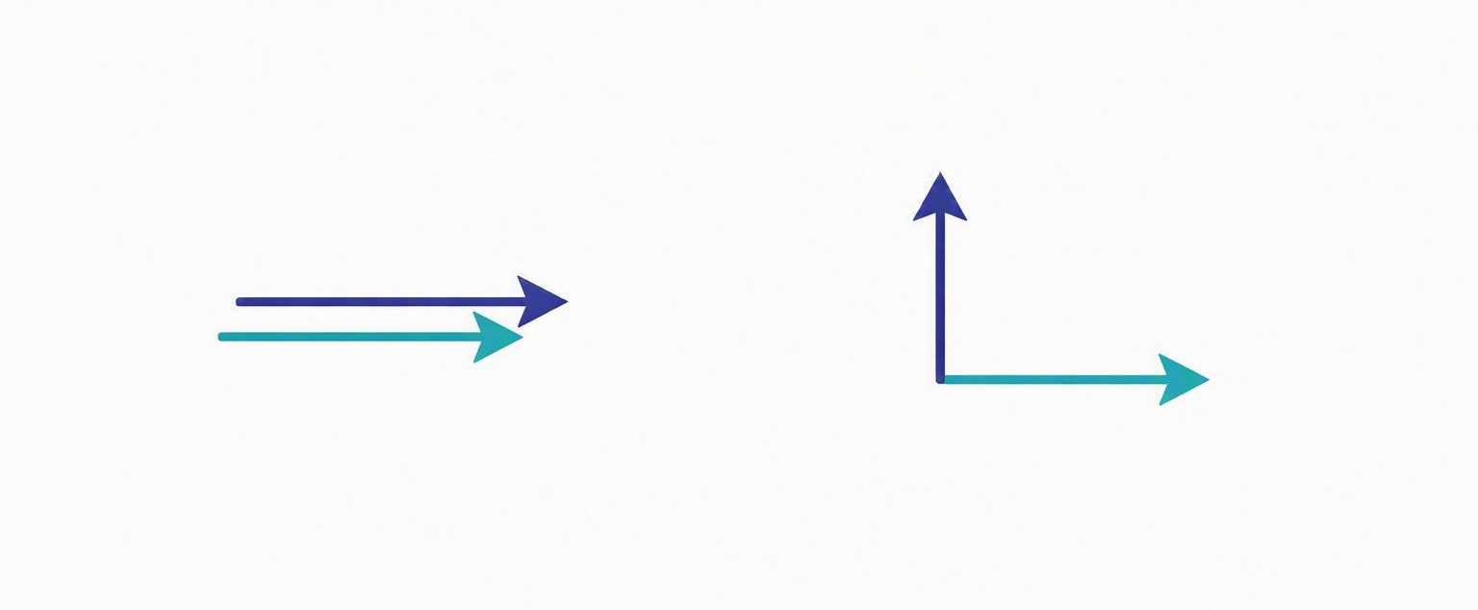
Inner Product: Quantifying Overlap Between Quantum States
Recall from Unit 1
⟨u|v⟩ = u† v
Example
⟨0|0⟩ = 1
⟨1|1⟩ = 1
⟨0|1⟩ = 0
Parallel vectors → Maximum overlap
Perpendicular vectors → Zero overlap
The inner product determines how likely one quantum state appears as another during measurement.
Notes:
Objective
Students should understand that the inner product is not merely another vector operation. In quantum mechanics, it has direct physical meaning.
Begin by asking: “Why did we spend so much time learning inner products in Unit 1?” Most students will answer: to calculate angles, to check orthogonality, to compute projections. Tell them that all these answers are correct.
Then explain that quantum mechanics assigns a completely new physical interpretation.
Write on the board
⟨0|1⟩ = 0
Ask: “What does zero mean?” Students usually answer “The vectors are perpendicular.” Now say: “In quantum mechanics it means much more.”
It means a measurement looking for |0⟩ will never identify |1⟩. Zero overlap means zero probability. This is an excellent place to plant the idea of the Born Rule without formally introducing it.
Classroom Question
Suppose |ψ⟩ = |0⟩. What is ⟨1|ψ⟩? Expected answer: zero.
Ask: “So what does this physically imply?” Guide them toward: the measurement outcome |1⟩ is impossible.
Common misconception
Students often think inner product = angle only. Clarify that in quantum mechanics it becomes a probability amplitude.
Transition: “If orthogonal states have zero overlap, how do we know whether two states form a valid basis?”

Slide 16
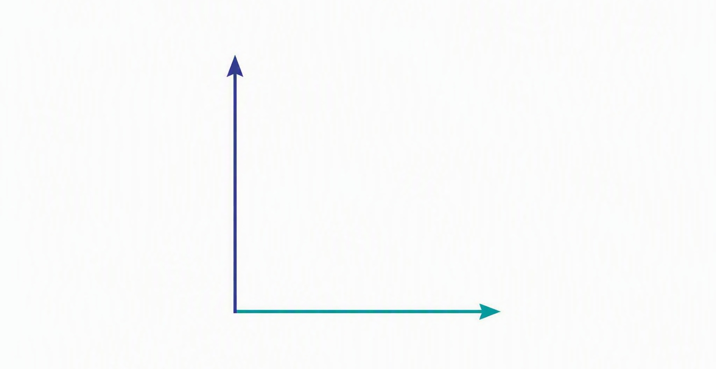
Orthonormal Basis
Definition
A valid quantum basis satisfies
Orthogonality
⟨i|j⟩ = δij
Normalization
⟨i|i⟩ = 1
Two perpendicular axes: |0⟩ and |1⟩
A qubit can always be expressed using an orthonormal basis.
Notes:
Grounding the idea
Tell students: every coordinate system you've ever used has a basis. Quantum mechanics is no different. The only difference is our vectors live in a complex vector space.
Do not spend time proving orthogonality — that has already been covered.
Instead ask: why do we insist on orthogonality? Guide discussion. Eventually explain: if basis vectors overlap, measurement cannot distinguish them perfectly. Nature requires distinguishable measurement outcomes. Hence orthogonal basis states.
Activity
Ask: “Would the following pair work as a basis?” |0⟩ and (|0⟩ + |1⟩)/√2. Allow discussion. Students should discover they are not orthogonal — hence not a valid measurement basis.
Transition: “Interestingly, the computational basis is not the only possible basis.”

Slide 17
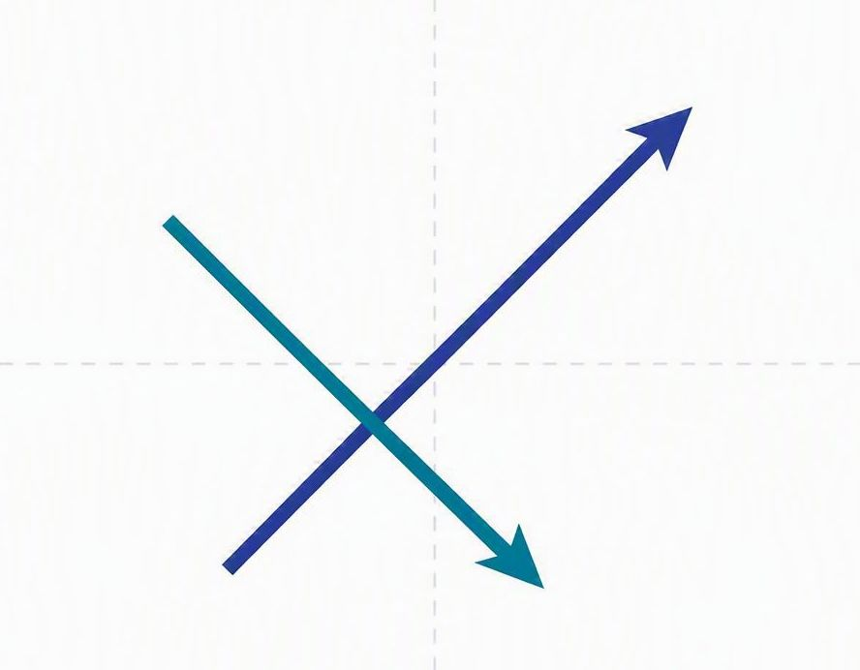
The Hadamard Basis
Introduce
|+⟩ =
|0⟩ + |1⟩
√2
|−⟩ =
|0⟩ − |1⟩
√2
Axes rotated 45° — same space, new coordinates
Changing basis changes the coordinate system—not the physical state.
Notes:
The coordinates analogy
Start by asking: “Do Cartesian coordinates describe every vector?” Students answer yes. Ask: “Can polar coordinates describe the same vector?” Again yes.
Now make the analogy: the computational basis and the Hadamard basis describe the same quantum state. Only the coordinates change. The physical state never changes.
Avoid mentioning the Hadamard gate yet — that belongs in the next chapter. Here, focus entirely on basis choice.
Classroom Question
If |0⟩ is measured in the Hadamard basis, will it still be 100% certain? Do not answer — tell students: “We'll compute that shortly.”
Transition: “Before measuring in another basis, we first need to know how to rewrite quantum states.”

Slide 18
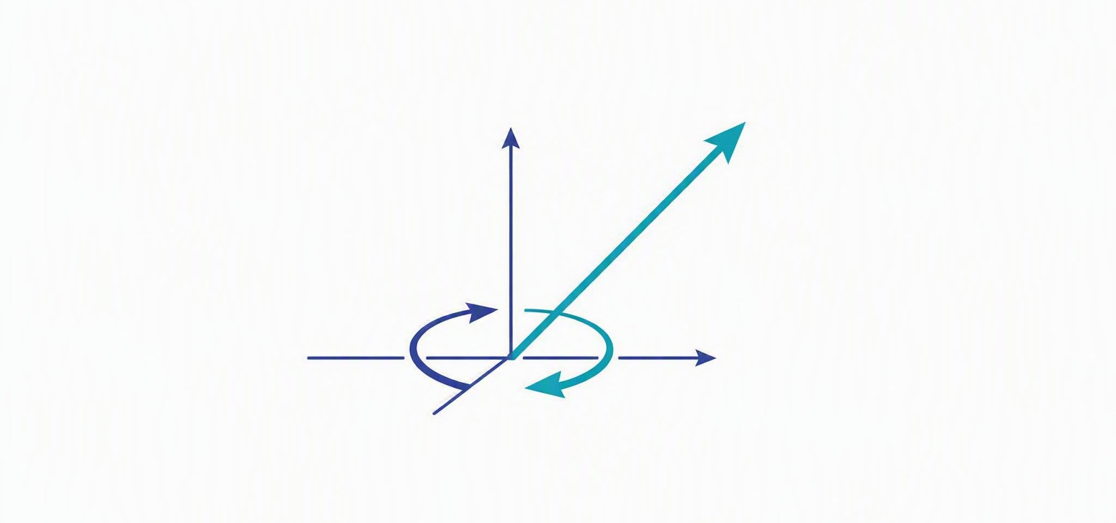
Basis Transformation
Start with
|ψ⟩ = α|0⟩ + β|1⟩
Rewrite each basis state
|0⟩ = ( |+⟩ + |−⟩ ) / √2
|1⟩ = ( |+⟩ − |−⟩ ) / √2
Final result
The state is unchanged — only its coordinates rotate
|ψ⟩ =
(α+β)|+⟩ + (α−β)|−⟩
√2
Changing basis never changes the physical state—only its coordinates.
Notes:
Derive, don't present
This is one of the few slides where I recommend a full derivation. Do not simply present the final equation — derive it line by line.
Students need to see the flow: substitution → expansion → grouping terms → final expression.
Point out: nothing happened to the state. Only the coordinates changed. This distinction becomes extremely important later when discussing quantum gates.
Analogy
Ask: “If I describe my location using latitude and longitude instead of street names, did I move?” Students immediately answer no. Exactly — changing basis never changes the quantum state.
Transition: “We now know how to express a state in any basis. The next question is: what happens when we actually perform a measurement?”

Slide 19

What Does It Mean to Measure a Qubit?
Unknown state
|ψ⟩
Outcome
|0⟩ or |1⟩
Measurement device
1
Measurement produces one classical outcome.
2
The outcome is probabilistic.
3
The quantum state changes after measurement.
Measurement is an active physical process.
Notes:
Open with discussion, not mathematics
This slide should begin with a discussion rather than mathematics.
Ask students: “When we measure temperature, does the thermometer change the room?” Usually, very little. “When we measure voltage, does the voltmeter change the circuit?” Ideally, no.
Then explain: quantum measurement is fundamentally different. It does not simply reveal information — it creates a definite outcome from a quantum state.
Refer back to the three-polarizer experiment. Tell students: “We now finally have the mathematical language to explain that mysterious experiment.”
Classroom Question
Suppose a photon is in the state |+⟩. If we measure in the computational basis, what should happen? Collect guesses.
Tell them: “We now have enough mathematics to calculate the answer exactly.”
Transition: “To calculate measurement probabilities, quantum mechanics gives us one remarkably simple rule — the Born Rule.”

Slide 20
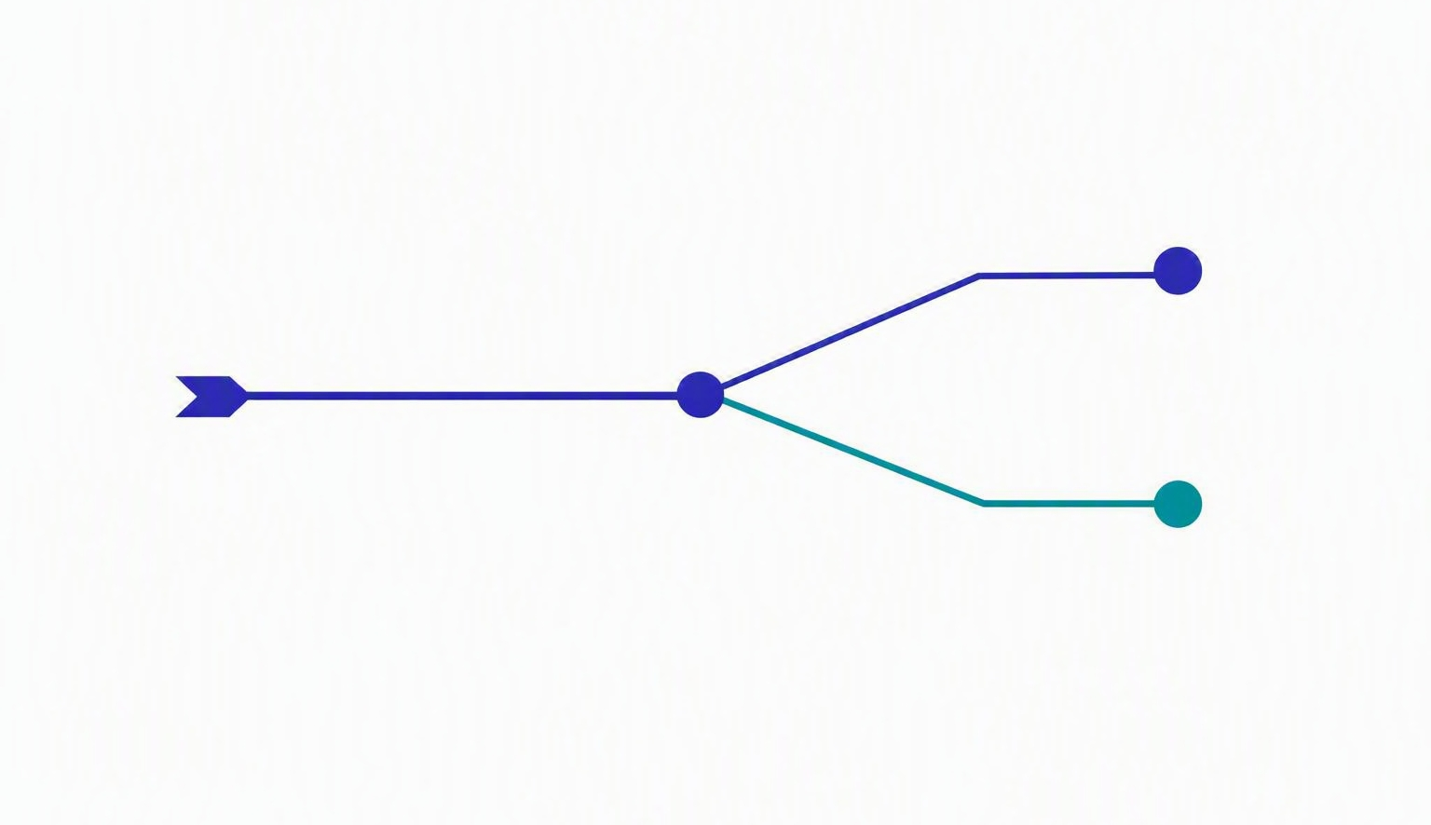
The Born Rule
State
|ψ⟩ = α|0⟩ + β|1⟩
Measured in the computational basis
P(0)
|α|²
P(1)
|β|²
The state branches into two possible outcomes
Probability = the modulus squared of the probability amplitude
Notes:
Objective
This is the single most important slide in the measurement unit. Students must leave understanding that amplitudes are not probabilities—probabilities come from squaring the modulus of the amplitude.
Begin by reminding them: in |ψ⟩ = α|0⟩ + β|1⟩, the numbers α and β are amplitudes. They can be negative, and in general they are complex. A probability can never be negative or complex, so α cannot itself be a probability.
The rule
State it cleanly: the probability of measuring |0⟩ is P(0) = |α|², and the probability of measuring |1⟩ is P(1) = |β|². The vertical bars mean modulus, and the square guarantees the result is a non-negative real number.
Emphasize the word modulus. For a complex amplitude α, |α|² = α*α. If a student has only seen real numbers so far, reassure them the rule still reduces to ordinary squaring.
Classroom Question
Suppose α = 1/√2 and β = 1/√2. Ask: what are P(0) and P(1)? Expected answer: each is 1/2. Then ask what happens if α = -1/√2 instead. Students should see the probability is unchanged—the sign disappears under the modulus square.
Common misconception
Students frequently report the amplitude as the probability. Watch for answers like 'P(0) = 1/√2'. Correct it immediately: that is the amplitude; the probability is its modulus squared.
Transition: 'Where does this squaring rule actually come from geometrically?'

Slide 21
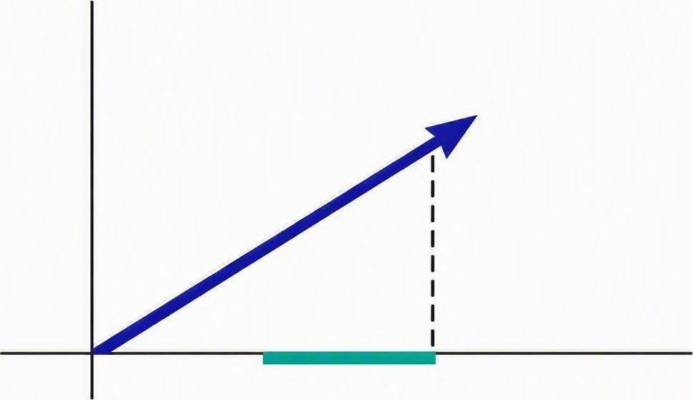
Measurement as Projection
Probability
P(0) = |⟨0|ψ⟩|²
1 Project the state onto |0⟩
2 The projection length is the amplitude ⟨0|ψ⟩
3 Square its modulus to get the probability
The state vector projected onto the |0⟩ axis
Measurement is mathematically a projection onto a basis state.
Notes:
Framing
The Born Rule can feel like a formula students memorize. This slide gives it a geometric meaning: measurement is a projection of the state vector onto a basis direction.
Walk the figure slowly. The state vector points somewhere in the plane. To find the amplitude for outcome |0⟩, drop a perpendicular from the tip of the vector onto the |0⟩ axis. The length of that projection is the amplitude ⟨0|ψ⟩.
Connect to the formula
Then square the modulus of that projected length and you have the probability: P(0) = |⟨0|ψ⟩|². Point out that this is exactly the Born Rule from the previous slide—just expressed with an inner product instead of the raw coefficient.
Stress that ⟨0|ψ⟩ simply reads off 'how much of |0⟩ is contained in |ψ⟩'. That is why the inner product from earlier in the unit matters here.
Classroom Question
Ask: if the state vector is already lying exactly along the |0⟩ axis, how long is its projection onto |0⟩? Onto |1⟩? Guide them to: full length onto |0⟩ (probability 1) and zero onto |1⟩ (probability 0).
Transition: 'Let us prove algebraically that the projection gives exactly the coefficient we expect.'

Slide 22
Deriving Measurement Probability
Start with
|ψ⟩ = α|0⟩ + β|1⟩
Orthogonality removes one term
⟨0|0⟩ = 1
Compute the amplitude ⟨0|ψ⟩
= α⟨0|0⟩ + β⟨0|1⟩
= α
⟨0|1⟩ = 0
The β term vanishes, leaving only α.
Probability
P(0) = |α|²
Orthogonality of basis states is what makes measurement probabilities clean.
Notes:
Derive, don't present
Do the derivation live, line by line. The goal is for students to see that the clean answer P(0) = |α|² falls out of orthogonality, not out of nowhere.
Start from |ψ⟩ = α|0⟩ + β|1⟩. Compute ⟨0|ψ⟩ by taking the inner product of ⟨0| with each term: ⟨0|ψ⟩ = α⟨0|0⟩ + β⟨0|1⟩.
The key step
Now invoke the orthonormal basis relations from earlier: ⟨0|0⟩ = 1 and ⟨0|1⟩ = 0. The second term dies. What remains is ⟨0|ψ⟩ = α.
Make this explicit: orthogonality is what removes the β term. Without an orthonormal basis, measurement probabilities would be tangled together.
Finally square the modulus: P(0) = |⟨0|ψ⟩|² = |α|². This closes the loop with the Born Rule.
Common misconception
Some students keep the β⟨0|1⟩ term because they forget ⟨0|1⟩ = 0. Pause on that cross term and ask the class its value before crossing it out.
Transition: 'If we do this for every outcome, what does the full picture of a measurement look like?'

Slide 23
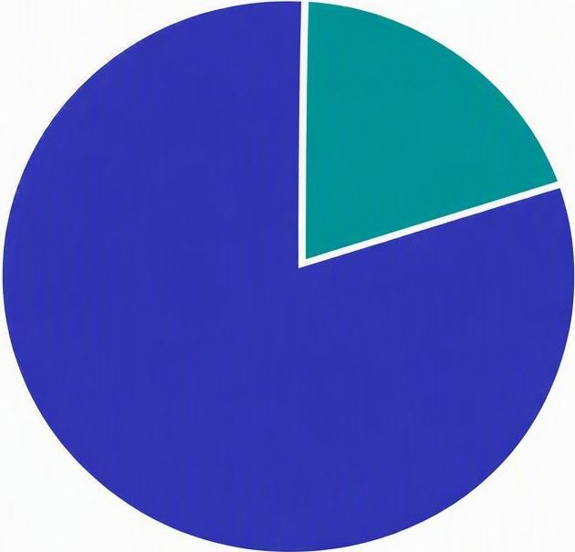
Complete Measurement in the Computational Basis
Measurement outcomes
Outcome | Probability
|0⟩ | |α|²
|1⟩ | |β|²
Normalization check
|α|² + |β|² = 1
■ P(0) = |α|² ■ P(1) = |β|²
The probabilities of all outcomes always sum to one.
Notes:
Assemble the full picture
This slide collects the individual results into one complete description of a computational-basis measurement. Each row of the table is one possible outcome and its probability.
Read the table aloud: outcome |0⟩ occurs with probability |α|², outcome |1⟩ with probability |β|². These are the only two outcomes for a single qubit in this basis.
The normalization condition
Draw attention to |α|² + |β|² = 1. Explain physically: the qubit must be found in some state, so the probabilities of all outcomes have to add to one. This is exactly why we require normalized state vectors.
The pie chart is a visual restatement: the whole circle is probability one, split between the two outcomes. If a student proposes amplitudes that do not satisfy the sum, the state is simply not physically valid.
Classroom Question
Give α = 1/2. Ask students to find |β| so the state is normalized. Expected: |β|² = 3/4, so |β| = √3/2. Then ask which outcome is more likely—outcome |1⟩, at 75%.
Transition: 'Everything so far assumed the computational basis. What if we measure in a different basis?'

Slide 24
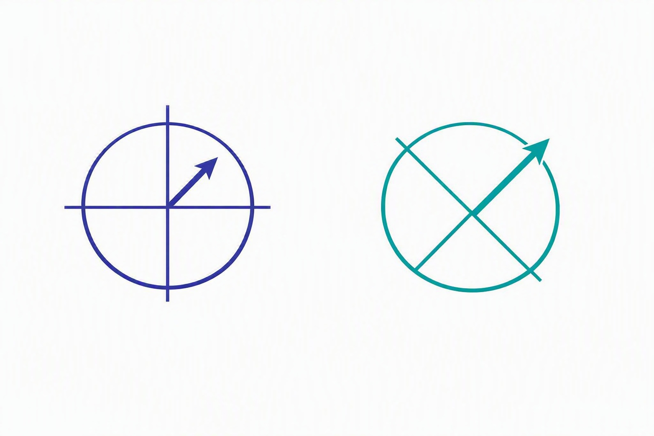
Measurement Depends on the Basis
Prepared state
|+⟩ = ( |0⟩ + |1⟩ ) / √2
Computational basis
50% |0⟩ / 50% |1⟩
Hadamard basis
100% |+⟩ / 0% |−⟩
Same state, two different measurement bases
Measurement outcomes depend on the chosen basis.
Notes:
The central surprise
This slide overturns a naive intuition. The same physical state can give completely different measurement statistics depending on which basis you measure in.
Take the state |+⟩ = (|0⟩ + |1⟩)/√2. Measured in the computational basis, it is an even split: 50% |0⟩ and 50% |1⟩, because |α|² = |β|² = 1/2.
Change the basis
Now measure the very same |+⟩ in the Hadamard basis. Because |+⟩ IS a basis state there, the outcome is certain: 100% |+⟩ and 0% |−⟩. Nothing about the physical state changed—only the question we asked of it.
Use the two diagrams: the left axes are the computational basis, the right axes are rotated 45 degrees to the Hadamard basis. The same arrow lands 'between' the first pair but 'on' the second pair.
Common misconception
Students may think a state has one true set of probabilities. Correct this: probabilities are defined only relative to a chosen measurement basis.
Transition: 'One more essential fact remains—what happens to the state itself the instant we measure it?'

Slide 25
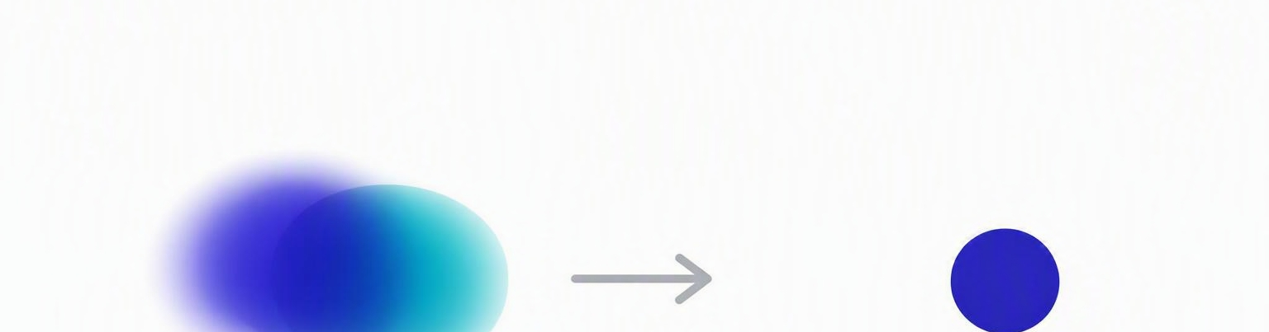
State Collapse
Before
|ψ⟩ = α|0⟩ + β|1⟩
Measurement
physical process
After
|0⟩ or |1⟩
After measurement, the original superposition no longer exists.
Notes:
The irreversible step
End the unit on collapse, because it is what makes quantum measurement fundamentally different from reading a classical value.
Before measurement the qubit is in the superposition |ψ⟩ = α|0⟩ + β|1⟩. The act of measuring forces a single outcome, and immediately afterward the state is exactly that outcome—either |0⟩ or |1⟩, not both.
Emphasize what is lost
The original amplitudes α and β are gone. You cannot recover the superposition from the post-measurement state. If you measure again in the same basis, you get the same result with certainty.
Contrast with classical measurement: reading a classical bit does not change it. Measuring a qubit generally does. This is the price of extracting classical information from a quantum system.
Classroom Question
Ask: after a measurement yields |0⟩, what is the probability of getting |1⟩ on an immediate second measurement in the same basis? Expected: zero. The superposition is already destroyed.
Wrap up: 'Measurement gives us a classical outcome, but it costs us the quantum state that produced it.'

Slide 26
Are These Two Quantum States Different?
A surprisingly difficult question
State A
Question
|ψ₁⟩ = ( |0⟩ + |1⟩ ) / √2
Do these represent two different physical states?
State B
|ψ₂⟩ = − ( |0⟩ + |1⟩ ) / √2
|ψ⟩
−|ψ⟩
Prediction?
Cast your vote before we reveal the answer
Notes:
Objective
Students should realize that mathematics can distinguish two vectors while physics may not. This is the doorway into global phase.
Start by asking everyone to vote. Option A: same state. Option B: different state. Do not answer immediately—let the room commit to a prediction.
Run the tension
Tell students plainly: 'Mathematically these are different vectors.' Pause. Then ask: 'But can Nature distinguish them?' That reframing is what grabs their attention.
Now compute
Compute the probability of measuring |0⟩ for both states. Both give 1/2. Then compute the probability of measuring |1⟩. Again 1/2 for both.
Now ask: 'What experiment could distinguish these states?' Students usually cannot name one. Exactly—Nature cannot distinguish them.
Important statement
If every possible measurement produces identical probabilities, the two mathematical vectors represent the same physical state. This is one of the foundational principles behind global phase.
Transition: 'So why do these vectors differ mathematically but not physically?'

Slide 27
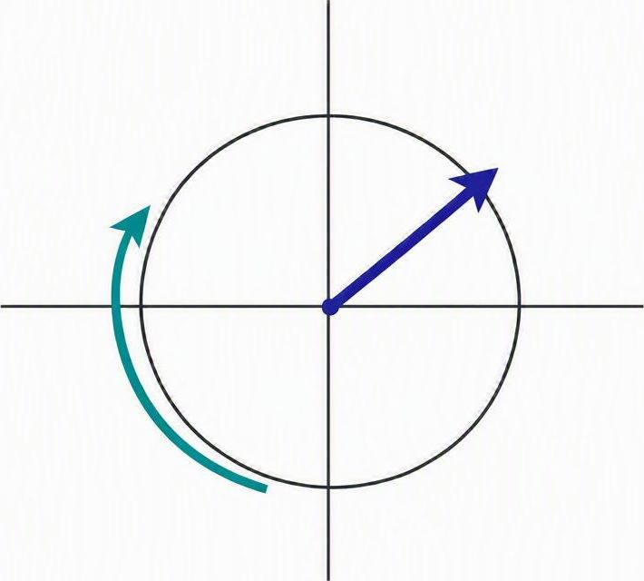
Global Phase
General expression
|ψ⟩ ⟶ e^{iθ}|ψ⟩
Examples
−|ψ⟩
i|ψ⟩
e^{iπ/4}|ψ⟩
Every amplitude rotates by the same angle
Multiplying every amplitude by the same complex number changes no measurement probability.
Notes:
Begin with Euler's formula
Remind students that e^(iθ) = cos θ + i sin θ. Multiplying an amplitude by e^(iθ) rotates it in the complex plane. Stress that here it multiplies EVERY amplitude equally.
Why probabilities are unchanged
Compute |e^(iθ) α|² = |α|², because |e^(iθ)| = 1. Since every amplitude is scaled by a number of modulus one, all measurement probabilities remain identical.
Introduce the terminology
Say: 'This common multiplication factor is called the global phase.' Write in large letters: Global phase is physically unobservable. If an experiment cannot distinguish two states, physics treats them as the same state.
Classroom Question
Take |ψ⟩ = (|0⟩ + |1⟩)/√2 and multiply it by i. Ask: 'Can any experiment distinguish these?' Expected answer: no.
Transition: 'But what if only one amplitude changes?'

Slide 28
Relative Phase
Compare two states
Measurement in the computational basis
|+⟩ = ( |0⟩ + |1⟩ ) / √2
State | P(0) | P(1)
|+⟩ | 0.5 | 0.5
|−⟩ | 0.5 | 0.5
|−⟩ = ( |0⟩ − |1⟩ ) / √2
If the probabilities are identical, are the states identical?
The computational basis tells only part of the story.
Notes:
Set the trap
Show (|0⟩ + |1⟩)/√2 and (|0⟩ − |1⟩)/√2 and ask whether they are the same state. Students usually answer yes, because both give P(0) = P(1) = 0.5 in the computational basis. Perfect—let them commit.
Spring it
Now tell them this is exactly where quantum mechanics becomes interesting. Although the computational basis gives identical probabilities, another basis can distinguish them perfectly. This immediately motivates the next slide.
Name the concept
Explain: the minus sign affects only one component. That is NOT a global phase. It changes the relationship between amplitudes. This is called relative phase.
Analogy
Two musicians. If both start one second late, the music sounds identical—that is global phase. If only one starts one second late, their synchronization changes—that is relative phase. Students tend to remember this.
Transition: 'So how do we experimentally detect relative phase?'

Slide 29
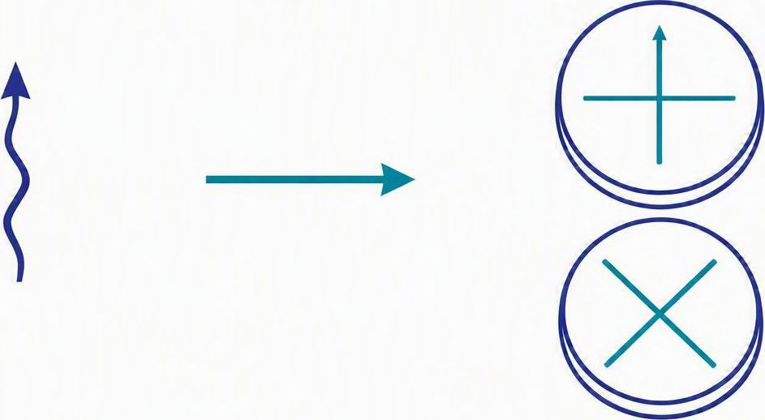
Measuring Relative Phase
Outcomes by measurement basis
State | Computational | Hadamard
|+⟩ | 50 / 50 | Always |+⟩
|−⟩ | 50 / 50 | Always |−⟩
Same in the computational basis — different in the Hadamard basis.
The minus sign is physically real.
One state, two measurement bases, two outcomes
Relative phase changes interference.
Notes:
One of the most important conceptual slides
Begin by recalling the Hadamard basis. Ask: 'What happens if we measure |+⟩ in the Hadamard basis?' Students should recognize 100% certainty. Then ask about |−⟩—again 100%, but for the opposite outcome.
The key statement
The computational basis cannot distinguish these states. The Hadamard basis distinguishes them perfectly. Therefore the minus sign is physically meaningful.
Write on the board: Global phase → no experiment detects it. Relative phase → experiments detect it.
Common misconception
Students often think a minus sign is always just a minus sign. Clarify: a minus sign multiplying the ENTIRE state is global; a minus sign affecting only ONE component is relative. This distinction is essential before introducing quantum gates.
Transition: 'We now understand why relative phase is physically meaningful. The next question is how to visualize both amplitudes and phase together—which leads us to the Bloch sphere.'

Slide 30
Summary: Global Phase vs Relative Phase
Global Phase | Relative Phase
Multiplies every amplitude equally | Changes amplitudes relative to each other
Cannot be measured | Can be measured
Does not affect probabilities | Affects interference
Physically irrelevant | Physically observable
Quantum information is encoded not only in probabilities, but also in relative phase.
Notes:
Consolidate, do not introduce
This slide should not present new material. Ask students to summarize the differences between global and relative phase before you reveal the table, then confirm with the comparison.
The core message
Emphasize that measurement probabilities alone do not completely specify a quantum state. Two states can yield identical probabilities in one basis yet behave differently in another because of their relative phase.
Conclude: 'If we ignored relative phase, there would be no quantum algorithms, no interference, and no quantum advantage. Relative phase is the feature that distinguishes quantum information from classical probability.'
Transition to the next section
'We now know everything needed to describe a single qubit algebraically: amplitudes, normalization, basis states, measurement, and phase. The next challenge is visualization. Can we represent every possible pure qubit state with a simple geometric picture? The answer is yes—and that picture is the Bloch sphere.'

Slide 31
From Algebra to Geometry
Why do we need another representation?
Current description
|ψ⟩ = α|0⟩ + β|1⟩
where α, β ∈ ℂ
?
Open questions
? Can we visualize every possible qubit?
? Can we compare quantum states geometrically?
? Can quantum gates be viewed as rotations?
Which point on the sphere is this state?
We need a geometric representation that captures every pure single-qubit state.
Notes:
Objective
Motivate why algebra alone is not enough. Students can write |ψ⟩ = α|0⟩ + β|1⟩, but that notation gives no intuition for how 'close' two states are, or what a gate does geometrically.
Put a concrete state on the board, for example |ψ⟩ = 0.63|0⟩ + (0.42 + 0.65i)|1⟩. Ask: 'Can you picture this state? Can you see how it differs from |0⟩?' Most students cannot — the complex numbers hide the geometry.
The analogy
Recall a classical force vector such as (3, 4). We instantly picture an arrow in the plane. We want the same for a qubit: a picture where every pure state is a point we can see, compare, and rotate.
Frame the three questions
Read the three questions aloud: Can we visualize every qubit? Can we compare states geometrically? Can gates be seen as rotations? Tell students the Bloch sphere will answer yes to all three.
Emphasize that the sphere complements Dirac notation — it does not replace the algebra, it gives it a geometric home.
Transition: 'Before drawing the picture, let us count how many real numbers a qubit truly needs.'

Slide 32

How Many Independent Parameters Describe a Qubit?
Count the raw numbers
α ∈ ℂ
2 real numbers
β ∈ ℂ
2 real numbers
4
real params
Remove the redundant degrees of freedom
4
−1 Normalization
3
−1 Global phase
2
$$|α|² + |β|² = 1$$
an overall phase is unobservable
Every pure qubit is completely described by only two real numbers.
Notes:
Objective
Show that although the algebra looks like it needs four real numbers, a pure qubit is fixed by only two. This is exactly why a two-dimensional surface — a sphere — is the right picture.
Count the raw parameters
α is complex, so it carries two real numbers. β is complex, so it carries two more. Naively that is four real parameters.
Remove the redundancy
First, normalization: |α|² + |β|² = 1 is one real constraint, removing one degree of freedom, leaving three.
Second, global phase: multiplying the whole state by e^{iγ} changes no measurement outcome, so an overall phase is unobservable. That removes one more, leaving two.
The payoff
Two real parameters means the state space is a two-dimensional surface. Ask students: 'What familiar two-dimensional surface could hold every direction?' Guide them toward the surface of a sphere.
Transition: 'Let us name those two real numbers and write the state in terms of them.'

Slide 33
Parameterizing a Single Qubit
Standard parameterization
|ψ⟩ = cosθ⁄2 |0⟩ + e^{iφ} sinθ⁄2 |1⟩
|0⟩
|ψ⟩
θ
|−⟩
θ
Polar angle
sets the measurement probabilities
|−i⟩
|i⟩
φ
|+⟩
φ
Azimuthal angle
sets the relative phase
|1⟩
θ and φ locate the state on the sphere
Every pure qubit corresponds to exactly one point on the sphere.
Notes:
Objective
Introduce the standard angular parameterization |ψ⟩ = cos(θ/2)|0⟩ + e^{iφ} sin(θ/2)|1⟩ and connect each angle to physical meaning.
Why this form works
Point out that normalization is automatic: cos²(θ/2) + sin²(θ/2) = 1 for any θ, so every choice of angles gives a valid state. That is why we can drop the normalization bookkeeping.
Explain the half-angle: as θ runs from 0 to π, the state moves from |0⟩ at the north pole to |1⟩ at the south pole, sweeping through all superpositions in between.
The two angles
θ is the polar angle. It controls the measurement probabilities: P(0) = cos²(θ/2), P(1) = sin²(θ/2).
φ is the azimuthal angle. It controls the relative phase between the |0⟩ and |1⟩ components — exactly the quantity we found was physically real in the last section.
Classroom Question
Ask: what state do we get for θ = π/2, φ = 0? Expected: (|0⟩ + |1⟩)/√2 = |+⟩, sitting on the equator. Then ask where φ = π sends it — to |−⟩.
Transition: 'Now let us assemble the full picture — the Bloch sphere itself.'

Slide 34
The Bloch Sphere
|0⟩
|ψ⟩
θ
|−⟩
|−i⟩
|i⟩
φ
|+⟩
|1⟩
Every pure single-qubit state corresponds to a unique point on the surface of the Bloch sphere.
Notes:
The central picture of the whole course
This is the most important visual in the single-qubit unit. Spend time here. Every pure state of one qubit is a single point on the surface of this sphere.
Walk the sphere
Start at the poles: the north pole is |0⟩, the south pole is |1⟩. These are the computational basis states, sitting opposite each other.
Move to the equator: |+⟩ and |−⟩ lie on the x-axis, |i⟩ and |−i⟩ on the y-axis. Every equatorial state is an equal superposition, differing only in relative phase.
Now the general state: the arrow from the center to the surface is |ψ⟩. Its polar angle is θ and its azimuthal angle is φ — the same two numbers from the previous slide.
Two facts to stress
Antipodal points are orthogonal states: |0⟩ and |1⟩, |+⟩ and |−⟩, |i⟩ and |−i⟩ are each pairs of opposite points. Orthogonal in Hilbert space maps to opposite on the sphere, not perpendicular.
Height on the sphere sets the measurement probabilities; the angle around the equator sets the relative phase.
Transition: 'Let us tabulate the states you will use most often and where they live.'

Slide 35
Important States on the Bloch Sphere
State | Coordinates | Physical meaning
|0⟩ | North pole | spin up along z
|1⟩ | South pole | spin down along z
|+⟩ | +x axis | equal superposition
|−⟩ | −x axis | opposite relative phase
|i⟩ | +y axis | phase +90°
|−i⟩ | −y axis | phase −90°
|0⟩
|−⟩
|−i⟩
|i⟩
|+⟩
|1⟩
Poles encode measurement probability; equator points encode relative phase.
Notes:
Consolidate the key landmarks
Use this slide as a reference map. The table pairs each important state with its location on the sphere and its physical meaning; the diagram shows all six at once.
Read the geography
The poles |0⟩ and |1⟩ are pure computational states — measuring gives a certain outcome. The four equatorial states |+⟩, |−⟩, |i⟩, |−i⟩ all give 50/50 in the computational basis and differ only by relative phase.
Emphasize the north–south direction encodes probability, while position around the equator encodes phase. This single idea ties the whole section together.
Classroom Question
Point to the +y point and ask which state it is and what its phase is. Expected: |i⟩, relative phase +90°. Then ask for its antipode: |−i⟩, phase −90°.
Close the section
Summarize: we now have a complete geometric language for a single qubit. Every pure state is a point, orthogonal states are antipodes, and — coming next — quantum gates will become rotations of this sphere.

Slide 36
Orthogonal States are Diametrically Opposite
Computational basis
Hadamard basis
Circular basis
|0⟩
|−⟩
|−i⟩
|i⟩
|+⟩
|1⟩
⟨ψ|φ⟩ = 0
Orthogonal states
Opposite points on the
Bloch sphere
Notes:
Objective
Students should understand the geometric meaning of orthogonality. Algebraically ⟨ψ|φ⟩ = 0; geometrically the two states sit at opposite ends of a diameter of the Bloch sphere.
Open the discussion
Ask: 'What does orthogonal mean?' Students immediately answer 'perpendicular vectors.' Reply: 'Correct mathematically — now let us understand what it means geometrically on the sphere.'
Point to |0⟩ and |1⟩ and ask: 'Could these ever produce the same measurement outcome?' Students answer no. Exactly — they are perfectly distinguishable, which is what orthogonality buys us.
Extend to superpositions
Now move to |+⟩ and |−⟩. Ask: 'Although these are superposition states, can they also be perfectly distinguished?' Students usually hesitate. Explain: yes, if measured in the Hadamard basis. Therefore they are orthogonal, and so they must lie at opposite ends of a diameter.
Important statement
Every diameter of the Bloch sphere defines a possible measurement basis. Pause here — this is deeper than students first realize. Nature does not prefer the Z-basis; any axis can serve as a computational basis.
Classroom Activity
Ask: 'If I draw a completely new diameter, does it define a valid basis?' Answer: yes. Any pair of antipodal points gives orthogonal states, hence a valid measurement basis.
Transition: 'If every diameter represents a measurement basis, how exactly do measurements work geometrically?'

Slide 37
Measurement on the Bloch Sphere
Measure along the Z-axis
Measure along the X-axis
|0⟩
|0⟩
|ψ⟩
|ψ⟩
|−⟩
|−⟩
|−i⟩
|i⟩
|−i⟩
|i⟩
|+⟩
|+⟩
|1⟩
|1⟩
Outcome: |0⟩ or |1⟩
Outcome: |+⟩ or |−⟩
The measurement axis determines the possible outcomes — the state itself does not move.
Notes:
One of the most visual slides
Avoid equations at first. Ask: 'If I rotate only the measurement apparatus, what changes?' Students answer 'the measurement.' Exactly — the state has not moved; only the measurement axis changed.
Connect back to Slide 22
Earlier students saw the Hadamard basis mathematically. Now they see it geometrically. Draw on the board: state vector fixed, rotate only the axis. The probabilities change because the projections change.
Students already know projection from Unit 1. Reinforce the chain: projection → amplitude → probability. The length of the vector's shadow on the measurement axis gives the amplitude; its square gives the probability.
Walk the two figures
Left: measuring along Z projects the same state onto the north/south axis, giving outcomes |0⟩ or |1⟩. Right: measuring the identical state along X projects it onto the |+⟩ / |−⟩ axis. Same vector, different axis, different statistics.
Common misconception
Students often think the Bloch sphere itself rotates. Clarify: the sphere never rotates. Only the state, or the measurement basis, is rotated depending on the physical operation.
Transition: 'If changing the measurement axis changes the probabilities, what happens if we rotate the quantum state itself?'

Slide 38
Quantum Gates as Rotations
|0⟩
Initial state → rotation → final state
Rotation about X-axis
initial
|−⟩
Rotation about Y-axis
|−i⟩
|i⟩
Rotation about Z-axis
|+⟩
final
|1⟩
Single-qubit gates correspond to rotations of the Bloch vector.
Notes:
Intentionally conceptual
Do not derive rotation matrices here — that belongs to the next module. Instead build the intuition that a single-qubit gate simply moves the Bloch vector along the sphere.
Work an example
Suppose the state is |0⟩ at the north pole. Apply a Hadamard. The state moves to |+⟩ on the equator — students have already seen this algebraically; now they see it is simply a rotation.
Ask: 'If I keep rotating, where will the state go?' Students answer 'toward |1⟩.' Exactly. This is why gates are far easier to understand geometrically.
Demonstration
Use a globe. Show north pole → rotate → equator → south pole. Students immediately understand that a gate is a controlled turn of the vector about one of the X, Y, or Z axes.
Important statement
Quantum computation is nothing more than carefully controlled rotations followed by measurements. This one sentence summarizes the first half of quantum computing.
Transition: 'So far we have rotated states. Can we also rotate the coordinate system instead?'

Slide 39
Changing Basis vs Rotating the State
Rotate the state
Rotate the axes
axes remain fixed
state remains fixed
|0⟩
z'
|ψ⟩
=
x'
|1⟩
Both give identical measurement statistics.
Changing basis and rotating the state are mathematically equivalent descriptions.
Notes:
A sophisticated conceptual slide
Students often confuse rotating the state with rotating the basis. Use an analogy: imagine a map — you can rotate the map, or you can walk around it. The relative orientation changes identically either way.
Two equivalent descriptions
Quantum mechanics allows both. Rotate the state while axes stay fixed, or rotate the basis while the state stays fixed. Both describe exactly the same physics and yield identical measurement statistics.
Draw coordinate axes and keep the vector fixed, then rotate the axes. Students immediately recognize this as an ordinary coordinate transformation from earlier math courses.
Why it matters
This equivalence is what lets us choose whichever picture is simpler for a given problem — active rotations for gate design, passive basis changes for measurement analysis.
Transition: 'Now that we understand the Bloch sphere, let us see why this picture becomes incredibly useful in quantum cryptography.'

Slide 40
Bloch Sphere Summary
|0⟩
Feature | Interpretation
Point | Pure quantum state
Diameter | Measurement basis
Opposite points | Orthogonal states
Rotation | Quantum gate
Projection | Measurement probability
|−⟩
|−i⟩
|i⟩
|+⟩
|1⟩
Every pure single-qubit state can be visualized as a point on the surface of the Bloch sphere.
Notes:
A concept map, not new material
Use this slide to consolidate. Ask students to explain each feature before revealing the interpretation.
'What does a point represent?' → a pure quantum state. 'What does a diameter represent?' → a measurement basis. 'Why are opposite points special?' → they are orthogonal states that can be perfectly distinguished. 'What does a rotation represent?' → a single-qubit gate. 'Why do we talk about projections?' → measurement probabilities arise from projections onto the chosen basis.
Important clarification
The Bloch sphere represents only pure single-qubit states. Mixed states lie inside the sphere, but tell students those are studied in a later module — do not elaborate here, keep the focus on pure states.
Transition to the next section
Return to the three-polarizer experiment from the start of the lecture. Ask: 'How did inserting a 45° polarizer suddenly allow light to pass?' Using the Bloch sphere, explain that the middle polarizer rotates (prepares) the photon's state into a new basis; the final horizontal polarizer then has a non-zero projection onto that state, so some photons pass.
Conclude: 'We now have all the tools needed to understand one of the first practical applications of quantum mechanics — BB84 Quantum Key Distribution. Everything in BB84 is built from concepts we have already learned: basis states, superposition, measurement, and the impossibility of measuring in the wrong basis without disturbing the state.'

Slide 41
What Does Cryptography Actually Do?
Secure communication
Three fundamental goals
Alice
Confidentiality
Only the intended recipient can read the message.
Internet
Eve
listening
Integrity
The message has not been modified.
Bob
Authentication
Verify the sender’s identity.
Key idea: Cryptography is much more than encryption.
Notes:
Objective
Students often believe cryptography simply means “encrypting messages.”
Begin by asking
“When you log into your bank, what security properties do you expect?”
Collect responses such as: no one can read my password; the bank knows it’s really me; nobody can modify the transaction.
Introduce the three fundamental goals
Confidentiality, Integrity, and Authentication. Explain each with a real-world example: Confidentiality → WhatsApp messages; Integrity → detecting if a software download was altered; Authentication → verifying you are communicating with your bank and not a phishing site.
Emphasize: encryption solves only one of these goals.
Transition: “Let’s first understand encryption.”

Slide 42
What is Encryption?
The encryption pipeline
Plaintext
Encryption
+ Key
Ciphertext
Decryption
+ Key
Plaintext
Sent over the network
Key terms
Plaintext
The readable, original message.
Ciphertext
The scrambled, unreadable form.
Encryption key
Locks the message.
Decryption key
Unlocks the message.
Definition: Encryption converts readable data into unreadable data using a key.
Notes:
Use an everyday analogy
Imagine sending a letter inside a locked box. The message itself has not changed — only its representation has. The lock corresponds to encryption; the key corresponds to the cryptographic key.
Explain: without the correct key, ciphertext appears meaningless. Avoid discussing algorithms like AES in detail — this slide is conceptual.
Classroom question
Ask: “If Alice and Bob both possess the key, what becomes the most difficult problem?” Students should answer: sharing the key. Excellent — that naturally motivates the next slide.

Slide 43
The Key Distribution Problem
The core challenge
Alice
? How do we securely share the key? ?
Bob
Encrypt the message
Easy
Share the secret key
Difficult
Bottom line: Secure communication depends on secure key distribution.
Notes:
This is the motivation for the entire BB84 protocol.
Ask
“Suppose I invent the world’s strongest encryption algorithm. How do Alice and Bob obtain the secret key?” Pause. Eventually students realize they must somehow exchange it.
Now ask: “If the key is sent through the Internet, can’t Eve simply copy it?” Exactly. This is called the Key Distribution Problem.
Stress that this is the problem QKD is designed to solve.
Transition: “There are two broad ways of using cryptographic keys.”

Slide 44
Symmetric-Key Cryptography
One shared secret key
Shared secret key (K)
Examples
AES • One-Time Pad
K
Alice
Bob
Advantages
✓ Fast ✓ Efficient
Encryption
Ciphertext
Decryption
Disadvantage
✗ Requires secure key distribution
Kerckhoffs’s principle: the algorithm can be public — only the key must stay secret.
Notes:
Explain that both parties use the same secret key.
Emphasize that the algorithm can be public. The security lies entirely in keeping the key secret. This is a fundamental design principle known as Kerckhoffs’s principle, though you need not dwell on the name.
Use a simple analogy
Alice and Bob share the same house key. Anyone with a copy of that key can unlock the door.
Ask: “What happens if Eve somehow learns the shared key?” Students immediately see that she can both decrypt future messages and impersonate one of the parties.
Conclude: symmetric encryption is extremely fast and is used for bulk data encryption, but its weakness is establishing the shared secret.
Transition: “Can we avoid sharing a secret key in advance?”

Slide 45
Asymmetric (Public-Key) Cryptography
Two mathematically linked keys
Alice: plaintext message
Bob’s key pair
Public key shared openly Private key kept secret
Encrypt with Bob’s public key
Examples
RSA • ECC (Elliptic Curve)
Ciphertext (sent to Bob)
Advantage
✓ No shared secret needed in advance
Bob decrypts with private key
Disadvantages
✗ Computationally slower
✗ Security depends on hard math assumptions
Key idea: Public-key cryptography removes the need to share a secret key first.
Notes:
Explain the idea without heavy mathematics.
Use the analogy of a padlock
Bob distributes open padlocks (public keys) to everyone. Anyone can place a message inside the box and lock it using the padlock. Only Bob has the unique key that opens the lock.
Stress that the public key cannot be used to decrypt the message.
Clarify that public-key cryptography solves the initial key exchange problem, but its security depends on assumptions such as the difficulty of factoring large integers or solving discrete logarithm problems.
Mention briefly
Large-scale quantum computers threaten many of these assumptions through algorithms such as Shor’s algorithm. Do not derive Shor’s algorithm here.
Transition: “If asymmetric cryptography already solves key exchange, why do we need Quantum Key Distribution?”

Slide 46
Authentication and Digital Signatures
Proving who sent a message — and that it was not changed
Alice
Message + Signature
signed with Alice’s private key
Bob
Verifies the signature
using Alice’s public key
Authentication
Answers: who sent the message?
Integrity
Answers: was the message modified?
Key idea: Encryption does not automatically provide authentication.
Notes:
Students frequently assume encryption proves identity. Demonstrate why that is false.
Suppose Eve encrypts her own message using Bob’s public key. Bob can decrypt it successfully. But how does Bob know it came from Alice? This motivates authentication.
Briefly explain digital signatures at a conceptual level
The sender uses a private signing key. Anyone with the corresponding public verification key can verify the signature. Do not discuss signature algorithms.
The goal is to distinguish
Encryption → confidentiality. Authentication → identity. Integrity → tamper detection.
Transition: “One final cryptographic idea appears frequently in secure communication systems — secret sharing.”

Slide 47
Secret Sharing
Splitting a secret so no single person holds it all
Share → Person A
Secret
Reconstruction
enough shares recombine
Share → Person B
Share → Person C
Threshold (e.g. 3-of-5)
Need any 3 of 5 shares to reconstruct the secret; fewer reveal nothing.
Applications
Distributed trust, secure backups, cryptocurrency wallets, key escrow.
Key idea: Secret sharing distributes trust rather than concentrating it.
Notes:
Explain that secret sharing is not encryption. Instead of locking a secret, we divide it into multiple pieces. No individual share reveals useful information. Only a sufficient number of shares can reconstruct the original secret.
Give a practical example
A company stores the master encryption key by distributing five shares among senior executives. Any three executives can reconstruct the key during an emergency, but no single executive can access it alone.
Mention that later in the curriculum students may encounter quantum secret sharing, which extends the idea using quantum states.
Transition: “We have now seen the major building blocks of classical cryptography. Among these, one problem remains particularly challenging: securely establishing a shared secret key. That is exactly the problem Quantum Key Distribution addresses.”

Slide 48
From Classical Cryptography to Quantum Key Distribution
What quantum changes — and what stays the same
Topic | Classical Approach | Quantum Approach
Encryption | AES | AES (still used)
Authentication | Digital signatures | Digital signatures (or post-quantum alternatives)
Key distribution | RSA / ECC / Diffie–Hellman | BB84 QKD
Bridge: QKD replaces only the key-distribution mechanism — not encryption or authentication.
Notes:
This is one of the most important conceptual slides before BB84.
Correct a common misconception
Students often leave their first QKD lecture believing: “Quantum cryptography replaces all of classical cryptography.” Correct this misconception explicitly.
Explain that QKD is not an encryption algorithm. After Alice and Bob establish a shared secret key using BB84, they still encrypt their data using efficient classical symmetric algorithms such as AES (or, in the ideal case, a One-Time Pad).
Similarly, QKD does not inherently provide authentication. Practical QKD systems require an authenticated classical channel to prevent man-in-the-middle attacks.
Conclude with
“BB84 solves one problem exceptionally well: secure key distribution. Everything you are about to learn addresses that single, but critically important, problem.”

Slide 49
Why Do We Need Quantum Cryptography?
Classical communication
Traditional solutions
Alice
→
RSA
relies on integer factorization
Public channel
Eve
listening
→
Diffie–Hellman
relies on the discrete logarithm
Bob
→
ECC
relies on elliptic-curve discrete log
Question
How do Alice and Bob secretly agree on a key?
Problem: security depends upon computational assumptions that a quantum computer can break.
Notes:
Objective
Motivate BB84 without yet discussing the protocol itself. The goal of this slide is to make students feel the key-distribution problem.
Begin with a familiar situation
Suppose Alice wants to send a bank password to Bob. Ask: 'Can she simply encrypt it?' Students usually answer yes. Then ask: 'What key should she use?' Eventually someone says they need to share one. Exactly.
Now ask: 'How do they securely exchange the key in the first place?' This is the Key Distribution Problem — you cannot encrypt the key with a key you have not yet shared.
Explain the classical assumption
Most classical cryptography assumes certain mathematical problems are hard: integer factorization (RSA), the discrete logarithm (Diffie–Hellman), and elliptic curves (ECC). Do not derive them — simply mention them.
Then say: 'Quantum computing threatens many of these assumptions.' A large enough quantum computer running Shor's algorithm breaks all three. This creates the motivation.
Transition: 'What if security did not depend on mathematics at all — but on the laws of physics?'

Slide 50
The Fundamental Quantum Principle Behind BB84
Unknown quantum states cannot be measured
without disturbing them.
Photon
prepared state
Eve measures
interacts with it
State changes
it collapses
Bob receives
a modified state
Measurement leaves evidence — eavesdropping can always be detected.
Notes:
This is the payoff for measurement
This is where students realize why they spent so much time learning measurement and collapse. Point out that no new physics appears in BB84 — it is purely an application of what they already know.
Draw it out
Ask: 'Can Eve secretly measure the photon?' Students often answer yes. Then ask: 'What happened during every measurement in this chapter?' Students reply: the state collapsed. Exactly — that is BB84.
Emphasize the chain: measurement leads to collapse, collapse leads to disturbance, and disturbance leads to detection. Walk the four boxes on the slide left to right.
Important statement
Quantum cryptography is secure because measurement is a physical interaction — not because Eve lacks computational power. Pause after this sentence and let it land.
Transition: 'So how can Alice encode information into quantum states in the first place?'

Slide 51
Choosing Two Bases
|0⟩
Basis | Bit 0 | Bit 1
Computational (+) | |0⟩ | |1⟩
Hadamard (×) | |+⟩ | |−⟩
Z
|−⟩
X
|+⟩
The two bases are mutually unbiased:
measuring in the wrong one gives a random result.
|1⟩
For every photon, Alice randomly chooses both the bit and the basis.
Notes:
Connect everything to the Bloch sphere
The computational basis is the vertical (Z) axis; the Hadamard basis is the horizontal (X) axis. Point to each on the diagram as you read the table.
Why exactly these two bases
Ask: 'Why these two?' Students answer: they are orthogonal. Clarify the subtlety: each basis is internally orthogonal, but the two bases are mutually unbiased with respect to each other.
Without introducing formal terminology, explain: if a photon prepared in the computational basis is measured in the Hadamard basis, the outcome is completely random — 50/50 — and vice versa. This property is what gives BB84 its security.
Classroom Question
Ask: 'If Alice prepares |0⟩, what are Bob's probabilities if he measures in the Hadamard basis?' Expected: P(+) = 0.5 and P(−) = 0.5. Link this back to Slide 22 on measurement in different bases.
Transition: 'Now let us see what Alice actually sends.'

Slide 52
Alice's Encoding Process
1. Random bit
2. Random basis
3. Prepare photon
4. Send
Example encodings
Alice prepares one photon per bit
Bit | Basis | State sent
0 | + | |0⟩
1 | + | |1⟩
0 | × | |+⟩
1 | × | |−⟩
Alice
source
photons → to Bob
The same bit maps to different states depending on the chosen basis.
Notes:
Two independent random choices
Stress that Alice makes two independent random choices for every photon: which classical bit to send, and which basis to use. Many students confuse these two choices.
Work the example
Suppose Alice wants to send the bit 1. Ask: 'Does that uniquely determine the quantum state?' Students often answer yes. Show that it does not.
If she chooses the computational basis she sends |1⟩; if she chooses the Hadamard basis she sends |−⟩. The same classical bit corresponds to different quantum states depending on the chosen basis. Walk all four rows of the example table.
This distinction becomes essential later when Bob performs his measurements.
Transition: 'Alice has sent the photons. Bob now faces an interesting challenge — he does not know which basis Alice used.'

Slide 53
Bob's Measurement Strategy
1. Incoming photon
2. Random basis
3. Measurement
4. Store result
Four possible cases
Why the outcome differs
Alice basis | Bob basis | Result
+ | + | Correct
× | × | Correct
+ | × | Random
× | + | Random
Same basis
deterministic — Bob recovers Alice's exact bit.
Different basis
projection onto the wrong axis gives a 50/50 random bit.
Bob also chooses his basis randomly — with no knowledge of Alice's choice.
Notes:
Bob has no prior information
Emphasize that Bob has no information about Alice's basis when a photon arrives. He must guess a basis at random for each one.
Can Bob always recover the bit
Ask: 'Can Bob always recover the correct bit?' Students should now realize the answer is no. Explain the four cases in the table: same basis gives a deterministic result; a different basis gives a completely random outcome.
Relate it to the Bloch sphere: when Bob measures along the wrong axis, he projects the state onto a different basis, producing equal probabilities. This is a good moment to revisit the projection interpretation from Slides 19–22.
Classroom Exercise
Suppose Alice sends |+⟩. Ask: what happens if Bob measures in the Hadamard basis (he gets |+⟩ with certainty)? What happens if he measures in the computational basis (he gets |0⟩ or |1⟩, 50/50)? Walk through both cases.
Transition: 'So after many photons are exchanged, how do Alice and Bob know which measurements to keep?'

Slide 54
Basis Reconciliation (Sifting)
How Alice and Bob agree
Sifting example
1
Alice announces her bases
Photon | Alice | Bob | Keep?
1 | + | + | ✓
2 | + | × | ✗
3 | × | × | ✓
4 | × | + | ✗
2
Bob announces his bases
3
Public discussion of bases only
4
Keep matching-basis results
5
Discard mismatched measurements
Only positions where the bases match survive.
Only the basis choices are revealed — never the bits; about half the photons are discarded.
Notes:
What gets revealed
Explain that Alice and Bob never reveal the actual bits — they reveal only their basis choices, over an ordinary public channel.
Does Eve learn the key
Ask: 'If Eve hears the basis discussion, does she learn the secret key?' Students usually think she does. Clarify: no. The actual bit values remain secret; only the positions where the bases matched are retained.
Introduce sifting
Name the process: sifting. Explain that roughly half of the transmitted photons are discarded because Alice's and Bob's basis choices disagree. Walk the example table — photons 1 and 3 are kept, 2 and 4 are discarded.
Point out that this loss is expected and is not a flaw in the protocol — it is the price of the security guarantee.
Transition: 'So far, everything works perfectly when no one interferes. But what happens if Eve tries to eavesdrop? That question reveals the real power of quantum mechanics.'

Slide 55
What Happens if Eve Listens?
Intercept–Resend Attack
Steps
1. Alice prepares a photon.
2. Eve intercepts it.
3. Eve randomly chooses a basis.
4. Eve measures.
5. Measurement collapses the state.
6. Eve prepares a replacement photon.
7. Bob measures the replacement.
Alice
Prepares a photon |+⟩
|+⟩
Eve
Random basis
Measures → collapses state
Prepares a new photon
new photon
Bob
Random basis
Eve cannot observe the photon without disturbing its quantum state.
Notes:
Objective
Students should understand why Eve cannot remain invisible.
Start with a question: "Suppose Eve is extremely clever. Can she secretly observe every photon?" Students usually answer "Yes."
Ask: "How did we measure a photon throughout this chapter?" Students answer "Using measurement." Exactly.
Measurement → collapse → the state changes. Therefore observation always leaves evidence.
Draw the complete path: Alice → Eve → Bob.
Ask: "What information does Eve actually know?" Students answer "Nothing." Correct. She does not know Alice's basis, so Eve must guess. This single fact creates all the errors.
Important statement
Eve's weakness is not poor technology — it is lack of basis information.
Transition: "So how often does Eve guess correctly?"

Slide 56
Probability Analysis of Eve's Attack
Correct basis
P = 1/2
Perfect copy
no disturbance
Alice sends
a photon
Eve chooses
a basis at random
Wrong basis
P = 1/2
Random result
state disturbed
→ Bob may receive an incorrect bit
We calculate the total error using conditional probability.
Notes:
This slide should be done almost entirely on the board. Do not rush — students should derive everything with you.
Ask: "What is the probability that Eve chooses the correct basis?" Students answer 50%. Excellent.
Then ask: "What happens?" Students answer: no disturbance. Exactly.
Now consider the wrong basis, probability 50%. Ask: "If Eve measures in the wrong basis, does she obtain the correct bit?" Students answer No. Explain: she obtains a completely random outcome.
Now ask: "If Eve resends this incorrect state, will Bob always notice?" Students usually answer Yes. Correct them: No. Bob only notices sometimes.
Transition: "So what is the total probability of an error?"

Slide 57
Deriving the 25% Error Rate
Case 1 · Correct basis
Probability P = 1/2
Error contributed = 0
Case 2 · Wrong basis
Probability P = 1/2
Bob receives wrong bit with P = 1/2
P(Error) = ½ × 0 + ½ × ½ = ¼
25%
Eve introduces a 25% Quantum Bit
Error Rate (QBER).
Notes:
Spend sufficient time here. Students often memorize 25% — do not allow memorization. Instead ask them to calculate every step.
Case A: correct basis. No disturbance. Error 0.
Case B: wrong basis. Students often immediately answer 100% error. Stop them. Explain: wrong basis → random outcome. Random → correct half the time, wrong half the time. Hence ½ × ½ = ¼.
Now ask: "Why isn't the answer 50%?" This discussion is extremely valuable.
Classroom exercise
Suppose Eve somehow guessed correctly 75% of the time. Ask students: "What would the QBER become?" This reinforces conditional probability.
Important statement
The 25% error is not arbitrary. It is a direct consequence of incompatible quantum bases.
Transition: "So why doesn't Eve simply make a copy before measuring?"

Slide 58
Why Can't Eve Copy the Photon?
Why not clone the photon?
Copy machine ?
Original (kept)
Unknown qubit
|ψ⟩
Perfect copy — forbidden
No-Cloning Theorem
Unknown quantum states cannot be copied perfectly.
Without copying, Eve must measure — and measurement causes disturbance.
Notes:
This is a beautiful opportunity to connect with students' intuition.
Ask: "If you receive a classical bit, can you make a copy?" Students answer: of course. Write 0 → 00.
Now ask: "What about a qubit?" Students usually answer "Probably." Explain: nature forbids it.
State the No-Cloning Theorem in words first: it is impossible to create an identical copy of an arbitrary unknown quantum state. Avoid proving the theorem here unless your curriculum explicitly requires it. Instead, give the intuition:
If Eve could make a perfect copy, she would keep one copy and send the other to Bob. She could wait until Alice and Bob reveal their bases, then measure her stored copy in the correct basis — obtaining the entire key without introducing any disturbance.
Then ask: "But BB84 is experimentally secure. What prevents this attack?" Answer: the laws of quantum mechanics themselves.
Emphasize that the No-Cloning Theorem is not an engineering limitation or a technological challenge — it is a fundamental physical law.
If you plan to cover the theorem formally in a later module, tell students: "Today we use the theorem as a physical principle. Later, when we study quantum gates and linearity, we'll prove why a universal quantum copier cannot exist." This keeps the flow intact while motivating future topics.
Transition: "So measurement cannot be hidden, and copying is impossible. These two principles together form the foundation of quantum key distribution. Let's conclude the chapter by bringing together everything we've learned."

Slide 59
Single-Qubit Systems: The Big Picture
Photon Polarization
Key Takeaways
• A qubit is a two-level quantum system.
• Quantum information is encoded in amplitudes and relative phase.
• Measurement is probabilistic and changes the state.
• The Bloch sphere gives a complete geometric picture of pure single-qubit states.
• Quantum cryptography derives its security from the laws of quantum mechanics.
Qubit Representation
Superposition
Dirac Notation
Measurement (Born Rule)
Global vs Relative Phase
Bloch Sphere
BB84 Quantum Key Distribution
Notes:
This final slide is not a summary to be read aloud. Instead, use it to reconstruct the story of the entire lecture. Walk through the concept map from top to bottom:
We began with photon polarization because students need a physical realization of a qubit.
That motivated the mathematical representation using vectors.
From vectors, we developed the idea of superposition.
To express quantum states elegantly, we introduced Dirac notation.
We then learned how measurement converts amplitudes into probabilities through the Born rule.
We discovered that relative phase carries physical information while global phase does not.
The Bloch sphere unified all these ideas geometrically.
Finally, we saw that BB84 is not a separate topic, but a direct application of superposition, basis choice, projection, and state collapse.
Conclude with a forward-looking statement: "Everything we have learned today concerns a single qubit. In the next module, we will study how multiple qubits interact through tensor products, entanglement, and quantum gates. Those ideas will build directly on the foundation established in this chapter."
This gives students a clear sense of progression and reinforces that the chapter is a coherent narrative rather than a collection of isolated concepts.

