Slide 1
Complex Instruction Set Computer (CISC) and Reduced Instruction Set Computer (RISC)

Slide 2
Microprocessor
A microprocessor is a processing unit on a single chip.
It is an integrated circuit that performs the core functions of a computer CPU.
It is a multipurpose programmable silicon chip constructed using Metal Oxide Semiconductor (MOS) technology which is clock-driven and register-based.
It accepts binary data as input and provides output after processing it as per the specification of instructions stored in the memory.

Slide 3
Characteristics of a microprocessor:
Instruction Set – The set of complete instructions that the microprocessor executes is termed the instruction set.
Word Length – The number of bits processed in a single instruction is called word length or word size. Greater the word size, the larger the processing power of the CPU.
System Clock Speed – Clock speed determines how fast a single instruction can be executed in a processor. The microprocessor’s pace is controlled by the System Clock.
Clock speeds are generally measured in millions of cycles per second (MHz) and thousand million cycles per second (GHz).

Slide 4
Classification of Microprocessors:
Besides the classification based on the word length, the classification is also based on the architecture i.e. Instruction Set of the microprocessor.
These are categorized into RISC and CISC.

Slide 5
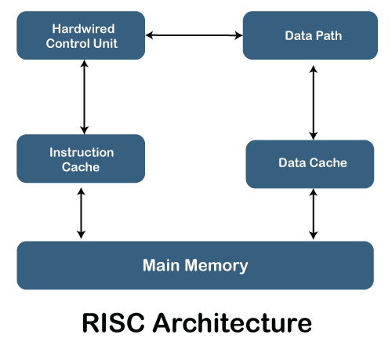
RISC: It stands for Reduced Instruction Set Computer.
It is a type of microprocessor architecture that uses a small set of instructions of uniform length.
These are simple instructions that are generally executed in one clock cycle.
RISC chips are relatively simple to design and inexpensive.
The setback of this design is that the computer has to repeatedly perform simple operations to execute a larger program having a large number of processing operations.
Examples: SPARC, POWER PC, etc.

Slide 6
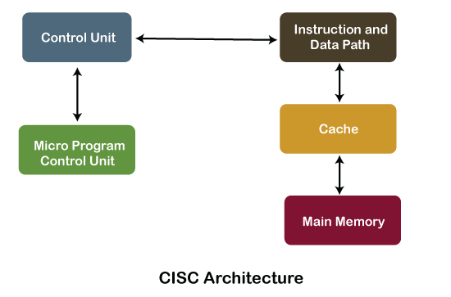
CISC: It stands for Complex Instruction Set Computer.
These processors offer the users, hundreds of instructions of variable sizes.
CISC architecture includes a complete set of special-purpose circuits that carry out these instructions at a very high speed.
These instructions interact with memory by using complex addressing modes.
CISC processors reduce the program size and hence lesser number of memory cycles are required to execute the programs.
This increases the overall speed of execution.
Examples: Intel architecture, AMD

Slide 7
Difference between the RISC and CISC Processors
RISC | CISC
It is a Reduced Instruction Set Computer. | It is a Complex Instruction Set Computer.
It emphasizes on software to optimize the instruction set. | It emphasizes on hardware to optimize the instruction set.
It is a hardwired unit of programming in the RISC Processor. | Microprogramming unit in CISC Processor.
It requires multiple register sets to store the instruction. | It requires a single register set to store the instruction.
RISC has simple decoding of instruction. | CISC has complex decoding of instruction.
Uses of the pipeline are simple in RISC. | Uses of the pipeline are difficult in CISC.
It uses a limited number of instruction that requires less time to execute the instructions. | It uses a large number of instruction that requires more time to execute the instructions.

Slide 8
Difference between the RISC and CISC Processors
RISC | CISC
It uses LOAD and STORE that are independent instructions in the register-to-register a program's interaction. | It uses LOAD and STORE instruction in the memory-to-memory interaction of a program.
RISC has more transistors on memory registers. | CISC has transistors to store complex instructions.
The execution time of RISC is very short. | The execution time of CISC is longer.
RISC architecture can be used with high-end applications like telecommunication, image processing, video processing, etc. | CISC architecture can be used with low-end applications like home automation, security system, etc.
It has fixed format instruction. | It has variable format instruction.
The program written for RISC architecture needs to take more space in memory. | Program written for CISC architecture tends to take less space in memory.
Example of RISC: ARM, PA-RISC, Power Architecture, Alpha, AVR, ARC and the SPARC. | Examples of CISC: VAX, Motorola 68000 family, System/360, AMD and the Intel x86 CPUs.

Slide 9
