Slide 1

Gene Selection For
Discriminant
Microarray Data Analyses
Wentian Li, Ph.D
Lab of Statistical Genetics
Rockefeller University
http://linkage.rockefeller.edu/wli/

Slide 2
Overview
review of microarray technology
review of discriminant analysis
variable selection technique
four cancer classification examples
Zipf’s law in microarray data

Slide 3
Microarray Technology
binding assay
high sensitivities
parallele process
miniaturization
automation

Slide 4
History
1980s: antibody-based assay (protein chip?)
~1991: high-density DNA-synthetic chemistry (Affymetrix/oligo chips)
~1995: microspotting (Stanford Univ/cDNA chips)
replacing porous surface with solid surface
replacing radioactive label with fluorescent label
improvement on sensitivity

Slide 5
Terms/Jargons
Stanford/cDNA chip
one slide/experiment
one spot
1 gene => one spot or few spots(replica)
control: control spots
control: two fluorescent dyes (Cy3/Cy5)
Affymetrix/oligo chip
one chip/experiment
one probe/feature/cell
1 gene => many probes (20~25 mers)
control: match and mismatch cells.

Slide 6
From raw data to expression level (for cDNA chips)
noise
subtract background image intensity
consistency
among different replicas for one gene, all genes in one slide, different slides
outliers
missing values
spots that are too bright or too dim
control
subtract image for the second dye
logarithm
subtraction becomes ratio (log (Cy5/Cy3))

Slide 7
From raw data to expression level
(oligo chips)
most of the above
control
match and mismatch probes (20~25mers)
combining all probes in one gene
presence or absence call for a gene

Slide 8
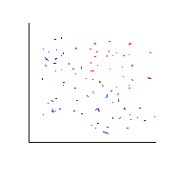
Discriminant Analysis
Each sample point is labeled (e.g. red vs. blue, cancer vs. normal)
the goal is to find a model, algorithm, method… that is able to distinguish labels

Slide 9
It is studied in different fields
discriminant analysis (multivariate statistics)
supervised learning (machine learning and artificial intelligence in computer science)
pattern recognition (engineering)
prediction, predictive classification (Bayesian)

Slide 10
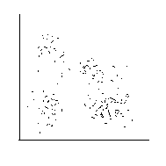
Different from Cluster Analysis
Sample points are not labeled (one color)
the goal is to find a group of points that are close to each other
unsupervised learning

Slide 11
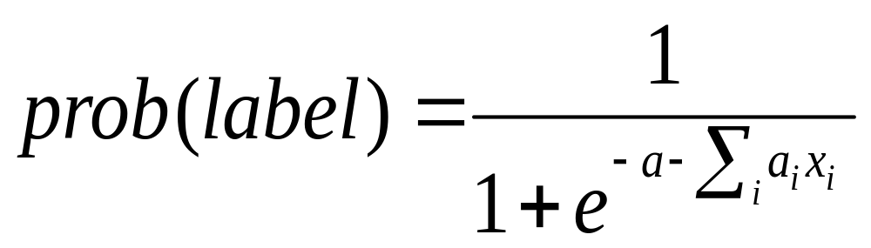
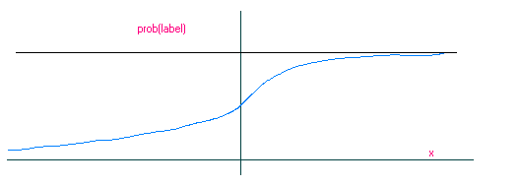
Linear Discriminant Analysis is the simplest
Example: Logistic Regression

Slide 12
Other Classification Methods
calculate some statistics within each label (class), then compare (t-test, Bayes’ rule…)
non-linear discriminant analysis (quadratic, flexible regression, neural networks…)
combining unsupervised learning with the supervised learning
linear discriminant analysis in higher dimension (support vector machine…)

Slide 13
It is typical for microarray data to have smaller number of samples, but larger number of genes (x’s, dimension of the sample space, coordinates, etc.). It is essential to reduce the number of genes first: variable selection.

Slide 14
Variable Selection
important by itself
gene can be ranked by single-variable logistic regression
important in a context
-combining variables
-a model on how to combine variables is needed
-the number of variables to be included can be dynamically determined.
combining important genes not in a context
-model averaging/combination, ensemble learning, committee machines
-bagging, boosting,

Slide 15
More on variable selection in a context
each variable has a parameter in a linear combination (coefficient, weight,...)
in a non-linear combination, a variable may have more than 1 parameter
too many parameters are not desirable: good performance of a complicated model is misleading (overfitting)
balancing data-fitting performance and model complexity is the main theme for model selection

Slide 16
Ockham(Occam)’s Razor(Principle)
Principle of Parsimony
Principle of Simplicity
“frustra fit per plura quod potest fieri per pauciora” (it is vain to do with more what can be done with fewer)
“pluralitas non est ponenda sine neccesitate” (plurality should not be posited without necessity)

Slide 17
Model/Variable Selection Techniques
Bayesian model selection: a mathematically difficult operation, integral, is needed
An approximation: Bayesian information criterion BIC (integral is approximated by an optimization operation, thus avoided)
A proposal similar to BIC was suggested by Hirotugu Akaike, called Akaike information criterion (AIC)

Slide 18

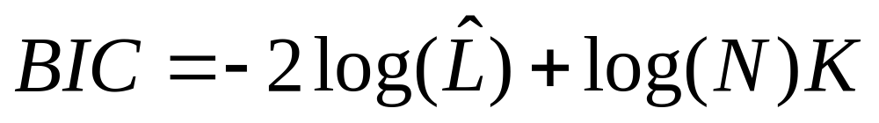
Bayesian Information Criterion(BIC)
Data-fitting performance is measured by likelihood (L): Prob(data|model, parameter), at its best (maximum) value ( )
Model complexity is measured by the number of free(adjustable) parameters (K).
BIC balances the two (N is the sample size):
A model with the minimum BIC is “better”.

Slide 19
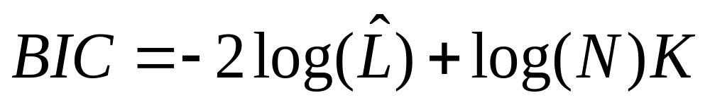

AIC is similar
When sample size N is larger 3.789, log(N) >2, BIC prefers a less complex model than AIC.

Slide 20
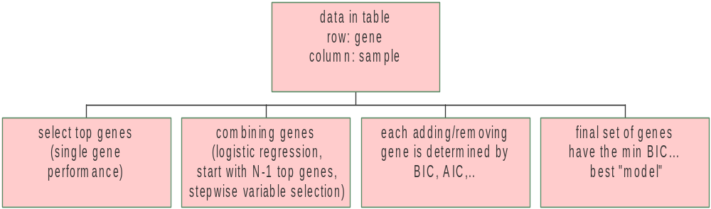
Summary of gene selection procedure in a context

Slide 21
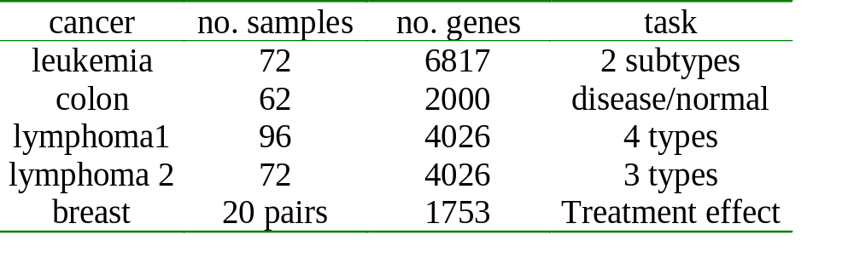
Cancer Classification Data Analyzed

Slide 22
Leukemia Data
Two leukemia subtypes (acute myeloid leukemia, AML, and acute lymphoblastic leukemia, ALL)
One of the two “meeting data sets” for Duke Univ’s CAMDA’00 meeting.
38 samples out of 72 were prepared in a consistent condition (same tissue type…). “training” set.
considered to be an “easy” data set.

Slide 23
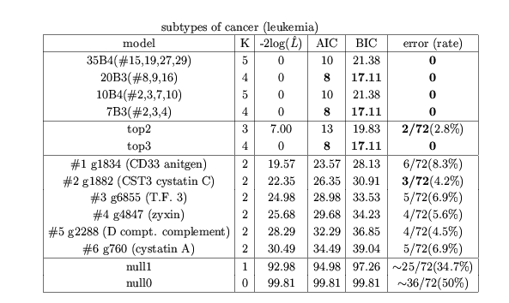
Variable Selection Result for Leukemia Data

Slide 24
Colon Cancer Data
distinguish cancerous and normal tissues
“harder” to classify than the leukemia data
classification technique is nevertheless the same (2 labels)

Slide 25
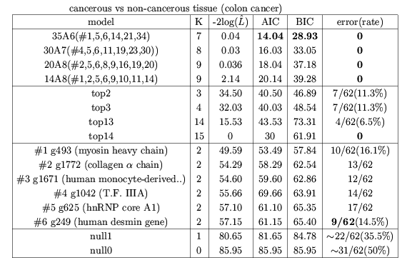
Variable selection Result for Colon Cancer

Slide 26
Lymphoma Data (1)
Four types: diffuse large B-cell lymphoma (DLBCL), follicular lymphoma (FL), chronic lymphocyte leukemia (CLL), normal
Multinomial logistic regression is used.
There are more parameters in multinomial … than binomial logistic regression.
A gene is selected because it is effective in distinguishing all 4 types

Slide 27
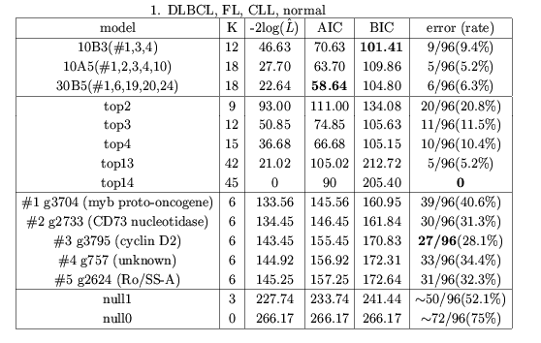
Variable Selection Result for Lymphoma
(4 types)

Slide 28
Lymphoma Data (2)
New subtypes of lymphoma were suggested based on cluster analysis of microarray data [Alizadeh, et al. 2000]: germinal centre B-like DLBCL (GC-DLBCL) and activated B-like DLBCL (A-DLBCL).
Strictly speaking, these two subtypes are not given labels, but a derived quantity. We treat them as if they are given.
Three-class multinomial logistic regression.

Slide 29
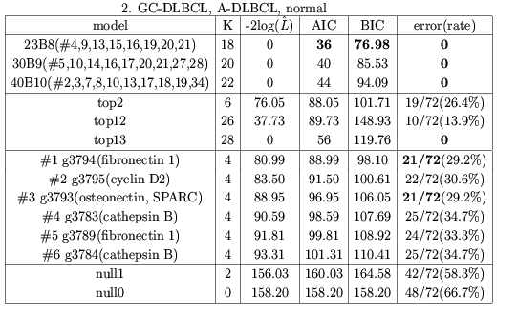
Variable Selection Result for Lymphoma
(3 types)

Slide 30
Breast Cancer Data
Microarray experiments were carried out before and after chemotherapy on the same patient.
Since these two samples are not independent, usual logistic regression can not be applied.
We use paired case-control logistic regression.
Two features: (1) each pair is essentially a sample without a label; (2) the first coefficient in LR is 0.

Slide 31
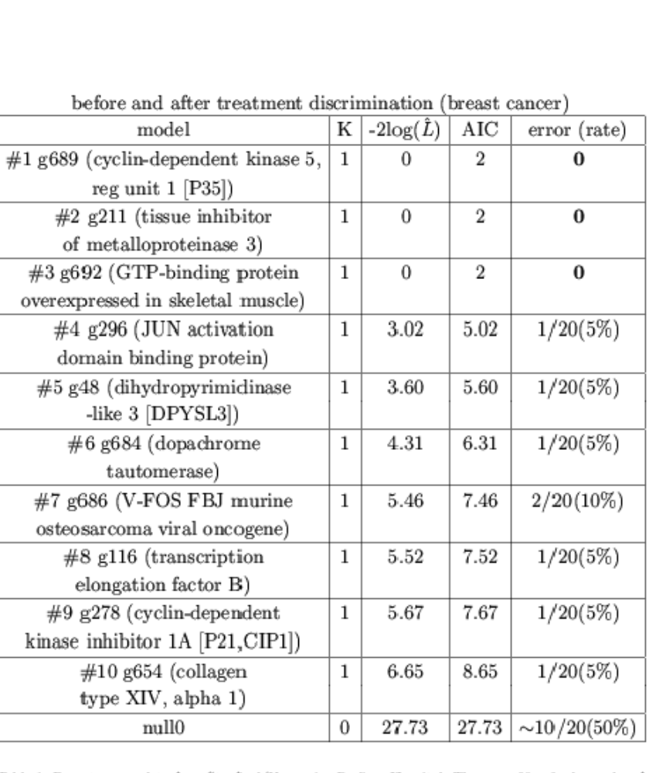
Breast Cancer Result
Paired Samples
many perfect fitting

Slide 32
Summary (gene selection result)
It is a variable selection in a context! Not individually! Not model averaging!
The number of genes needed for good or perfect classification can be as low as 1 (breast cancer, leukemia with training set only), 2-4 (leukemia with all samples), 6-8-14 (colon), 3-8-13-14 (lymphoma).
The oftenly quoted number of 50 genes for classification [Golub, et al. 1999] has no theoretical basis. The number needed depends!

Slide 33
Rank Genes by Their Classification Ability (single-gene LR)
maximum likelihood in single-gene LR can be used to rank genes.
maxL(y-axis) vs. rank (x-axis) is called a rank-plot, or Zipf’s plot.
George Kingsley Zipf (1902-1950) studied many such plots for natural and social data
He found most such plots exhibit power-law (algebraic) functions, now called Zipf’s law
Simple check: both x and y are in log scale.

Slide 34
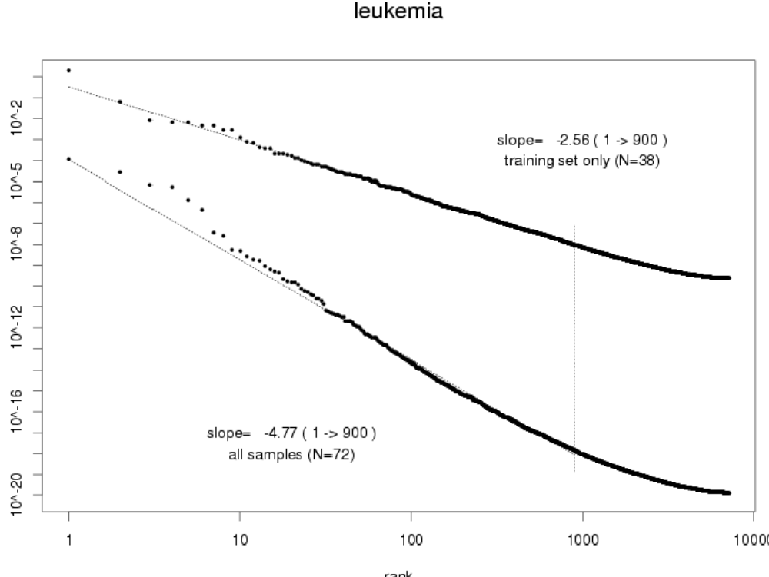

Slide 35
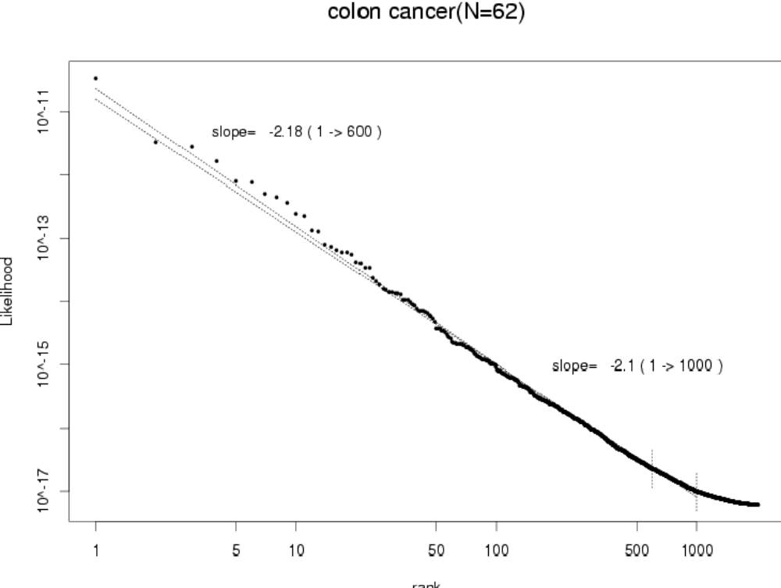

Slide 36
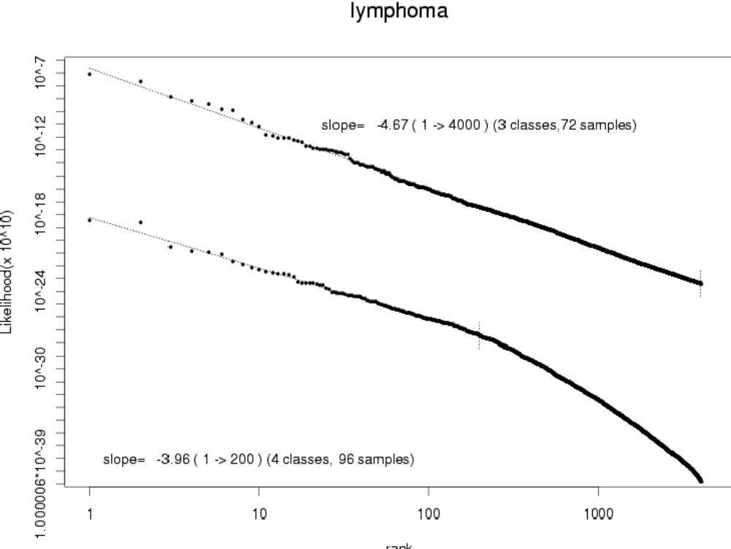

Slide 37
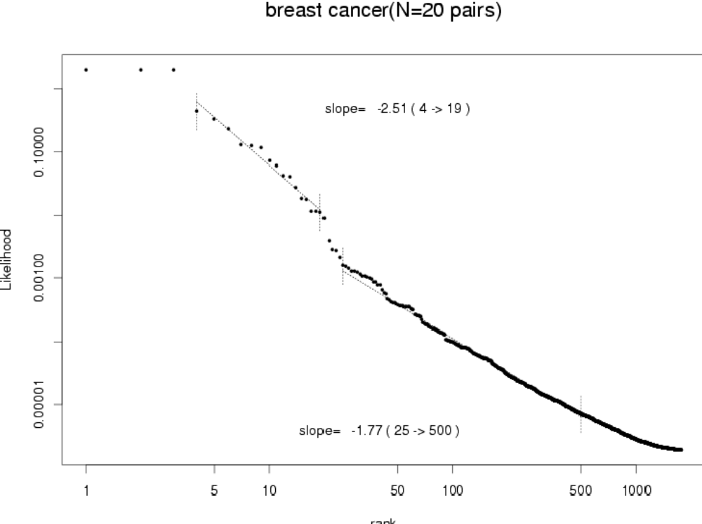

Slide 38
Summary (Zipf’s law)
Zipf’s law describes microarray data well
The fitting ranges from perfect (3-class lymphoma) to not so good (breast cancer).
The exponent of the power-law is a function of the sample size, not intrinsic.
It is a visual representation of all genes ranked by their classification ability.

Slide 39
Acknowledgements
Collaborations:
Yaning Yang (RU)
Fatemeh Haghighi (CU)
Joanne Edington (RU)
Discussions:
Jaya Satagopan(MSK)
Zhen Zhang (MUSC)
Jenny Xiang (MCCU)

Slide 40
References
(leukemia data, model averaging)
Li, Yang (2000), “How many genes are needed for discriminant microarray data analysis”, Critical Assessment of Microarray Data Analysis Workshop (CAMDA00), Duke U, Dec2000.
(Zipf’s law)
Li (2001), “Zipf’s law in importance of genes for cancer classification using microarray data”, submitted.
(more data sets)
Li, Yang, Edington, Haghighi (2001), in preparation.

Slide 41
A collection of publications on microarray data analysis
linkage.rockefeller.edu/wli/microarray

