Slide 1
Study Design and Analysis Guidelines for Genomic Scale Data
Laying down the foundation for reproducible findings

Slide 2
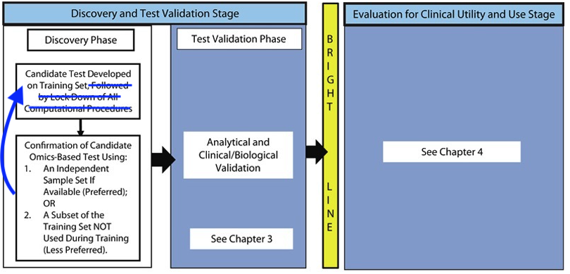


Slide 3
Evolution of Translational Omics (ETO): Lessons Learned and the Path Forward Institute of Medicine
“Omics” is a term encompassing multiple molecular disciplines, which involve the characterization of global sets of biological molecules such as DNAs, RNAs, proteins, and metabolites.
Key feature is that there are many more variables than analysis units in the data sets.
ETO: Recommendations for a discovery and development process to usher tests using omics based technologies into the clinical setting for use in patient care.
Guidelines for procedures and methods are intended to protect the public from the dangers of bringing flawed tests into the clinic.
Includes information dissemination guidelines meant to promote transparency to improve the success rate.
Adopting some of these guidelines will help our internal development process: avoid the propagation of flawed results and catch errors early.
Where ETO report refers to an Omics-based test, we can replace with Omics-based results, the building blocks of eventual tests.

Slide 4
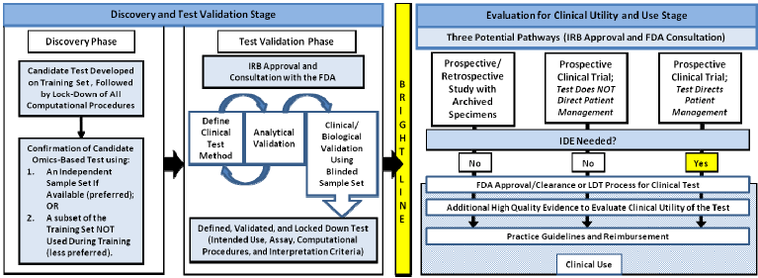
Omics-based test development process.

Slide 5
Omics-based Model Development Process – Discovery Phase
Candidate Model Developed
On Training Data
Mutation Profiling
Algorithm
At lock-down,
the evaluation criteria
must be specified and
Locked.
All Validation Sets
are Not Equal!
Lock-Down of All
Analytical and Computational
Procedures
Evaluation of Candidate
Omics-Based Test using:
Data from an Independent Sample set if available (preferred); -or-
2. Data from a subset of the Training Set NOT Used during training (less preferred).
Simple enough – what could possibly go wrong?

Slide 6
ASCO 21012 - New Diagnostics and Devices: Evaluating new technologies for diagnosis and prognosis
David F. Ransohoff, MD – “Bias is the main problem in non-randomized studies”
Strength of Science: Do we trust the results?
Threats to validity of results include:
Weak or ill-specified question
Weak method
Design – biased or under-powered
Overfitting - Analysis produces “chance” results
Bias in the examples that follow means that there are systematic (non-biological) differences between sample sets being compared
When these biases exist, one cannot attribute observed effects to biology (not without making some assumptions or getting more data and doing more analyses)
Notes:
Also see talk by Daniel Hayes.
“The Question” may change over time, but at a particular point in time a particular question is being addressed by a particular analysis – that question should be stated clearly when results are being presented

Slide 7
Bias Example 1 – Use of proteomic patterns in serum to identify ovarian cancer
The Lancet, Vol. 359, No. 9306. (16 February 2002), pp. 572-577, doi:10.1016/S0140-6736(02)07746-2
A training set of mass spectroscopy data from 50 unaffected woman and 50 patients with ovarian cancer was used to build a classifier.
When applied in a blinded fashion to 50 ovarian cancers and 66 un-affected cases, the classifier correctly identified all cancer cases and misclassified 3 un-affected cases.
Sensitivity = 100%, Specificity = 95% using a Fit Set/Test Set approach – but these results were not reproducible.
What went wrong?
Mass spec measurements for cancer and non-cancer cases were done on different days, prior to allocation to Fit Set or Test Set. Ie. These were not independent data sets.
K. Baggerly “discovered” this by looking at the chip numbers.
Took a year took figure it out.
Full disclosure of methods would have made this problem readily apparent.

Slide 8
Bias Example 2: Differential exoprotease activities confer tumor-specific serum peptidome patterns
The Journal of Clinical Investigation, Vol. 116, No. 1. (08 January 2006), pp. 271-284, doi:10.1172/JCI26022
Results: Peptide patterns are 100% sensitive and specific to Prostate cancer
Groups:
Cancer:
Control:
mean age = 67, Gender = 100% M
mean age = 35, Gender = 42% M

Slide 9
Bias Example 3: GHI Colon Polyps Experiment
Sample Tissue Block Descriptions
Sample set 1
Year | Benign | Cancerous
2008 | 60 | 8
2007 | 1 | 48
In studies based on archival specimens that we obtain from tissue banks,
or hospitals, how can we exercise more control over the sample selection
process?

Slide 10
Bias Example 4: Affymetrix Genechip profiles find tumor subtypes
Several hundred samples from breast tumors were hybridized to early versions of Affymetrix Genechips.
Unsupervised clustering on the gene expression profiles led to 2 very distinct clusters ☺
Gene signatures driving the clusters were not interpretable ☹
Possible explanation:
For 2 weeks prior to the end of the year, production was running 7 days of week in order to meet bonus goals.
The two groups of samples corresponding to the two clusters were processed on two consecutive week-ends.
Notes:
This is a true story that I know happened at this particular site, but I’m sure this scenario unfolded at many other sites.
Deming to Ford – The problem with your manufacturing process is your management

Slide 11
Batch effects, a significant threat to the validity of Omics results
Batch effects on microarray data have been well documented.
Batch effects in RNASeq data are also starting to be addressed
These can be mitigated by proper sample processing designs.
Batch effects may be an even bigger threat to the validity of results in mutation profiling
Patterns of sequencing errors found in one study (Nakamura 2011) are not observed in the next study (Minoche 2011).
Suggests including several independent sequencing data sets in analysis.
The plethora of methods is astounding: GATK, Samtools, VarScan, SNVMix, SERVIC4E, CrossSampleErrEst, SNVer, CRISP, Atlas-SNP2, and many more
The key to arriving at valid – generalizable – results will be sound sample selection and processing and careful data analysis to guard against overfitting.

Slide 12
ETO: Steps to Ensure the Validity of Results
Data Quality Assessment
Crucial first step.
Includes both general and application specific assessments.
A data quality report must be produced and examined before proceeding.
Computational Model Development
Overfitting is a major concern: performance will be great on training set, but poor on other samples.
Confirmation on an Independent Evaluation Dataset
A computational model’s ultimate utility is measured by its performance on future samples.
Documentation of Data and the Fully Specified Computational Procedures should be made available
These should be stored in a protected area under version control, etc.
Notes:
QA is Most important as subsequent steps may very well assume good quality data.
Quality of the data that will make or break the day: It is at this step that we can catch problems and Learn and Improve.
QA is an active, engaging process – not just a routine that needs to be checked off a list.
At this point in NGS, every data set should have some interesting quality features. The results of QA, the report, should not be “pass qa”, but rather “here are the quality features of this data set”
Sometimes business constraints force us to take shortcuts – this is not a good place to make cuts.

Slide 13
Computational Model Development: Training - Evaluation Set Separation
Evaluation set should be representative of future samples (tissue type, stage, etc.), and ideally fully independent of the Training set – processed separately from beginning to end at a different point in time, for example.
When this is not possible, the analysis data set should be split into Training and Validation subsets at random.
Some mutation analysis method developers split the genomic region into Training and Validation subregions – this is the least desirable split.
To avoid overfitting, the Training set itself can be randomly split in a Fit set and a Test set, or cross-validation can be used to arrive at a final computational model
Test set or cross-validated performance assessments are usually optimistic as the fit and test sets share similarities that may not be shared by future samples processed later in time, potentially coming from different populations
Cross-validation estimates can also suffer from bias and high-variance (Elements of Statistical Learning)
Notes:
If we were to commercialize a mutation profiling product, we might want to get samples from future customers as part of the evaluation set.

Slide 14
Omics-based Model Development Process – Discovery Phase
Training Data
Candidate Model Developed
On Training Data
Fit Set/Test Set or
Cross validation done here
Lock-down of Model and
Evaluation Procedure
Evaluate.
If the computational model
requires adjustments,
a new evaluation set
is required
Lock-Down of All
Analytical and Computational
Procedures
Evaluation Data
Evaluation of Candidate
Omics-Based Test using:
Data from an Independent Sample set if available (preferred); -or-
2. Data from a subset of the Training Set NOT Used during training (less preferred).
Estimated Performance Level should be High, and Accurate!
Notes:
Accuracy of performance estimate is more important. Performance can always be improved. IF we have an accurate estimate, we will see that P needs improvement.
Idea: Instead of setting a Perf target for bonus – link bonus to accuracy of training data Perf as estimate of Evaluation data Perf

Slide 15
ETO – Best Practices for the discovery phase for Omics-based test development
Recommendation:
Confirm results on one or more independent sets of samples
Oncotype DX example: Recurrence Score was validated using multiple independent datasets (Paik et al., 2004). The data were analyzed by the same investigators, but different data sets were derived from different trials at multiple institutions.
Data used for analyses should be documented and made available
Computer code and fully specified computational procedures should be documented and made available
Omics-based test or procedure should be defined precisely, including lab protocols, the computational procedures and the intended uses.

Slide 16
References
[] ASCO 2012 Meeting Session: New Diagnostics and Devices in the Era of Comparative Effectiveness, Daniel F. Hayes, MD, chair.
[] Baggerly, K.A., Morris, J.S. and Coombes, K.R. 2004. Reproducibility of SELDI-TOF protein patterns in serum: comparing datasets from different experiments, Bioinformatics, 20(5):777–785 PDF
[] Baggerly, K.A., Morris, J.S., Edmonson, S.R., Coombes, K.R. 2005. Signal in Noise: Evaluating Reported Reproducibility of Serum Proteomic Tests for Ovarian Cancer, Journal of the National Cancer Institute, 97(4):307-309 PDF
[] Baggerly, K.A. and Coombes, K.R. 2009. Deriving Chemosensitivity from Cell Lines: Forensic Bioinformatics and Reproducible Research in High-Throughput Biology, The Annals of Applied Statistics. 3(4):1309–1334 PDF
[] Hastie, T., Tibshirani, R. and Friedman, J. 2009. The Elements of Statistical Learning: Data Mining, Inference, and Prediction, Springer; 2nd ed.
[] Hayes D. F et al. 1996. Tumor marker utility grading system: a framework to evaluate clinical utility of tumor markers. J. Natl. Cancer Inst., 88: 1456-1466. PDF
[] Micheel, C.M., Nass, S.J. and Omenn, G.S., Editors. 2012. Evolution of Translational Omics: Lessons Learned and the Path Forward, Institute of Medicine, Washington, DC: The National Academies Press. PDF
[] Kim, K.I. and Simon, R. 2011. Probabilistic classifiers with high-dimensional data, Biostatistics 12(3): 399–412. PDF suppPDF
[] Petricoin E.F., Ardekani, A.M. et. al. 2002. Use of proteomic patterns in serum to identify ovarian cancer, The Lancet, 359(9306):572-577 PDF
[] Simon, R., Radmacher, M.D., Dobbin, K., McShane, L.M. 2003. Pitfalls in the Use of DNA Microarray Data for Diagnostic and Prognostic Classification, Journal of the National Cancer Institute, 95(1): 14-18 PDF supp_PDF
[] Simon, R., Paik, S., Hayes, D.F. 2009. Use of Archived Specimens in Evaluation of Prognostic and Predictive Biomarkers. Journal of the National Cancer Institute, 101(21): 1446-1452 PDF
[] Teutsch, S.M., Bradley, L.A., et.al. 2009. The Evaluation of Genomic Applications in Practice and Prevention (EGAPP) initiative: methods of the EGAPP Working Group. Genetics in Medicine 11(1):3-14, PDF
[] Varma, S. and Simon, R. 2006. Bias in error estimation when using cross-validation for model selection, BMC Bioinformatics, 7:91. PDF
[] Villanueva, J., Shaffer, D.R., et. al. 2006. Differential exoprotease activities confer tumor-specific serum peptidome patterns, The Journal of Clinical Investigation http://www.jci.org 116(1):271-284 PDF

Slide 17
References – batch effects
Batch effects on microarray data
[] Leek, J. T., R. B. Scharpf, H. C. Bravo, D. Simcha, B. Langmead, W. E. Johnson, D. Geman, K. Baggerly, and R. A.Irizarry. 2010. Tackling the widespread and critical impact of batch effects in high-throughput data. Nat Rev Genet 11(10):733-739. PDF supPDF
[] Leek JT, Storey JD. 2007. Capturing heterogeneity in gene expression studies by surrogate variable analysis. PLoS Genet 3(9): e161. PDF
[] Gagnon-Bartsch JA, Speed TP. 2012. Using control genes to correct for unwanted variation in microarray data. Biostatistics. 13(3):539-52. PDF
[] Scherer, A., Editor. 2009. Batch Effects and Noise in Microarray Experiments: Sources and Solutions. John Wiley & Sons, Ltd. ISBN: 978-0-470-74138-2 PDF
Batch effects in sequencing data
[] Auer, P.L. and Doerge,R.W. 2010. Statistical Design and Analysis of RNA Sequencing Data. Genetics Society of America DOI: 10.1534/genetics.110.11498. PDF Supp

Slide 18
Extras

Slide 19
Laying down the foundation for reproducible findings - Summary
Recommendations come from basic scientific principles and are fairly obvious.
As we strive to accelerate the development process, we are incurring higher risks of errors; we should simultaneously strive to make the process more robust and rigorous.
Most errors or flawed results are based on faulty assumptions.
As we get flooded with more and more data, it is Good Quality Data and Careful Data Analysis that is going to save the day.
It is everybody’s responsibility to ensure that sensible methods are used.
Notes:
Maybe it is because these principles are so basic that they are easily and often ignored?
Everybody’s responsibility – what is the evidence?

Slide 20
Emerging Omics Data Analysis Techniques
Extremely high data dimensionality gives rise to extreme risk of overfitting computational models
Analyzing several independent sequencing data sets is crucial to overcoming these risks.

Slide 21
"Personalized" Oncology? Approaching Tumor Biomarkers the Same Way We Approach Drugs
Daniel F. Hayes, MD - “A bad tumor marker is as harmful as a bad drug!”
Undervalue of Tumor Biomarkers is a Vicious Cycle:
Marker Utility is Poorly Valued
-> Low Funding for Research
-> Low Level of Evidence
-> Higher Skepticism and Few Recommendations for Clinical Use
-> Marker Utility is Poorly Valued :
Way out of the vicious cycle
Studies of convenience: “I have lunch with a colleague. I happen to have samples in a freezer. He has an idea for a BM. We put the two together p<0.05 …” – 98% of BM discovery studies (Ok to generate hypotheses - sometimes)
Applying the same level of evidence that are required for drugs to tumor biomarker discovery: Design a prospective start study with protocol and analysis plan of the sort used in drug discovery.

Slide 22
TMUGS: Levels of Evidence
Prospectively designed studies with written protocol in which the Marker is Primary Objective
Prospective, Marker is Secondary Objective
Most Tumor Marker Studies
Retrospective, Outcomes, Multivariate Analysis
Retrospective, Outcomes, Univariate Analysis
Retrospective, Correlation with Other Market, No Outcomes
The prospective-retrospective design using archived specimens.

Slide 23
Sample Selection and Handling
(Un)Common sense examples
Tests should be developed on samples that are properly selected from the population in which the test will be applied.
Sample processing – order, machine, lane, etc. – should be fully specified and optimized where possible.
When data are used to tune how the data are manipulated to arrive at the test results, these data cannot be used to evaluate how the test will perform with other data.

Slide 24
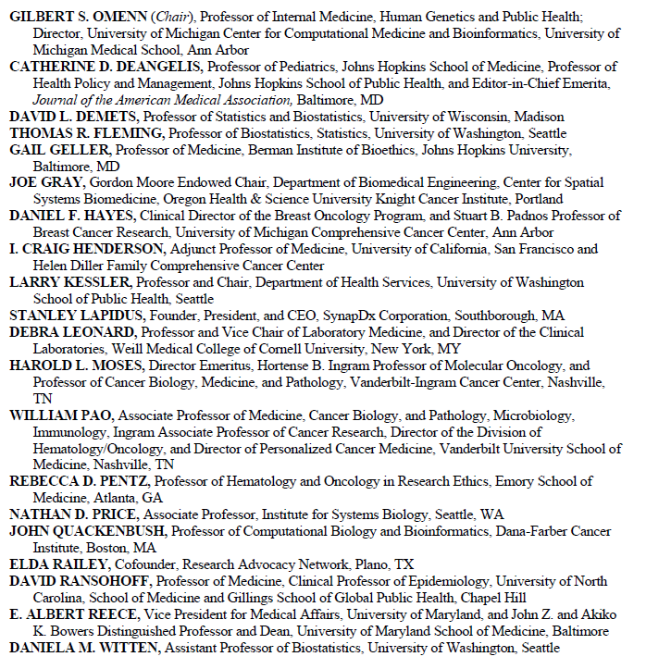
COMMITTEE ON THE REVIEW OF OMICS-BASED TESTS FOR PREDICTING PATIENT OUTCOMES IN CLINICAL TRIALS

Slide 25
Bias Example 3: GHI Colon Polyps Experiment
Sample Tissue Block Descriptions
Sample set 1 |  |  |  | Sample set 2
Year | Benign | Cancerous |  | Year | Benign | Cancerous
2007 | 1 | 48 |  | ≤ 2002 | 53 | 7
2008 | 60 | 8 |  | > 2002 | 1 | 42
In studies based on archival specimens that we obtain from tissue banks,
or hospitals, how can we exercise more control over the sample selection
process?

