Slide 1
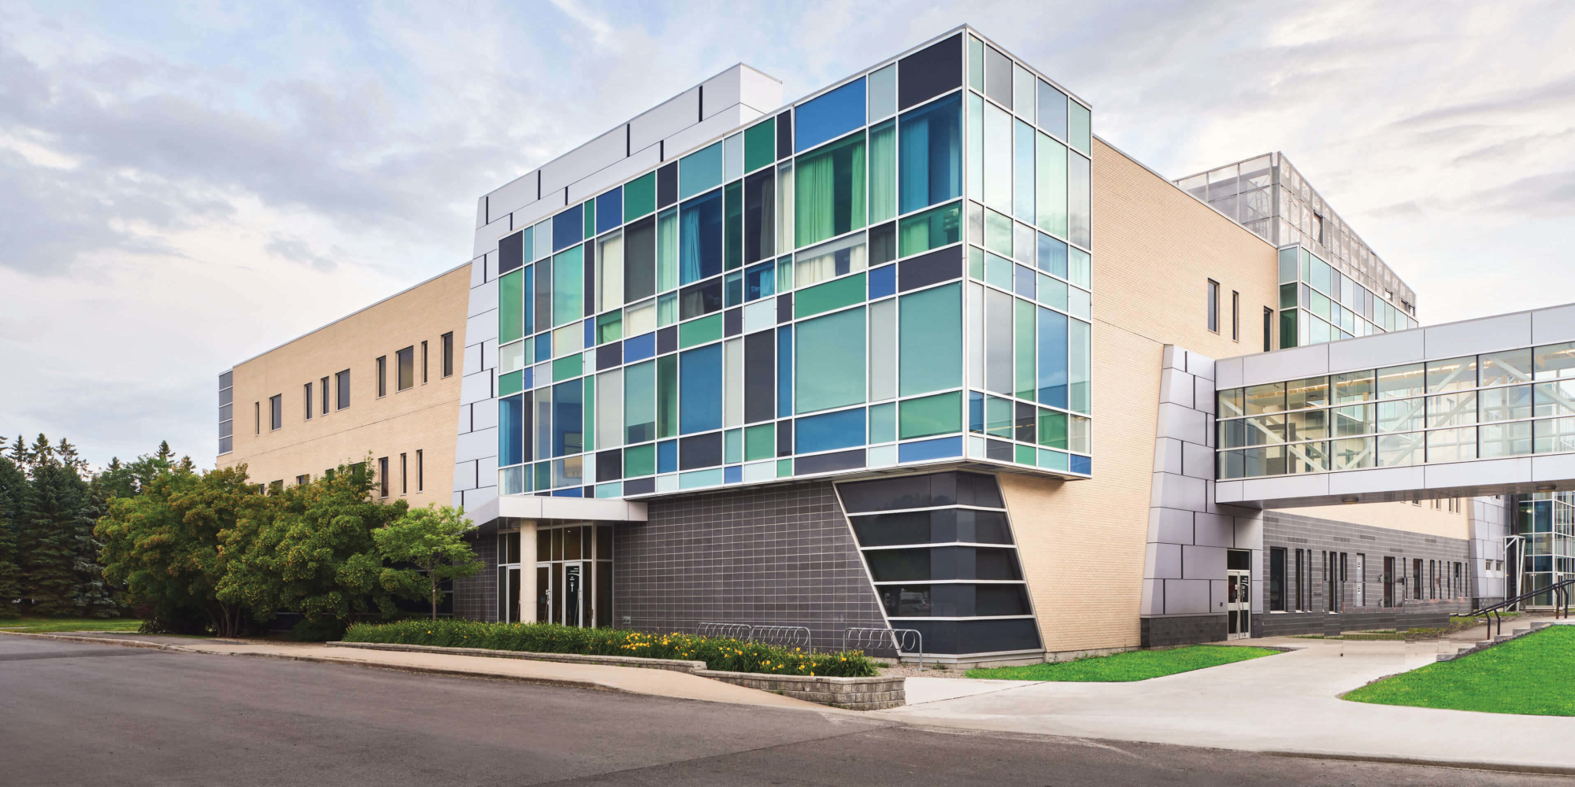
Algonquin College
Sol
A21
Computer Engineering Technology
CST8152
Compilers
Fall, 2021
Name: Brendan O’Hara &
Name: Erneste Iradukunda Senga

Slide 2
Regular Expressions
(0) L = [A-Za-z] (Letters)
(1) D = [0-9] (Digits)
(2) M = ( (Method name suffix)
(3) Q = “ (SL delimitator – double quotes)
(4) U = _ (Underscore)
(5) P = . (Period)
(6) O = [^LDUMQP] (Other chars)

Slide 3
SL = Q[^Q]*Q
KEY = {break, return, false, true, null, local, global, and, or, continue, def, del, if, elseif, finally, for, while, in, is, pass, with, yield, try, expect, as, class, raise }
MNID = L[L|D|U]*M
INTEGER = D+
Floats = D+PD+
VARIABLES = L[L|U|D ]*

Slide 4
Automata
L|D|U
S1
M
S7
S2
MNID
L
^Q
S4
S0
Q
^LDUM
S6
S3
*
KEY
D
D
Q
S10
S6
S5
SL
P
D
^DP
S7
D
S7
*
S8
S9
IL
^D
S10
S10
*
FL

Slide 5
TT (Transition Table)
Input | Input Symbol |  |  |  |  |  |  | Output
State \ Classes | 0 | 1 | 2 | 3 | 4 | 5 | 6 | Type
 | L(A-Z) | D(0-9) | U(_) | M(() | Q(“) | P(.) | O | -
S0 | 1 | 6 | ESNR | ESNR | 4 | ESNR | ESNR | NOAS [0]
S1 | 1 | 1 | 1 | 2 | 3 | 3 | 3 | NOAS [1]
S2 | FS | FS | FS | FS | FS | FS | FS | ASNR (MNID) [2]
S3 | FS | FS | FS | FS | FS | FS | FS | ASWR (KEY) [3]
S4 | 4 | 4 | 4 | 4 | 5 | 4 | 4 | NOAS [4]
S5 | FS | FS | FS | FS | FS | FS | FS | ASNR (SL) [5]
S6 | 7 | 6 | 7 | 7 | 7 | 8 | 7 | NOAS [6]
S7 | FS | FS | FS | FS | FS | FS | FS | ASWR (IL) [7]
S8 | ESNR | 9 | ESNR | ESNR | ESNR | ESNR | ESNR | NOAS [8]
S9 | 10 | 9 | 10 | 10 | 10 | 10 | 10 | NOAS [9]
S10 | FS | FS | FS | FS | FS | FS | FS | ASWR (FL) [10]

Slide 6
TT:
static jer_intg transitionTableMin[][TABLE_COLUMNS] = {
/* [A-z], [0-9], _, &, “, ., other */
/* L(0), D(1), U(2), M(3), Q(4), P(.), O(6) */
/* S00 */ { 1, 6, ESNR, ESNR, 4, ESNR, ESNR}, /* NOAS */
/* S01 */ { 1, 1, 1, 2, 3, 3, 3}, /* NOAS */
/* S02 */ { FS, FS, FS, FS, FS, FS, FS}, /* ASNR (MNID) */
/* S03 */ { FS, FS, FS, FS, FS, FS, FS}, /* ASWR (KEY) */
/* S04 */ { 4, 4, 4, 4, 5, 4, 4}, /* NOAS */
/* S05 */ { FS, FS, FS, FS, FS, FS, FS}, /* ASNR (SL) */
/* S06 */ { 7, 6, 7 , 7, 7, 8, 7}, /* NOAS */
/* S07 */ { FS, FS, FS, FS, FS, FS, FS}, /* ASWR (IL) */
/* S08 */ { 10, 9, 10, 10, 10, 10, 10}, /* NOAS */
/* S09 */ { FS, FS, FS, FS, FS, FS, FS}, /* ASWR (FL) */
};

Slide 7
End of Models

