Slide 1

FOREST RESOURCE
Dr. Pooja Sharma

Slide 2

Forest Resource
A forest , a biotic community with predominance of trees is an important Renewable natural resource.
Types of forest
  Very dense – above 70%
  Moderately dense – 41 – 70%
  Open forest – 10 – 40%
33% should be forest
24.39% in India
Average annual growth:
  1990-2000: 0.22%
  2000-2010: 0.46%
  2010-2020: 0.38%

Slide 3
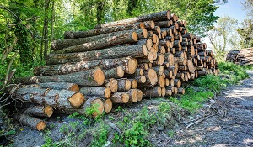
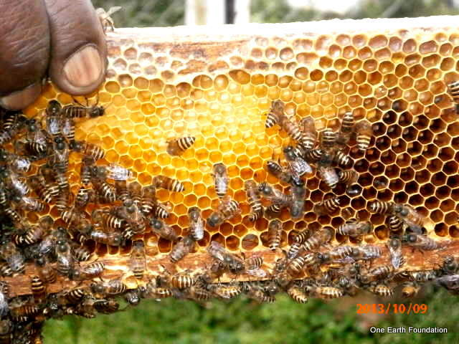
Functions of forests
Commercial use
  Timber, pulpwood
  Raw materials: oil, bamboo, cotton, jute, rubber, gum, fibers etc.
  Edible products: Fruits, condiments, spices, Beverages, fodder
  Manure, fuel wood
  Medicines
  Minerals
  Employment opportunity
  Recreation: Tourism

Slide 4
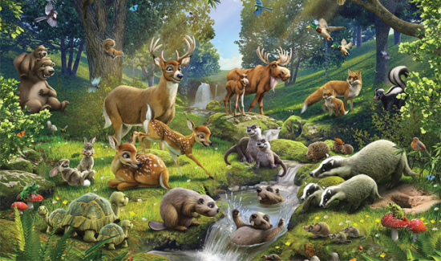
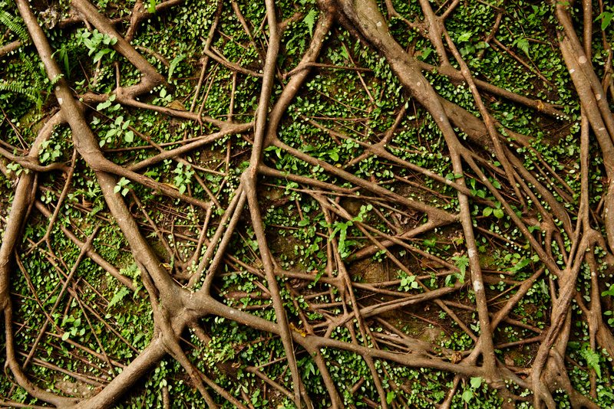
Functions of forests
Environmental functions
  Regulation of hydrological cycles
  Produces oxygen
  Soil conservation
  Pollutants moderators
  Driving energy flow and nutrient cycle
  Wild life habitat
  Reducing Greenhouse gas

Slide 5
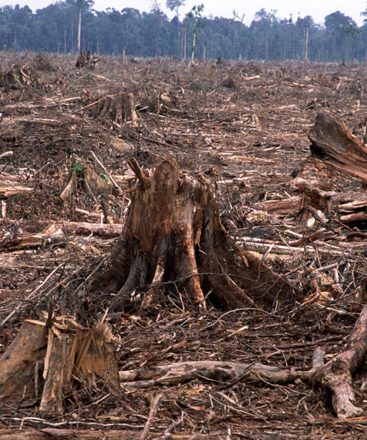
Over-exploitation of forests (Deforestation)
Causes
  Extensive wood cutting and logging
  Deforestation due to road construction
  Clearing forest for agriculture
  Overgrazing
  Mining activities
  Big hydropower projects
  Forest fire

Slide 6
Over-exploitation of forests (Deforestation)
Effects
  Threatens the existence of wildlife species
  Biodiversity is lost
  Hydrological cycle gets affected
  Soil erosion and loss of soil fertility
  Siltation of river and lakes
  May lead to landside
  Global warming
  Flood
  Loss of revenue
  Socio-economic problems: Relocation, threat to culture and tradition

Slide 7
Over-exploitation of forests (Deforestation)
Control
  Mining activities should be prohibited in protected forests
  Cutting of trees should follow massive plantation
  Environmental laws and legal provisions must be strictly followed
  Social forestry, agro-forestry, recreational forestry, extension forestry
  Public awareness
  Participation in forest conservation programs

Slide 8
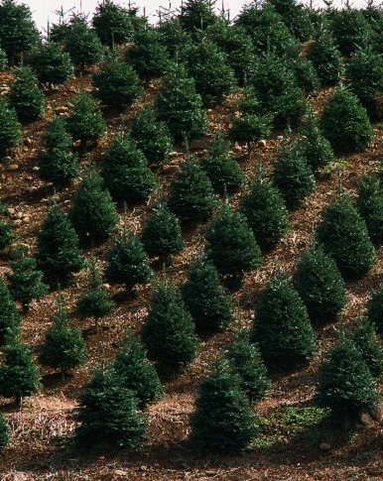
Control of deforestation
Control
  Reforestation
    Reforestation is the reestablishment of forest cover, either naturally or artificially in a deforested area.
  Afforestation
    Afforestation is the establishment of a forest or stand of trees in an area where there was no forest.

Slide 9
ENERGY RESOURCE
Dr. Pooja Sharma

Slide 10
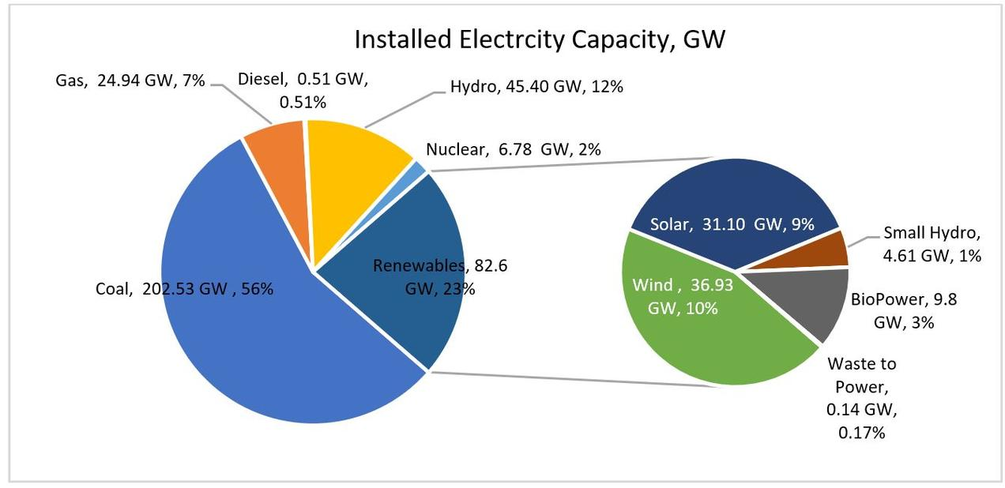
Energy resource
What is energy: Capacity to do work
Source of energy: Sun
Energy sources in India:

Slide 11
Renewable and non-renewable energy
Non-renewable
  Sources: Coal, oil, natural gas, nuclear energy
  Problems
    Leakage during transportation – water pollution
    Accidental fire – air pollution
    Refinery waste – solid waste, salt, grease, cleaning of oil tankers
    Vehicular emission
Renewable
  Solar energy, wind energy, hydro-power, Tidal energy, Ocean thermal energy, Geo thermal energy, biomass energy, biogas, biofuel, hydrogen fuel
  [Note: Alternative sources of energy = Non-fossil fuel sources]

Slide 12
Non-renewable resources
Coal
  Types of coal
    Anthracite: The highest rank of coal. It is a hard, brittle, and black lustrous coal, often referred to as hard coal, containing a high percentage of fixed carbon and a low percentage of volatile matter.
    Bituminous: Bituminous coal is a middle rank coal between subbituminous and anthracite. Bituminous usually has a high heating (Btu) value and is the most common type of coal used in electricity generation in the United States. Bituminous coal appears shiny and smooth when you first see it, but look closer and you may see it has layers.
    Subbituminous: Subbituminous coal is black in color and dull (not shiny), and has a higher heating value than lignite.
    Lignite: Lignite coal, aka brown coal, is the lowest grade coal with the least concentration of carbon.
    Also, there is peat. Peat is not actually coal, but rather the precursor to coal. Peat is a soft organic material consisting of partly decayed plant and, in some cases, deposited mineral matter. When peat is placed under high pressure and heat, it becomes coal.

Slide 13
Non-renewable resources
Petroleum
  Organization of Petroleum Exporting Countries (OPEC) consists of 13 countries and having 67% of worlds petroleum reserve.
  Petroleum is a complex mixture of alkane hydrocarbons.
  It is purified and refined by the process of fractional distillation.
  Petroleum is a cleaner fuel as compared to coal.
  Petroleum products
    Petroleum gas, kerosene, petrol, diesel, lubricating oil, paraffin, wax, asphalt, plastic etc.
  Liquefied Petroleum Gas: mainly composed of butane, other being propane and ethane.

Slide 14
Non-renewable resources
Natural gas
  Natural gas is the cleanest fossil fuel.
  composed of 95% methane, small amount of propane and ethane.
  It has been formed by decomposing remains of dead plants and animals.
  It has high calorific value (about 50 KJ/g)
  Compressed Natural Gas (CNG): It is used as an alternative to petrol and diesel in many cities including Delhi.
  Synthetic Natural Gas (SNG): It is a mixture of carbon monoxide and hydrogen. Low grade coal is first transformed into synthetic gas, then into methane by catalytic conversion.

Slide 15
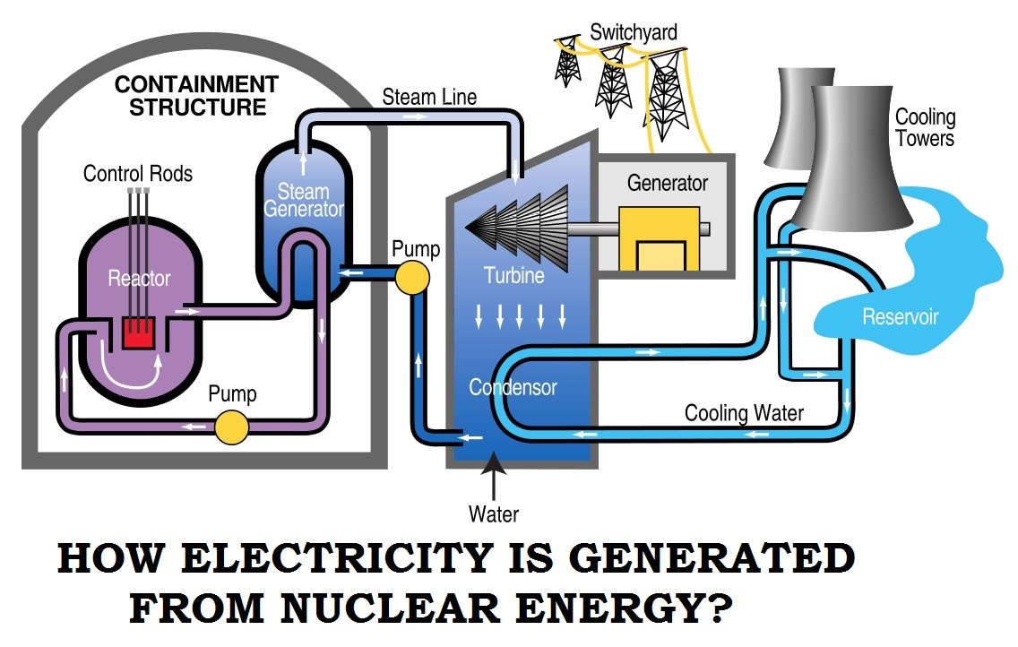
Nuclear energy
Types of nuclear reactions
  Fission: Splitting of large nucleus into smaller nuclei.
  Fusion: Joining of small nuclei into a large nucleus.
Elements used in nuclear energy production: Uranium, Thorium, Plutonium
Advantages:
  Less fuel offers more energy.
  The cost of nuclear fuel is only 20% of the cost of energy generated.
  The production of electric energy is continuous (almost 90% of annual time).
Disadvantages:
  Risk of unexpected event or nuclear accidents.
  Difficulty in the management of nuclear waste.
  Nuclear plants have a limited life.

Slide 16
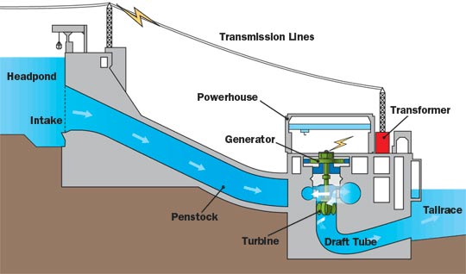
Hydro-electric energy
The potential energy in the water stored in dams is converted into electrical energy by releasing the water flow and rotating the turbine
Advantages
  Low operating and maintenance cost
  Non-polluting
  Reliable
  Flexible
  Safe
Disadvantages
  High setup cost
  Affects fish population
  Limited reservoirs
  Affected by draught
  Probable seismic activity

Slide 17
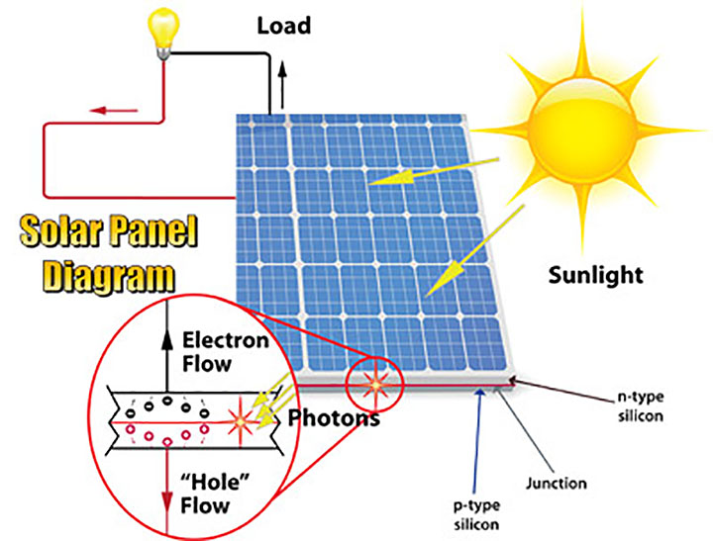
Solar energy
1 hour solar energy can be used for 1 year
Uses of solar energy
  Solar heating of home (sunspace)
  Solar water heating, solar cooker, solar furnace
  Solar desalination system
Photovoltaic energy: Silicon -> PV cells -> PV modules -> PV array -> solar panel
Advantages
  Easy to install
  No pollution, no noise
  Can be installed anywhere
Disadvantages
  Doesn’t work when light is not available
  Requires energy storage device
  Low efficiency
  Damage easily

Slide 18
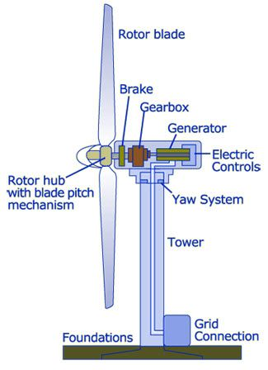
Wind energy
One of the earliest renewable energy – sail ships, windmills
India is the 4th largest producer of wind energy (after China, US and Germany).
Advantages
  Unlimited, free, renewable resource
  Low maintenance cost
  No pollution
Disadvantages
  High setup cost
  Birds and bats get killed
  Noise and signal reception problem

Slide 19
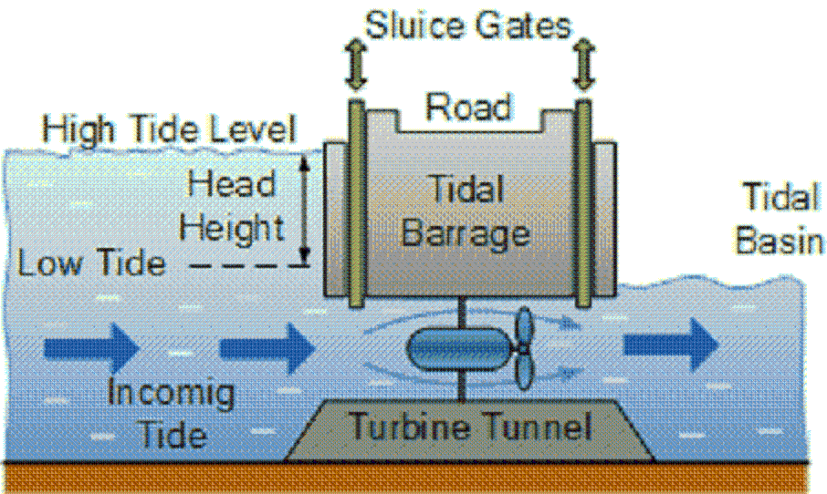
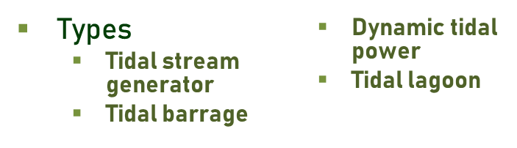
Tidal energy
Tidal power or tidal energy is a form of hydropower that converts the energy obtained from tides into electricity.
Advantages
  Tides are more predictable than the wind and the sun
  Uses less area.
  No emission of gaseous or particulate pollutants
Disadvantages
  Electro-magnetic emission affects the aquatic life.
  High construction cost

Slide 20
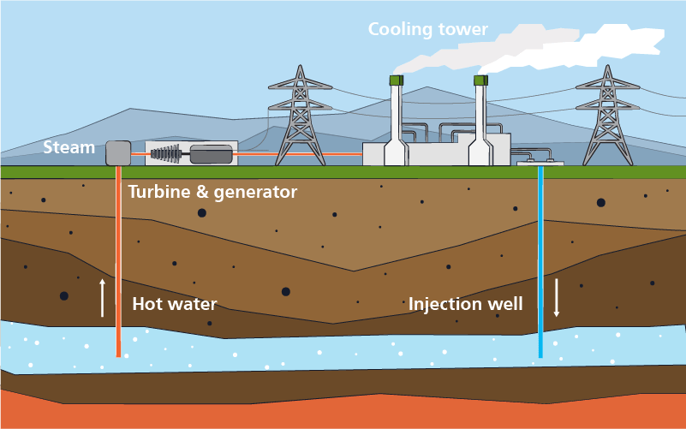
Geo-thermal energy
The energy harnessed from the hot rocks present inside the earth is called geothermal energy.
Sometimes natural geysers or artificially drilled holes can be used to released the water vapour underneath the earth surface.
Advantages
  No pollutant emission
  Reliable source of renewable energy
  Less operating cost
  Less maintenance cost
Disadvantages
  Possibility of emissions of H₂S, CO₂, CH₄ during extraction
  High Investment Costs

Slide 21
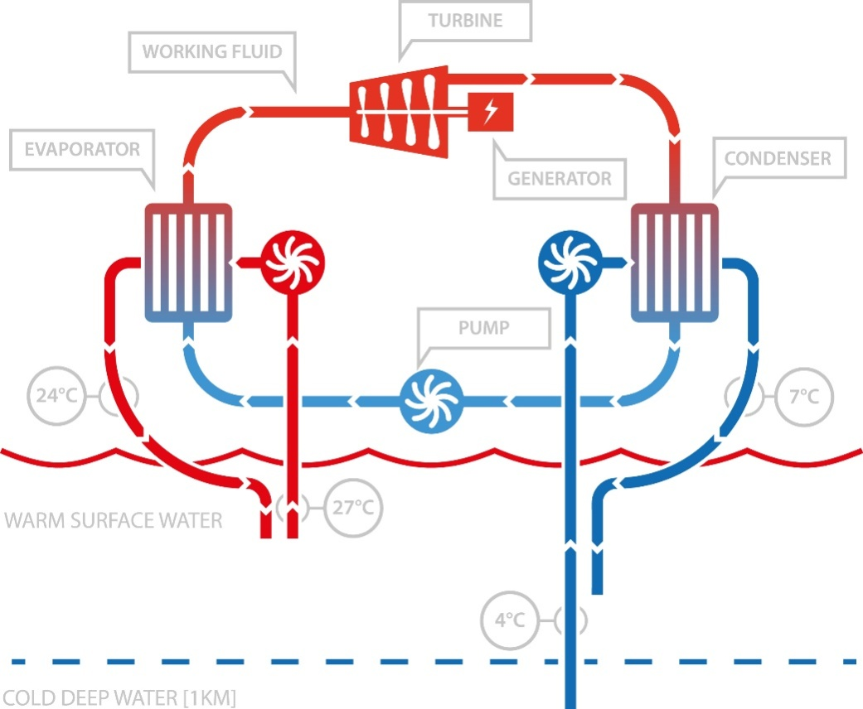
Ocean-thermal energy
The energy available due to the difference in temperature of water at the surface of tropical oceans and deeper levels is called ocean-thermal energy.
A difference of at least 20⁰ C is required
The heat is used to vaporize ammonia and rotate the turbine sing the vapour.
Advantages
  Continuous source of energy
  No pollutant emission
  Output shows very little seasonal variation
Disadvantages
  Capital investment is very high
  High maintenance cost
  Low efficiency
  Pipes could damage coral reefs

Slide 22
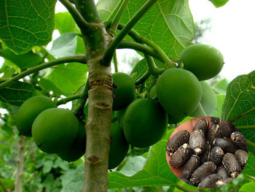
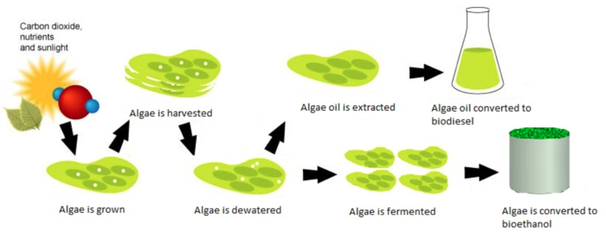
Biomass energy
Biomass is the organic manure produced by plants and animals includes wood, crop residue, cattle dung manure an agricultural waste
Log burning is a simple way use biomass energy
Wood is the largest source of biomass energy. It can also be used in electricity production in wood-based power stations.
Energy crop
  An energy crop is a plant grown as a low-cost and low-maintenance harvest used to make biofuels, such as bioethanol, or combusted for its energy content to generate electricity or heat. Example: Jatropha, Sunflower etc.
Energy trapped inside biomass
Biofuels
  Biodiesel
  Biogas
  Bio-ethanol
  Bio-methanol

Slide 23
Energy recovery
Getting energy by burning the waste
Advantages
  Reduced number of coal fired power plants
  Reduced airborne particles
  Improved air quality
  Lower fuel bills on transport
  Longer availability of crude oil
  Reduction of waste volume (up to 90%)
  Less requirement of landfill space
Disadvantages
  Release of toxic substances
  Residual ash may contain heavy metal

Slide 24
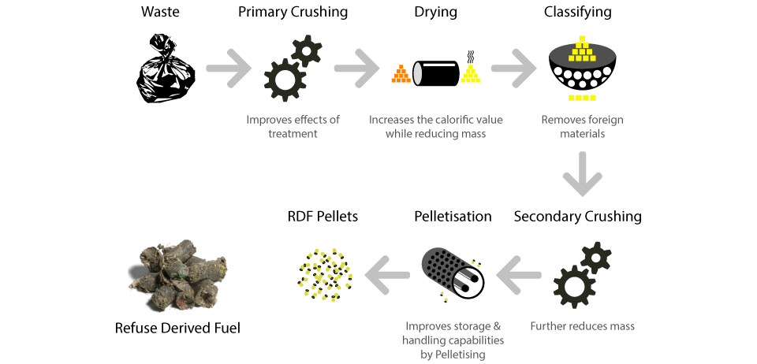
Refuse Derived Fuel (RDF)
RDF consists largely of combustible components of such waste, as non recyclable plastics , paper cardboard, labels etc.
These fractions are separated by different processing steps in order to produce a homogeneous material which can be used as substitute for fossil fuels

Slide 25
Thank You

