Slide 1
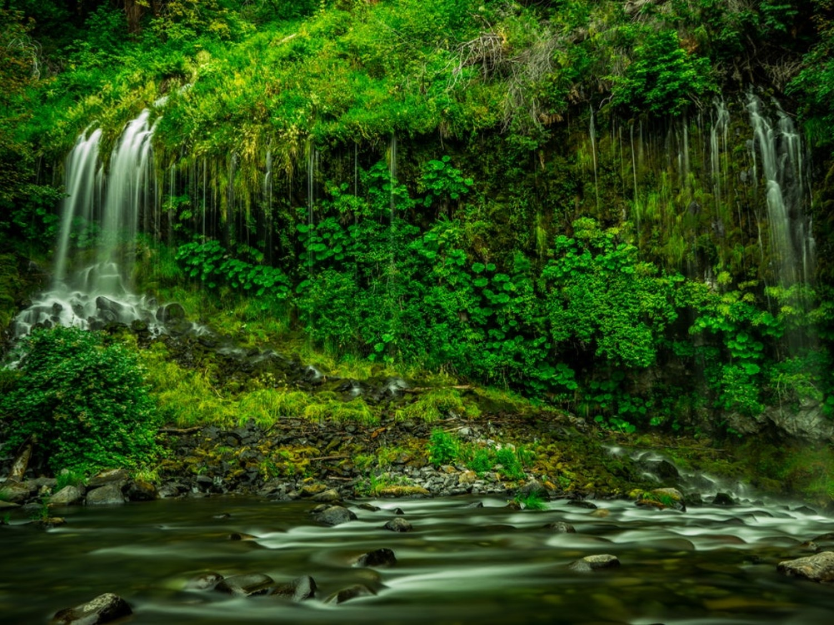
Environmental Pollution - 1
Dr. Pooja Sharma

Slide 2
Pollution
Pollution is the introduction of contaminants into the natural environment that cause adverse change. Pollution can take the form of chemical substances or energy, such as noise, heat or light.
Pollutants, the components of pollution. They can be either foreign substances/energies or naturally occurring contaminants.
12/03/19

Slide 3
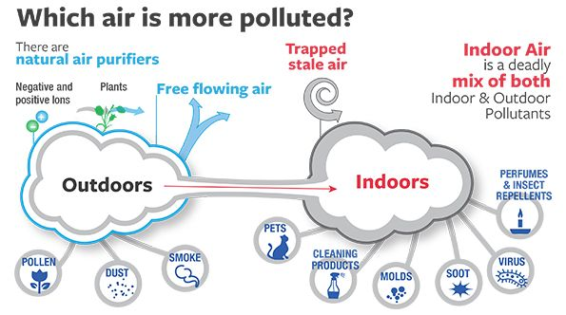
Air Pollution
Air pollution Air pollution is said to exist if the levels of gases, solids, or liquids present in the atmosphere are high enough to harm humans, other organisms, or materials.
Indoor Air Pollution
Outdoor Air Pollution
12/03/19

Slide 4
Air Pollution
Types of Air Pollutants
Primary
harmful chemicals that are released directly from a source into the atmosphere.
Examples: Particulate matter such as soil particles, lead, and asbestos, Oxides of carbon and nitrogen and sulphur dioxide, Hydrocarbons like methane and benzene
Secondary
produced from chemical reactions involving the primary pollutants.
Example: Ozone, Sulphur trioxide, PAN (Peroxy Acetyl Nitrate), Photochemical smog
12/03/19

Slide 5
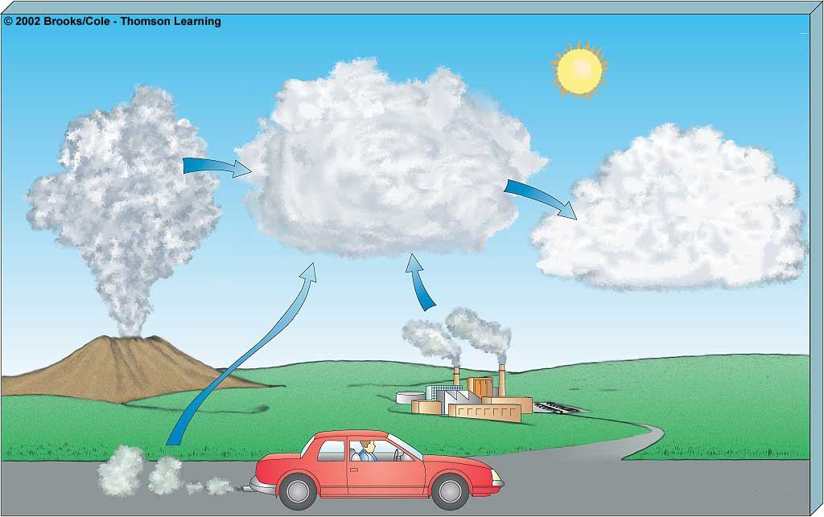
Primary Pollutants
CO
CO₂
Secondary Pollutants
SO₂
NO
NO₂
SO₃
Most hydrocarbons
HNO₃
H₂SO₄
Most suspended
particles
H₂O₂
O₃
₂
Most
NO₃
and
SO₄
–
salts
–
Mobile
Natural
Sources
Stationary
Notes:
5

Slide 6
Air Pollution
Major Air Pollutants
Carbon Monoxide
Product by incomplete combustion of fuel such as natural gas, coal or wood. Vehicular exhaust is a major source of carbon monoxide.
Causes carboxyhaemoglobin
Carbon Dioxide
A greenhouse gas emitted from combustion but is also a gas vital to living organisms. It is a natural gas in the atmosphere.
CFCs
Source: Refrigerators, air conditioners, foam shaving cream, spray cans and cleaning solvents
Destroy ozone layer
Ozone
Ground level ozone (O₃) formed from NO_{x} and VOCs. Ozone (O₃)
Damages skin and many materials, constituent of smog
12/03/19

Slide 7
Air Pollution
Major Air Pollutants
Nitrogen oxides
Especially nitrogen dioxide are emitted from high temperature combustion. Nitrogen dioxide is the chemical compound with the formula N02. It is responsible for photochemical smog, acid rain etc.
Sulphur dioxide
SO₂ is produced by volcanoes and in various industrial processes. Since coal and petroleum often contain sulphur compounds, their combustion generates sulphur dioxide. Further oxidation of SO₂, usually in the presence of a catalyst such as NO₂, forms H₂SO₄, and thus acid rain.
Suspended Particulate Matter (SPM)
Particulates, alternatively referred to as particulate matter (PM) or fine particles, are tiny particles of solid or liquid suspended in a gas. Sources of particulate matter can be manmade or natural. Increased levels of fine particles in the air are linked to health hazards such as heart disease, altered lung function and lung cancer.
12/03/19

Slide 8
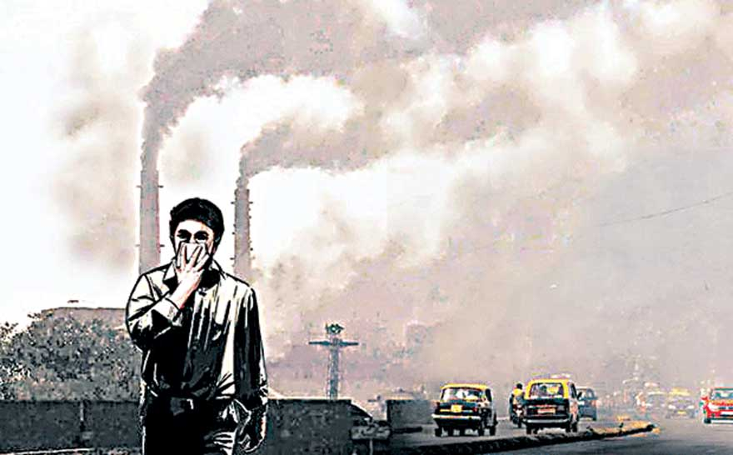
Air Pollution
Causes of Air Pollution
Natural Causes
Natural disasters like volcanic eruption, cyclones, forest fires, microbes(CH₄)
Natural emissions from animals, decaying organic matter
Anthropogenic (Man made) Causes
Industrial emissions
Automobiles
Thermal power stations
Nuclear explosions
Nuclear power plants
Agricultural activities
Disposal of garbage
Mining activities
12/03/19

Slide 9
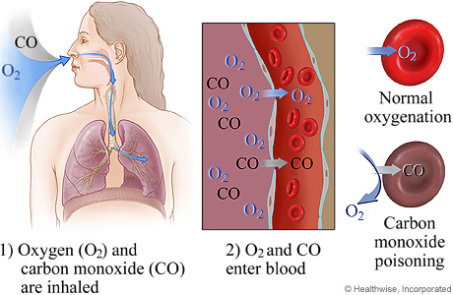
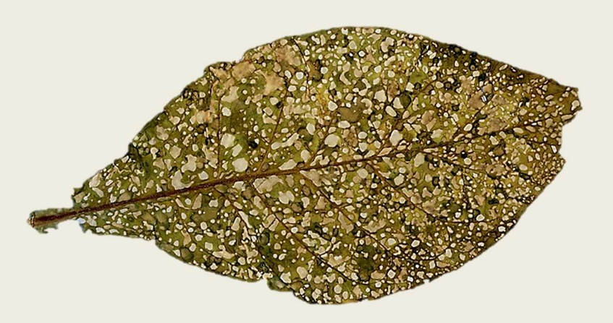
Air Pollution
Effects of Air Pollution
Effects on Human Health
Carboxyhaemoglobin
Inflammation of lungs
Damage to respiratory system, and blood vascular system,
Cancer
Effects on Plants
Bleaching of the leaf pigment
Development of necrotic spots
Premature falling of leaves
Effects on Climate
Greenhouse effect and global warming
Acid rain
Ozone (O3) layer depletion

Slide 10
Air Pollution
Prevention and control of air pollution
Air pollution can be prevented by
Adopting cleaner technologies,
Reducing pollution at the source,
Implementing laws and regulations to make people pollute less,
Introducing appropriate transportation policies
Making cleaner and fuel-efficient vehicles
Air pollution can be controlled by
Various Air Pollution Control (APC) devices
Sprinkling water on soil that is being evacuated during road construction

Slide 11
Air Pollution
Air Pollution Control (APC) devices
Particulate Matter
Cyclone separator
Bag house filter
Scrubbers
Electrostatic precipitators
Gaseous pollutants (Adsorption and Absorption)
Venturi scrubbers
Packed bed scrubbers
Spray towers
12/03/19

Slide 12
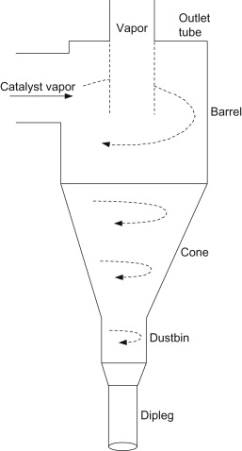
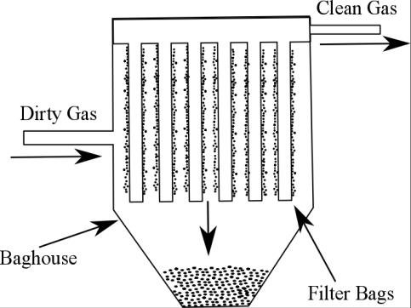
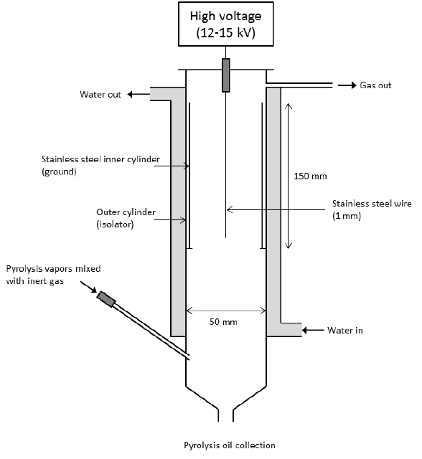
Air Pollution Control Devices
Baghouse Filter
Cyclone separator
Electrostatic Precipitator

Slide 13
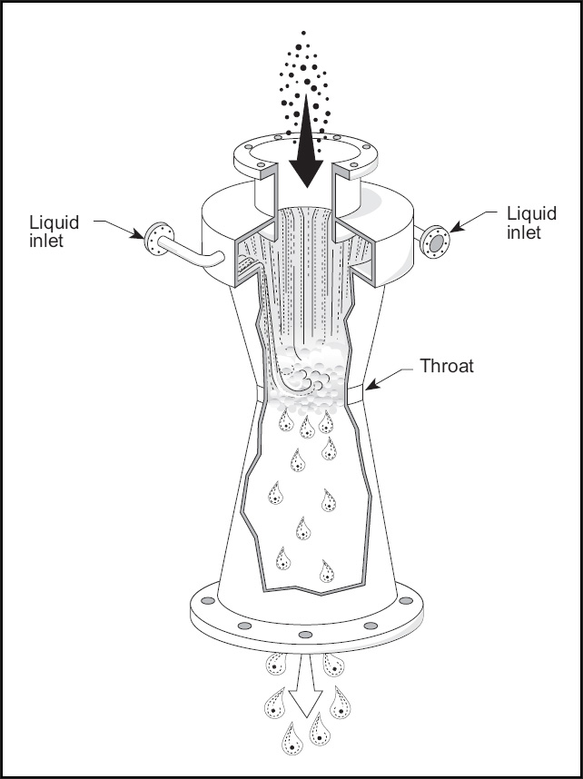
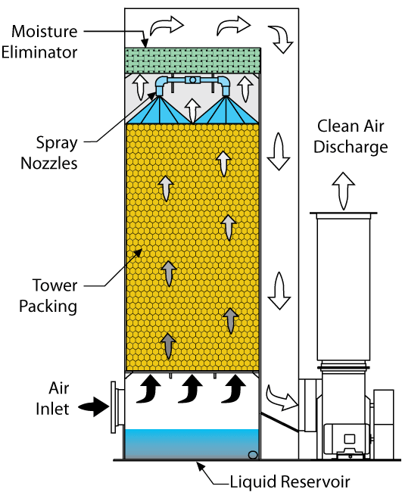
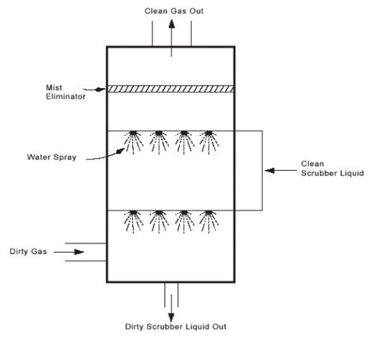
Air Pollution Control Devices
Venturi Scrubber
Packed bed Scrubber
Spay Tower

Slide 14
Cyclone separator & Baghouse Filter
Cylindrical tube with inverted cone attached at the bottom
Gas particle enter from the top and spins forming a vortex
Due to centrifugal force, the particles strikes on walls of cylinder
The particles fall down due to gravity
Cyclone separator
Baghouse Filter
Contains a large number of filter bags made of fabric
Hung upside down in several compartments
Dirty gas is passed through filter bags which leaves through pores
Dust particles get deposited on the inner surface

Slide 15
Electrostatic Precipitator & Spray Tower
Plate type or cylinder type
Vertical wire is placed between two parallel plates
High negative voltage is applied
Dust particles while passing from lower end becomes negatively charged and are then collected
Dirty gas is passed through a chamber and water is sprayed on the gas

Slide 16
Venturi Scrubber
3 sections- converging, throat and diverging sections
Dirty gas enters through converging section
As the area decreases velocity increases
Liquid is introduced in throat section
It is then passed through throat section where gas is forced to move at extremely high velocities
Mixing with liquid forming tiny droplets
Venturi Scrubber

Slide 17
Ill Effects of Fireworks
Fire Hazards: Fireworks can set fire to huts, heaps of dry grass and even houses.
Noise Pollution: Firecrackers make more noise than the allowed decibel limit.
Air Pollution: Components of the smog caused by firecrackers are harmful when inhaled. Such as,
Copper causes irritation in the respiratory tract. Cadmium causes anemia.
Lead in the body has a harmful effect on the nervous system.
Magnesium: Magnesium and zinc fumes cause metal fume fever.
Smokes from fireworks causes reduced visibility.

Slide 18
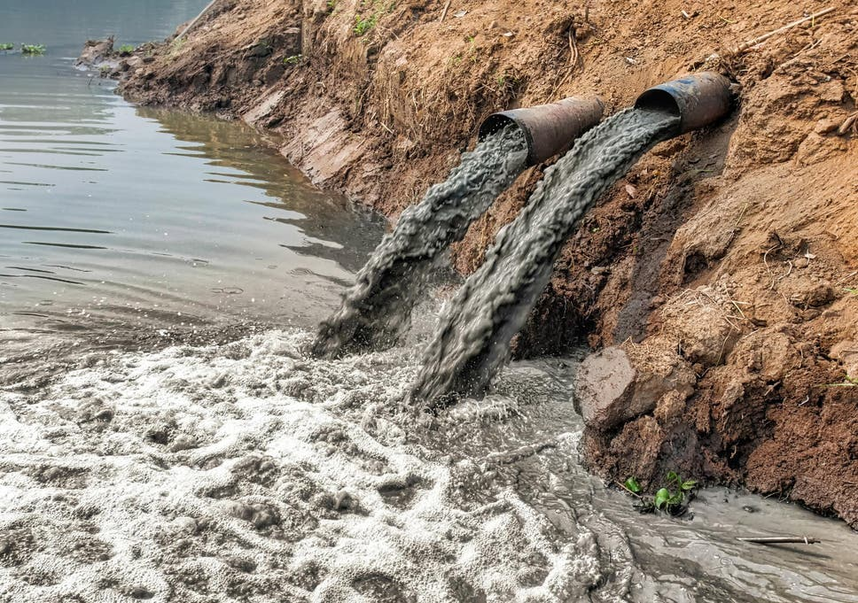
Water Pollution
The addition of various organic and inorganic substances that change the physical and chemical properties of water thereby leading to detrimental effects on living organisms and reducing water usability is termed as water pollution.
12/03/19

Slide 19
Causes of Water Pollution
Natural Causes-
Soil erosion due to rain, floods, high speed wind.
Deposition of dead and decaying remains of plants and animals.
Man-made Causes-
Sewage and other wastes: Includes papers, cloth, soap, detergents, waste.
Industrial waste: effluents such as oil, grease, plastic, metals, acids and other toxic chemicals.
Agricultural waste: fertilizers, pesticides.
Human activities: bathing, washing clothes (use of synthetic detergents).
Customs and traditions: disposal of dead bodies, immersion of idols of gods.
12/03/19

Slide 20
Sources of water pollutants
Point sources
Pollutants enter the water at a single point. Examples: sewage treatment plant and factories. These can be regulated through law.
Non point source
pollutants enter the water over large areas. Examples: Surface run off, mining wastes, municipal wastes, acid rain and soil erosion
12/03/19

Slide 21
Water Pollutants and its effects
Sediments: Excessive amounts of soil particles carried by flowing water, when there is severe soil erosion. Sediments cloud the water and reduces photosynthesis, destroys feeding ground of fishes, clogs reservoirs and channels.
Oxygen-demanding wastes (BOD and COD): Organic waste such as animal manure and plant debris that are decomposed by bacteria, from sewage, animal feedlots, paper mills, and food processing facilities. These bacteria deplete the oxygen and causes death of fish.
Infectious microorganisms (Pathogens): Parasitic worms, viruses and bacteria from infected organisms as well as human and animal wastes. They are responsible for water borne diseases.
Synthetic chemicals: Synthetic chemicals from industrial effluents, surface runoff, and cleaning agents. These chemicals causes health problems for humans and harm fishes.
12/03/19

Slide 22
Water Pollutants and its effects
Inorganic nutrients: Substances like nitrogen and phosphorus from animal waste, plant residues, and fertilizer runoff. These nutrients causes eutrophication.
Radioactive substances: Wastes from nuclear power plants, nuclear weapons production, mining and refining uranium and other ores. Such substances causes cancer and birth defects.
Thermal pollution: Hot water from industrial processes. Heat lowers oxygen demand and makes aquatic life more vulnerable to diseases, parasites. Thermal shock in aquatic organisms.
12/03/19

Slide 23
Effects of Water Pollution
Effect on human health
Infectious diseases can be spread through contaminated water. These water-borne diseases are caused by bacteria (Typhoid, Cholera, diarrhoea etc. ) or by viruses (Infectious Hepatitis)
Pesticides – can damage the nervous system and cause cancer.
Mercury – Minamata disease
Chlorides can cause reproductive and endocrinal damage.
Nitrates – are especially dangerous to babies that drink formula milk. It restricts the amount of oxygen in the brain and cause the “blue baby” syndrome.
Lead – can accumulate in the body and damage the central nervous system.
Arsenic – causes liver damage, skin cancer and vascular diseases
Flourides - in excessive amounts can make your teeth yellow and cause damage to the spinal cord.
12/03/19

Slide 24
Effects of Water Pollution
Effects on animals
Loss of aquatic biodiversity: Harmful chemicals and pollutants in water effect survival of aquatic organisms
Effects on plants
Eutrophication of water bodies: Nitrate and phosphate fertilizer used to increase nitrogen and phosphate content of soil goes in water and increases the growth of certain plants on surface of water body.
Polluted water contains high concentration of heavy metals becomes toxic for plants.
12/03/19

Slide 25
Pollution of Groundwater
Excessive extraction of groundwater leads to the natural pollution of groundwater. Examples are fluoride and arsenic contamination.
Groundwater receives pollutants from septic tanks, landfills, hazardous waste dumps, and underground tanks containing petrol, oil, chemicals, etc.
12/03/19

Slide 26
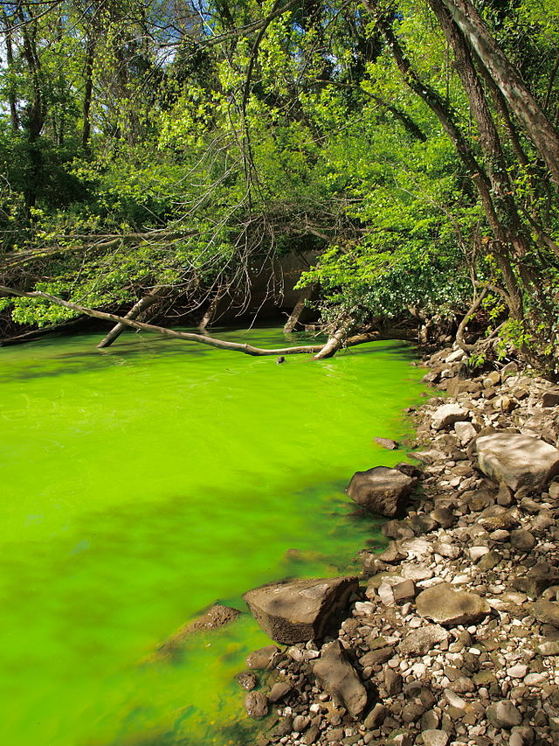
Eutrophication
Enrichment of a standing water body by nutrients, such as phosphorus and nitrogen.
Increased photosynthetic activity.
Excessive algae die, they fall to the bottom and gets decomposed. This process requires dissolved oxygen, some fish species die.
12/03/19

Slide 27
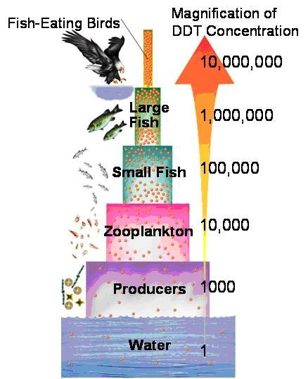
Biomagnification
Biomagnification is the increase in concentration of a substance, such as the pesticide, that occurs in a food chain. The pollutant enters the first organism in a food chain. When the second organism in the chain consumes the first one, the pollutant too moves into the second organism.
As we go up the levels of the ecological pyramid, there is energy loss. Hence, at each succeeding level, the predator consumes more of the prey. As a result, the organisms at higher levels have greater concentrations of the pollutant.
12/03/19

Slide 28
Control of Water Pollution
Treatment of domestic and industrial waste in order to reduce toxicity.
Control on excess use of fertilizers and pesticides in agriculture
Human activities such as bathing, washing ; throwing dead bodies should be stopped.
Non- biodegradable waste material such as plastic should not be disposed in water bodies.
Strict enforcement of rules
Public awareness
12/03/19

Slide 29
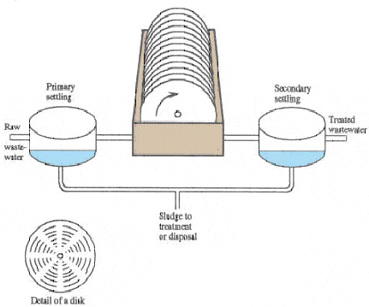
Waste water treatment
Primary treatment
Grit removal
Sedimentation
Floatation
Secondary treatment
Trickling filters
Activated sludge process
Rotating biological contactor
Tertiary treatment
Chlorination
Anaerobic treatment
Hydrolysis, Acidogenesis, Acetogenesis, Metanogenesis
12/03/19

Slide 30
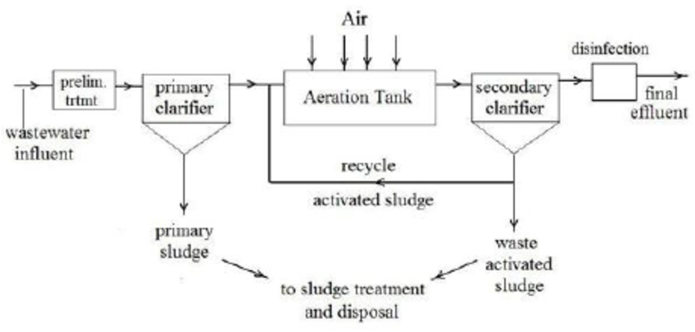
12/03/19

Slide 31
Thermal Pollution
Presence of waste heat in water which causes undesirable changes in the natural environment
Causes of thermal pollution
Heat producing industries (thermal power plants, nuclear power plants, refineries, steel mills etc.)
Effects of Thermal Pollution
The dissolved oxygen content of water is decreased.
The composition of flora and fauna changes
Metabolic activities of aquatic organisms increase at high temperature and require more oxygen, whereas oxygen level falls under thermal pollution.
Toxicity of pesticides, detergents and chemicals in the effluents increases with increase in temperature
High temperature becomes a barrier for oxygen penetration into deep cold waters
12/03/19

Slide 32
Thermal Pollution
Control of Thermal Pollution
Cooling ponds: water from condensor is stored in ponds where natural evaporation cools the water
Spray Ponds: water from condensor is received in spray ponds. Water is sprayed through nozzles
Cooling Towers
Wet cooling tower: hot water is sprayed over baffles. Cool air enters from sides and takes away the heat
Dry cooling tower: air is passed over hot pipes with fans
12/03/19

Slide 33
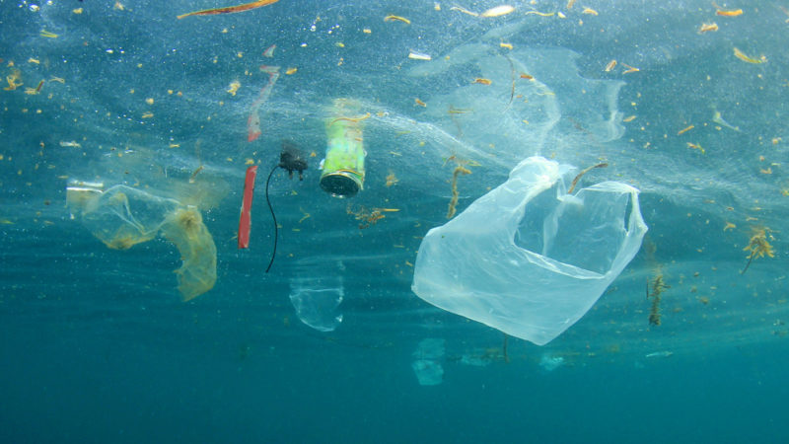
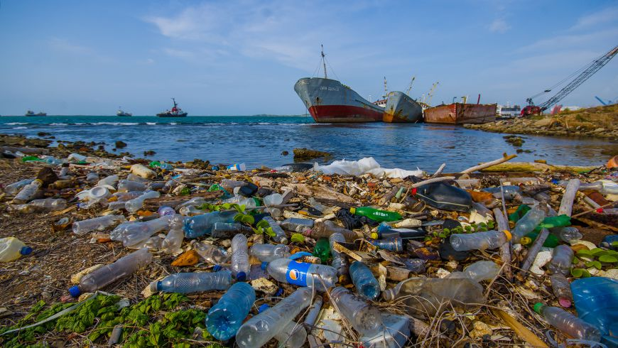
Marine Pollution
Sources of marine pollution
Rivers, Catchment area, coastline, oil drilling and shipment.
Pollutants
sewage sludge, industrial effluents, synthetic detergents, agrochemicals, solid wastes, plastics, metals and waste heat
12/03/19

Slide 34
Control of Marine Pollution
Toxic materials from the industrial plants should not be discharged in coastal water.
Run off from non-point source should be controlled.
Sewer overflow should be prevented.
Oil and grease from the service stations should be reused.
Oil blast should not be dumped into the sea.
Developmental activities in the coastal region should be minimized.
12/03/19

Slide 35
To be continued...

