Slide 1
OBE Implementation
Module-1:Blooms Level setting
Submitted By: TEAM 404,TEAM NAME NOT FOUND
Tanishq Shreeyas Sunkara AP23110011165
Garlapati.Eswar RamaKrishna AP23110011173
Rapolu.Balaji AP23110011174
Raveloson Iary Finaritra AP23110011176
Nambi.Sandeep AP23110011183
Manchi.Phanindra sitha rama raju AP23110011214
Department :CSE-Q | Semester : 3rd semester | 2023-27

Slide 2
Introduction to Project
This C++ program manages Bloom's taxonomy levels, providing functions to create, update, retrieve, delete, and sort entries. Each entry includes an ID, code, level name, and description. Users can interact through a menu-driven interface, performing operations like Bubble Sort for sorting and Linear Search for retrieval. Additionally, the program saves data to a file and displays algorithmic details, making it a useful tool for both learning and managing educational data efficiently.

Slide 3
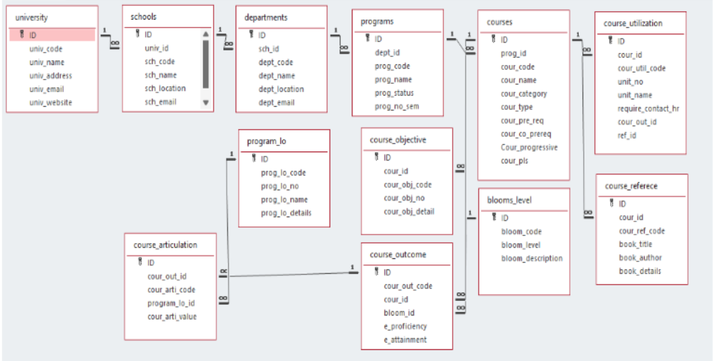
Architecture Diagram[*highlight your module as shown]

Slide 4
Module Description : Blooms level Setting
This C++ program implements a "Blooms Level" management system to store, manipulate, and display details of Bloom’s Taxonomy levels. The program supports CRUD operations (Create, Retrieve, Update, Delete) and allows sorting, searching, and storing data to/from files. Additionally, the module compares and explains time complexities and algorithms for bubble sort and linear search.
This module is educational, focusing on basic data management with algorithms, making it suitable for students learning sorting, searching, and data structure fundamentals.

Slide 5
Blooms Level Setting:Field/table details
Field Name | Data type
id | Integer
blooms_code | String
blooms_level | String
blooms_description | String
blooms_level_list | Array
length | Integer

Slide 6
Blooms Level Setting:Programming Details
File name:Team_404_Team_Name_Not_Found_Blooms_Level
Function/method name
Create:Team_404_Team_Name_Not_Found_Blooms_Level_create
Update:Team_404_Team_Name_Not_Found_Blooms_Level_update
Retrieve:Team_404_Team_Name_Not_Found_Blooms_Level_retrive
Delete:Team_404_Team_Name_Not_Found_Blooms_Level_delete
Sorting:Team_404_Team_Name_Not_Found_Blooms_Level_bubble sort
Searching:Team_404_Team_Name_Not_Found_Blooms_Level_linear search
Storing:Team_404_Team_Name_Not_Found_Blooms_Level_Setting_storing

Slide 7
Blooms Level Setting:Programming Details
Comparison Functions
Sorting Comparison:Team_404_Team_Name_Not_Found_blooms_level_Compare_sorting_bubble_sort
Searching Comparison: Team_404_Team_Name_Not_Found_blooms_level_Compare_Search_linear_search
Time Complexity Functions
Sorting Time Complexity: Team_404_Team_Name_Not_Found_blooms_level_complexity_sorting
Searching Time Complexity: Team_404_Team_Name_Not_Found_blooms_level_complexity_Search

Slide 8
Blooms level Setting:Programming Details
Algorithm Details(pseudocode or steps)(both searching and Sorting):
For Searching-Team_404_Team_Name_Not_Found_blooms_level_linear_search_details
For Sorting-Team_404_Team_Name_Not_Found_blooms_level_bubble_sort_details
File name(for storing the details)
File name to be used is:-blooms_level .txt

Slide 9
Blooms level : Sorting Algorithm used
Sorting Algorithm Name: Bubble sort
Algorithm:
Step-1: Ask user to choose a field to sort by (ID, Blooms Code, or Blooms Level).
Step-2: Loop from 0 to length - 1.
Step-3: Loop from 0 to length - i - 1.
Step-4: Swap elements if blooms_level_list[j] > blooms_level_list[j + 1].
Step-5: Continue until no swaps are needed (array is sorted).
Step-6: Print success message and display the sorted list.

Slide 10
Blooms level : Comparison of Sorting Algorithm
Algorithm used for comparison:Quick sort
Algorithm
Step-1: Choose a pivot element (usually the last element in the array).
Step-2: Partition the array so that elements less than the pivot are on the left, and elements greater than the pivot are on the right.
Step-3: Place the pivot in its correct position in the sorted array.
Step-4: Recursively apply quick sort to the sub-arrays on the left and right of the pivot.
Step-5: Continue until all elements are sorted.
Step-6: Print success message and display the sorted list.

Slide 11
Blooms level : Time Complexity of Sorting Algorithm
Sl.No | Algorithm Name | Compared Algorithm
01 | Bubble Sort | O(n²)
02 | Quick Sort | O(n²)

Slide 12
Blooms level : Searching Algorithm used
Algorithm Name:Linear Search
Algorithm:
Start from the first element in the list.
Initialize the search by selecting the first element from the list (i.e., blooms_level_list[i]).
Compare each element with the target value.
For each element in the list, compare its value (blooms_level_list[i].blooms_code or blooms_level_list[i].blooms_level) with the search value (search_value).
If a match is found, return the details of the element.
If a match is found (i.e., blooms_level_list[i].blooms_code == search_value or blooms_level_list[i].blooms_level == search_value), display the details of that element.
If no match is found after checking all elements, display a "not found" message.
If no element matches the search value, print a message like "Value Not Found."

Slide 13
Blooms level : Comparison of Searching Algorithm
Algorithm used for comparison:Binary Search
Algorithm
Step 1: Initialize the search range.
Set two pointers: one pointing to the start of the array (low), and one pointing to the end of the array (high).
Step 2: Check if the search range is valid.
If low is greater than high, the search range is invalid, and the item is not found. In that case, return "not found."
Step 3: Find the middle element.
Calculate the middle index of the current range: mid = (low + high) / 2.
Step 4: Compare the middle element with the target.
If the element at mid is equal to the target value, you've found the element, and the search ends.
Step 5: Narrow the search range.
If the middle element is greater than the target, move the high pointer to mid - 1 (i.e., focus on the left half).
If the middle element is less than the target, move the low pointer to mid + 1 (i.e., focus on the right half).
Step 6: Repeat the process.
Continue the search by repeating steps 2 to 5 until the element is found or the search range becomes invalid (when low > high).

Slide 14
Blooms level : Time Complexity of Searching Algorithm
Sl.No | Algorithm Name | Compared Algorithm
01 | Linear Search | O(n)
02 | Binary Search | O(n²)

Slide 15
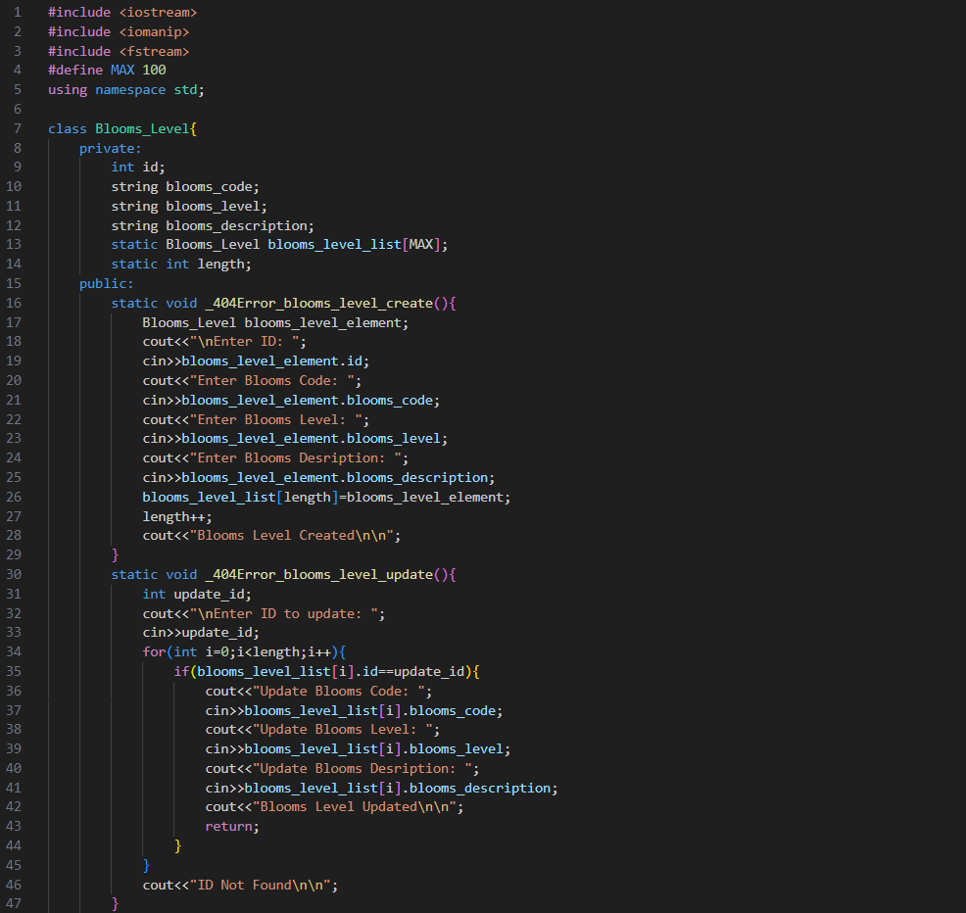
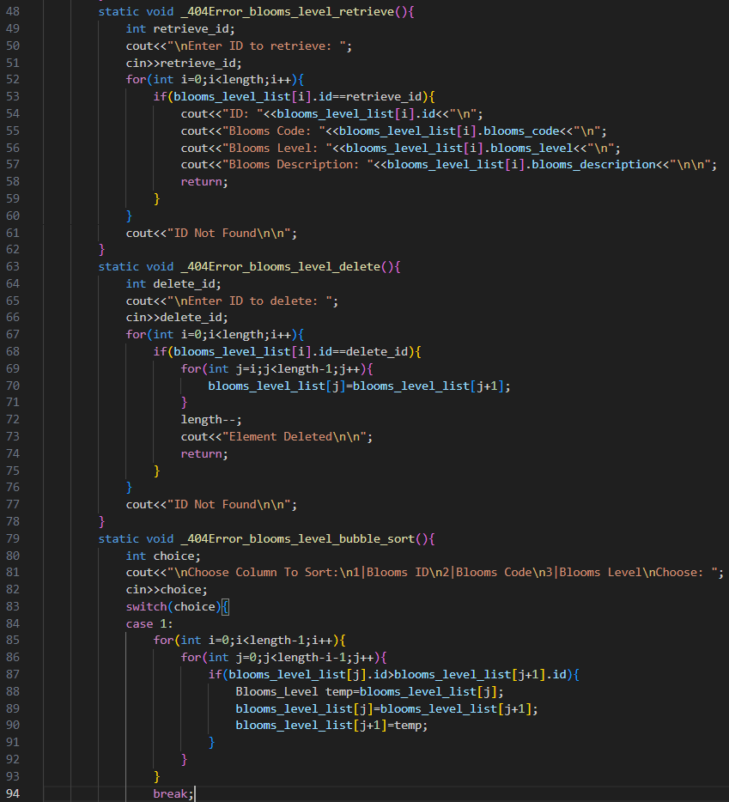
Sample Source Code[*Depict the routine of searching,Sorting,CRUDD and Storage options]

Slide 16
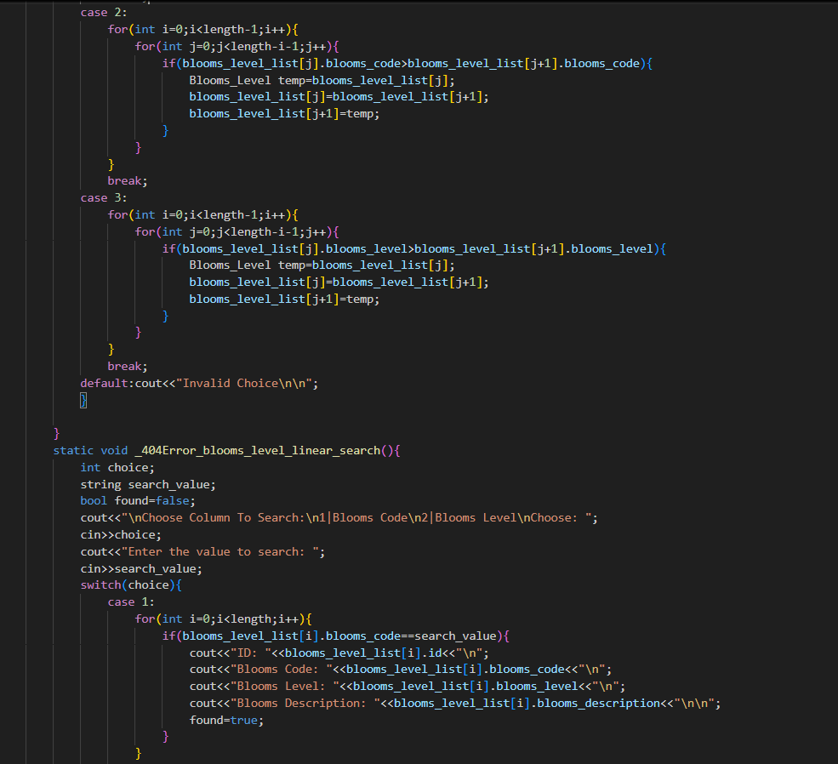
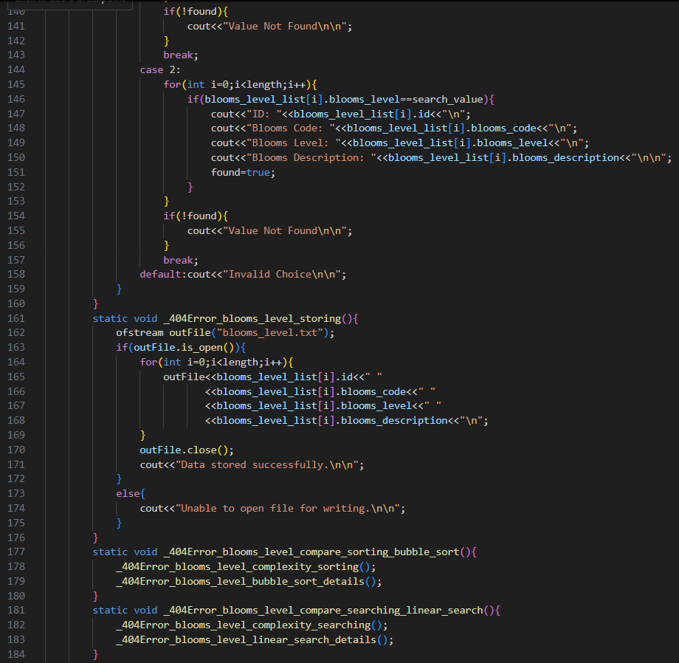

Slide 17
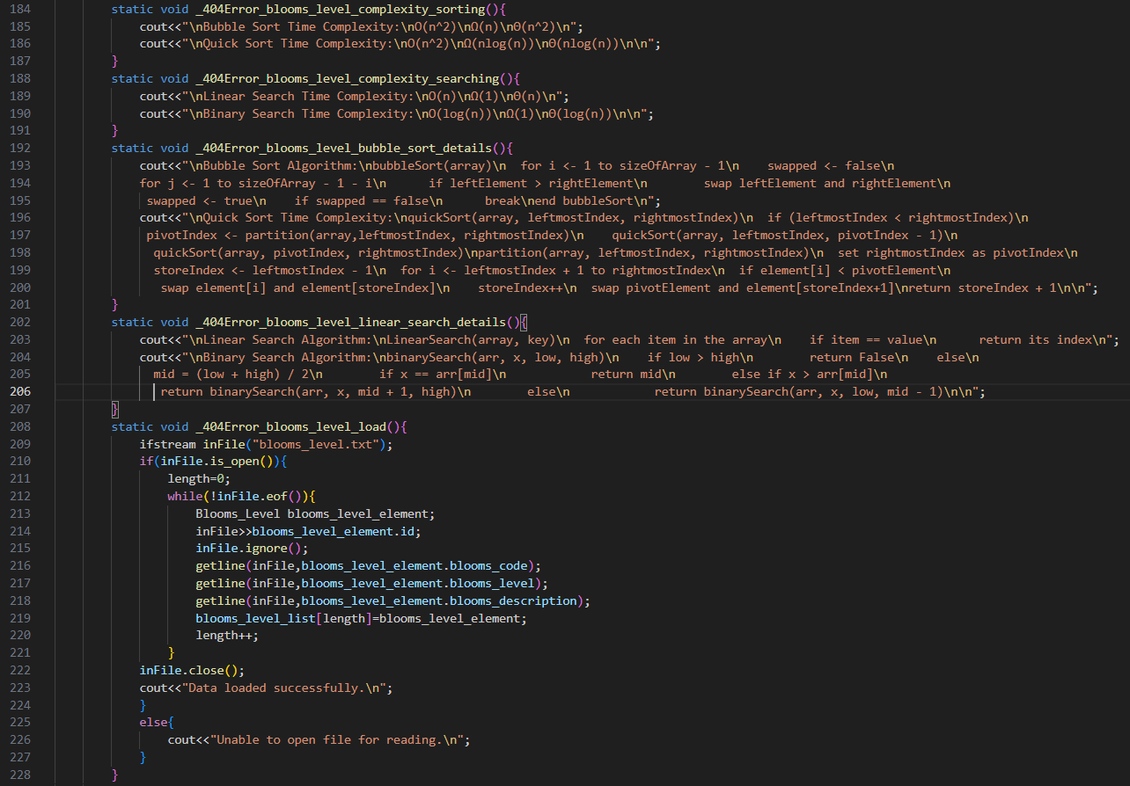
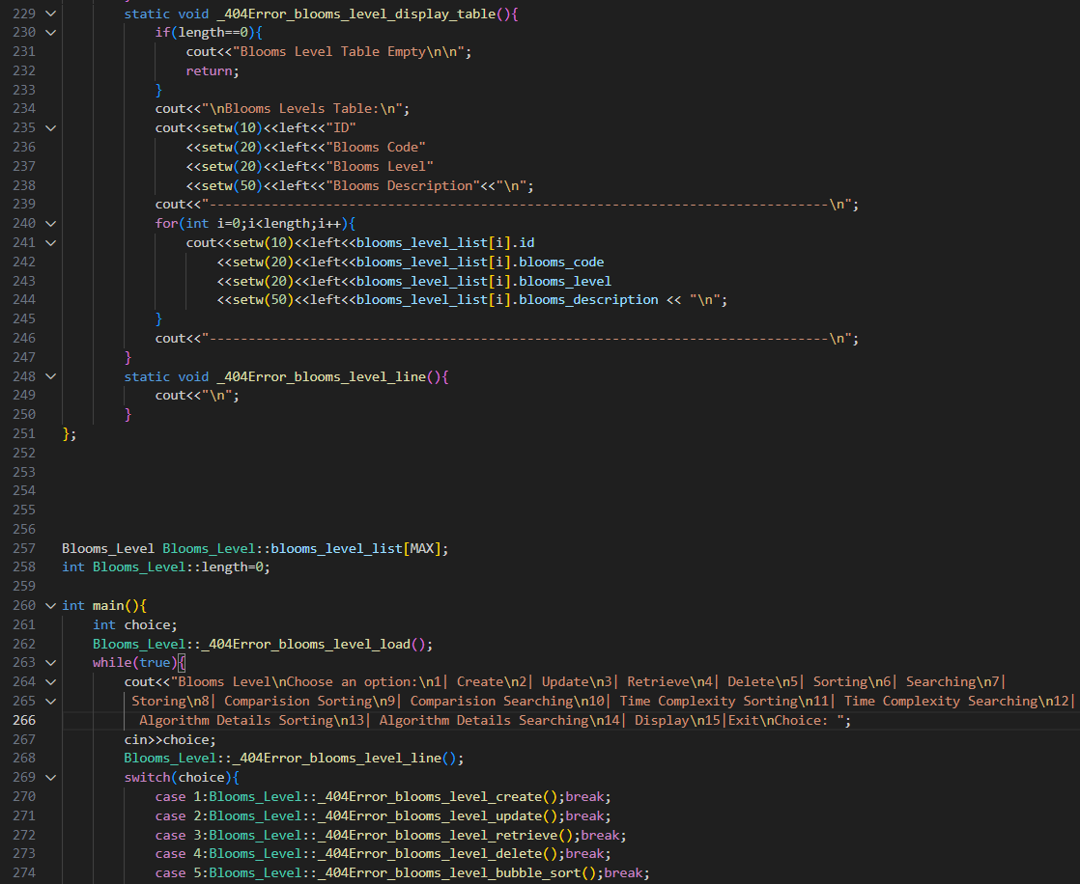

Slide 18
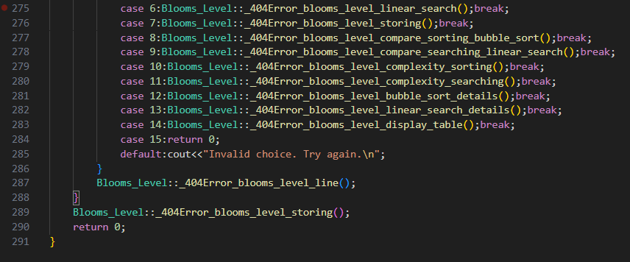

Slide 19
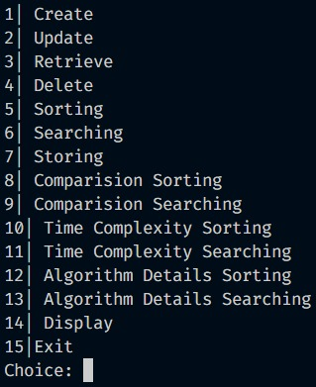
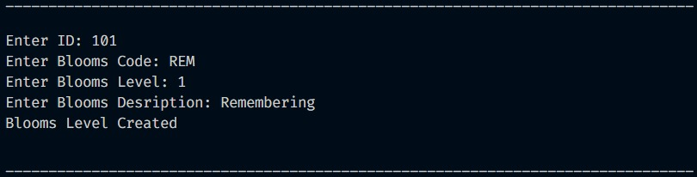
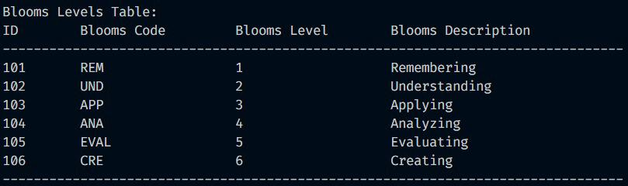
Sample Screen Shots:
INTERFACE:
CREATE:
DISPLAY:

Slide 20
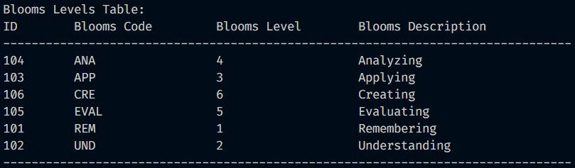
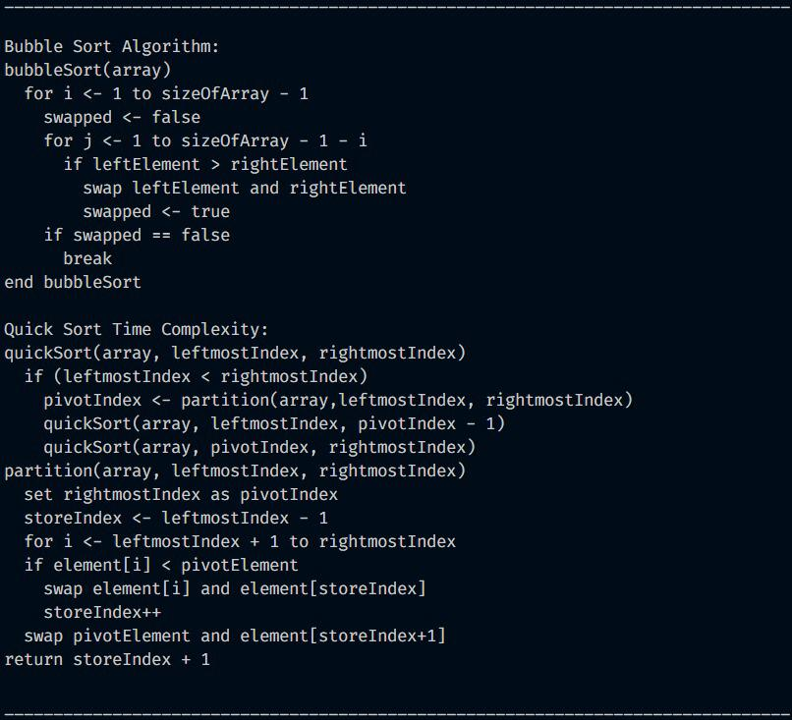
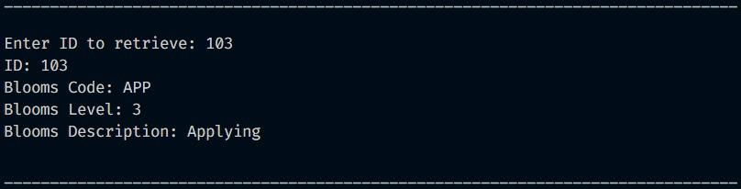
SORTING:
ALGORITHM DETAILS SORTING:
RETRIEVE:

Slide 21
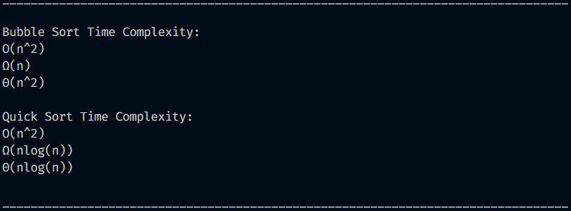
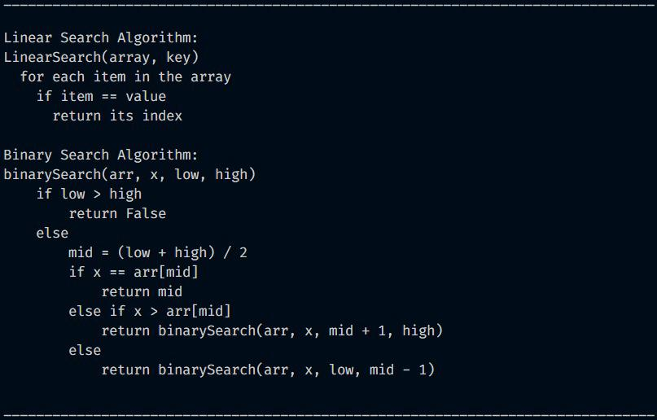
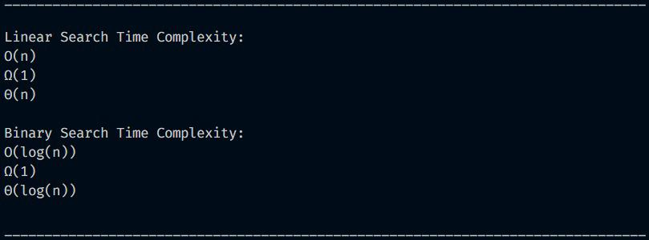
TIME COMPLEXITY SORTING:
ALGORITHM DETAILS SEARCHING:
TIME COMPLEXITY SEARCHING:

Slide 22
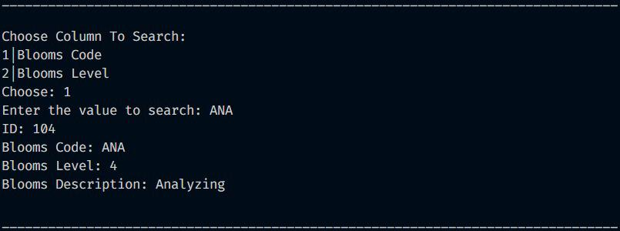

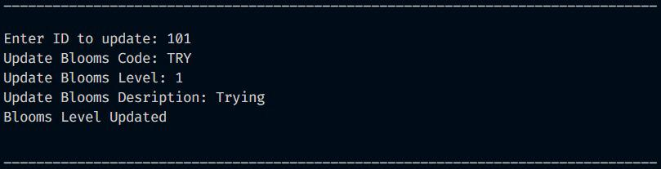
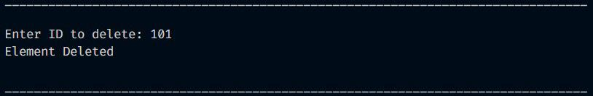
SEARCHING:
STORING:
UPDATE:
DELETE:

Slide 23
Conclusion
The Blooms Level Management project provides a robust system for managing Bloom's taxonomy levels with key functionalities for creating, updating, retrieving, and deleting records. Through this system, users can efficiently handle Bloom's levels, helping to ensure a structured approach to education and assessment standards.
Key Achievements:Efficient Data Management: CRUD operations (Create, Retrieve, Update, Delete) are seamlessly integrated, allowing users to manage Bloom's level records effectively.Sorting and Searching Capabilities: The system offers essential sorting and searching functionalities:Bubble Sort serves as a straightforward sorting mechanism suitable for smaller datasets, making it easier for users to organize Bloom’s levels based on ID, code, or name.
Linear Search enables easy retrieval of data for unsorted records, with Binary Search offered as a comparison algorithm to demonstrate faster search efficiency on sorted data.File Storage: Persistent storage of data in blooms_level.txt ensures that all changes are saved and accessible after program termination, making the system practical and reliable.Learning Outcomes:Algorithm Comparisons: This project highlights the efficiency of different algorithms (Bubble Sort vs. Quick Sort and Linear Search vs. Binary Search) and their impact on performance, especially for varying dataset sizes.Complexity Awareness: By comparing time complexities, the project demonstrates the limitations of basic algorithms like Bubble Sort and Linear Search, encouraging consideration of more efficient alternatives for larger datasets.Future Improvements:Enhanced Sorting and Searching: Implementing more efficient sorting and searching algorithms, such as Quick Sort and Binary Search, as primary methods for larger datasets can improve the system's scalability.User Interface Improvements: Adding a more intuitive interface, such as a graphical user interface, could enhance usability for a broader range of users.Data Validation: Adding validation for inputs and ensuring data consistency can further enhance reliability.In conclusion, this Blooms Level Management project provides a strong foundation for organizing and accessing Bloom's taxonomy levels, fulfilling the goal of supporting educational program objectives. Through the inclusion of primary and comparison algorithms, it illustrates the importance of algorithm choice in data management systems and encourages further exploration of optimization techniques for improved efficiency.

Slide 24
Thank You

