Slide 1
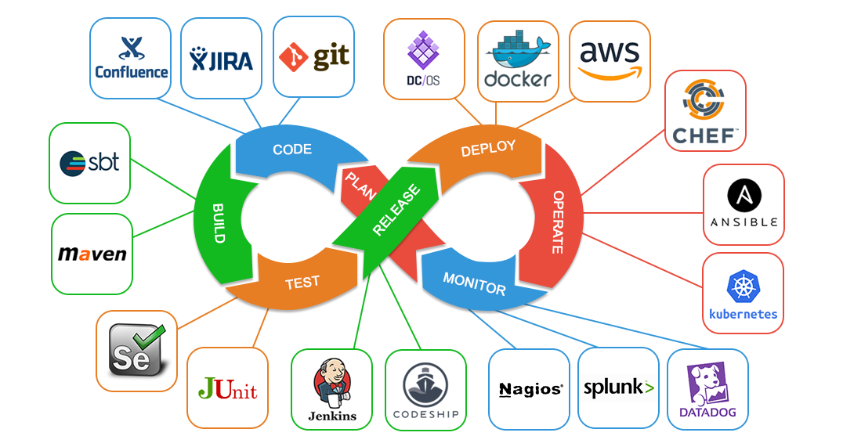

Slide 2
DevOps
DevOps is a set of practices that combines software development and IT operations. It aims to shorten the systems development life cycle and provide continuous delivery with high software quality.
the DevOps approach to software development requires frequent, incremental changes, and DevOps Engineers rarely code from scratch.
However, they must understand the basics of software development languages and be familiar with the development tools used to create a new code or update the existing one

Slide 3
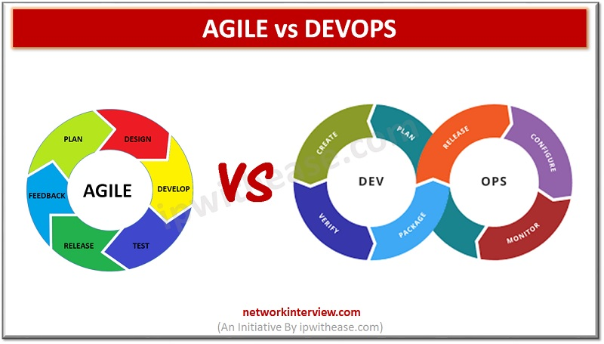
How is DevOps different from agile methodology
DevOps is a culture that allows the development and the operations team to work together. This results in continuous development, testing, integration, deployment, and monitoring of the software throughout the lifecycle.
Agile is a software development methodology that focuses on iterative, incremental, small, and rapid releases of software, along with customer feedback. It addresses gaps and conflicts between the customer and developers.

Slide 4
The most popular DevOps tools
Selenium
Puppet
Chef
Git
Jenkins
Ansible
Docker

Slide 5
The different phases in DevOps
Plan - Initially, there should be a plan for the type of application that needs to be developed. Getting a rough picture of the development process is always a good idea.
Code - The application is coded as per the end-user requirements.
Build - Build the application by integrating various codes formed in the previous steps.
Test - This is the most crucial step of the application development. Test the application and rebuild, if necessary.
Integrate - Multiple codes from different programmers are integrated into one.
Deploy - Code is deployed into a cloud environment for further usage. It is ensured that any new changes do not affect the functioning of a high traffic website.
Operate - Operations are performed on the code if required.
Monitor - Application performance is monitored. Changes are made to meet the end-user requirements.

Slide 6
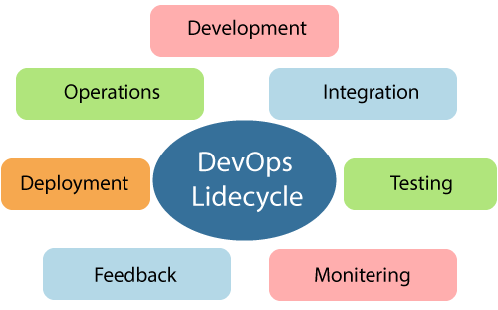
DevOps Life cycle
DevOps lifecycle is defined as a combination of different phases of continuous software development, integration, testing, deployment, and monitoring.
A competent DevOps lifecycle is necessary to build superior quality software through the system.

Slide 7
Some of the core benefits of DevOps
Technical benefits
Continuous software delivery
Less complex problems to manage
Early detection and faster correction of defects
Business benefits
Faster delivery of features
Stable operating environments
Improved communication and collaboration between the teams

Slide 8
The role of AWS in DevOps
Flexible services - Provides ready-to-use, flexible services without the need to install or set up the software.
Built for scale - You can manage a single instance or scale to thousands using AWS services.
Automation - AWS lets you automate tasks and processes, giving you more time to innovate
Secure - Using AWS Identity and Access Management (IAM), you can set user permissions and policies.
Large partner ecosystem - AWS supports a large ecosystem of partners that integrate with and extend AWS services.

Slide 9
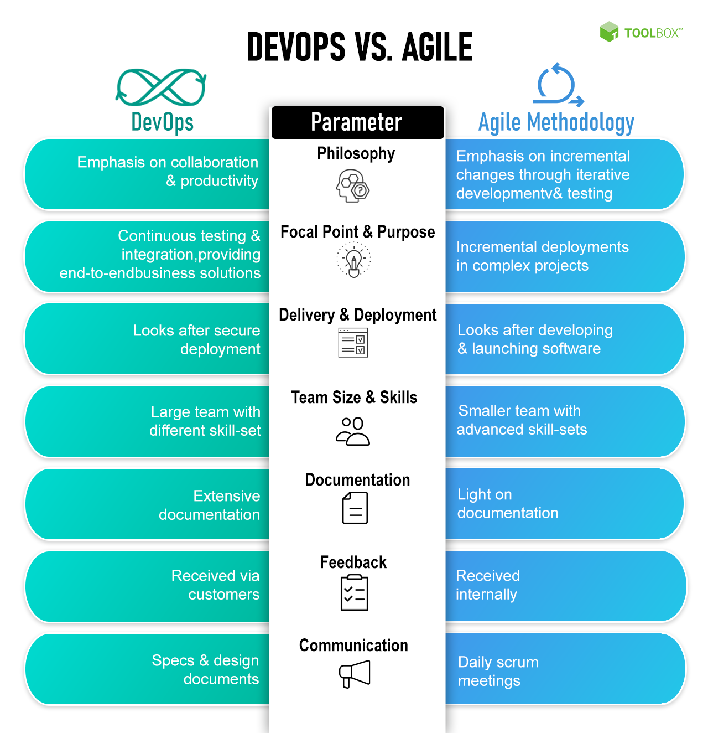

Slide 10
Benefits of Devops
Renews focus on the customers. A key reason for the move to DevOps is that it gets the team back in the mindset of the customer.
Unites teams for faster product shipments.
Simplifies development focus.
Introduces automation to the development process.
Supports end-to-end responsibility.

Slide 11
Drawbacks of Devops
DevOps Requires Culture Change. It's commonly observed that you cannot just change a company's culture on command.
DevOps May Not Solve Your Problem.
Organizational.
Processes.
Technology.
Speed and Security.

Slide 12
THANK YOU

