Slide 1


Slide 2
What is GitHub?
GitHub is a collaboration platform built on top of a distributed version control system called Git. One does not have to worry about losing data on his hard drive or managing a project across multiple computers - one can sync from anywhere. You can track issues, build & test the things and finally deploy.
Why Use of GitHub for Projects?
Version Control (Allows experiments and mistakes without messing up in final product)
Keep your Code in One Place
Great Collaboration Platform

Slide 3
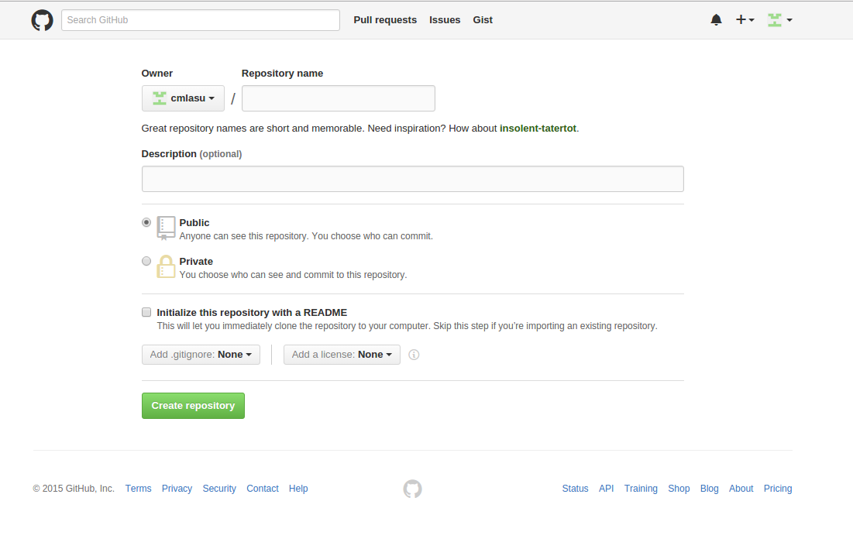
GitHub Repositories
Basic unit of GitHub, most commonly a single project. Repositories can contain folders and files, including images – anything your project needs. ReadME – Project Description
Contains all of the project files (including documentation), and stores each file's revision history.

Slide 4
Clone Repository
Go to the directory where you want to have your repository folder (usually, your home) and then type the clone command for your repository. For example,
git clone git@github.com:cmlasu/cml-cgra.git
To update your repository with existing version, type
git pull origin master.
If it it other branch than your master then type –
git pull origin your_branch_name
Public Repository (Any Number, Free) - Anyone can see a public repository, but you choose who can commit to it.
Private Repository (Paid Subscription) - By default, only you can see a private repository. You choose who can see and commit to this repository by adding collaborators.

Slide 5
Thank You

