Slide 1


Slide 2
Operating System
An operating system (OS) is system software that manages computer hardware, software resources, and provides common services for computer programs.
An operating system is a software programme required to manage and operate a computing device like smartphones, tablets, computers, supercomputers, web servers, cars, network towers, smartwatches, etc.
It is the operating system that eliminates the need to know coding language to interact with computing devices.
Windows, Linux, and Android are examples of operating systems that enable the user to use programs like MS Office, Notepad, and games on the computer or mobile phone.

Slide 3
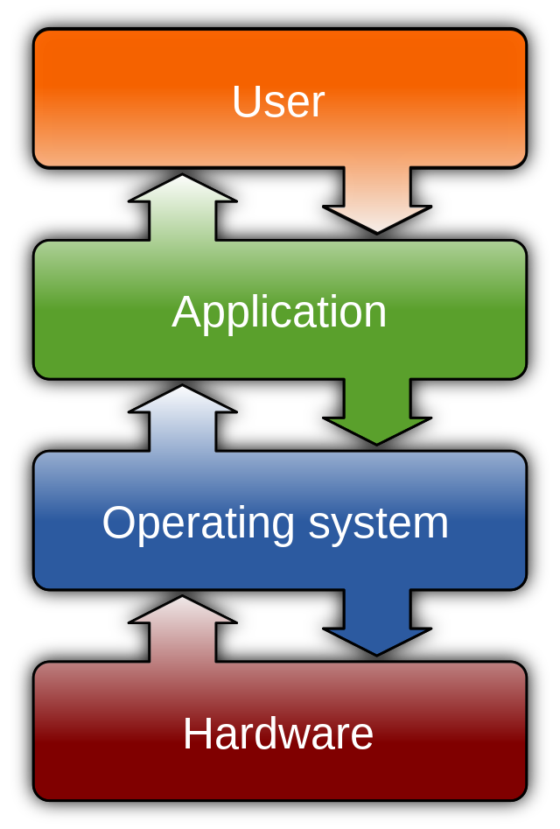

Slide 4
Linux Operating System
Linux is a family of open-source Unix-like operating systems based on the Linux kernel.
An operating system kernel first released on September 17, 1991, by Linus Torvalds. Linux is typically packaged in a Linux distribution.
Linux offers great speed and security.
Original author: Linus Torvalds
Initial release date: 17 September 1991
Developer: Linus Torvalds
Programming languages: C, Assembly language
Update methods: KernelCare, dpkg, GNOME Software

Slide 5
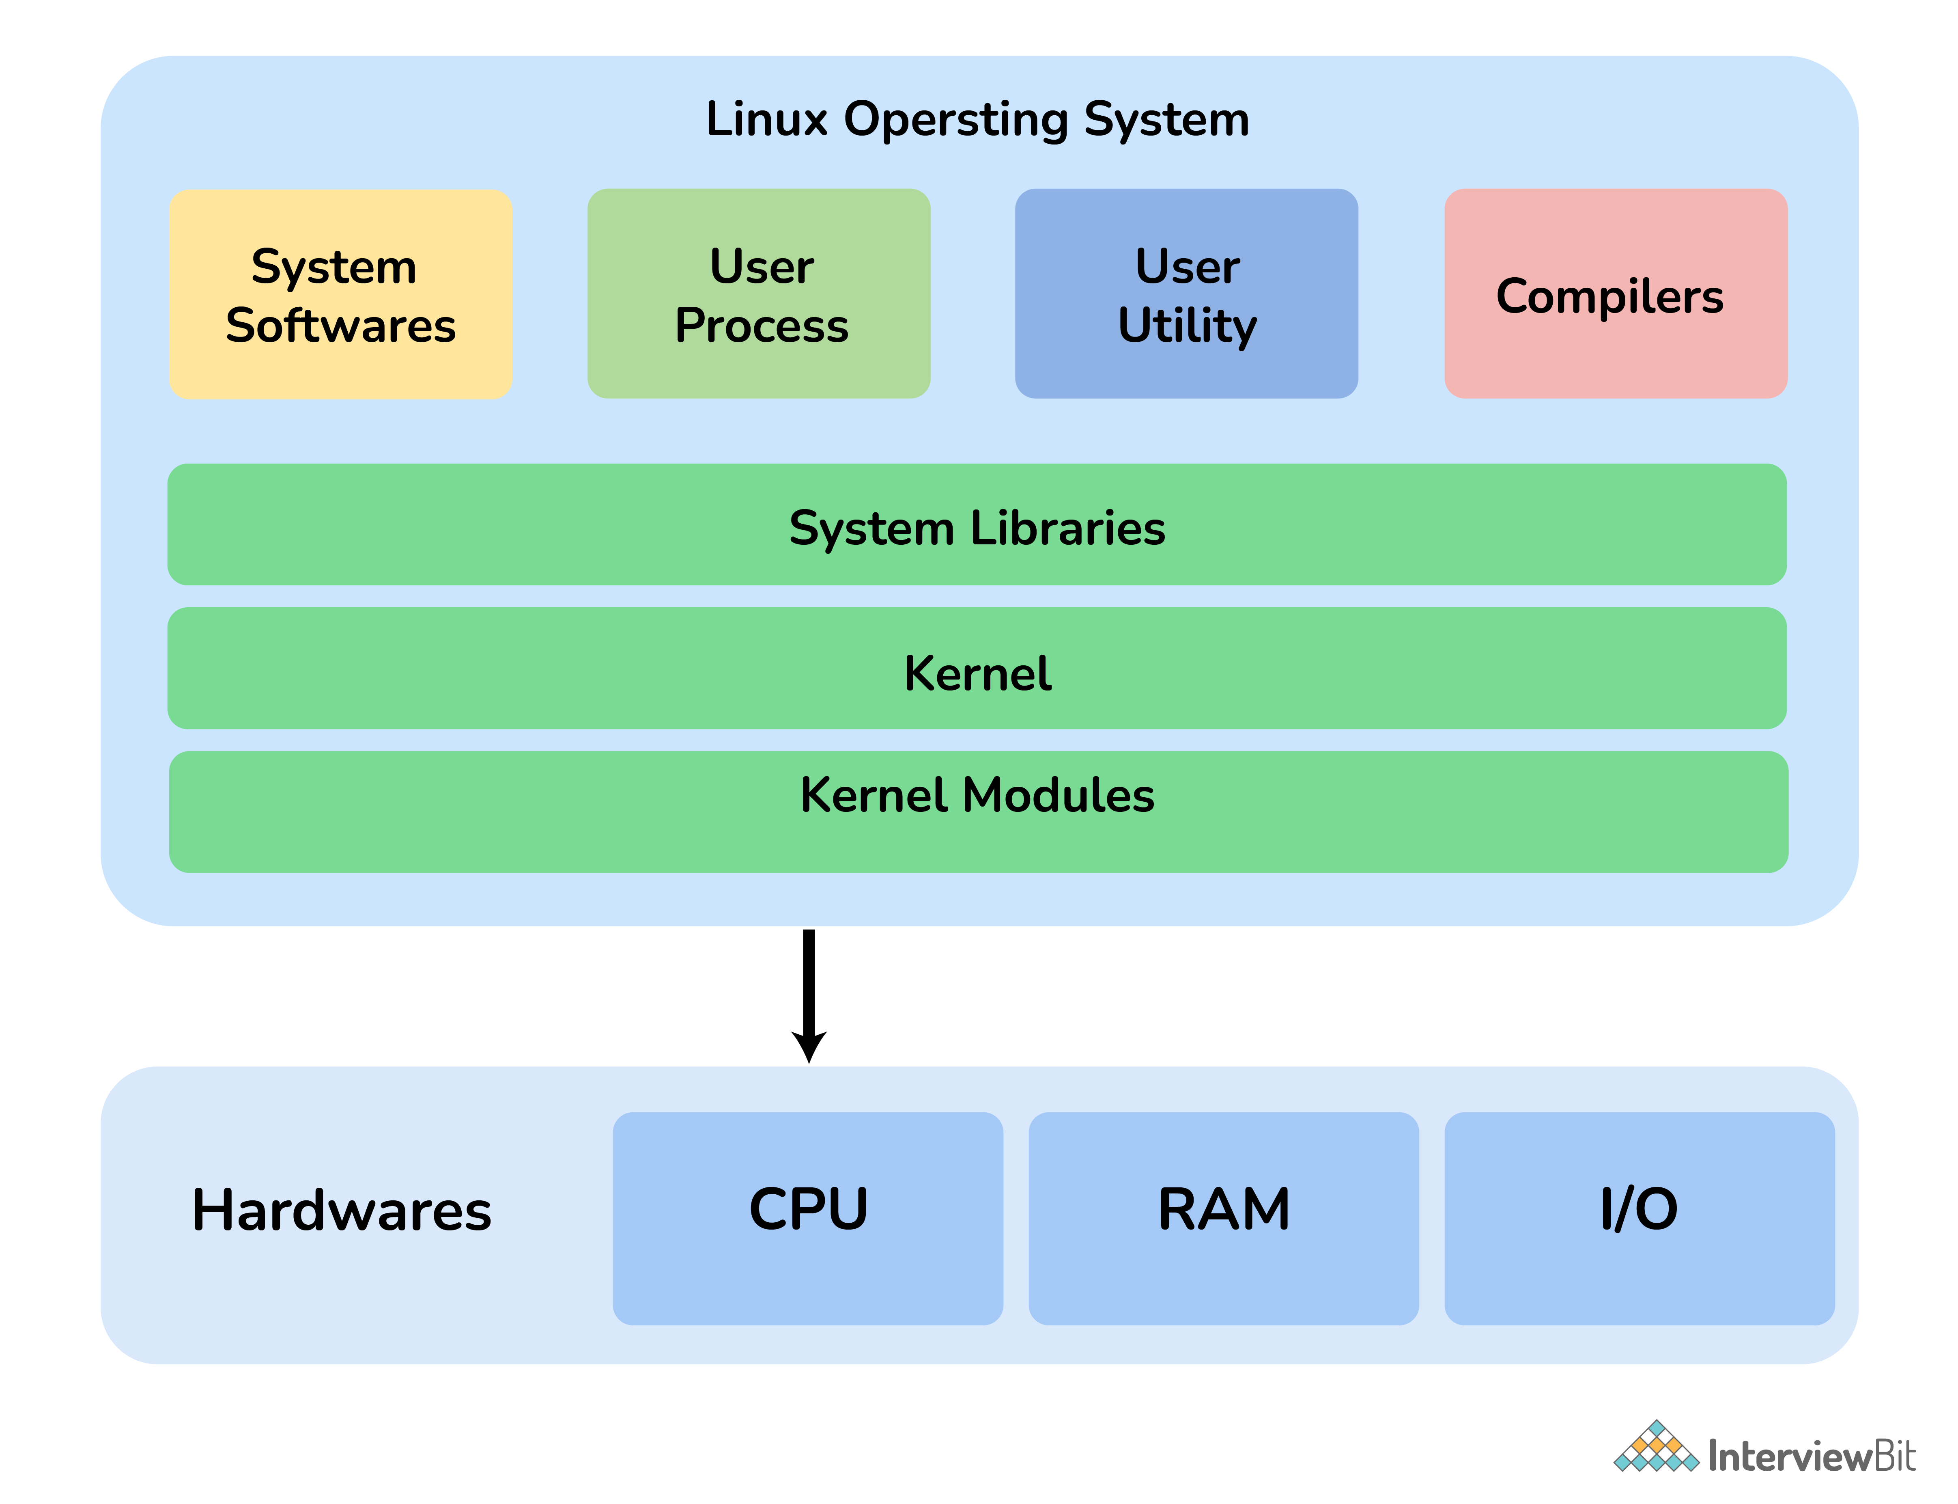

Slide 6
Some important features of Linux OS include:
Free and Open Source: It is freely and easily available to anyone.
Robust and Adaptable: Linux can operate for prolonged periods without crashing and considered to have very much immune to security threats.
More secure: It is more secure as it provides security using authentication features like password authentication, security auditing, and file system access control.
Multiprogramming System: More than one can function or an application can run simultaneously.
Application Support: It has its own software repository i.e., place or storage location from where software can be retrieved so that users can download and install applications.
Supports customized keywords: There are many different languages used throughout the world, therefore Linux supports the installation of multiple languages keyboards.
GUI (Graphical User Interface): It provides an interface for users to interact with the system and allows to use of GUI applications such as VLC, Firefox, etc.

Slide 7
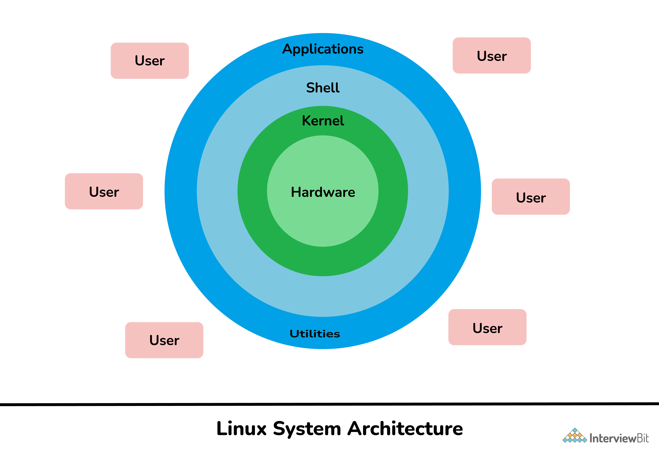
LINUX OS ARCHITECTURE

Slide 8
Linux OS Architecture
Kernel: It is considered a core or main part of Linux and is generally responsible for all major activities of OS such as process management, device management, etc.
System Library: These are special functions or programs with the help of which application programs or system utilities can access features of the kernel without any requirement of code. It is simply used to implement the functionality of the OS.
System Utility: These are utility programs that are responsible to perform specialized and individual-level tasks. They are considered more liable and allow users to manage the computer.
Hardware: It is physical hardware that includes items such as a mouse, keyboard, display, CPU, etc.
Shell: It is an environment in which we can run our commands, shell scripts, and programs. It is an interface between user and kernel that hides all complexities of functions of the kernel from the user. It is used to execute commands.

Slide 9
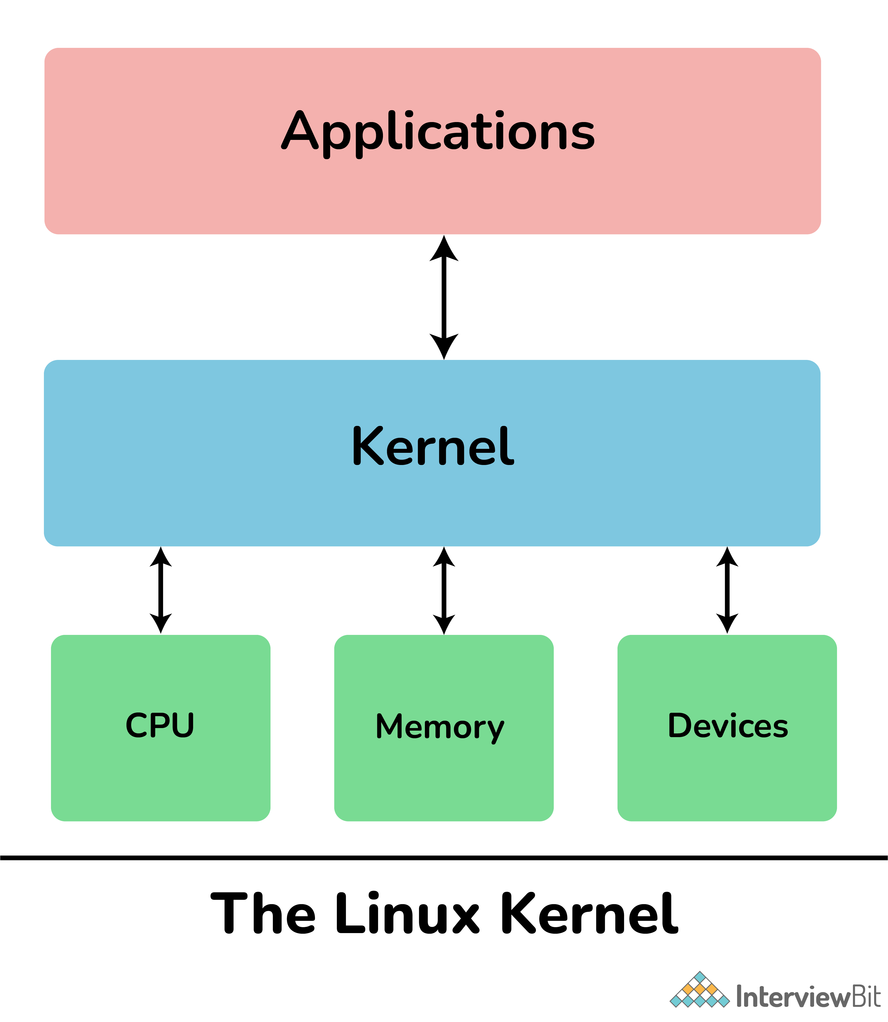
KERNEL
A kernel is considered the main component of Linux OS. It is simply a resource manager that acts as a bridge between hardware and software.
Its main role is to manage hardware resources for users and is generally used to provide an interface for user-level interaction.
A kernel is the first program that is loaded whenever a computer system starts. It is also referred to as low-level system software.
Its other main functions include:
Memory Management
Process Management
Device Management
Storage Management
Manage access, and use of various peripherals that are connected to the computer.

Slide 10
BASH
BASH (Bourne Again Shell) is basically a command language interpreter.
It was written by Brian Fox for GNU OS and can be used in place of Bourne Shell.
It is similar to Bourne Shell but includes some additional features such as command-line editing that make it easier and more convenient to use. It is the default user shell on most Linux installations.
It is basically an interpreted and non-compiled process that can also run in the terminal window.
It is also capable of reading commands from shell scripts.

Slide 11
LINUX SHELL
Linux shell is a user interface present between user and kernel.
It is used for executing commands and communication with Linux OS.
Linux shell is basically a program used by users for executing commands.
It accepts human-readable commands as input and converts them into kernel understandable language.
Different types of shells are commonly used on typical Linux system as listed below:
CSH (C Shell)
KSH (Korn Shell)
BASH (Bourne Again Shell)
TCSH
Bourne Shell

Slide 12
SHELL SCRIPTING
Shell Script, as name suggests, is a script especially written for shell.
Script means programming language that is being used to control applications.
It simply allows the execution of different commands that are entered in the shell.
It generally helps you to create complex programs containing conditional statements, loops, and functions.
It is very easy to debug, can simplify everyday automation processes, and is much quicker as compared to writing big programs.

Slide 13
Shell variable
Shell variables are integral parts of all Shell programs and scripts.
In general, we know that variables usually store data either in the form of characters or numbers.
Generally, shell variables are stored as strings.
Variables in the shell provide the information needed for scripts/commands to execute.
Shell scripts usually have two types of variables:
System-defined variables: Also called environment variables, these are special built-in variables in the Linux kernel for each shell. They are normally defined in capital letters by the OS (Linux) and are standard variables.
User-defined variables: These variables are created and defined by users in order to store, access, read, and manipulate data. In general, they are defined in lowercase letters. The Echo command allows you to view them.

Slide 14
Shell Commands
cat | concatenate and print data
lpr | spool file for line printing
cd | change current directory
lprm, cancel | remove jobs from line printer queue
chgrp | change file group
ls | list and generate statistics for files
chmod | change file mode
mkdir | make a new directory
cp | copy file data
file | determine file type
mv | move or rename files
find | find files
pwd | print working directory
grep | search file for regular expression
rm, rmdir | remove (unlink) files or directories
head | give first few lines
tail | print last lines from file
just | text justification program
touch | update access and modification times of a file

Slide 15
File permissions in Linux
There are three owners in the Linux System i.e., user, group, and others. These owners have three types of permissions defined as listed below:
Read (r): It allows the user to open and read the file or list the directory.
Write (w): It allows the user to open and modify the file. One can also add new files to the directory.
Execute (x): It allows the user to execute or run the file. One can also lookup a specific file within a directory.

Slide 16
Advantages of Shell Scripting
An interactive debugging tool, as well as a quick start.
Programmers need not change their syntax since both command and syntax are identical to those entered directly into the command line.
Shell scripts are easy to use and quicker to write.
It helps automate administrative tasks, so it is time-saving.
As shell scripts are written in an interpreted language, they can be run without any additional effort on almost any modern operating system, including UNIX, Linux, BSD, and Mac OS X.
They can be utilized for bulk execution rather than single instructions.
Using it, you can develop your own custom operating system with relevant features.
Software applications can be developed according to their respective platforms with this tool.

Slide 17
Drawbacks of Shell Scripting
Errors are frequent and costly, and a single error can alter the command.
The execution speed is slow.
Bugs or inadequacies in the language's syntax or implementation.
Large, complex tasks aren't well suited to it.
Contrary to other scripting languages, etc., it provides a minimal data structure.
Every time a shell command is executed, a new process is launched.

Slide 18
THANK YOU

