Slide 1


Slide 2
Introduction
Maven it is a Yiddish word meaning accumulator of knowledge.
The Maven concept is began to simplify the build processes in the Jakarta Turbine project.
In this the project the JARs were checked into CVS. We wanted a standard way to build the projects, a clear definition of what the project consisted of, an easy way to publish project information, and a way to share JARs across several projects.
The result is a tool that can now be used for building and managing any Java-based project. They have created something that will make the day-to-day work of Java developers easier and generally help with the comprehension of any Java-based project.

Slide 3
Maven
Apache Maven is a software project management and comprehension tool.
Based on the concept of a project object model (POM), Maven can manage a project's build, reporting and documentation from a central piece of information.
Maven project provides default Project structure and POM.xml file
Where POM.xml file will have two entry points that is
* Dependencies
* Plugins

Slide 4
POM.xml
The POM stands for “Project Object Model”. It is a xml file which contains information of project and configuration information for the maven to build the project such as dependencies, build directory, source directory, test source directory, plugin, goals etc.
XML
XML stands for “Extensible Markup Language” is a markup language and file format for storing, transmitting, and reconstructing arbitrary data.
It defines a set of rules for encoding documents in a format that is both human-readable and machine-readable.

Slide 5
POM.xml file consist of:
DEPENDENCIES
In Maven, a dependency is just another archive—JAR, ZIP, and so on—which our current project needs in order to compile, build, test, and/or run. These project dependencies are collectively specified in the pom. xml file, inside of a <dependencies> tag.
PLUGINS
The maven plugins are central part of maven framework, it is used to perform specific goal. The plugins are used for configuration purpose.
According to Apache Maven, there are 2 types of maven plugins.
Build Plugins
Reporting Plugins

Slide 6
Continue..
Build Plugins
These plugins are executed at the time of build. These plugins should be declared inside the <build> element.
Reporting Plugins
These plugins are executed at the time of site generation. These plugins should be declared inside the <reporting> element.

Slide 7
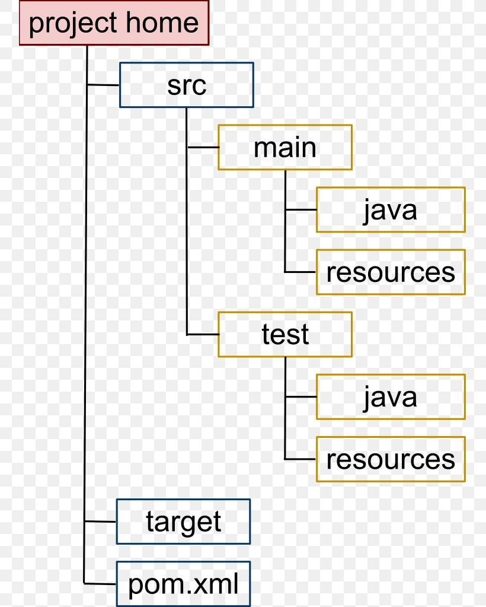
Maven Project Structure
Maven project structure defines a folder in order to store all resources and files needed by a web application.

Slide 8
Objectives of MAVEN
Making the build process easy
Providing a uniform build system
Providing quality project information
Encouraging better development practices

Slide 9
Advantages of Maven
Helps to manage all the processes, such as building, documentation, releasing, and distribution in project management.
Simplifies the process of project building.
Increases the performance of the project and the building process.

Slide 10
Drawbacks of Maven
Conversely, Maven has a few drawbacks.
If the Maven code for an existing dependency is unavailable, you cannot add that dependency using Maven itself.
Some sources claim that Maven is slow.

Slide 11
THANK YOU

