Slide 1
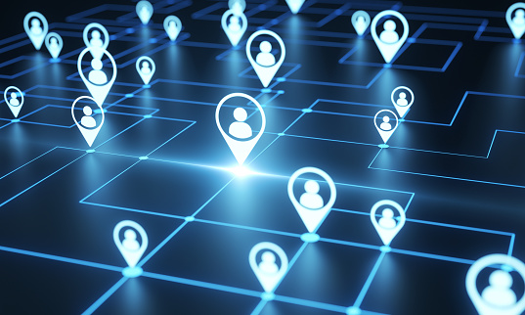
NETWORKING

Slide 2
What is Network?
Set of devices connected through links.
The nodes of a computer network may include personal computers, servers, networking hardware, or other specialized or general-purpose hosts.

Slide 3
Networking devices
Routers
Hub
Switches
Modem

Slide 4
ROUTER
It is a networking device operating at layer 3 or a network layer of the OSI model.
They are responsible for receiving, analysing, and forwarding data packets among the connected computer networks.
Routers provide protection against broadcast storms.

Slide 5
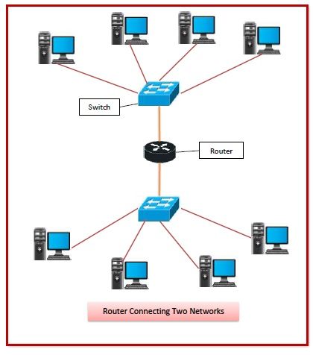
Router

