Slide 1
Devops
CHAPTER – 1
OVERVIEW OF CLOUD COMPUTING

Slide 2
Cloud Computing
Cloud Computing is the delivery of computing services such as servers, storage, databases, networking, software, analytics, intelligence, and more, over the Cloud (Internet).
The term Cloud refers to a Network or Internet. In other words, we can say that Cloud is something, which is present in a remote location. Cloud can provide services over public and private networks, i.e., WAN, LAN, or VPN.
Applications such as e-mail, web conferencing, and customer relationship management (CRM) executing on the cloud.
Cloud Computing refers to manipulating, configuring, and accessing the hardware and software resources remotely. It offers online data storage, infrastructure, and application.

Slide 3
Cloud Terminology
1. XaaS (Anything-as-a-Service)
This is a generic term that refers to any service which is available as a cloud-enabled service through the internet. Sometimes it is also called ‘everything-as-a-service’. It includes SaaS, DaaS, PaaS, IaaS, etc.
2. Cloud Computing
Cloud computing is the on-demand delivery of IT services from a third-party provider over the Internet
3. Cloud Provider / Cloud Service Provider
A company that provides a cloud service to organizations and/or individuals

Slide 4
Cloud Terminology
4.” Pay as you go” or “pay per use”
You are charged only for what you use. Analogous to a utility bill
5. Multi-tenant
Multiple customers consume services delivered using shared infrastructure
6. Cloud Service
The IT capability that is being provided by the cloud provider

Slide 5
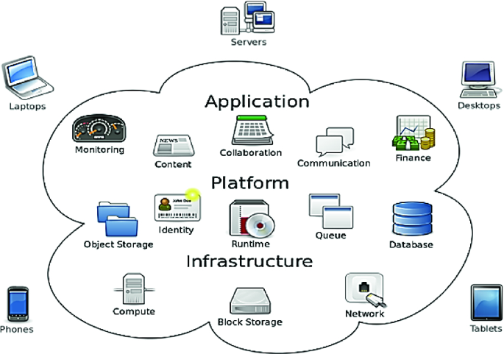
Key Characteristics of Cloud Computing
On-demand Self-service
Multi-tenancy and Resource Pooling
Broad Network Access
Rapid Elasticity and Scalability
Resource Pooling
Measured and Reporting service
Automation
Resilience
Large Network Access
Availability

Slide 6
On-demand Self-service
Cloud computing delivers on-demand service. It provides the feature of monitoring server uptime with computing capabilities to the end-users. Cloud computing provides predefined network storage that enables the end-users to monitor their computing capabilities. Cloud computing works on a self-service model.
They help end-users to make better decisions as they know how to use cloud computing services.
Multi-tenancy and Resource Pooling
One of the most important features of cloud technology is multi-tenancy. It can be defined as the software architecture that enables the single program instance to provide services to multiple end-users. This feature enables the usage of the same computing resources by multiple customers.

Slide 7
Broad Network Access
Cloud computing is achieved through standard computing mechanisms, and this feature helps promote heterogeneous thick and thin client platforms.
Examples of such platforms comprise mobile phones, laptops, dedicated workstations, and tablets. The capabilities are delivered across multiple networks. Cloud computing, therefore, helps break barriers and boundaries as they function across multiple geographies.
Rapid Elasticity and Scalability
Cloud computing capabilities can be released elastically. It enables you to scale the cloud computing services inward and outward, and it helps to be commensurate with the dynamic demand posted by the end-users.

Slide 8
Resource Pooling
Cloud computing delivers affordable resource pooling solutions. With resource pooling, organizations can reduce substantial computing costs, and it helps in the dynamic pooling of resources that enable them to deliver computing services to several consumers.
Measured and Reporting Service
Cloud systems offer the metering capability to monitor, control, and optimize the usage of cloud resources. This feature can be defined as a measured service.
The metering capability is placed at some level of the abstraction of applicable services. Therefore, this feature enables transparency for both the provider of service and the consumer.

Slide 9
Automation
Through automation, IT teams and developers maintain and modify cloud services. When cloud infrastructure is in place, it ensures minimum interaction from humans. All the configurations are installed to ensure the monitoring and maintenance of cloud computing services, and such configurations are mostly automated. Therefore, automation in cloud computing facilitates the faster expansion of cloud services.
Resilience
Cloud computing delivers continuous server uptime, and hence it offers resilient services. It offers the capability to recover from any service interruption. The cloud service provider also develops strategies that boost disaster management, achieved by maintaining backup cloud nodes.

Slide 10
Large Network Access
Cloud computing is so versatile that it enables its users to access cloud services. These fundamental characteristics of Cloud Computing also enable them to upload data to the cloud from anywhere. For this, you need to have a decent internet connection and a robust device that helps make a connection to the cloud.
Availability
Cloud computing offers highly resilient services, and the cloud services are available for 24 x7 duration if the cloud resource faces downtime, the system recovers and starts within no time.
While the cloud service makes a recovery, information stored in servers, networks, and databases remains to be secured. Since cloud services can be accessed from any geographical location, their services remain available most of the time.

Slide 11
Cloud Computing Service Models
Infrastructure as a Service (IaaS)
Infrastructure as a Service (IaaS) is a self-service model for managing remote data center infrastructures. IaaS provides virtualized computing resources over the Internet hosted by a third party such as Amazon Web Services, Microsoft Azure, or Google.
Instead of an organization purchasing hardware, companies purchase IaaS based on a consumption model. It is like buying electricity. You only pay for what you use. This model enables companies to add, delete or reconfigure IT infrastructure on-demand.

Slide 12
Advantages of IaaS
Cost-Effective: Eliminates capital expense and reduces ongoing cost and IaaS customers pay on a per-user basis, typically by the hour, week, or month.
Website hosting: Running websites using IaaS can be less expensive than traditional web hosting.
Security: The IaaS Cloud Provider may provide better security than your existing software.
Maintenance: There is no need to manage the underlying data center or the introduction of new releases of the development or underlying software. This is all handled by the IaaS Cloud Provider
The various companies providing IaaS are IBM, Open stack, VMware, and BlueStack.

Slide 13
Platform as a Service (PaaS)
Platform as a Service (PaaS) allows organizations to build, run and manage applications without the IT infrastructure. This makes it easier and faster to develop, test and deploy applications.
Developers can focus on writing code and creating applications without worrying about time-consuming IT infrastructure activities such as provisioning servers, storage, and backup.
PaaS brings more value to the cloud. It can reduce your management overhead and lower your costs. PaaS also makes it easier for you to innovate and scale your services on demand

Slide 14
Advantages of PaaS
Simple and convenient for users: It provides much of the infrastructure and other IT services, which users can access anywhere via a web browser.
Cost-Effective: It charges for the services provided on a per-use basis thus eliminating the expenses one may have for on-premises hardware and software.
Efficiently managing the lifecycle: It is designed to support the complete web application lifecycle: building, testing, deploying, managing, and updating.
Efficiency: It allows for higher-level programming with reduced complexity thus, the overall development of the application can be more effective.
The various companies providing PaaS are Amazon Web services Elastic Beanstalk, Salesforce, Windows Azure, Google App Engine, cloud Bess and IBM smart cloud.

Slide 15
Software as a Service (SaaS)
Software as a service (SaaS) replaces the traditional on-device software with software that is licensed on a subscription basis. It is centrally hosted in the cloud. A good example is Salesforce.com.
Most SaaS applications can be accessed directly from a web browser without any downloads or installations required. However, some SaaS applications require plugins.

Slide 16
Advantages of SaaS
Cost-Effective: Pay only for what you use.
Reduced time: Users can run most SaaS apps directly from their web browser without needing to download and install any software.
Accessibility: We can Access app data from anywhere.
Automatic updates: Rather than purchasing new software, customers rely on a SaaS provider to automatically perform the updates.
Scalability: It allows the users to access the services and features on-demand.
The various companies providing SaaS are Cloud9 Analytics, Salesforce.com, Cloud Switch, Microsoft Office 365, Big Commerce, Eloqua, Dropbox, and Cloud Tran.

Slide 17
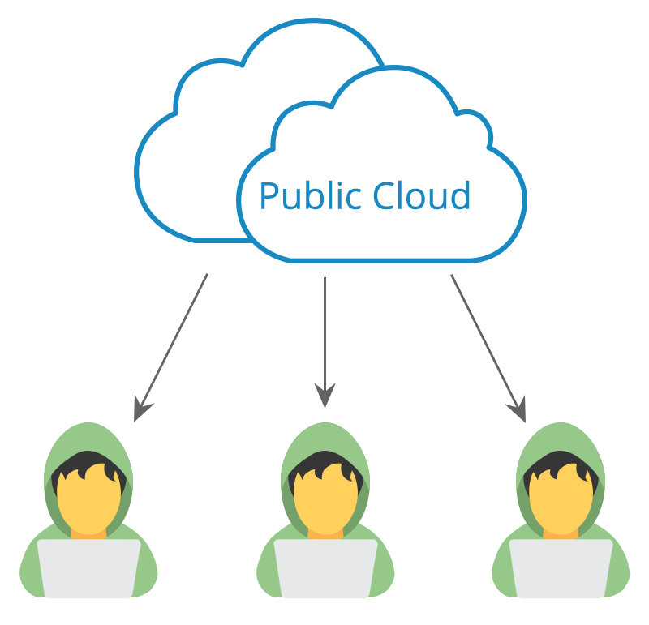
CLOUD COMPUTING DEPLOYMENT MODELS
Public Cloud
In a public cloud, the services which are deployed are open for public use and general public cloud services are free. Technically there may be no difference between a public cloud and a private cloud, but the security parameters are very different, since the public cloud is accessible by anyone there is a more risk factors involved with the same.

Slide 18
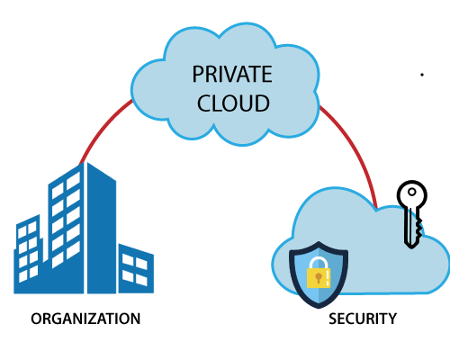
Private Cloud
A private cloud is operated solely for a single organization, it can be done by the same organization or a third-party organization. But usually, the costs are high when you are using your cloud since the hardware would be updated periodically, security also has to be kept in check since new threats come up every day

Slide 19
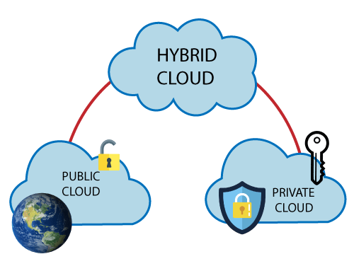
Hybrid Cloud
It combines public and private clouds, and may even include on-premises legacy servers. An organization may use their private cloud for some services and their public cloud for others, or they may use the public cloud as a backup for their private cloud.

Slide 20
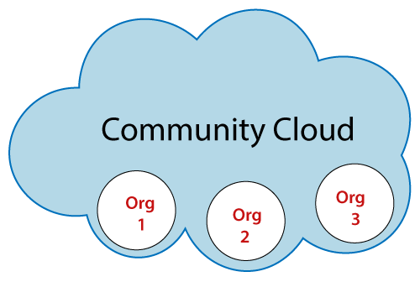
Community Cloud
A community cloud is a cloud infrastructure that allows systems and services to be accessible by a group of several organizations to share information. It is owned, managed, and operated by one or more organizations in the community, a third party, or a combination of them.

Slide 21
Cloud vs Legacy IT
What I mean by legacy IT is self-managed systems deployed within a company’s own data center (on-premises), or in a shared data center (co-location) where the company leases space. This equipment is typically purchased and owned by the company and may also be fully or partially managed by the company’s IT staff.
This model requires large amounts of capital expenditure (CAPEX) to pay for data center costs, equipment purchase, software licensing, maintenance contracts, staff wages and more. Typically equipment is then depreciated over the course of 3-5 years, and must then be replaced
With cloud computing, you consume on-demand computing resources as services. In this self-service model, the service is metered so you pay only for what you use.

Slide 22
Advantages of Cloud Computing
Trade fixed expense for variable expense – Instead of having to invest heavily in data centers and servers before you know how you’re going to use them, you can pay only when you consume computing resources, and pay only for how much you consume.
Benefit from massive economies of scale – By using cloud computing, you can achieve a lower variable cost than you can get on your own. Because usage from hundreds of thousands of customers is aggregated in the cloud, providers such as AWS can achieve higher economies of scale, which translates into lower pay-as-you-go prices.
Stop guessing capacity – Eliminate guessing about your infrastructure capacity needs. When you make a capacity decision before deploying an application, you often end up either sitting on expensive idle resources or dealing with limited capacity. With cloud computing, these problems go away. You can access as much or as little capacity as you need, and scale up and down as required with only a few minutes’ notice.

Slide 23
Advantages of Cloud Computing
Increase speed and agility – In a cloud computing environment, new IT resources are only a click away, which means that you reduce the time to make those resources available to your developers from weeks to just minutes. This results in a dramatic increase in agility for the organization since the cost and time it takes to experiment and develop is significantly lower.
Stop spending money running and maintaining data centers – Focus on projects that differentiate your business, not the infrastructure. Cloud computing lets you focus on your customers, rather than on the heavy lifting of racking, stacking, and powering servers.
Go global in minutes – Easily deploy your application in multiple regions around the world with just a few clicks. This means you can provide lower latency and a better experience for your customers at a minimal cost.

Slide 24
Thank You

