Slide 1




Hayley Ellis Workforce Learning & Development Officer
Small Steps Big Changes
Notes:
This presentation provides an overview of the changes to the Healthy Start Scheme, it is hoped that this information will enable family facing services to discuss the scheme confidently and provide advice and guidance when needed.

Slide 2
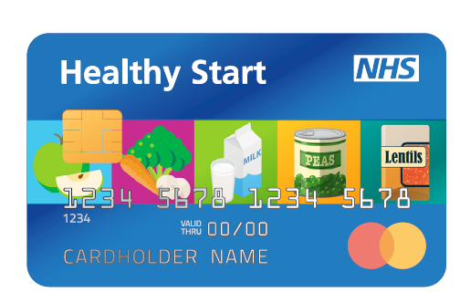
Transition to digital
The former ‘voucher’ version of the Healthy Start scheme will cease to operate from March 2022.
All current beneficiaries have been sent a letter about changes to the scheme. They will need to re-apply online for the card scheme.
Current beneficiaries will be contacted a second time if they have not re-applied for the scheme following their invitation letter.
All new applications can be made online via the Healthy Start website

Slide 3
Test your
knowledge
Who is eligible for Healthy Start?

Slide 4

Who is eligible?
Pregnant women or families who have a child under four years old and receive one or more of the following:
Income Support
Jobseeker’s Allowance
Income-related Employment and Support Allowance
Child Tax Credit with a family income of £16,190 or less per year
Pension Credit
Universal Credit with no earned income or total earned income of £408 or less per month for the family.
Pregnant women under the age of 18 are also eligible, even if they do not receive any of the above benefits.
Families with no recourse to public funds should email Healthystartclaim@dhsc.gov.uk
to discuss their claim.
Families should visit www.healthystart.nhs.uk to check their eligibility.

Slide 5
How to apply
Eligible families can apply online:
www.healthystart.nhs.uk/how-to-apply
If an interpreter is required, call the Healthy Start Helpline:
0300 330 7010
Select option 3
Or email: healthy.start@nhsbsa.nhs.uk
All applicants need to provide the following information on their application form:
Name
Address
Date of birth
National Insurance number
Baby’s due date or child’s birth date
Notes:
Eligible families can apply online at www.healthystart.nhs.uk/how-to-apply, however, typically, eligible families for whom English is not a first language are less likely to apply for the Healthy Start scheme.
They may benefit from targeted efforts to increase awareness of the scheme alongside additional support to complete the online application form.
An interpreter service is available by calling the Healthy Start helpline on 0300 330 7010 and selecting option 3 or by emailing healthy.start@nhsbsa.nhs.uk
It is worth noting that that the helpline is in an automated call in English
Applicants need to provide the following information on their application form:
Name
Address
Date of birth
National Insurance number
Baby’s due date or child’s birth date

Slide 6
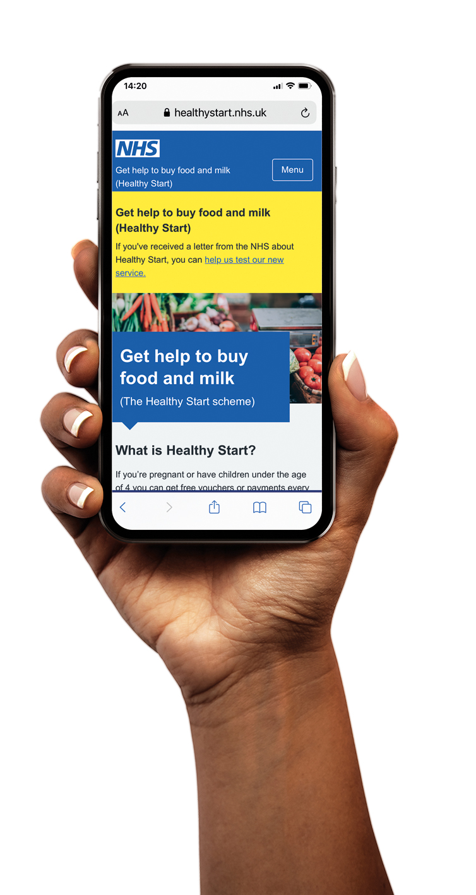
Data mismatches
Applicants will find that their application is declined if the information they provide does not match the records held by the benefits agency.
This includes the applicant’s name and address.

Slide 7
Activating the card
The Healthy Start card will be sent directly to the family in the post. It will be pre-loaded with the first payment.
To activate the Healthy Start card, the beneficiary must call 0300 330 2090.
If an interpreter is required, call the Healthy Start Helpline:
Call 0300 330 7010 (select option 3)
Or email: healthy.start@nhsbsa.nhs.uk
They will need their:
Healthy Start card
Date of birth
Client ID (located at the top of the letter that came with the card)

Slide 8
Test your
knowledge
How much money do you get per week if your child is 2yrs old?

Slide 9
The card’s value
The card will be automatically topped up every 4 weeks.
The value added to the card depends on the age of the child.
£4.25 per week of pregnancy (from the 10th week until the baby is born)
£8.50 per week for children from birth to age 1
£4.25 per week for children aged between 1 and 4

Slide 10
Test your
knowledge
What can you not buy with your Healthy Start card?

Slide 11

What can you buy with the card?
Fruit, vegetables and pulses (with no added ingredients)
Fresh, frozen or tinned
Whole, chopped, packaged or loose
Fruit in fruit juice, or fruit or vegetables in water
Plain cow’s milk
Pasteurised, sterilised, long-life or ultra-heat treated (UHT).
Infant formula made from cow’s milk
Stage one only (first infant formula)
Nutritionally complete
Does not include follow-on formula or milk (‘from 6 months’,
or ‘from 6 to 12 months’).

Slide 12
Test your
knowledge
Where can you buy fresh cow’s milk with a Healthy Start card?

Slide 13

Where can you shop?
You can use a Healthy Start card anywhere that accept Mastercard® and sells items covered by the scheme.
This includes:
Supermarkets
Convenience stores
Pharmacies
Markets
Newsagents
Butchers
Petrol stations
The Mastercard® symbol is normally shown on the shop door or at the till.

Slide 14
How to use the card
The first transaction is made using a pin – this is provided when the card is activated.
Subsequent payments can be contactless up to £45.
Payments higher than the card balance will not be accepted.
Splitting payments
A Healthy Start card can be used for split payments.
If using a self-checkout machine, split payments can only be made if the remaining balance is paid in cash (not by card).
Refunds
The Healthy Start card can have payments refunded onto the card, in the same way as any bank card.

Slide 15
Why might a card be declined?
Card not activated before use.
PIN must be used for the first transaction
Contactless can only be used up to 4 times in a row. For the fifth transaction, the PIN must be entered.
Insufficient Funds – Check your balance using an ATM or by calling 0300 330 2090
The card should be inserted into the card reader. The card will be declined if it is swiped (like the voucher).

