Slide 1


Healthy start scheme
David Johns, PhD. RD
Public Health Consultant, Nottingham City Council
Date:

Slide 2
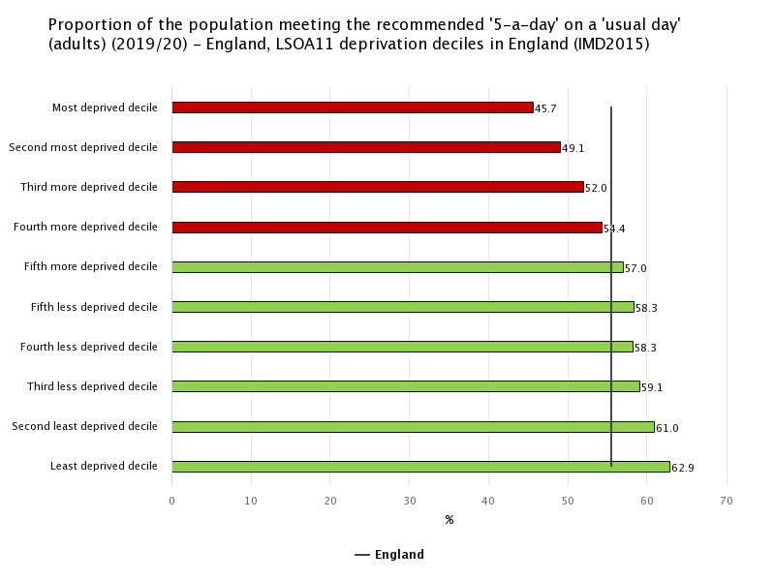
Inequalities in diet & nutrition (2019/20)

Slide 3
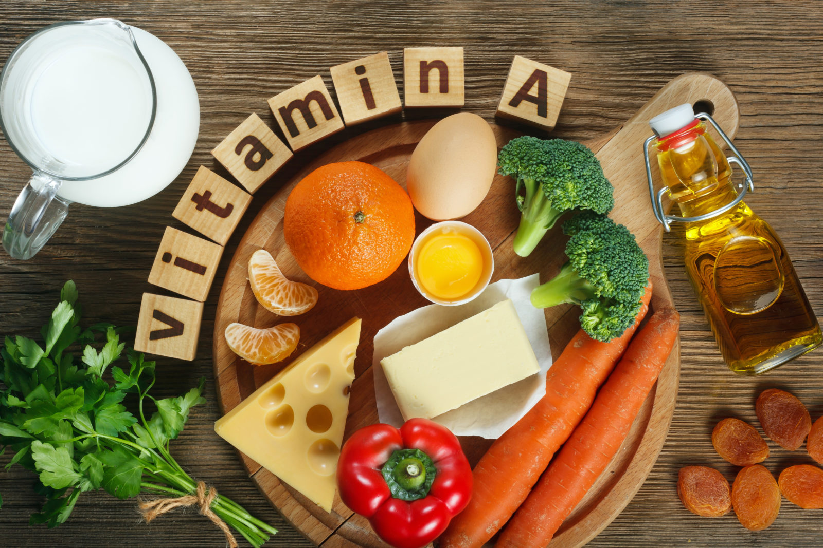
Vitamin deficiencies
8% of children under 5 in the UK do not have enough Vitamin A in their diet

Slide 4
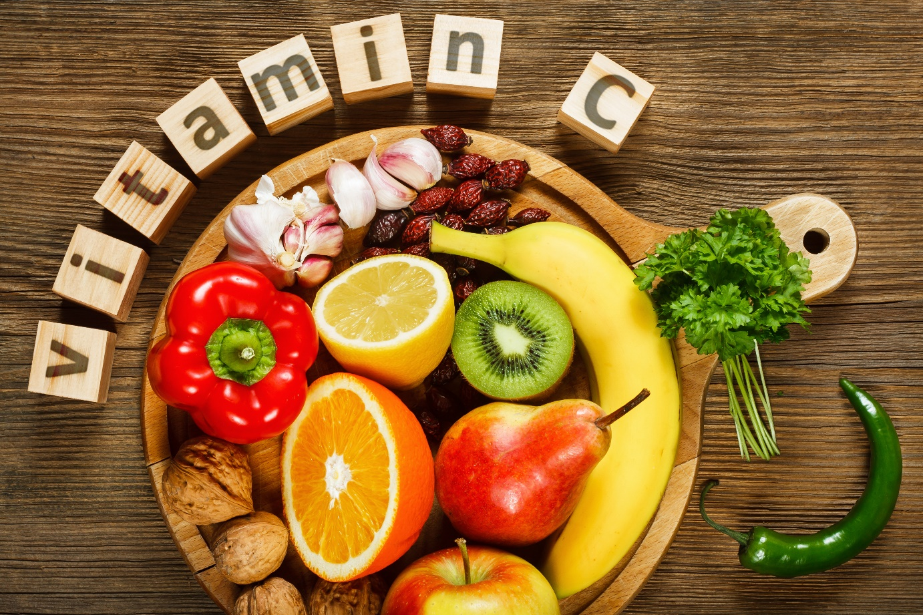
Vitamin deficiencies
Families in lower-income groups tend to have less vitamin C in their diet

Slide 5
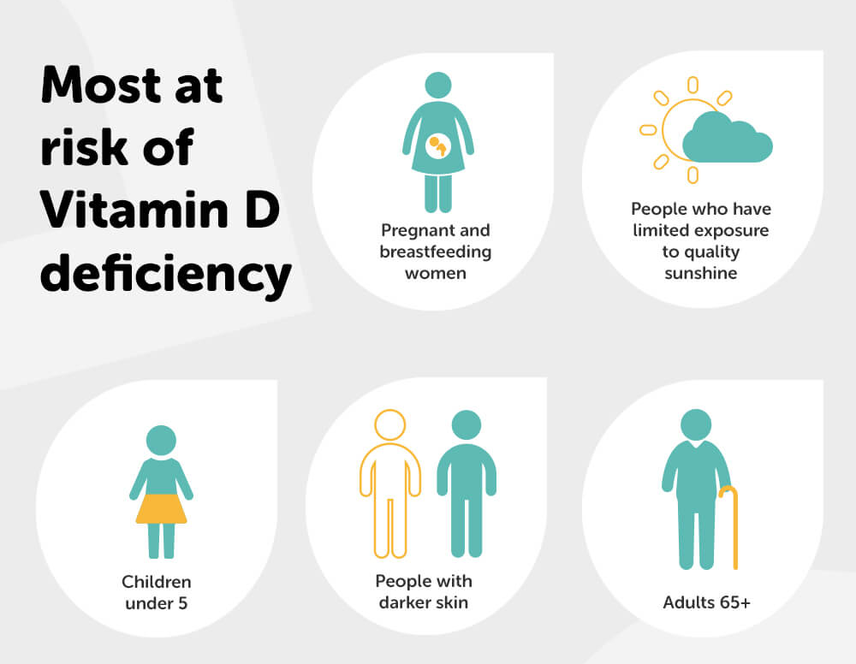
Vitamin deficiencies
All pregnant and breastfeeding women and young children are at risk of vitamin D deficiency (teenagers, younger women and those from ethnic minorities are particularly at risk)

Slide 6
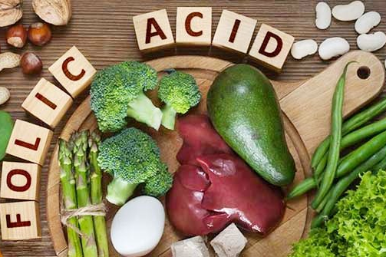
Vitamin deficiencies
Deficiency can occur if you are not getting enough folate in your diet or if requirements increase (such as during pregnancy).
If you do not get enough folic acid before and during pregnancy, your baby is at higher risk for neural tube defects.
Neural tube defects are serious birth defects that affect the spine, spinal cord, or brain

Slide 7
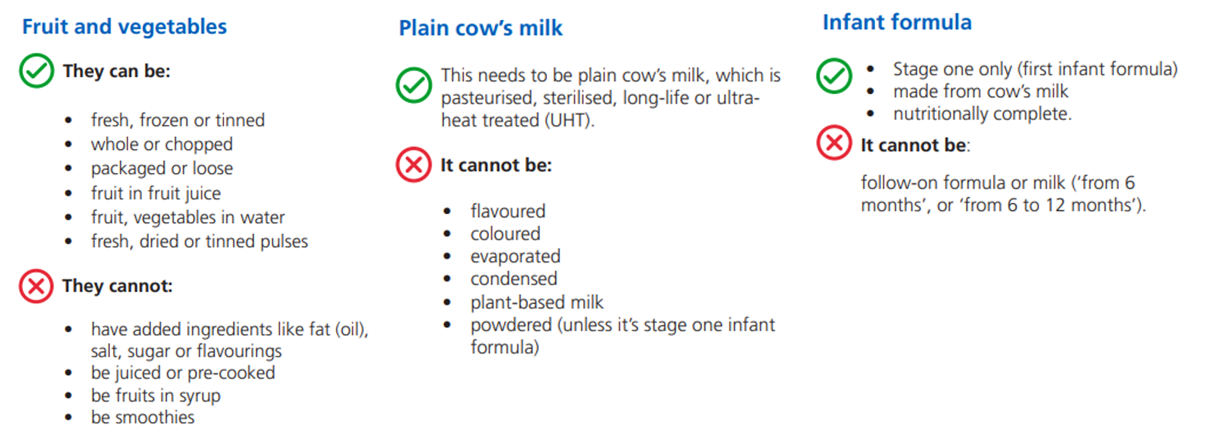
Healthy Start Scheme

Slide 8
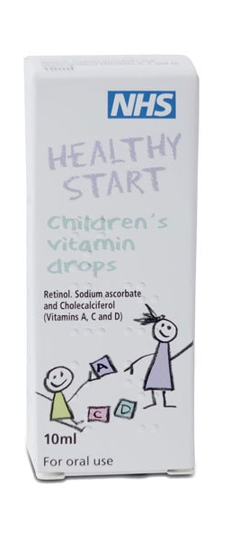
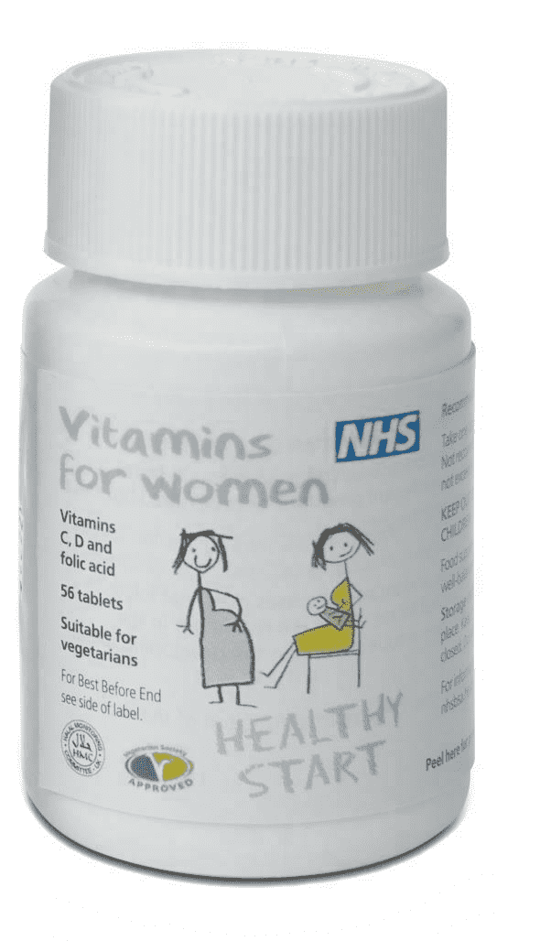
Healthy Start Scheme
Children receiving Healthy Start vouchers qualify for free vitamin from birth until their 4th birthday.
The daily dose of 5 drops contains:
233 micrograms of vitamin A
20 milligrams of vitamin C
10 micrograms of vitamin D3
Children who are having 500ml or more of formula a day do not need Healthy Start vitamins.
The daily dose is 1 tablet, which contains:
70 milligrams of vitamin C
10 micrograms of vitamin D
400 micrograms of folic acid

Slide 9
Healthy Start Scheme: Nottingham
Date | Numbers who are eligible | Nottingham uptake | East Midlands uptake | National uptake
Dec - Jan 22 | 3587 | 54% | 47% | 50.5%
Nov - Dec 21 | 4065 | 47% | 46% | 46.3%
Oct - Nov 21 | 3852 | 73% | 60% | 65%
Sept - Oct 21 | 4839 | 65% | 61% | 60.6%
Aug - Sept 21 | 4839 | 70% | 60.4% | 59.7%
Jun - Jul 21 | 4865 | 70% | 59.7% | 59 %

Slide 10
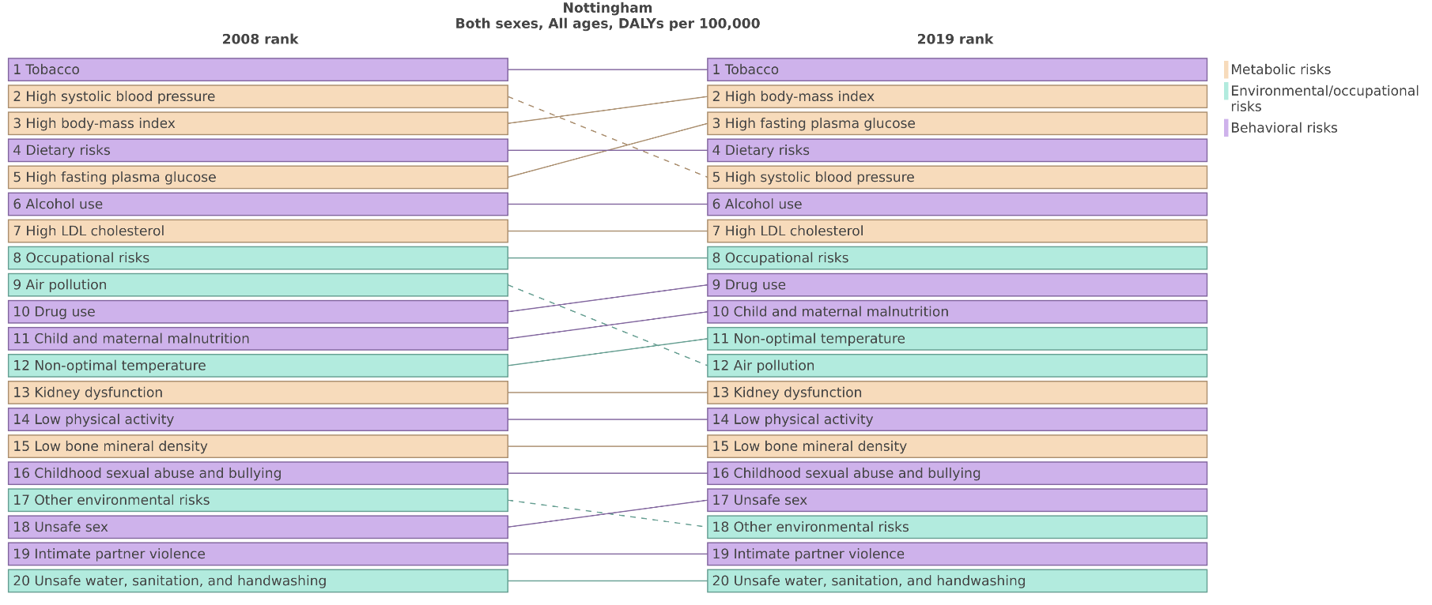
Healthy Start Scheme: Nottingham

Slide 11
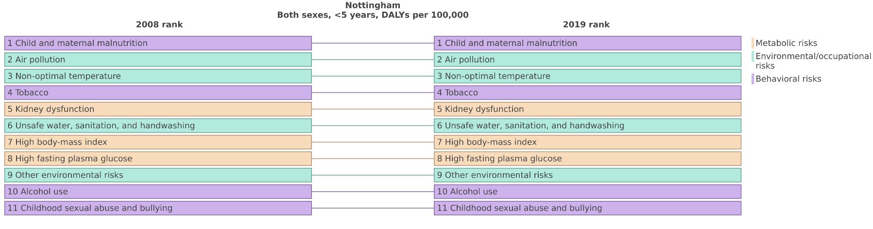
Healthy Start Scheme: Nottingham

