Slide 1

High Performance Secure Container: Quark
Yulin Sun & Ying Xiong
Futurewei Technologies
#ossummit

Slide 2
Agenda
Why
Goal
Architecture
Performance Extension
TCP Socket over RDMA
Service Mesh optimization
2-stage container startup
Q&A

Slide 3
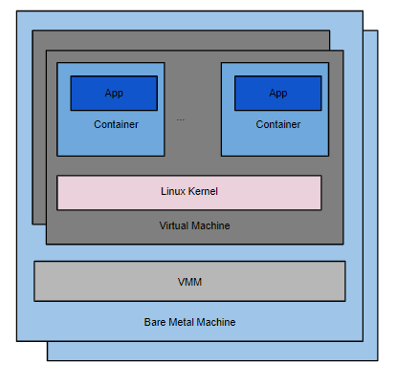
Secure Container Background
Linux container is not secure: VM isolation is must in multi-tenant environment
Virtual Machine overhead
Memory
Disk IO
Network IO
Management Overhead: IaaS + PaaS

Slide 4
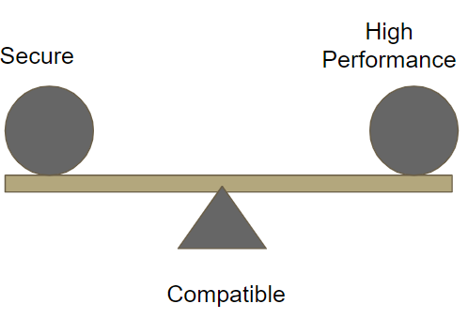
Goal
Secure
KVM VM isolation
Secure program language
High Performance
Design for Cloud Native application
Containerized workload: e.g., K8S
Serverless
Optimized for Data center environment
Data center network
Multi-core server
Compatible
Linux
OCI/CRI

Slide 5
Architecture #1 System Call Virtualization
Quark
Linux Virtual Machine
Guest Application
Linux Container Application
Linux Container Application
System Call Virtualization
Guest Kernel
Quark Runtime
QKernel
Linux Guest Kernel
Device Virtualization
VMM
QVisor
QEMU
Linux Container
Linux Process
Linux Host Kernel

Slide 6
Architecture #2 IO Optimization
Linux Container Application
HCall (Hyper Call) :
QCall (Quark Call) :
Submit Queue ( Share memory)
Task manager integration: No Complete Queue
No guest/host context switch
UCall (IO-Uring Call):
Submit Queue: IO-Uring
Complete Queue: IO-Uring
Bypass QVisor
RCall (RDMA Call):
Zero memory copy from QKernel
Bypass Linux kernel
Dedicated control plan service
Quark Runtime
QKernel
Guest
Memory Manager
Task Manager
HCall
QCall
UCall
RCall
File System
IO System
QVisor
Host
Linux Container
Linux Host Kernel
RDMA NIC

Slide 7
Test Result
Machine Spec
RunC | 33901
Quark | 20542.19
gVisor | 10112.63
Kata | 4114.02
Nginx (RPS)
CPU | 11th Gen Intel(R) Core(TM) i7-11700K @ 3.60GHz
Memeory | 2 x 16GB, DDR4, 3200 MT/s
SSD | 250GB, PCIe

Slide 8
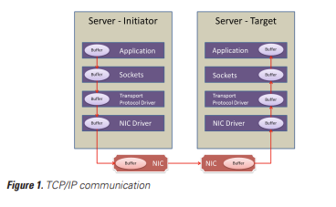
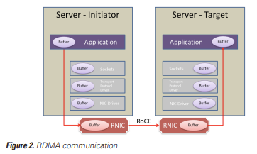
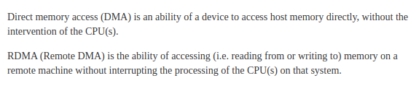
Performance Extension : TCP Socket Over RDMA#1
Why not used in Cloud Development?
API compatibility: TCP to RDMA?
Container network Virtualization

Slide 9
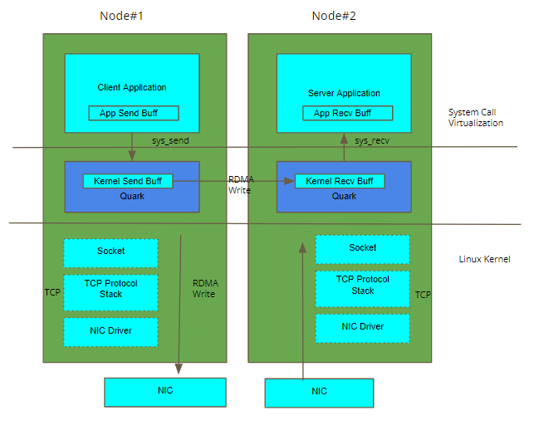
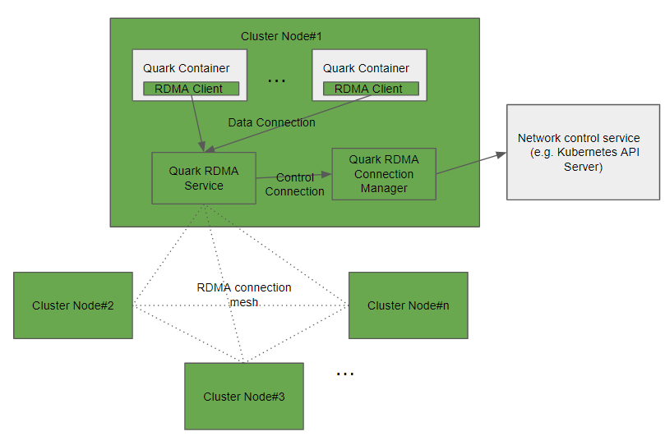
Performance Extension : TCP Socket Over RDMA#2
1. TCP Socket Virtualization
2. Container Network Integration

Slide 10
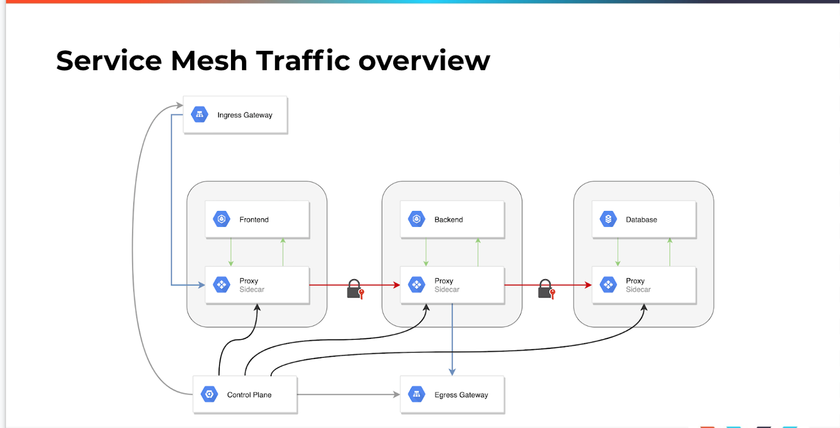
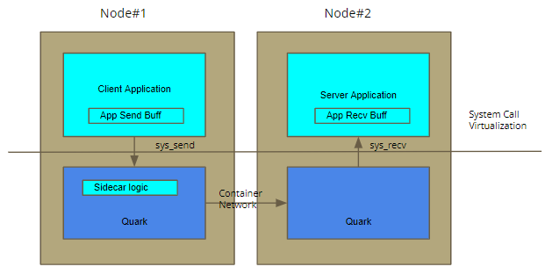
Performance Extension : Service Mesh Optimization
Envoy based Service Mesh
Quark based Service Mesh
TCP connection between application to sidecar
Extra 2 TCP hops between client/server
Low throughput / High latency
Function call between application to sidecar
No extra hop between client/server
High throughput / Low latency

Slide 11
Performance Extension : 2-stage container start
Container quick start in serverless
Solution#1: Warm up container
Reserve all resource beforehand
High resource consumption
Soution#2: 2-stage container start
(1) Sandbox setup
(2) Application start
Container schedule
Choose node
Notify node
Image preparation
Download image
Decompress
Container network setup
Propagate route
Register SLB
…
Stage#1: Sandbox Setup
Low memory usage
High latency (100s ms to 10s sec)
Container setup
Create Linux namespaces
Create cgroup
File system mount
Load ELF
Block Options
Block at Entry Point
Block by memory consumption (e.g., 20 MB)
Application Start
Enter entry point
Stage#2: Customer application start

Slide 12
Q & A
Quark https://github.com/QuarkContainer/Quark
Centaurus https://www.centauruscloud.io/
Futurewei https://www.futurewei.com/

