Slide 1
TCP Socket over RDMA (TSoR)

Slide 2
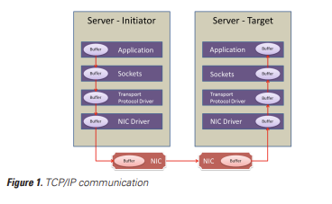
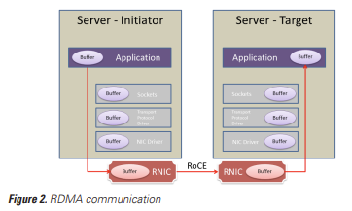
Goal: Transfer Cloud Native container TCP traffic through RDMA Transparently
Delivery
Challenges
API compatibility: TCP to RDMA
Container network Virtualization
Deliveries
TCP over RDMA protocol stack
RDMA based K8S network provider

Slide 3
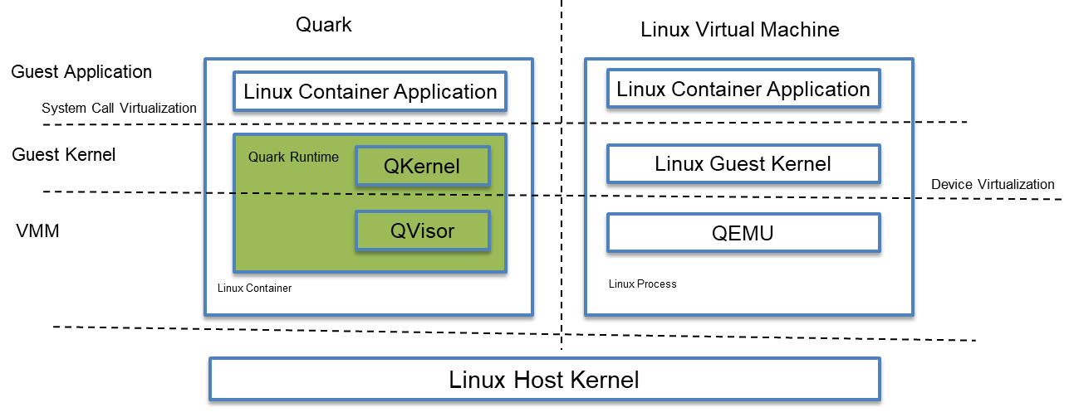
Quark Secure Container Runtime

Slide 4
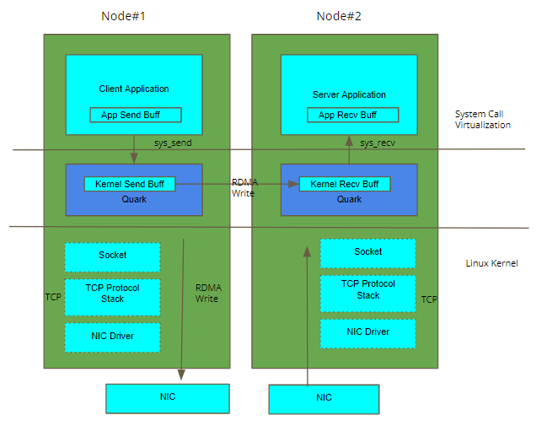
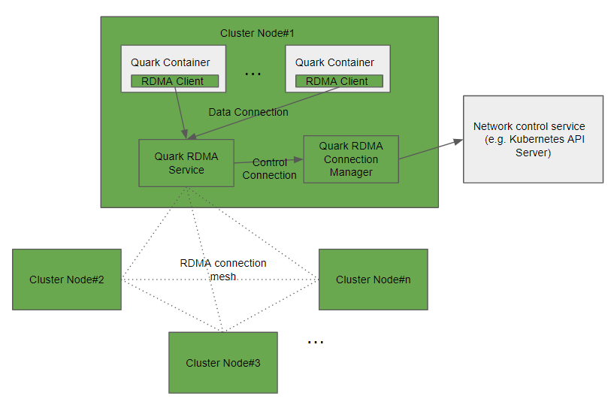
Design
1. TCP Socket over RDMA
2. Container Network Integration

Slide 5
Redis Perf test result (V0.1.0 release)
Summary
Throughput:
RDMA is better than Flannel with small connection count
RDMA performance decrease with more connections (Redis client benchmark bottleneck, need perf tuning)
Latency
RDMA is always better than Flannel

Slide 6
Collaboration proposal
Performance/Scalability
l2/l3 to RDMA
QoS/Network Policy
VPC integration
Service Mesh
…

Slide 7
Links
Quark container: https://github.com/QuarkContainer/Quark

