Slide 1

RECOMMENDATION SYSTEM USING
FREQUENT ITEM DATA SETS
Author: Abhinav Singhal , Prof .Dr .Bhaskar Pant (Graphic Era University , Dehradun)

Slide 2
Agenda
Introduction : Recommendation System
Types of System
Apriori Algorithm: Applications , Pseudo code,
Limitations ,Advantages and Disadvantages.
Methodology
Results and Discussion.
Conclusion and Future scope.
References.

Slide 3
What is Recommendation System and Its Types.
The recommendation system is a prediction of ratings given by users for a particular item or it is a subclass of information filtering system.
The main significance of the Recommendation system is to get some useful recommendation of different items for users.

Slide 4
Types of Recommendation System
Collaborative filtering.
Content-based filtering.
Hybrid Recommender System.
Content-based filtering recommends items based on a comparison between the content of the items and a user profile. The content of each item is represented as a set of descriptors.

Slide 5
In Collaborative filtering, a model is built from users past activity it has been noticed that similar decisions were made by new users.
Examples- are Movies, Electronic gadgets and the products in general.
Recommendation system is evolved from data analyzed and from new classes.

Slide 6
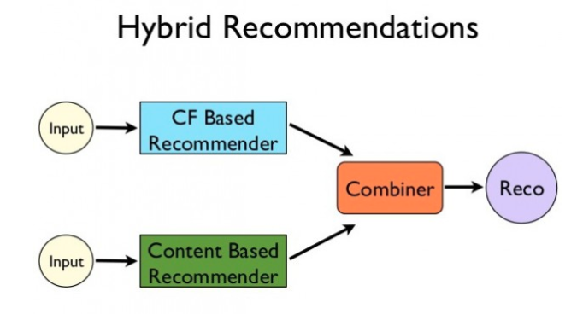
Hybrid Recommender System is the combination of Collaborative based filtering and combined based filtering.
A hybrid approach can be applied in many ways by making collaborative and content-based work separately and then combining them.

Slide 7
Why would businesses want to implement this?
It provides personalization-so individual approach will be shown to each customer based on their past purchases and preferences.
It provides information about the customer-by learning more about the buyers they can make better business decisions.

Slide 8
Apriori Algorithm
The Apriori Algorithm is an influential algorithm for mining frequent item sets for boolean association rules.
Apriori uses a ”Bottom-Up“ approach ,where frequent subsets are extended one item at a time.
Apriori is designation to operate on a database containing transactions
Example - a collection of items bought by customer or detail of a website frequentation.

Slide 9
Key Concepts
Frequent Item sets: All the sets which contain the item with the minimum support (denoted Li for ith items).
Apriori properties: Any Subset of frequent items must be frequent.
Join operations: To find Lk, a Set of candidate K-item sets is generated by joining Lk-1 with itself.

Slide 10
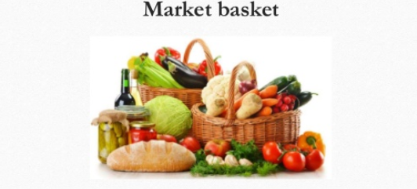
Application of Apriori Algorithm

Slide 11
Market Basket Analysis
Provides insight into which products tend to purchase together and which are most amenable to promotion.
Actionable rules.
Trivial rules: People who buy chalk piece also buy duster.
Inexplicable : People who buy laptop also buy bag.

Slide 12
The Apriori Algorithm
Join step: is generated by joining with itself.
Prune Step: any (k-1) item set that is not frequent cannot be a subset of a frequent k-item set.

Slide 13
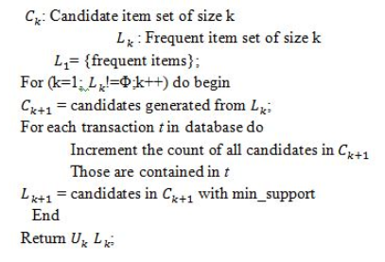
Pseudo-code:

Slide 14
Limitations
Apriori algorithm can be very slow and the bottleneck is candidate generation.
For example, if the transaction DB has10⁴ frequent 1-itemsets, they will generate 10⁷ candidate 2-itemsets even after employing the downward closure.
To compute those with sup more than min sup, the database need to be scanned at every level. It needs (n +1 ) scans, where n is the length of the longest pattern.

Slide 15
Apriori Advantages/Disadvantages
Advantages
Uses large item set property.
Easily parallelized.
Easy to implement.
Disadvantages
Assumes transaction database is memory resident.
Requires many database scans.

Slide 16
Methodology
The data is fetched from (movieslens.comhttps://grouplens.org/datasets/movielens).
Which contains some necessary supplies such as User Id or (we can say number of users), Movie Id, Movie Name,
Categories in which user can comment (Action, Adventure, Animation, children, comedy, crime, drama, Fantastic, mystery, music, Horror, romantic, Documentary, thrilling, war, western ) i.e genre and
The ratings that are done from 1to 5.
we have taken review from 40 users and then applying algorithm of frequent item data set.

Slide 17
Methodology(cont)
Basically, there are 16 categories in which 40 users can give there comment. so when we make the combination of 2 items i.e 7C2=21 possible combination are formed out of which 20 passes the threshold value i.e 20.
Now we have applied our algorithm for a combination of three items i.e 7C3=35 possible combination are formed out of which 22 items pass the threshold value.
Then we have moved further and make the combination of 4 items i.e 7C4=35.now out of these 35 possible combinations, 7 items pass the threshold value and reaches to the next level.

Slide 18
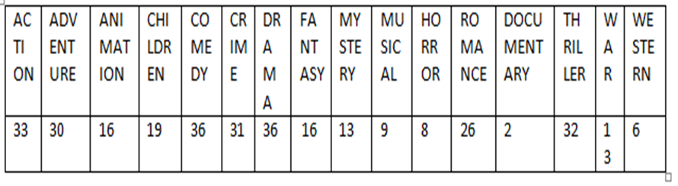
Now I have tried to make the combination of 5 items i.e 4 possible combinations are formed and no one has passed the threshold value. So (ACTION, ADVENTURE, COMEDY, DRAMA, CRIME, THRILLER, ROMANCE) are the items which are most liked by the users from the fig given below.

Slide 19
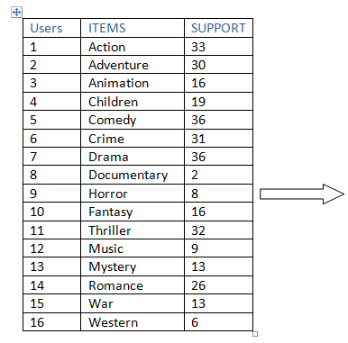
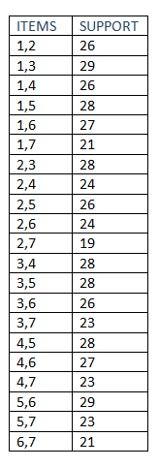
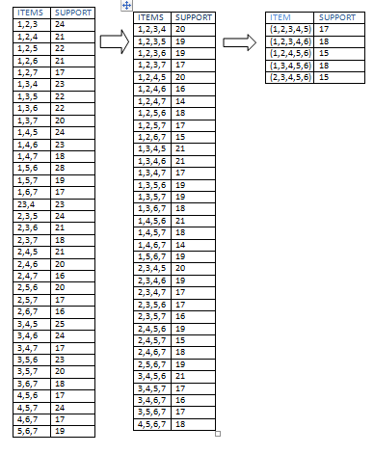
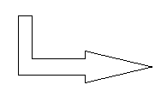

Slide 20
Results And Discussion
After applying algorithm of frequent item datasets with minimum support as 10.
The result obtained is very large and time taking.
Then we have taken minimum support as 20 and applied the algorithm in dataset.
Then there are 5 tables each table shows us the different combinations of items and the rating of the items. Now we got top 5 movie categories liked by users (ACTION, ADVENTURE, COMEDY, DRAMA, CRIME ).
So after looking at these results, one can predict the liking and disliking of peoples.

Slide 21
Conclusion And Future Scope
Hash-based item set counting: A k-item set whose corresponding hashing bucket count is below the threshold cannot be frequent
Transaction reduction: A transaction that does not contain any frequent k-item set is useless in subsequent scans
Partitioning: Any item set that is potentially frequent in DB must be frequent in at least one of the partitions of DB.
Sampling: mining on a subset of given data, lower support threshold + a method to determine the completeness
Dynamic item set counting: add new candidate item sets only when all of their subsets are estimated to be frequent
In Future we can have more number of instances and data in more Distributed manner to get more accuracy and better results.

Slide 22
References
Agarwal, R.imielinski,t., and swami, A.N.,”Mining associates rules between sets of items in large database”, in Proceeding of the 1993 ACM SIGMOD international conference on management of data pp207-216,1993.
D.Burdik, M calimlim and j.gehrke., “MAFIA; a maximal itemset algorithm for transactional database “in intl.conf on data engineering.apr.2001
Greg Linden, Brent, and Jeremy York,”amazon.com recommendation item to item collaborative filtering “, industry report published by IEEE computer society, pp.76-79, January & febuary 2003.
J.B Schafer, j.Konstanz, and I.Ridl,”E-commerce Recommendation Application,”data mining and knowledge discovery, Kluwer Academics, pp.115-153,2001.
Jeff m.phillips”|13: frequent items”, data mining, Springer 2013, University of Utah.

Slide 23
karandeep Singh Talwar, Abhishek oraganti, and Mahajan, Parvin Narsale”recommendation system using apriori algorithm”,”USRD-international journal for scientific research and development, pp.183-185, vol.3, issue 01,2015.
m.Boley and h.grosskreutz.approximating the numbers of frequent sets in dense data .knowl.inf.syst.,page65=89,2009.
Rakesh Aggarwal and Ramakrishnan Srikant,”Fast Association for data Mining Rules”, IBM Almaden Research center, 650 Harry Road, San Jose, CA 95120.
Recommendation System hand look ,Ricci,f:;Rokeach,I;Shapira ,b.;Kantor,p.B(eds),2011,Springer.
Sarwar, B, M., Kaypis, G., Konstan, J.A., and tried, J.,”Analysis of Recommendation Algorithm for E-commerce .in Proceeding of the ACM EC”, conference.Minneapolis,MN.pp.158-167,2000.

Slide 24
Thank you.

