Slide 1
Hypothesis Testing Exercise
A F&B manager wants to determine whether there is any significant difference in the diameter of the cutlet between two units. A randomly selected sample of cutlets was collected from both units and measured? Analyze the data and draw inferences at 5% significance level. Please state the assumptions and tests that you carried out to check validity of the assumptions.
Minitab File : Cutlets.mtw

Slide 2
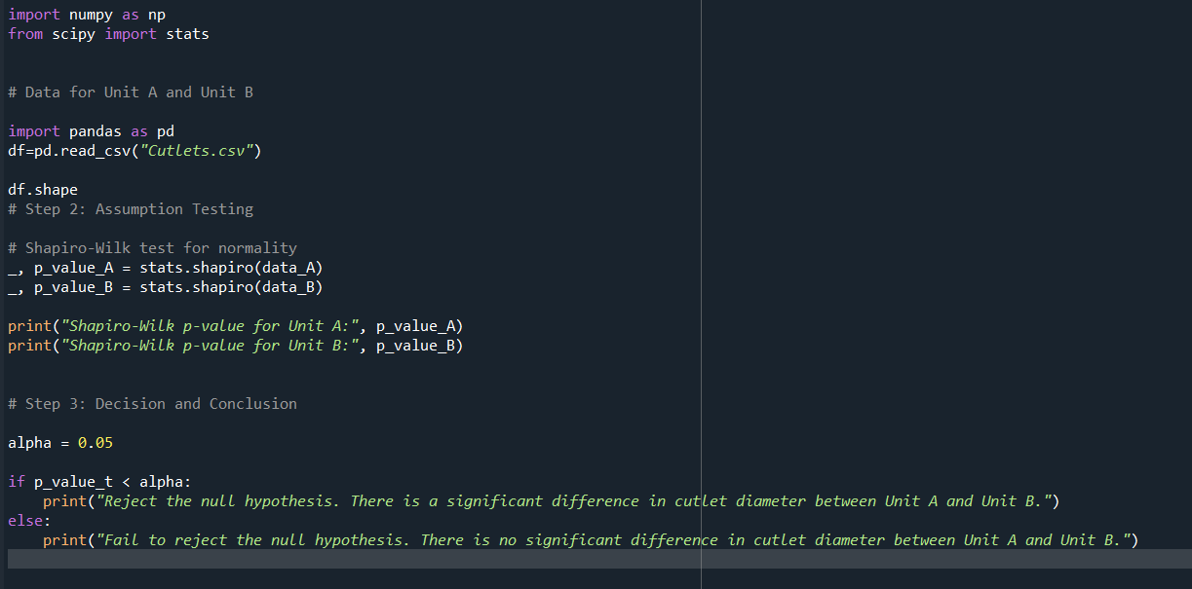
Assumption 1 Shapiro-Wilk test for normality
The Shapiro-Wilk test is a statistical test of the hypothesis that the distribution of the data as a whole deviates from a comparable normal distribution.
If the test is non-significant (p>. 05) it tells us that the distribution of the sample is not significantly different from a normal distribution.

Slide 3
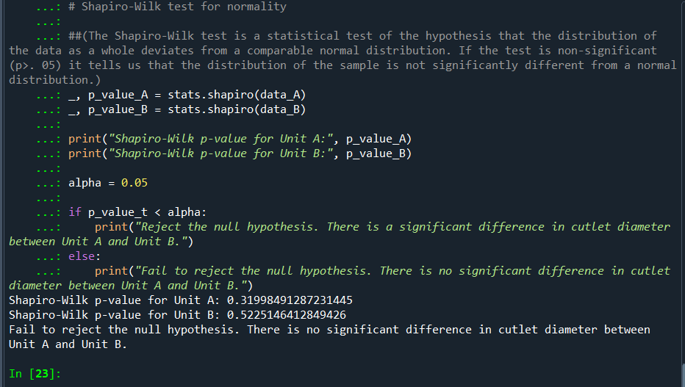
Output of the assumption
Null Hypothesis (H0): There is no significant difference in the diameter of the cutlet between Unit A and Unit B.
Alternative Hypothesis (Ha): There is a significant difference in the diameter of the cutlet between Unit A and Unit B.
In this, Null Hypothesis is accepted. This means there is no significant difference in the cutlet diameter between unit A and unit B.

Slide 4
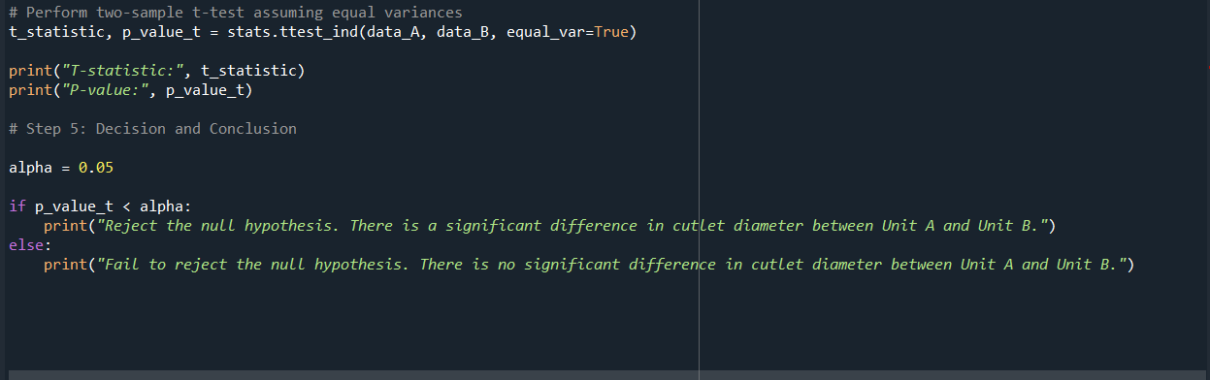
Assumption 2 Two-sample t-test
The two-sample t-test (also known as the independent samples t-test) is a method used to test whether the unknown population means of two groups are equal or not.

Slide 5
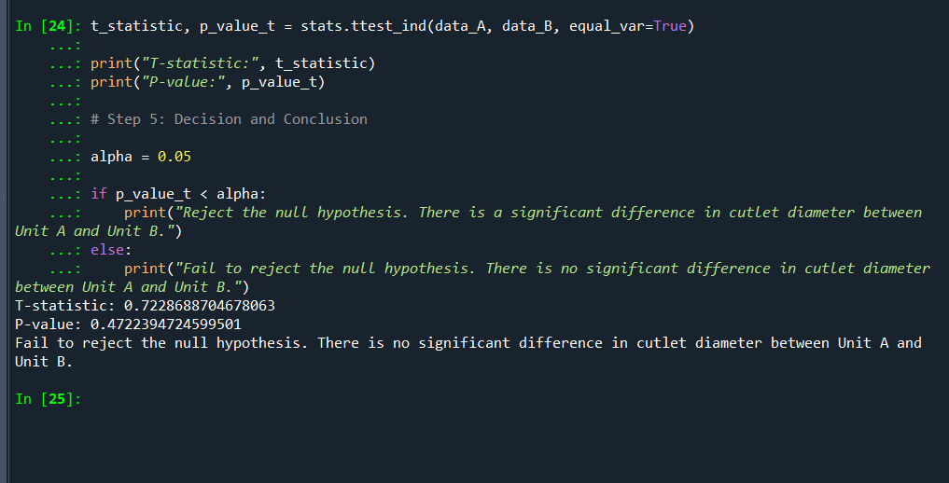
Output of the assumption
Null Hypothesis (H0): There is no significant difference in the diameter of the cutlet between Unit A and Unit B.
Alternative Hypothesis (Ha): There is a significant difference in the diameter of the cutlet between Unit A and Unit B.
In this, Null Hypothesis is accepted. This means there is no significant difference in the cutlet diameter between unit A and unit B.
T-statistic: 0.7228688704678063 P-value: 0.4722394724599501

Slide 6
Conclusion
Based on the above results, we can interpret as follows:
In simpler terms, the analysis suggests that the cutlet diameters in Unit A and Unit B are not significantly different from each other at the 5% significance level. The T-statistic being relatively small and the high p-value indicate that any observed difference in means is likely due to random variation rather than a true difference in the populations.

Slide 7
Hypothesis Testing Exercise
A hospital wants to determine whether there is any difference in the average Turn Around Time (TAT) of reports of the laboratories on their preferred list. They collected a random sample and recorded TAT for reports of 4 laboratories. TAT is defined as sample collected to report dispatch.
Analyze the data and determine whether there is any difference in average TAT among the different laboratories at 5% significance level.
Minitab File: LabTAT.mtw

Slide 8
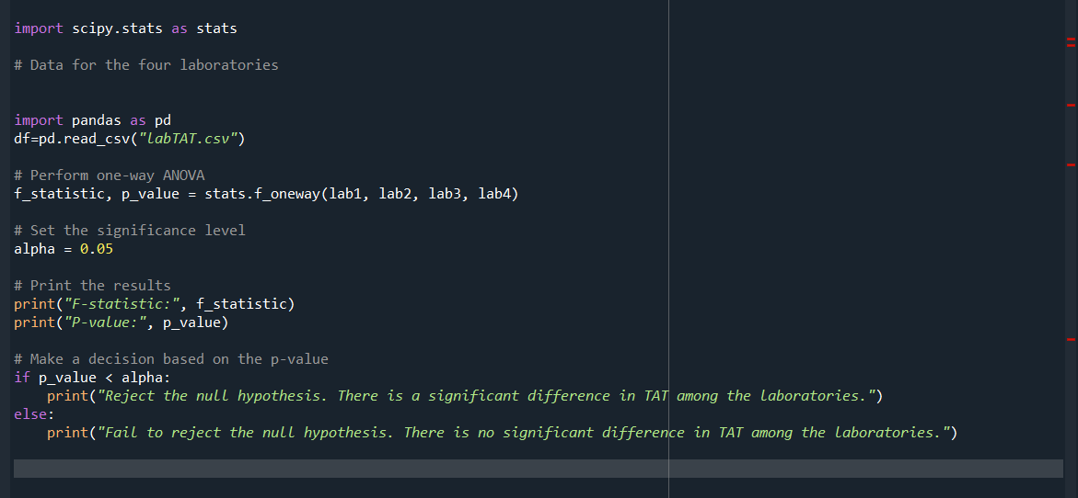
To determine whether there is any difference in the average Turn Around Time (TAT) among the different laboratories, you can perform an analysis of variance (ANOVA) test. ANOVA is used to compare the means of three or more groups to determine, if there are statistically significant differences between them.
ANOVA Test

Slide 9
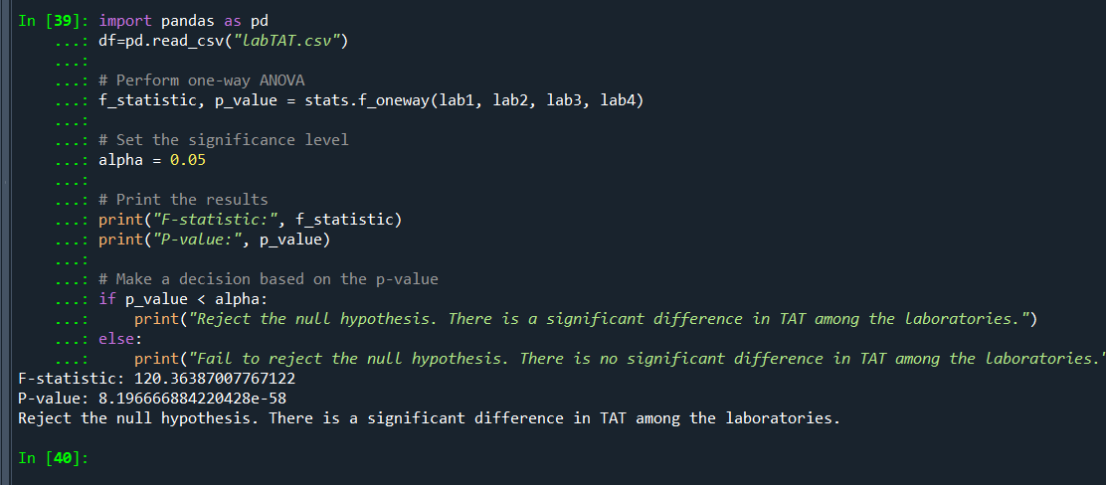
Output of the assumption
Null Hypothesis (H0): There is no significant difference in the average TAT among the four laboratories.
Alternative Hypothesis (H1): There is a significant difference in the average TAT among the four laboratories.

Slide 10
Conclusion
Reject the null hypothesis: There is a significant difference in Turn Around Time (TAT) among the four laboratories.
In other words, the data provides strong evidence to suggest that at least one of the laboratories has a significantly different average TAT compared to the others. Further post hoc tests or pairwise comparisons can be conducted to determine which specific laboratories differ from each other, but the overall conclusion is that there is a statistically significant difference in TAT among these laboratories.

Slide 11
Hypothesis Testing Exercise
Sales of products in four different regions is tabulated for males and females. Find if male-female buyer rations are similar across regions.
 | East | West | North | South
Males | 50 | 142 | 131 | 70
Females | 550 | 351 | 480 | 350
Check p-value
If p-Value < alpha, we reject Null Hypothesis
H0
All proportions are equal
Ha
Not all Proportions are equal
Buyer Ratio.mtw

Slide 12
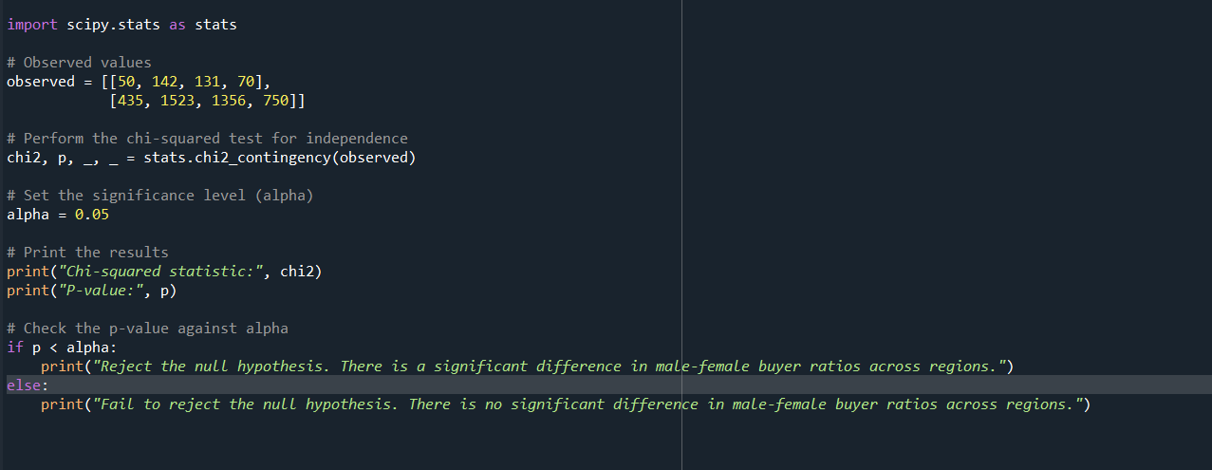
chi-squared test
The chi-squared test is used in statistics to determine if there is a significant association or relationship between two categorical variables.
H0: All proportions are equal, H1: All proportions are not equal.

Slide 13
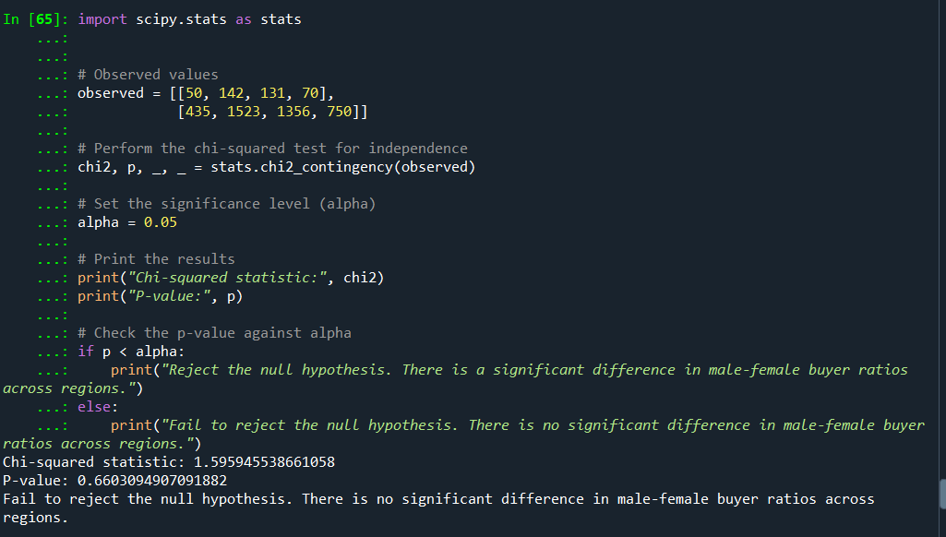

Slide 14
Conclusion
The p-value (0.6603094907091882) is greater than the significance level (alpha), which is typically set at 0.05.
When the p-value is greater than alpha, it suggests that you fail to reject the null hypothesis (H0). In other words, you do not have enough evidence to conclude that there is a significant difference in male-female buyer ratios across regions.
The chi-squared statistic (1.595945538661058) is relatively small, which further supports the lack of evidence for a significant difference.
Therefore, based on the output you provided, you would typically conclude that there is no significant difference in male-female buyer ratios across regions at the 0.05 significance level. In practical terms, this means that, with the data you have, you do not have enough evidence to suggest that the preferences of males and females significantly vary across the different regions.

Slide 15
Hypothesis Testing Exercise
TeleCall uses 4 centers around the globe to process customer order forms. They audit a certain % of the customer order forms. Any error in order form renders it defective and has to be reworked before processing. The manager wants to check whether the defective % varies by centre. Please analyze the data at 5% significance level and help the manager draw appropriate inferences.
Minitab File: CustomerOrderForm.mtw

Slide 16
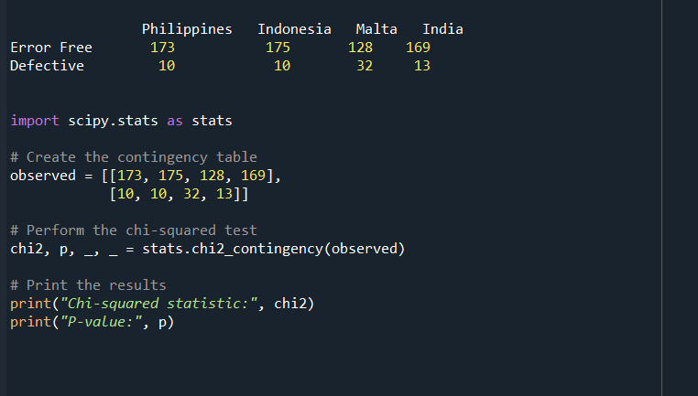
chi-squared test
The chi-square statistic compares the size of any discrepancies between the expected results and the actual results, given the size of the sample and the number of variables in the relationship.

Slide 17
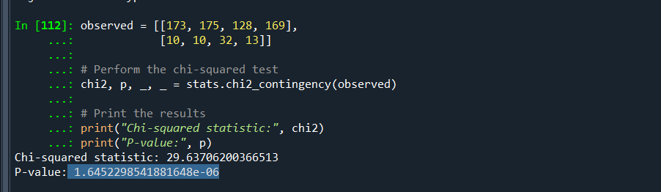
Null Hypothesis (H0): There is no significant difference in the defective percentage among the four centers.
Alternative Hypothesis (Ha): There is a significant difference in the defective percentage among the four centres.

Slide 18
The p-value, which is approximately 1.6452e-06 (or 0.0000016452). This is an extremely small p-value, much less than the common significance level of 0.05 (5%). Therefore, we would typically reject the null hypothesis at the 5% significance level.

