Slide 1
Production Debugging 101
A JJTV Tools Night presentation
Tomer Gabel, newBrandAnalytics

Slide 2
Knowledge is Power
Know your stack
Thread model
GC
Know your tools
jstack
jstat
jvisualvm
Save your livelihood, sanity and your little dog too

Slide 3
DEADLOCK
Scenario 1

Slide 4
Busy Wait
Scenario 2

Slide 5
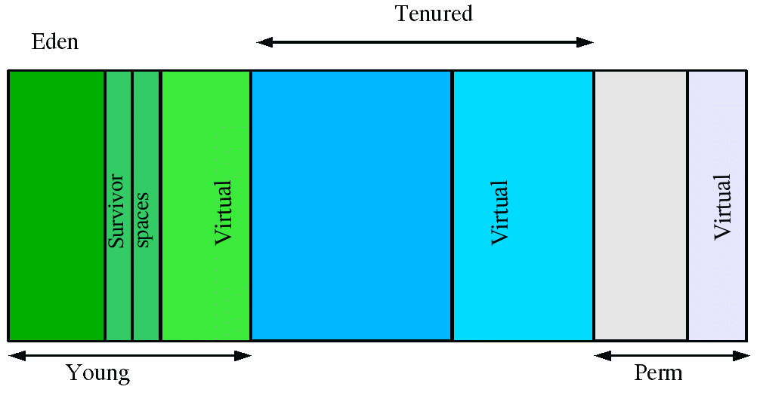
Interlude: JVM heap

Slide 6
GC storm
Scenario 3

Slide 7
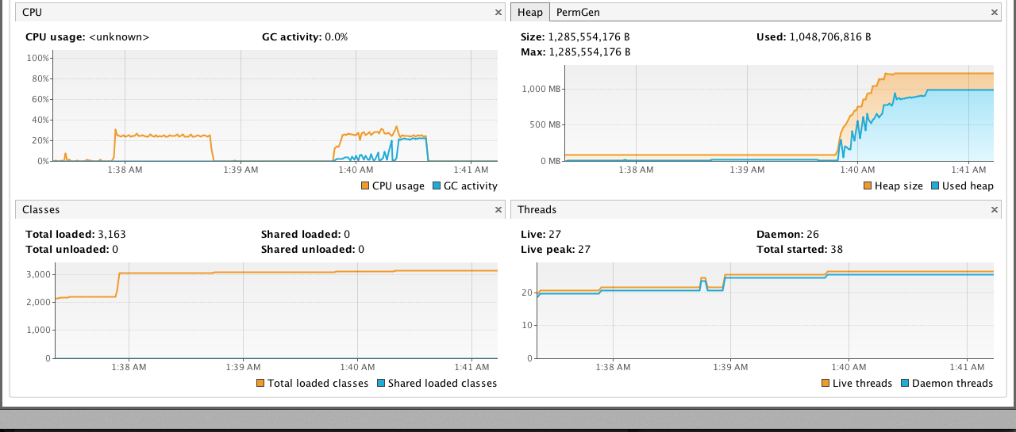
JVISUALVM
And now, with GUI

Slide 8
Meet MAT (sic.)
If there’s time…

Slide 9
Hurrah
Thank you for your time!
Presentation and code samples:
http://bit.ly/PUFHws
Comments, questions etc.:
tomer@tomergabel.com
http://www.tomergabel.com

