Slide 1
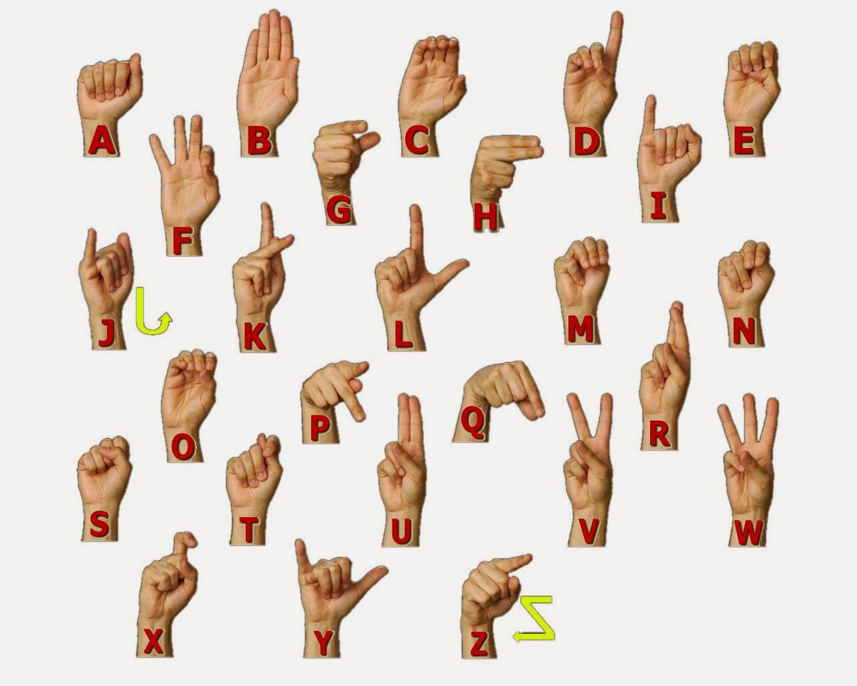
AUTOMATED SIGN TO SPEECH CONVERSION

Slide 2
GROUP MEMBERS :
Sr. No. | GR No. | NAME | ROLL No.
1 | 11811285 | ARYAN GUPTA | 06
2 | 11810037 | DIVSEHAJ SINGH ANAND | 16
3 | 11810002 | SHREYAS KHARE | 28
4 | 11810528 | DHEERAJ SHARMA | 56
5 | 11810740 | PRACHI TAPADIYA | 64

Slide 3
ABSTRACT
There is an undeniable communication problem between the Deaf community and the hearing majority.
Innovations in automatic sign language recognition try to tear down this communication barrier.
Our contribution considers a recognition system using the Microsoft Kinect,convolutional neural networks (CNNs).
Instead of constructing complex handcrafted features, CNNs are able to auto-mate the process of feature construction. With the help of this technique we would recognize some English Alphabets with a high accuracy.

Slide 4
PROBLEM STATEMENT
The aim behind this work is to develop a system for recognizing the sign language, which provides communication between people with speech impairment and normal people, thereby reducing the communication gap between them.

Slide 5
WORK FLOW
We have started our journey by collecting the datasets of the required alphabets. These all datasets are collected by us. Initially they are converted into the textual format and from there it is converted to speech.
We have used the concept of Convolution Neural Network in which we are at first training our model with some pre-acquired datasets upto 100 epocs.
Followed by the testing of the model using some of the testing datasets. The testing datasets are being provided in the real time using webcam
The gestures are at first identified and it is then compared with the trained datasets to identify the text and using the conversion mechanism it is being converted to the speech.

Slide 6

CONVOLUTIONAL NEURAL NETWORK
A CNN is a Deep Learning algorithm which can take in an input image, assign importance to various aspects/objects in the image and be able to differentiate one from the other.

Slide 7
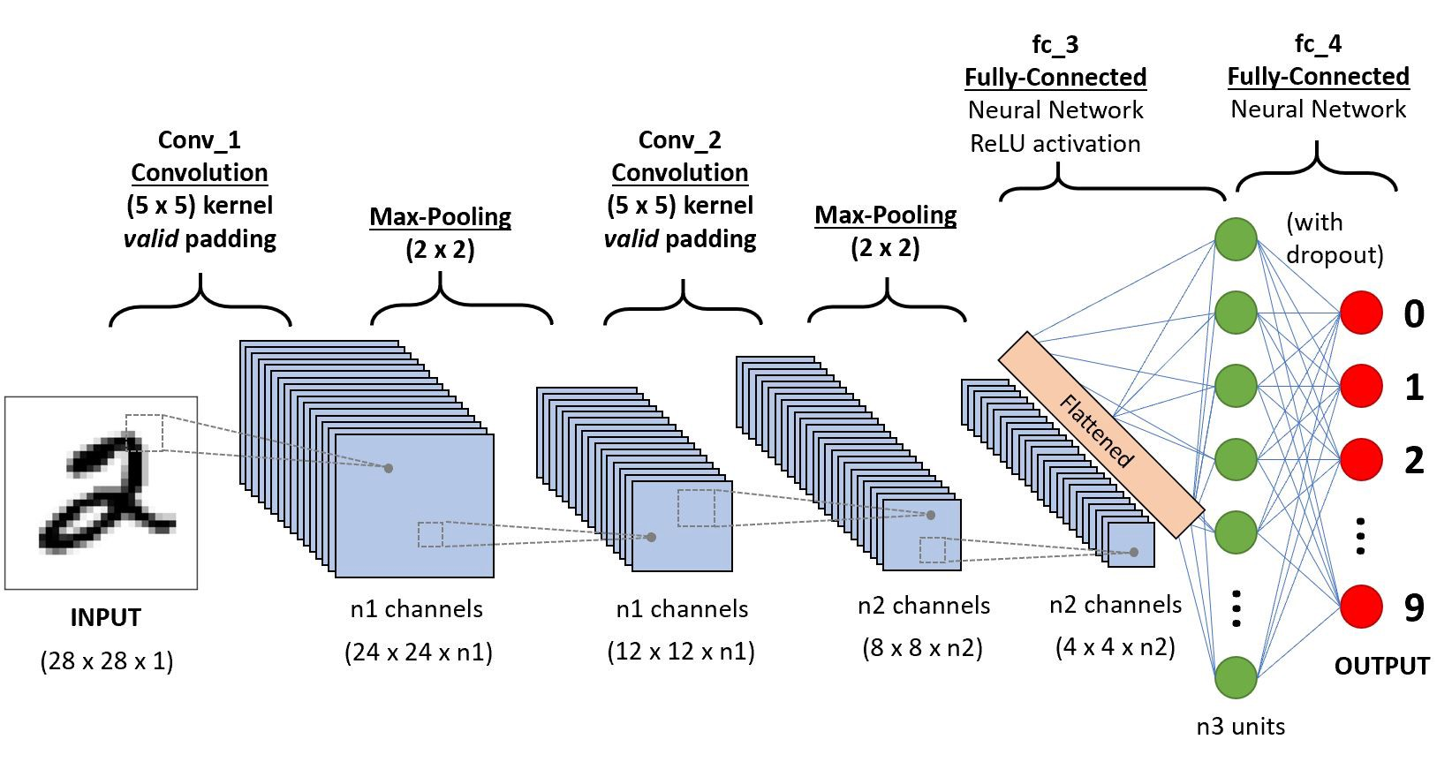
Execution

Slide 8
CONVOLUTIONAL NEURAL NETWORK
It has the following main components which includes
Convolution Layer
Relu Layer
Pooling
Fully Connected Layer

Slide 9
CONVOLUTION LAYER
The objective of the Convolution Operation is to extract the high-level features such as edges, from the input image.
Convolutional layers convolve the input and pass its result to the next layer. This is similar to the response of a neuron in the visual cortex to a specific stimulus. Each convolutional neuron processes data only for its receptive field.
This is the convolution layer based concept in which a whole matrix is being converted into a small matrix.

Slide 10
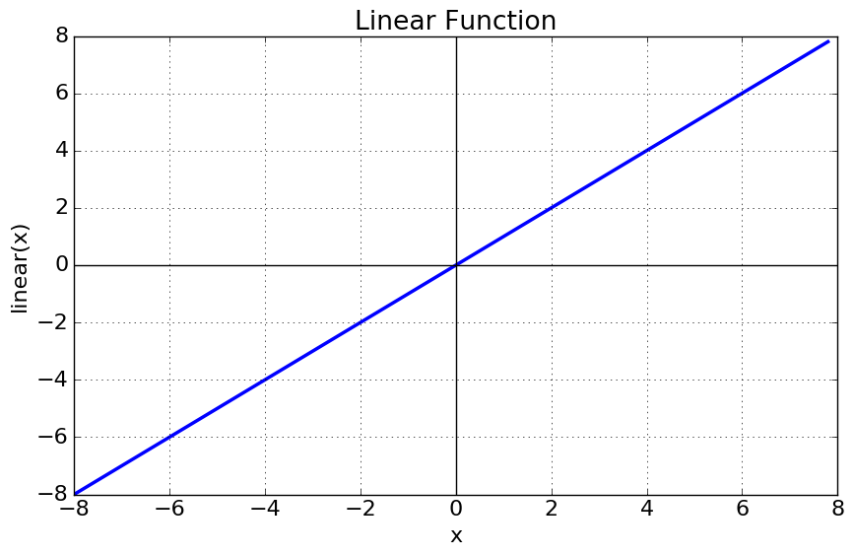
RELU LAYER
It is used to determine the output of neural network like yes or no. It maps the resulting values in between 0 to 1 or -1 to 1 etc.
It is among one of the activation functions that a CNN system possess.

Slide 11
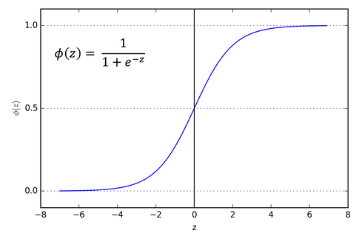
SIGMOID FUNCTION
The main reason why we use sigmoid function is because it exists between (0 to 1). Therefore, it is especially used for models where we have to predict the probability as an output. Since probability of anything exists only between the range of 0 and 1 sigmoid is the right choice.

Slide 12
POOLING
Its function is to progressively reduce the spatial size of the representation to reduce the amount of parameters and computation in the network.
This is an example of the conversion of the representation

Slide 13
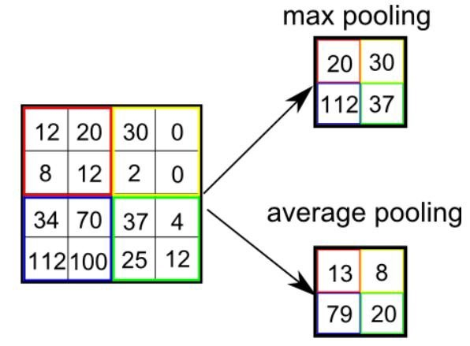
MAX POOLING AVG POOLING
Max Pooling returns the maximum value from the portion of the image covered by the Kernel.
Average Pooling returns the average of all the values from the portion of the image covered by the Kernel.

Slide 14
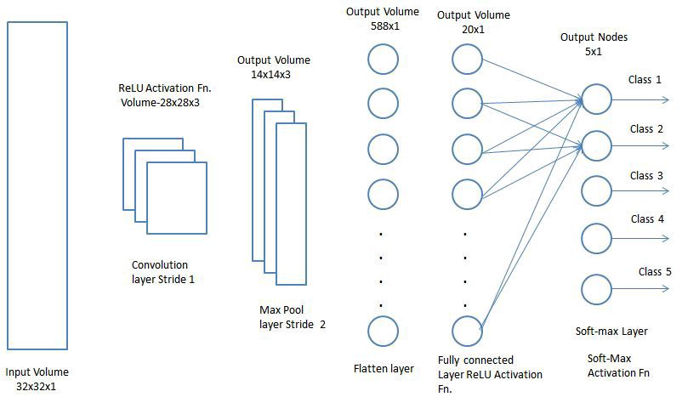
FULLY CONNECTED LAYER
Now that we have converted our input image into a suitable form for our Multi-Level Perceptron, we shall flatten the image into a column vector. The flattened output is fed to a feed-forward neural network and backpropagation applied to every iteration of training

Slide 15
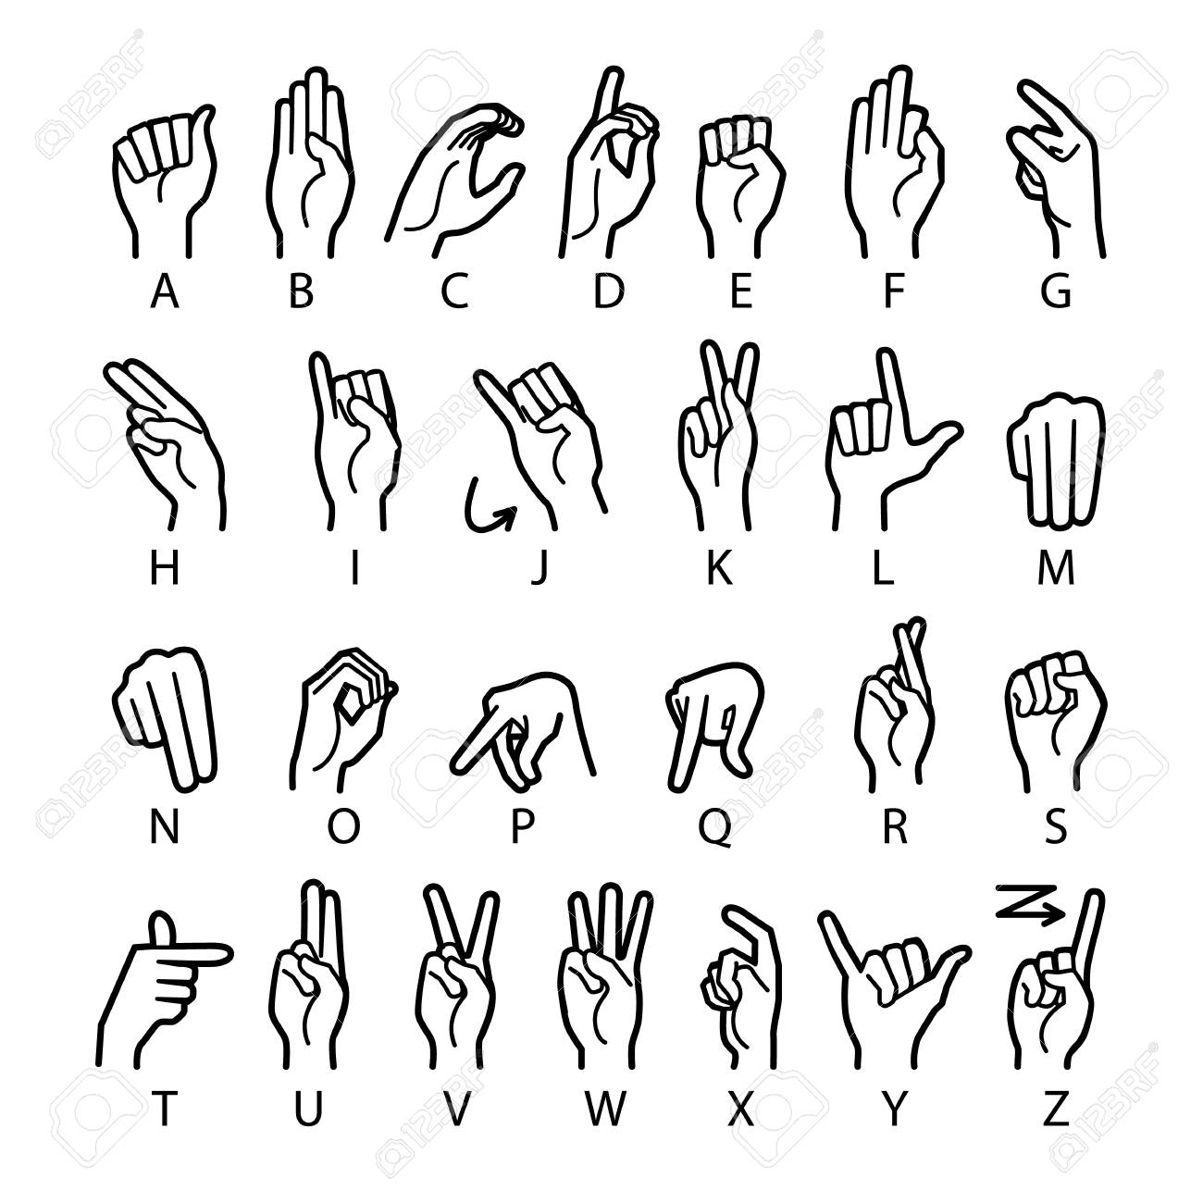
DATASETS
The DATASETS what we are using here is the input sign language that the system will predict and convert it to the required speech language.
##NEXT SLIDE DTA SET GENERATION

Slide 16
THE TRAINING PHASE
Here we are proceeding by training the model in which we have taken a total of 400 dataset images out of which we have passed 60 images to the testing part which is 15% and the rest 340 are sent to the training part which is approximately equal to 85%.
In the training part we have actual training and the validation split training.
In Actual training we have 300 images datasets and in the validation split training part we are having 34 images.
After the model was trained the net parameters were saved so that it can be used in the testing phase for testing the accuracy of the model and also for classification of the input symbols

Slide 17
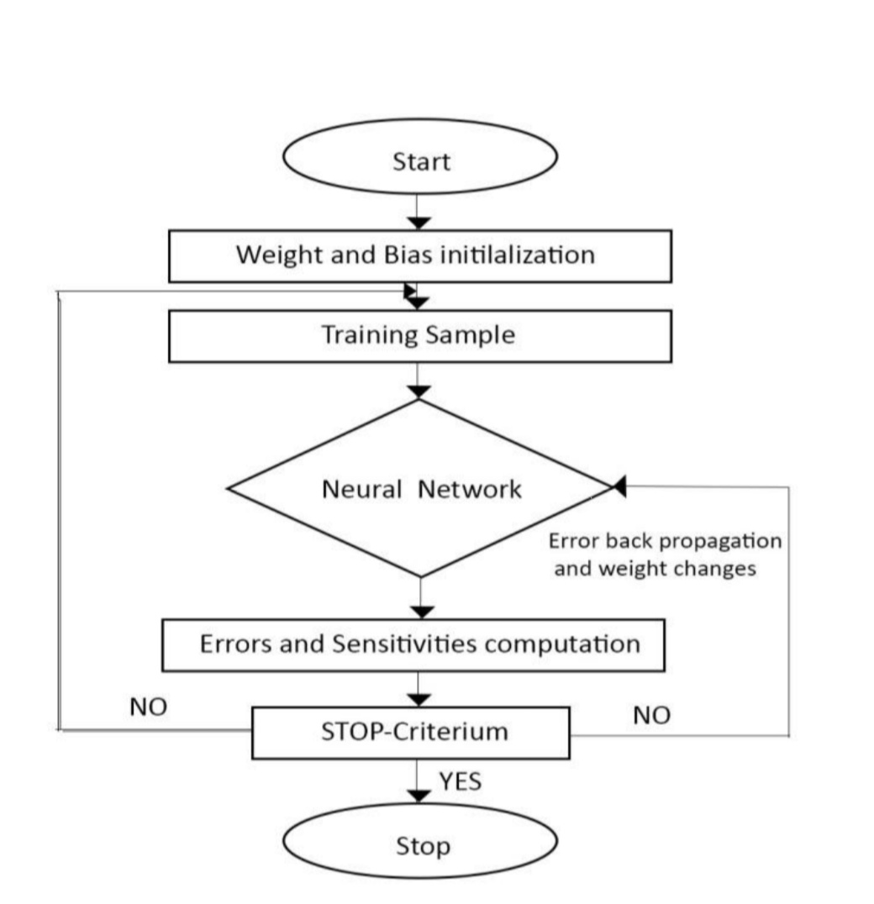
THE TRAINING PHASE WORKFLOW
Here we started our system by weight and bias initialization
Followed by the Training of the sample and passing the same to the Neural Network chamber.
Then the errors and sensitivities are computed and the system goes on until the final prediction occurs

Slide 18
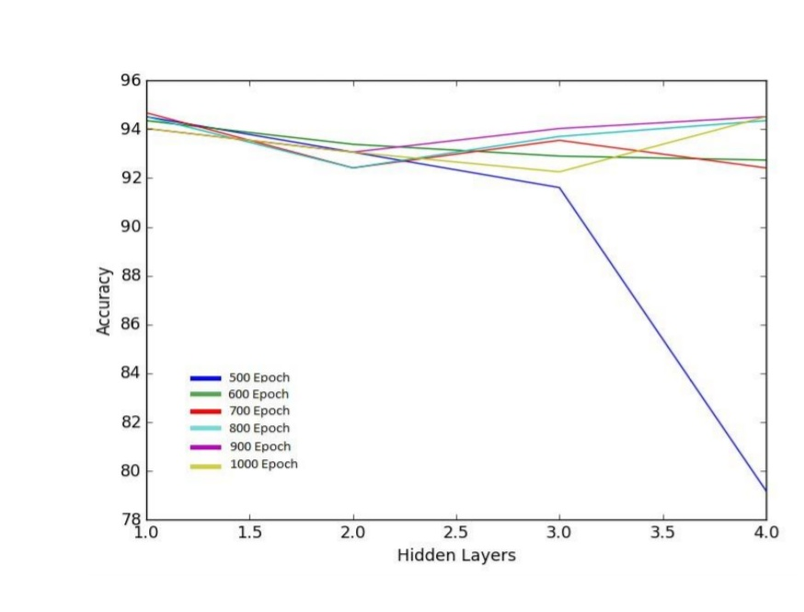
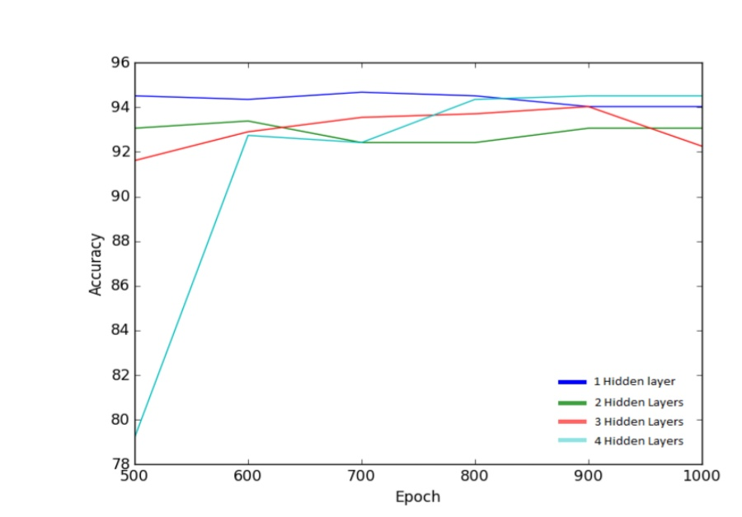
ACCURACY vs EPOCH GRAPHS
The sample ACCURACY vs EPOCH graphs.

Slide 19
TESTIN ACC Graphs
TRAIN ACC

Slide 20
The Testing Phase
The saved network parameter is loaded to test the dataset and determined the accuracy.
A simple java GUI application is created to test out classifier for the purpose of static sign language translation. The application allows the user to select the images of the sign language static gestures that need to be classified
The application used our trained CNN network to classify these symbols and produce their corresponding labels.
The labels are then turned to their corresponding alphabets/numbers and they are grouped to form words or sentences.
The words/sentences are then spoken out using the python pyttsx text to speech module

Slide 21
The Testing Phase outputs
GUI Interface of Application

Slide 22
CONCLUSION
Communications between deaf-mute and a normal person have always been a challenging task. The goal of this project is to reduce the barrier of communication by contributing to the field of automatic sign language recognition
Through this work, a CNN classifier is constructed which is capable of recognizing static sign language gestures. A basic GUI application is created to test our classifier in this system.
The application allows users to select the static sign gestures as input and it will speak out the words or sentences corresponding to the gesture.

Slide 23
FUTURE SCOPE
In this project we have converted some alphabets and real time gestures into speech. Further by concatenating those alphabets we can convert phrases and sentences into speech.
By using high end processor we can have more number of data sets to increase the training and testing accuracy of the model.

Slide 24
THANK YOU

