Slide 1
Special Course in Software Engineering ‘24
MINI-PROJECT PRESENTATION
GROUP NO. 2

Slide 2
Group Introduction

Slide 3
Group members and their contribution
Member Name | Contribution to the Mini-project
Zengyun Zou | Integration work
Mingyu Ding | Analysis and ppt
Hejia Xu | Analysis
Kerui Cheng | Analysis

Slide 4
Dataset

Slide 5
Dataset introduction
Dataset name: ObesityDataSet.csv
Brief description: The dataset is focused on predicting obesity levels based on various health and lifestyle factors such as age, physical activity, calorie consumption, and daily habits. It includes both numerical and categorical variables relevant to personal health and behavior.
Variable | Type of data | Mean / Median / Mode | Kurtosis | Skewness | Normality

Slide 6
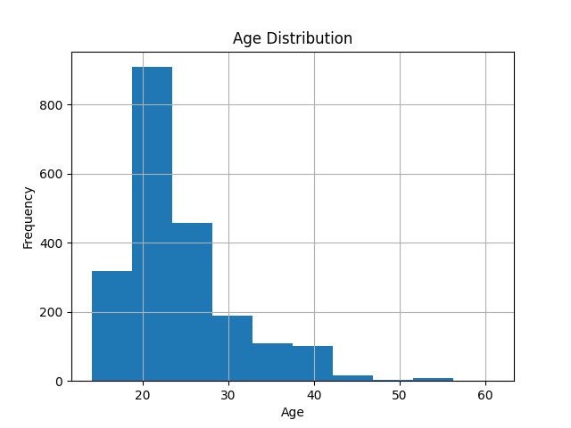
(Age#1) distribution

Slide 7
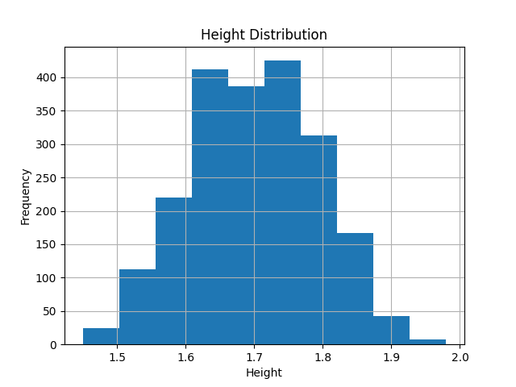
(Height#2) distribution

Slide 8
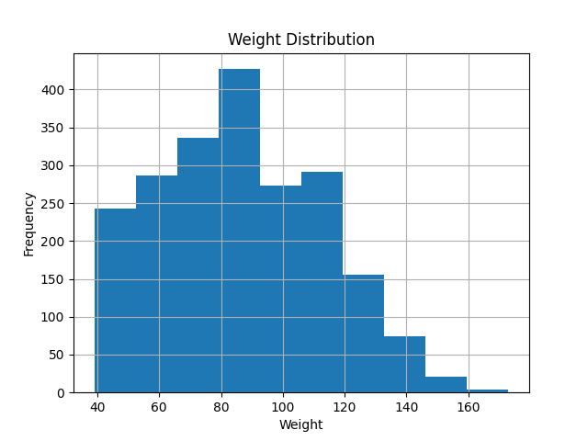
(Weight#3) distribution

Slide 9
Analysis

Slide 10
Hypothesis #1
H₀ : There is no significant difference in obesity rate between Weight and NObeyesdad.
H₁ : There was a significant difference in obesity rates between Weight and NObeyesdad.

Slide 11
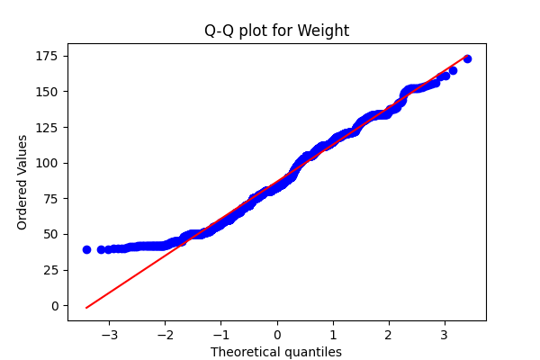
Testing Hypothesis #1

Slide 12
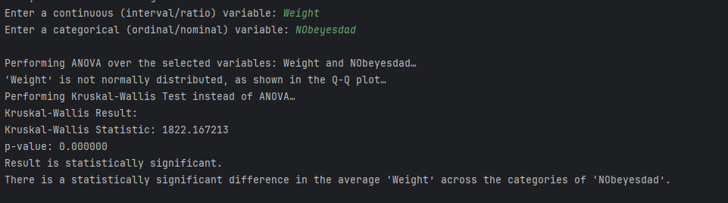
Testing Hypothesis #1

Slide 13
Testing Hypothesis #1
According to the results:Since the P-value is 0.000000 (much less than 0.05), we reject the null hypothesis.This suggests that there is indeed a significant difference in the mean value of 'Weight' between different 'NObeyesdad' categories.

Slide 14
Hypothesis #2
H0: There was no significant relationship between age and overweight (NObeyesdad).
H1: There is a significant relationship between age and overweight (NObeyesdad).

Slide 15
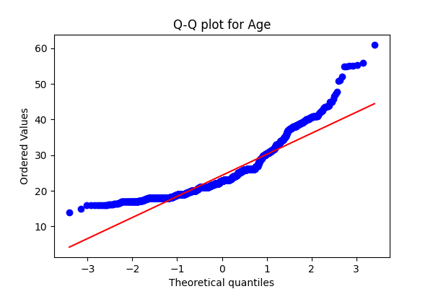
Testing Hypothesis #2

Slide 16
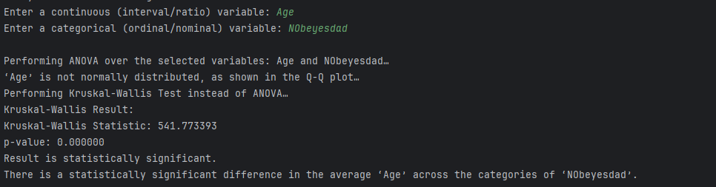
Testing Hypothesis #2

Slide 17
Testing Hypothesis #2
According to the Age of the result, there were significant differences among the different overweight categories (NObeyesdad). The statistic of Kruskal-Wallis test was 541.77, and the p value was 0.000000, indicating that the result was statistically significant (p < 0.05). There are significant differences in mean Age between the different overweight categories (NObeyesdad)

Slide 18
Hypothesis #3
H0: There is no significant positive relationship between NCP and MTRANS.
H1: There is a significant positive correlation between NCP and MTRANS.

Slide 19
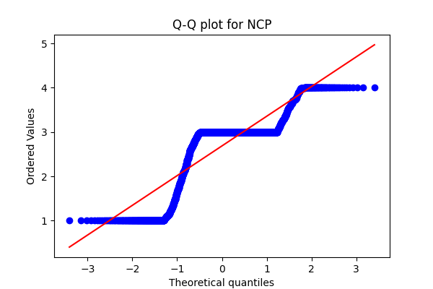
Testing Hypothesis #3

Slide 20
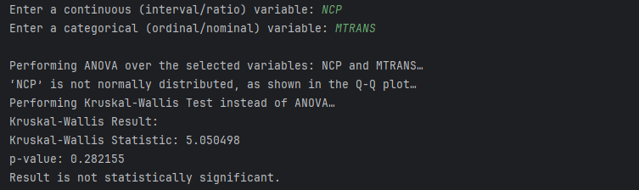
Testing Hypothesis #3

Slide 21
Testing Hypothesis #3
According to the results, there was a clear relationship between NCP and MTRANS five

Slide 22
Regression#1
Linear regression model is used to explore the relationship between "Age" and "Height"

Slide 23
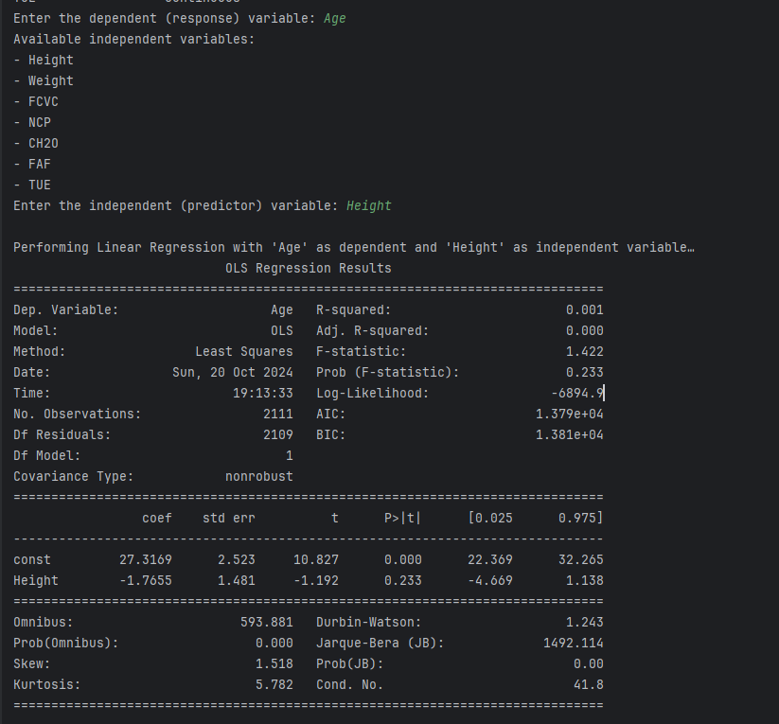
Result-Regression#1
R-squared: 0.001This value represents the ratio of the variation in the dependent variable explained by the model. In this case, R² is 0.001, meaning that height has very limited explanatory power for age, with almost no correlation.Adj.
R-squared: 0.000This adjusted R² value is also low, further confirming the model's inadequacy in interpreting the data.
F-statistic: 1.422The F statistic is used to test the overall significance of the regression model. Lower F-values and corresponding p-values indicate that the model may not be significant.
Prob (F-statistic): 0.233A p value greater than 0.05 means that height has no significant effect on age, so we cannot reject the null hypothesis (that is, height has no significant effect on age).
The results showed no significant linear relationship between height and age.

Slide 24
Regression#2
Linear regression model is used to explore the relationship between "Age" and “Weight"

Slide 25
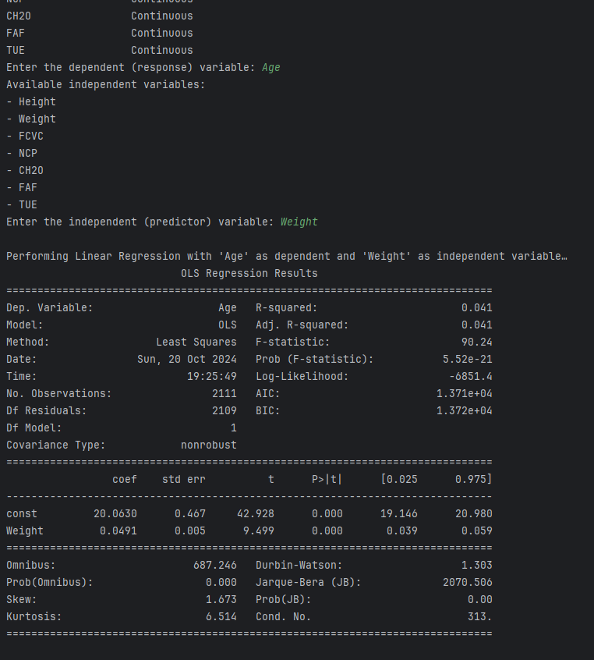
Result-Regression#2
R-squared: 0.041An R² value of 0.041 means that the model explains only 4.1% of the age variation. This suggests that weight has a limited ability to explain age.Adj.
R-squared: 0.041The adjusted value of R² is the same as that of R², indicating that the model still does not significantly improve its explanatory power after adjustment.
F-statistic: 90.24The F statistic is used to test the overall significance of the regression model. This value is relatively high, indicating that the model is significant in some way.
Prob (F-statistic): 5.52e-21This P-value is much less than 0.05, indicating that the model as a whole is statistically significant, and we can reject the null hypothesis (that is, weight has no significant effect on age).
The results showed that there was a significant positive relationship between body weight and age

Slide 26
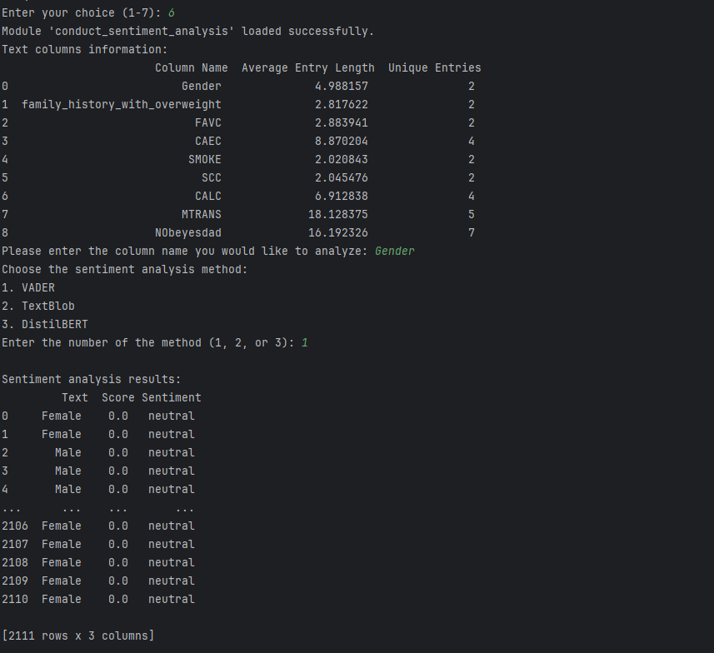
Sentiment Analysis-Gender

Slide 27
End

