Slide 1
SUNWAY UNIVERSITY · SCHOOL OF MATHEMATICAL SCIENCES & COMPUTING
Autonomous Wildfire Risk
Assessment & UAV Surveillance
Mamdani fuzzy inference driving a four-probe UAV inside an NVIDIA Isaac Sim digital twin
CSC3034 Computational Intelligence Supervisor: Dr. Tang Tiong Yew
NAME
STUDENT ID
ROLE
Yeoh Choon Hern
23100795
Project lead — coordination and integration
Pang Wei Sheng
24035115
Fuzzy inference engine & simulation evaluation
Roshan A/L Sivakumar
23028285
Technical report — defuzzification analysis
Dinesswar A/L Sathasivam
23096910
Isaac Sim OpenUSD stage — sensor bridge
Notes:
OPEN (30 s). Yeoh Choon Hern leads the project and handles coordination and integration. I am Pang Wei Sheng and I own the fuzzy inference engine and the simulation evaluation.
- One line on the problem: forest and peat fires are caught late because patrols rely on single-threshold thermostats.
- One line on the build: a four-input Mamdani controller flying a UAV inside an Isaac Sim digital twin, closed loop.
- Read the roadmap: problem, pipeline, fuzzy engine, rule base, twin, flight results, defuzzification study, feasibility, conclusion.
TRANSITION: let me show why the standard approach fails.

Slide 2
BACKGROUND
Why a threshold is the wrong tool
THE PROBLEM
THE APPROACH
A single threshold cannot see interaction.
Continuous membership.
A 40 °C cut-off cannot separate 38 °C at 15 % humidity and 70 km/h wind from 42 °C in saturated still air. The first case is the dangerous one.
Four overlapping sets per variable replace the cliff edge, so the output moves smoothly with the input.
Spread is non-linear.
Four-probe fusion.
Dry wind at moderate temperature ignites faster than a hot, humid afternoon, so a temperature-only trigger fires late.
Temperature, relative humidity, wind speed and fuel dryness combine into one fire risk index.
The telemetry is noisy.
The output flies the aircraft.
Rotor vibration and turbulence corrupt raw readings, so a hard edge flickers between alarm states.
Throttle scales from 20 % patrol to 90 % emergency, so the UAV closes its own loop above a hotspot.
CSC3034 · Computational Intelligence · Autonomous UAV wildfire surveillance
02
Notes:
PROBLEM (60 s). The argument is that one threshold is blind to interaction.
- Concrete example from the engine itself: 38 C at 85 % humidity scores FRI 14.0, NORMAL; 26 C at 15 % humidity with 65 km/h wind scores FRI 71.4, WARNING. A T>40 rule ranks them the other way round.
- Control consequence: a false alarm burns crew hours and erodes trust in the alert.
- Land the right column: continuous membership instead of a cliff, four probes fused, and the output is a throttle command, so the aircraft closes its own loop.
Q: why fuzzy and not a neural net? A: ten auditable rules, no training set, and every decision traces to a rule the fire authority can read.

Slide 3
SYSTEM PIPELINE
Sensing to actuation in five stages
01
02
03
04
05
Synthetic sensing
Fuzzification
Fuzzy inference
Defuzzification
Actuation and alert
Four probes on the OpenUSD stage, keyed at the 30 fps frame rate.
16 input sets, four per variable, triangular and trapezoidal.
10 expert rules; min for AND, max for aggregation.
Centroid of area; continuous output, 0.07 ms median per loop.
Throttle 20-90 %; alert 0-3 as a third fuzzy output.
30 fps
0.07 ms
0.1 %
stage playback rate
median per loop, p99 0.23 ms
of the 50 ms control budget
CSC3034 · Computational Intelligence · Autonomous UAV wildfire surveillance
03
Notes:
PIPELINE (60 s). Walk left to right and name the data rate.
- 01: four probes keyed at the 30 fps stage frame rate.
- 02: sixteen input sets, four per variable.
- 03: ten rules, min for AND, max for aggregation.
- 04: centroid defuzzification; 0.07 ms median per loop, p99 0.23 ms, measured.
- 05: throttle 20 % to 90 %, alert WATCH / WARNING / CRITICAL.
Say the number that matters: the whole chain is 0.1 % of a 50 ms control budget.

Slide 4
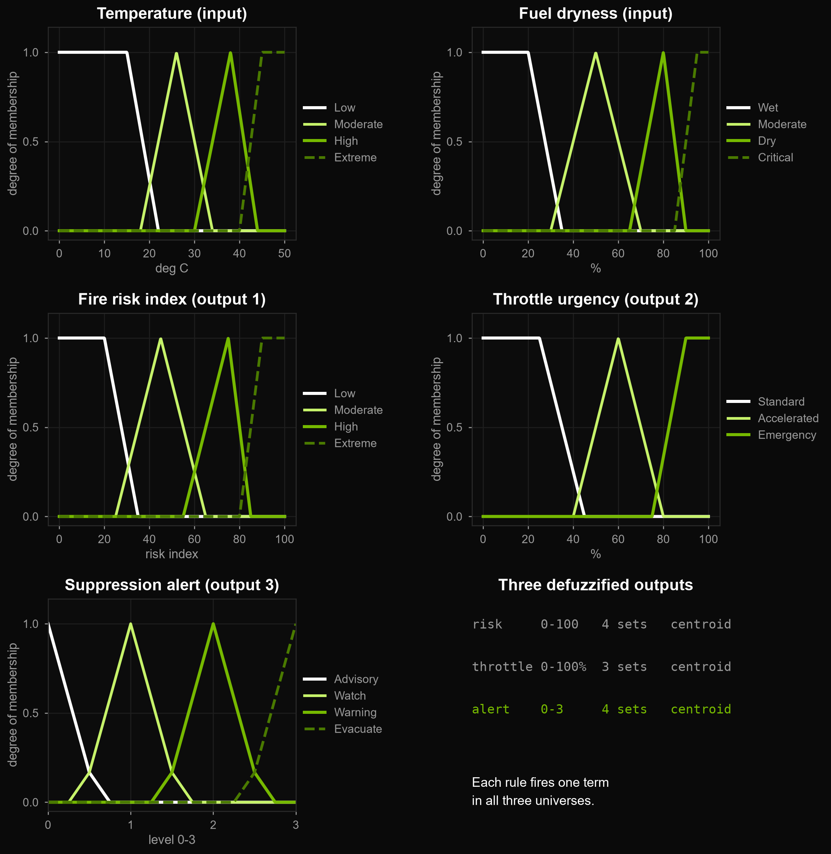
FUZZY ENGINE
Linguistic variables and membership functions
INPUTS
Temperature (T)
0 - 50 °C low · moderate · high · extreme
Relative humidity (RH)
0 - 100 % very low · low · moderate · high
Wind speed (WS)
0 - 100 km/h calm · moderate · high · severe
Fuel dryness (FD)
0 - 100 % wet · moderate · dry · critical
OUTPUTS
Fire risk index (FRI)
0 - 100 low · moderate · high · extreme
Throttle urgency
0 - 100 % standard · accelerated · emergency
Suppression alert
0 - 3 advisory · watch · warning · evacuate
Trapezoids close the outermost sets, so readings past the sensor range saturate instead of running off the universe. Each rule fires one term in all three universes.
Temperature and fuel dryness shown; humidity and wind use the same four-set template. Output 3 adds the alert consequent.
CSC3034 · Computational Intelligence · Autonomous UAV wildfire surveillance
04
Notes:
FUZZY ENGINE (75 s). Point at the figure, do not read the text.
- Universes: temperature 0-50 C, humidity and wind 0-100, fuel dryness 0-100 %.
- Why trapezoids at the ends: they saturate, so the controller stays well behaved past the sensor range.
- Overlap is deliberate: adjacent sets cross near 0.5, so output is continuous, never a step.
- The emergency set centres at 90 %, which is where the 90 % throttle figure comes from.
Q: how were the breakpoints chosen? A: domain literature plus iteration against the twin; ANFIS in the conclusion is the principled way to tune them.

Slide 5
KNOWLEDGE BASE
Ten curated rules out of 256 combinations
RULE
ANTECEDENT
FIRE RISK
THROTTLE
ALERT (0-3)
R09 · R07
Temperature extreme AND (fuel critical OR humidity very low)
92
90 %
2.87
R04
Temperature moderate AND wind high AND fuel dry
71
60 %
2.00
R03
Temperature moderate AND fuel moderate
45
20 %
1.00
R01 · R10
Humidity high AND (fuel wet OR wind calm)
20
20 %
1.00
4 inputs × 4 sets = 256 antecedent combinations, curated down to the 10 that are physically meaningful.
Mamdani: min for AND, max for aggregation, centroid for defuzzification.
Cost: 0.07 ms per loop on the build machine; each rule fires all three consequents.
CSC3034 · Computational Intelligence · Autonomous UAV wildfire surveillance
05
Notes:
RULE BASE (75 s). Do not read all four rows - trace one rule end to end.
- 4 inputs x 4 sets is 256 antecedent combinations; the controller carries 10 curated rules because most combinations are physically meaningless.
- Take R09: extreme temperature AND critical fuel dryness. Fed the critical scenario (46 C, 12 %, 85 km/h, 95 %) it drives FRI 92.3 and 90.8 % throttle, so the pair of high memberships is what lifts both outputs.
- R03 is the counter-example: moderate temperature with moderate fuel tops out at FRI 55.6 on the dry-spring-heat scenario, well short of the critical band.
- Aggregation is max, so the strongest rule dominates without a hand-written priority order.
Q: what if two rules conflict? A: max aggregation resolves it and the centroid weights the overlap - which is why COG beat MOM.

Slide 6
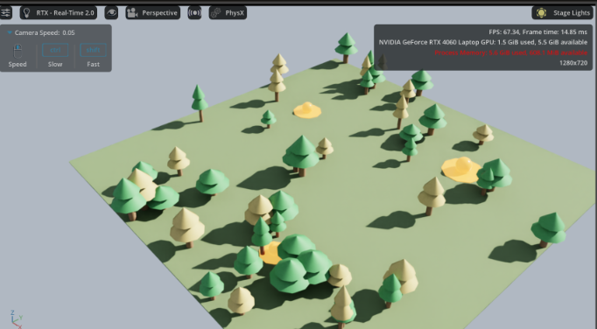
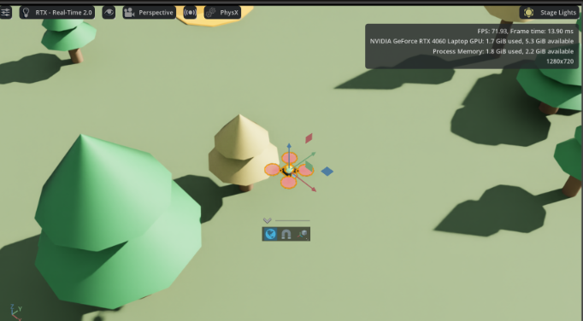
3D DIGITAL TWIN
NVIDIA Isaac Sim 6.2.0 — procedural forest stage
65 m procedural forest: 48 pines, hotspot plumes, chase camera
UAV prim over hotspot 01 — probe readings feed the next inference tick
65 × 65 m
3
2
14
OpenUSD stage, procedurally generated
active hotspots, up to 44.5 °C core plumes
cameras: chase view and thermal gimbal
keyframes over frames 0-620 at 30 fps
CSC3034 · Computational Intelligence · Autonomous UAV wildfire surveillance
06
Notes:
DIGITAL TWIN (60 s). This slide proves the loop is closed in a 3D scene, not on a spreadsheet.
- 65 m x 65 m OpenUSD stage, 47 procedurally placed trees, 3 active hotspots, 14 keyframes over frames 0-620.
- Viewport frame rate was not instrumented, so no FPS figure is quoted; the sensor ingest runs on the stage timeline.
- Two cameras: chase view for context, thermal gimbal for the plume.
Q: does the twin actually affect the controller? A: yes - probe readings are read from the stage each keyframe, so moving over a plume changes the next inference immediately.

Slide 7
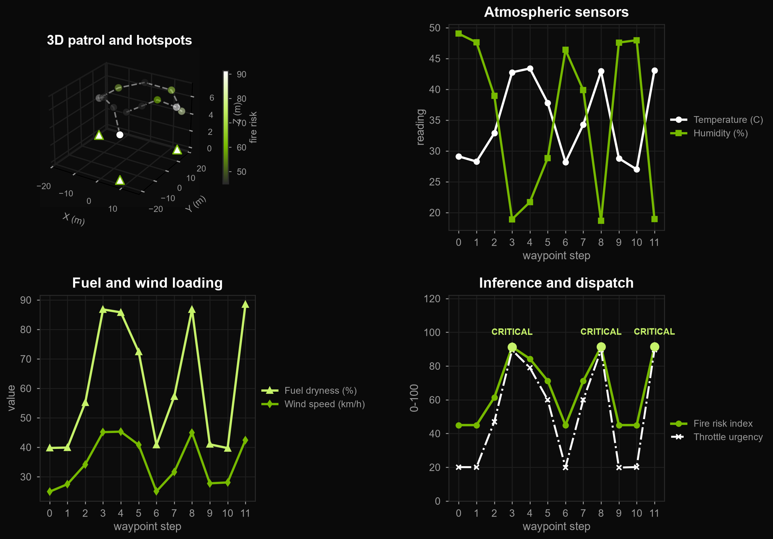
FLIGHT RESULTS
Twelve waypoints, closed loop, no retuning
WHAT THE RUN SHOWS
Baseline, WP 00-01
29.1 °C, RH 49.0 %. FRI 45.0 holds at WATCH, throttle 20.1 %, alert 1.000.
Hotspot entry, WP 03
42.8 °C, RH 18.9 %, fuel 86.8 %. FRI 91.4, throttle 89.5 %, alert 2.826.
Second plume, WP 08
42.9 °C, RH 18.7 %. FRI 91.4, alert 2.829 — same response, no retuning.
Recovery, WP 06
28.2 °C, RH 46.4 %. FRI returns to 45.0, throttle 19.9 %, alert 1.000.
Numbers are the printed output of run_stage_patrol_simulation(seed=0), reproducible from the repository.
CSC3034 · Computational Intelligence · Autonomous UAV wildfire surveillance
07
Notes:
FLIGHT RESULTS (90 s). This is the evidence slide - slow down.
- Baseline WP 00: 29.1 C, RH 49.0 %, fuel 39.8 %, risk 45.0, WATCH, throttle 20.1 %.
- Hotspot entry at WP 03: 42.8 C, RH 18.9 %, fuel 86.8 % - all four probes move together, so it is not a single-sensor artefact. Risk 91.4, throttle 89.5 %.
- WP 08 repeats it at 91.4 with no retuning, and WP 06 returns to 45.0 and 19.9 %, so nothing latches.
- Mention that the 89.5 is a centroid output, not a hardcoded 90.
Q: any overshoot? A: no oscillation - the output sets are continuous, which is the comparison on the next slide.

Slide 8
DESIGN DECISION
Why centroid, when all three are this cheap
Method | Critical FRI | Actuator smoothness | Noise | Flight suitability
Centroid (COG) | 92.2 | continuous | high | selected
Bisector | 92.5 | good | moderate | viable
Mean of max (MOM) | 95.1 | step jumps | low | unsafe
Continuity, not speed.
MOM jumps between peaks.
Centroid integrates the whole aggregated area, so a small input change produces a small output change. On a 250 g airframe that is the difference between smooth thrust and torque steps.
Mean of maxima returns the average of the aggregated set's maxima, so as the input crosses a boundary the output leaps to the next peak: 95.1 against 92.2.
All three are cheap.
Bisector is the compromise.
A full evaluation loop is 0.07 ms, so none of the methods is the bottleneck. They differ only in the 2.9-point gap MOM shows at the critical scenario.
Smooth and within 0.3 points of centroid on every scenario, but no better on the flight logs, so the simpler method wins.
CSC3034 · Computational Intelligence · Autonomous UAV wildfire surveillance
08
Notes:
DEFUZZIFICATION STUDY (75 s). Frame it as a design decision with a measured cost.
- All three methods run inside the same loop budget: the full evaluation loop is 0.07 ms, so defuzzification is not where they differ.
- MOM averages the maxima of the aggregated set, so crossing a boundary jumps the output between peaks - a torque step on a 250 g airframe.
- Centroid weights the whole area, so output is continuous in the input. That property matters more than raw latency.
- 0.07 ms is 0.1 % of a 50 ms loop, so continuity is free: pick the method that does not chatter.
Q: measured or estimated? A: the loop figure is measured on the build machine; there is no Jetson run yet, so quote the edge figure as a projection and say so.

Slide 9
FEASIBILITY
It fits on the aircraft
EDGE STACK
WHY IT MATTERS
Jetson Orin Nano, 8 GB.
SDG 13.1, climate action.
7-15 W envelope, inside a micro-UAV battery budget.
Early thermal detection catches a fire before crown spread, which is where the emission saving is.
0.07 ms inference.
SDG 15.2, life on land.
median per loop; 0.1 % of the 50 ms budget.
Protects forest reserves and the habitat inside them.
Sensors already proven.
Operational value.
FLIR Lepton 3.5 LWIR for the plume, Sensirion SHT40 for temperature and humidity.
Exact coordinates cut containment time, water use and crew exposure.
LoRa backhaul.
Offline by design.
Carries the GPS fix of a confirmed hotspot to the ground crew.
The decision survives link loss, which is exactly when the fire matters most.
CSC3034 · Computational Intelligence · Autonomous UAV wildfire surveillance
09
Notes:
FEASIBILITY (45 s). Keep it short - it answers 'can this fly?'
- Jetson Orin Nano at 7-15 W fits a micro-UAV pack.
- 0.07 ms median measured, p99 0.23 ms; edge figure is a projection.
- Payload pairing: FLIR Lepton 3.5 LWIR plus SHT40 for temperature and humidity; LoRa carries the GPS fix to the crew.
- SDG 13.1 and 15.2, plus the cost argument: exact coordinates cut containment time and water use.
Q: why not the cloud? A: link loss is exactly when a fire matters most, so the decision has to survive offline.

Slide 10
CONCLUSION
Delivered, and what is next
DELIVERED
NEXT
Fuzzy engine.
ANFIS.
Four inputs, ten rules, verified against the report's test vectors.
Replace hand-tuned memberships with functions fitted to satellite burn history.
Digital twin.
65 m procedural forest on the 30 fps stage timeline.
Multi-UAV mesh.
Decentralised coverage for areas a single airframe cannot hold.
Closed-loop actuation.
20 % to 90 % throttle demonstrated over a live hotspot.
Field trials.
PX4 and Matrice 300 under a controlled-burn permit.
Edge speed.
0.07 ms median per loop, p99 0.23 ms; edge figure projected, not measured.
Limitation, stated plainly: every result here is simulation-only, and the rule base is expert-tuned rather than learned.
CSC3034 · Computational Intelligence · Autonomous UAV wildfire surveillance
10
Notes:
CONCLUSION (45 s). Four claims, each already evidenced.
- Engine: four inputs, ten rules, verified against the report's test vectors.
- Twin: 65 m procedural forest, 47 trees, 3 hotspots; viewport frame rate not instrumented, so no FPS claim.
- Actuation: 20 % to 90 % closed loop over a live hotspot.
- Speed: 0.07 ms median per loop measured, p99 0.23 ms; edge figure is a projection.
- Future: ANFIS to replace hand-tuned memberships, multi-UAV mesh, PX4 / Matrice 300 field trials.
Say the limitation before they do: simulation only, rule base expert-tuned.

Slide 11
Thank you
Questions, then the live Isaac Sim run
Pang Wei Sheng · Roshan A/L Sivakumar · Dinesswar A/L Sathasivam · Yeoh Choon Hern
Sunway University · CSC3034 Computational Intelligence · Dr. Tang Tiong Yew
github.com/123haiku/csc3034-fuzzy-wildfire-sim
Slides, figures and simulation output regenerate from the repository.
Notes:
CLOSE (15 s). Thank the panel, point at the repository for reproducibility.
Invite the two questions you are ready for: rule-base justification and validation method.
Have one sentence ready: the whole pipeline regenerates from the repo, and be able to name the command.

