Slide 1
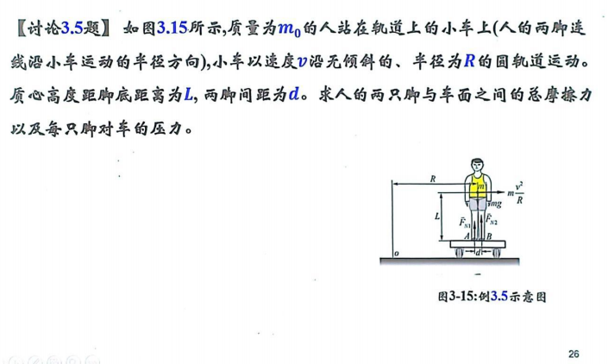
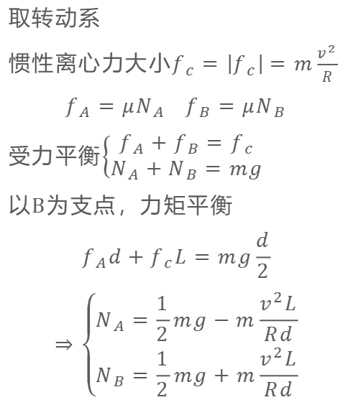
思考题
取转动系
惯性离心力大小$f_{c}=\left|f_{c}\right|=m\frac{v^{2}}{R}$
$$f_{A}=μN_{A} f_{B}=μN_{B}$$
受力平衡$\left\{\begin{aligned}f_{A}+f_{B}=f_{c} \\ N_{A}+N_{B}=mg\end{aligned}\right.$
以B为支点，力矩平衡
$$f_{A}d+f_{c}L=mg\frac{d}{2}$$
$$⇒\left\{\begin{aligned}N_{A}=\frac{1}{2}mg−m\frac{v^{2}L}{Rd} \\ N_{B}=\frac{1}{2}mg+m\frac{v^{2}L}{Rd}\end{aligned}\right.$$

Slide 2
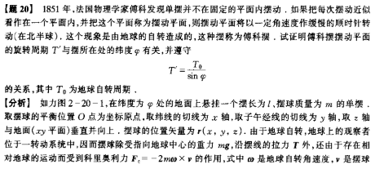
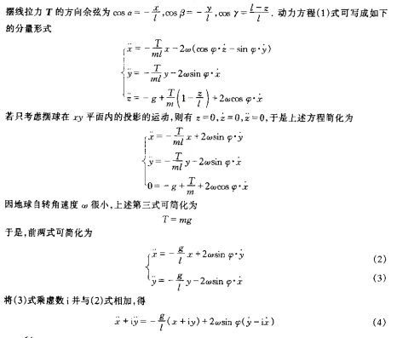
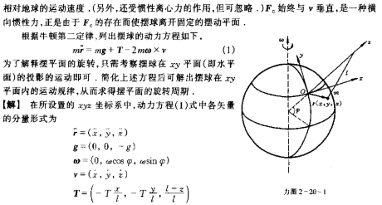
感兴趣的同学可以看一下详细计算

Slide 3
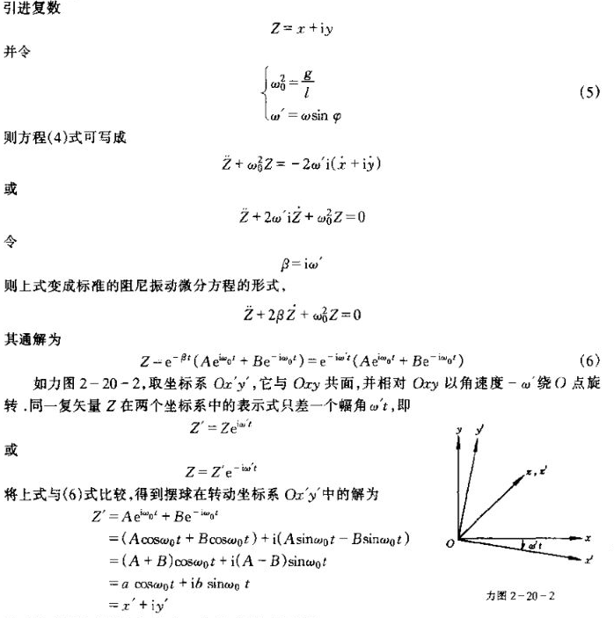
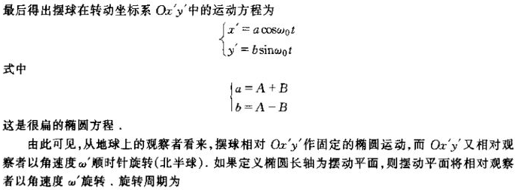
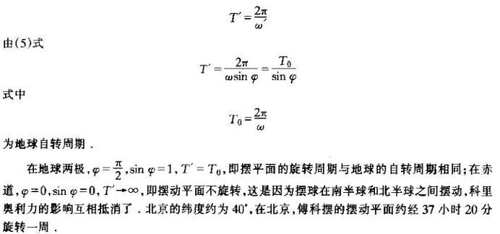

Slide 4
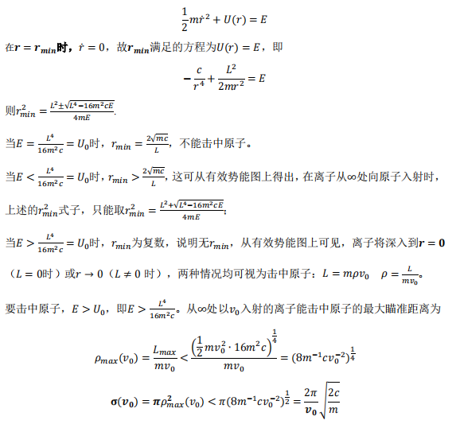
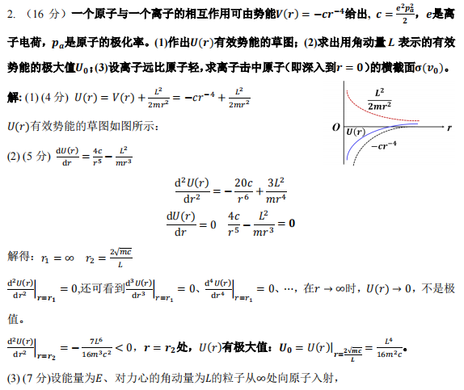

Slide 5
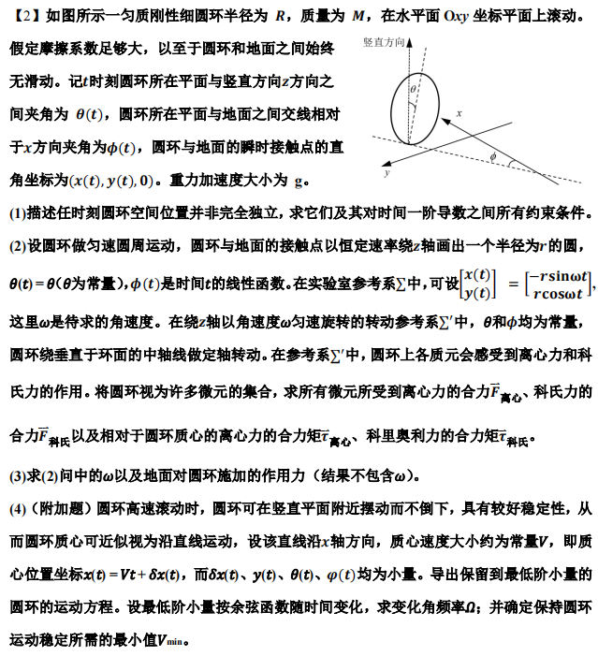
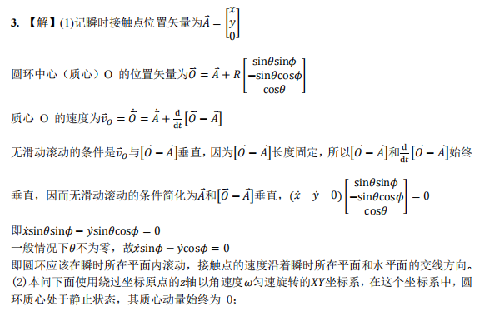
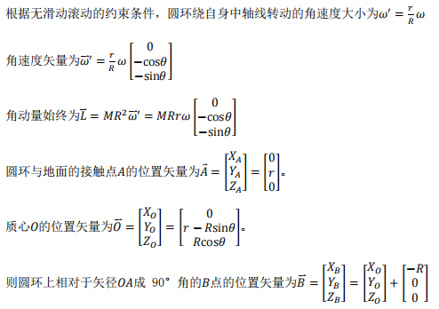

Slide 6
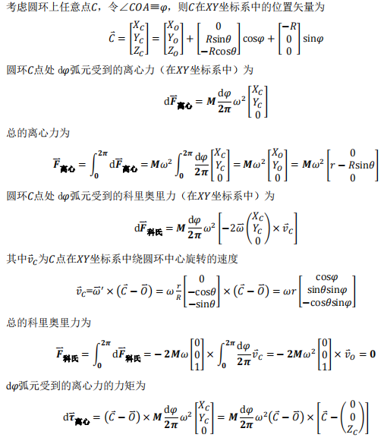
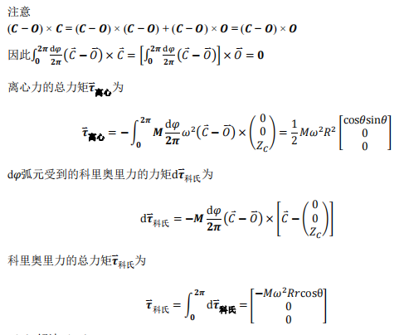

Slide 7
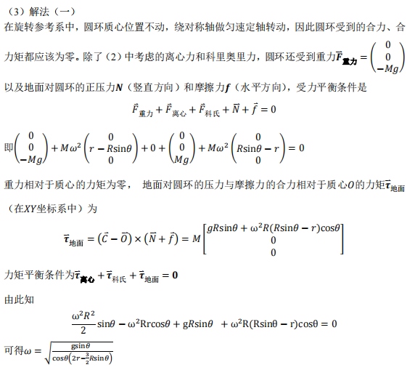


Slide 8
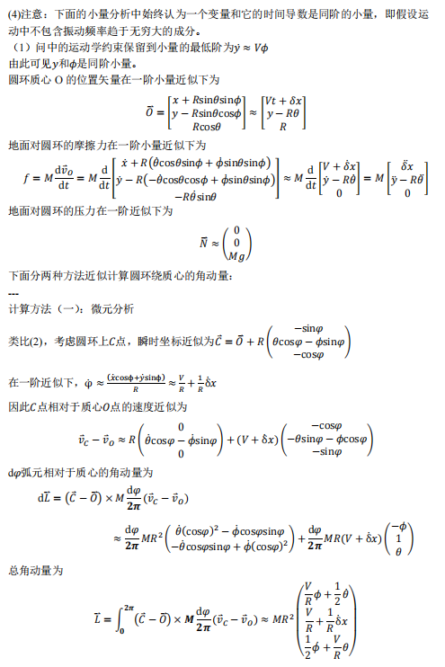
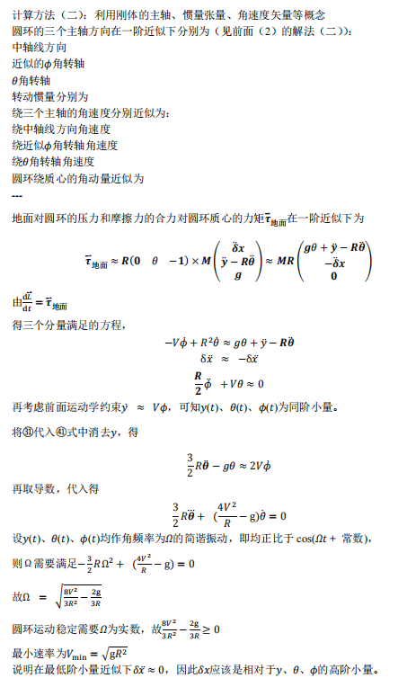

Slide 9
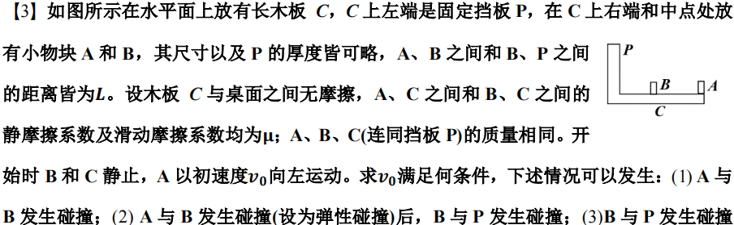
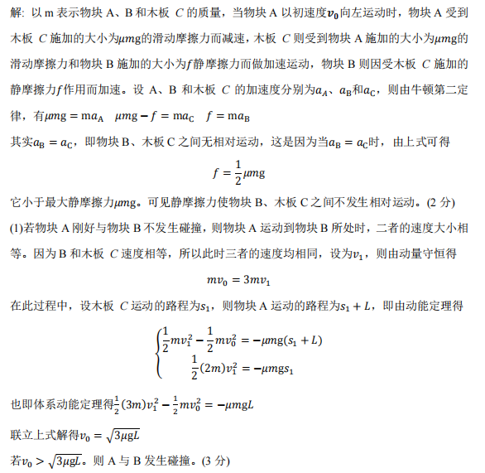

Slide 10
