Slide 1
Smart Parking System
Smart Parking
Navigate directly to the best available slot for the garage visitor
Contact:
Ido Harel - 0542429131
Gmail – idoharel123@gmail.com
“Best slot” is selected based on multiple considerations such as:
walking time from the parking slot to destination (e.g. stairs, elevator)
drive time from garage entrance to parking slot
garage layout
Additional services
Live navigation to the parking slot
Navigation back to car
1 / 9

Slide 2
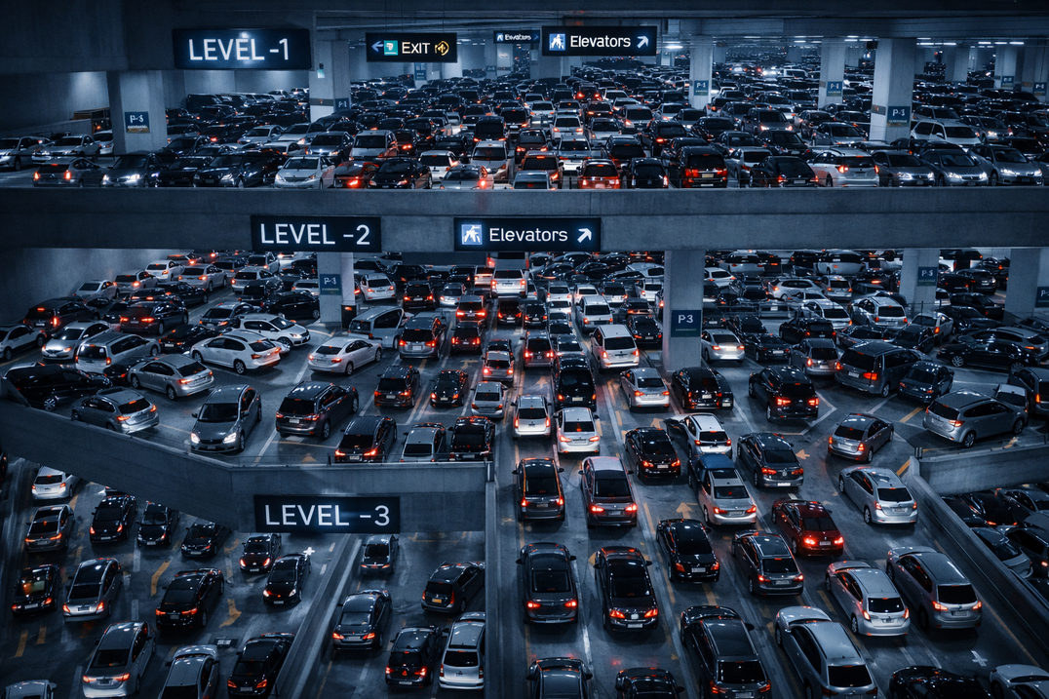
2 / 9
The Problem — Underground Chaos
01
Time Loss while looking for available parking slot
02
Uncertainty and Stress
03
Visitor Frustration
04
Difficulties in finding the car when leaving

Slide 3
3 / 9
Today’s Solutions Fall Short
• Static Signs reporting Floor-Level occupancy
• Sensor Systems with red/green lights per parking slot
Problems
Lack of Visibility of available parking slots (sensors are unseen from distance)
Lack of Guidance to available slots
Not helping for finding the car when leaving
So, Why not provide Waze-like solution for garage?

Slide 4
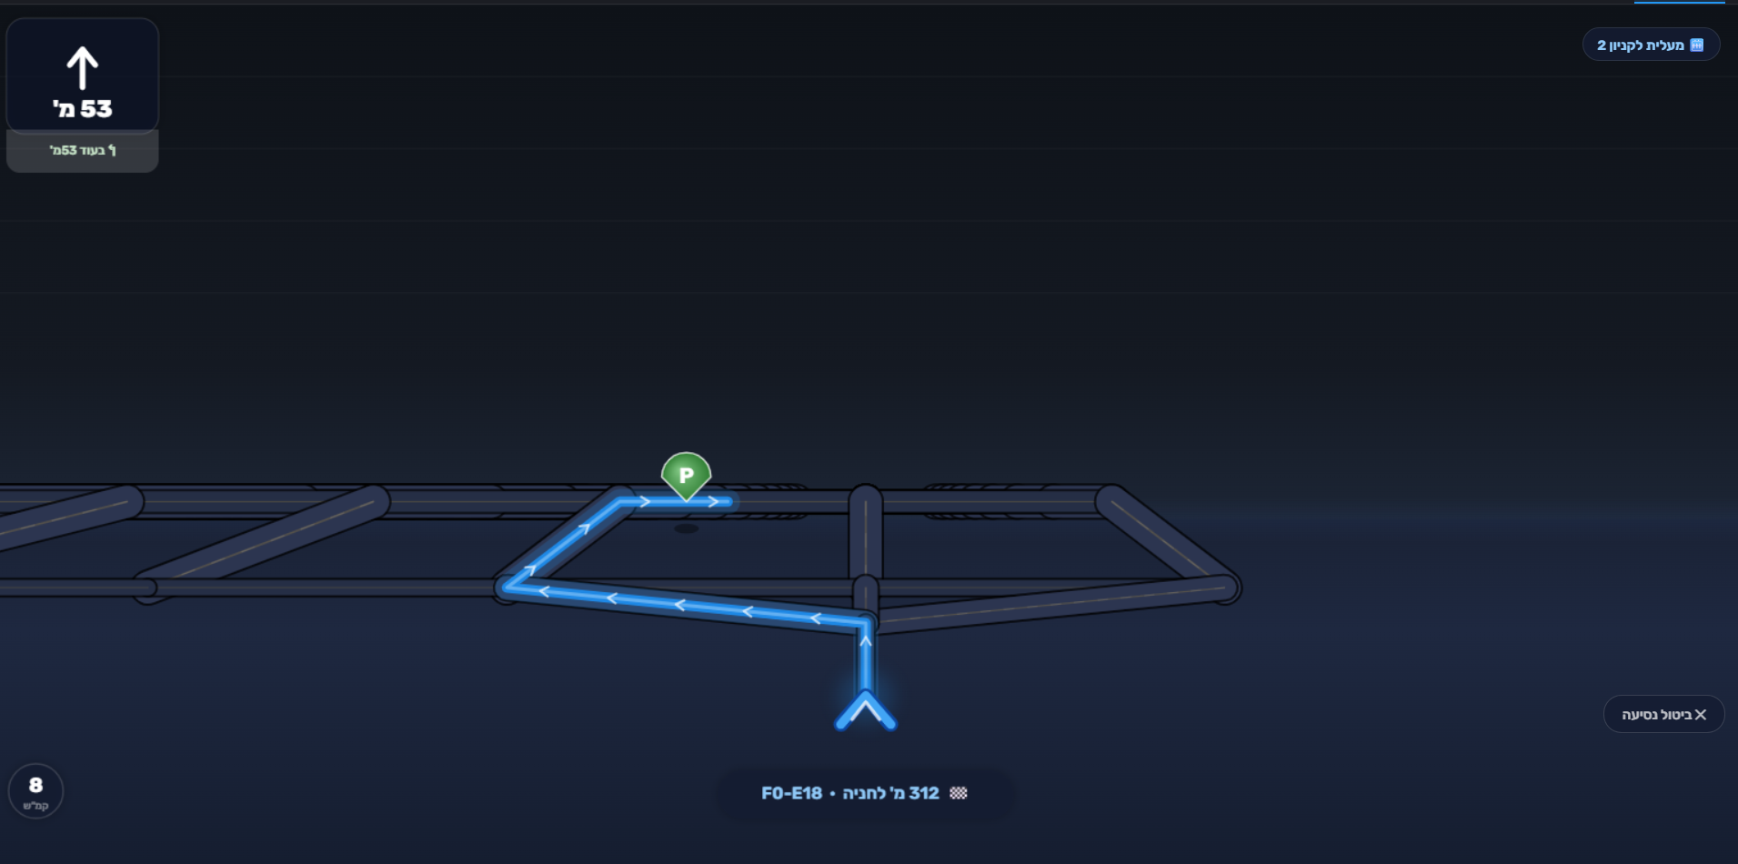
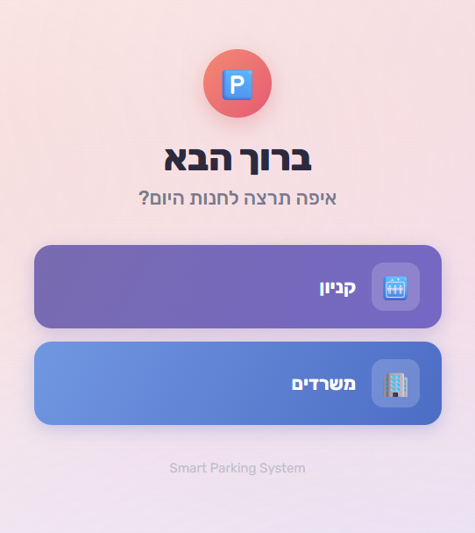
Our Solution — User (Visitor) View
4 / 9
• Pick your destination (mall, offices ..)
• Navigate immediately to best available slot
Notes:
The app activation can be done in various ways: automatically for pre registered visitors, QR code scanning at garage entrance, etc. Shall be discussed with Garage operator.
Can support English as interface language

Slide 5
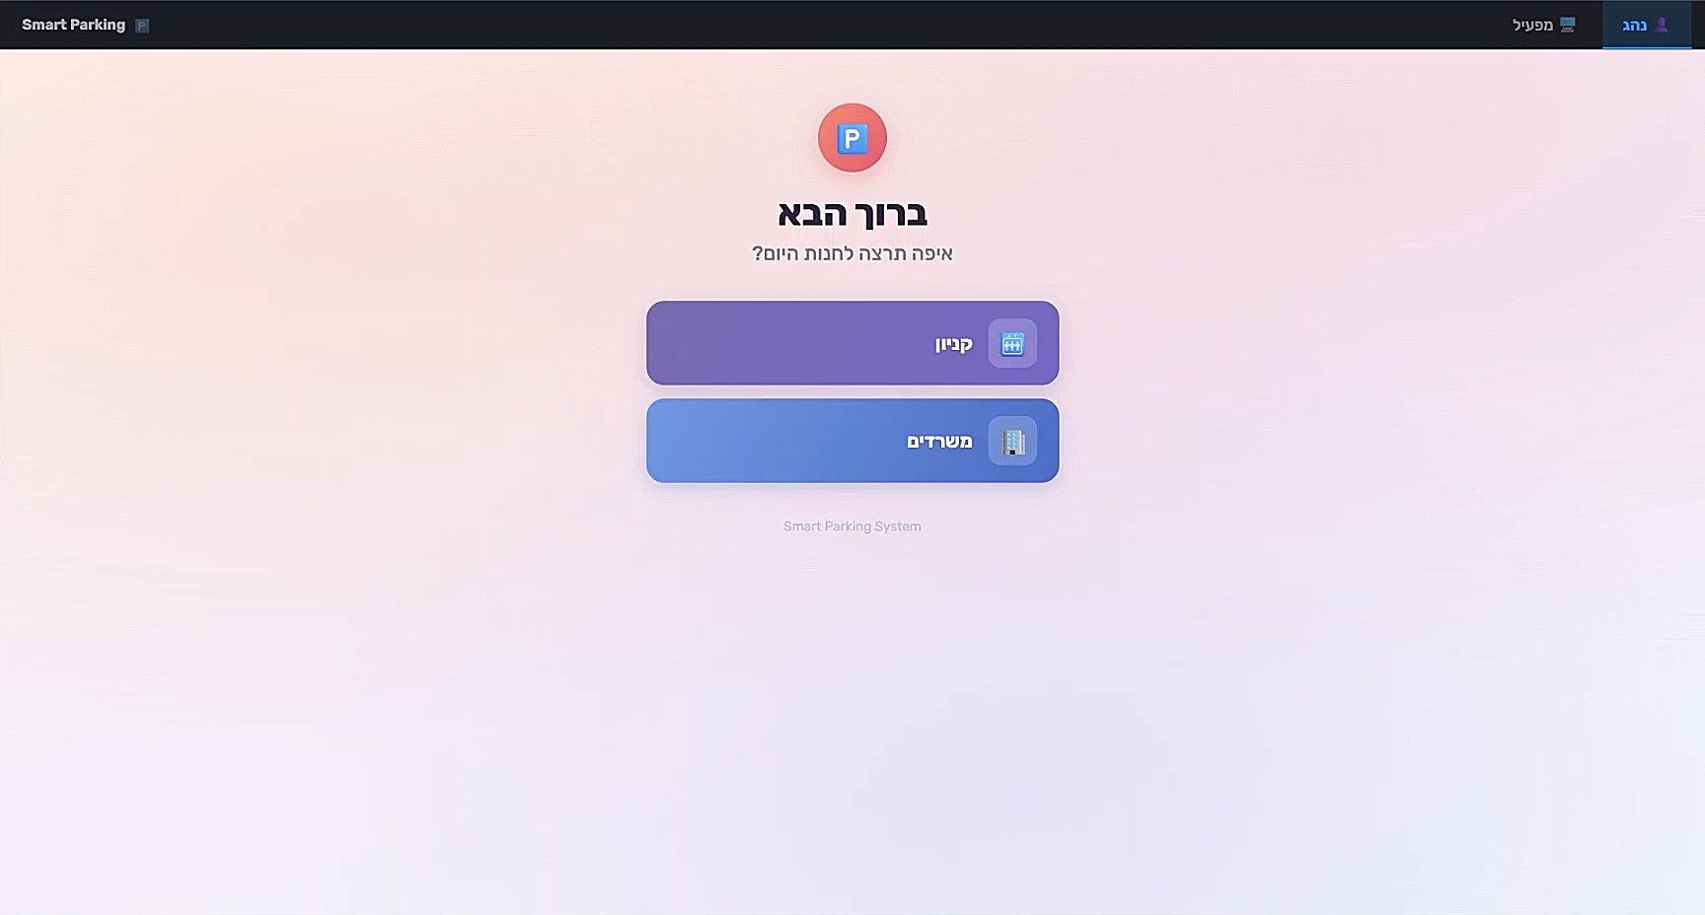
Video (Click to view the “play” button):
5 / 9

Slide 6
User (Visitor) View — Navigation Back To Car
6 / 9
Commonly, people forget where they parked.
They try to Take pictures, memorize the parking or texting themselves the location
Our solution: Just like GoogleMaps for the garage:
• The system remembers your parking slot
• Navigates to your parking slot when leaving

Slide 7
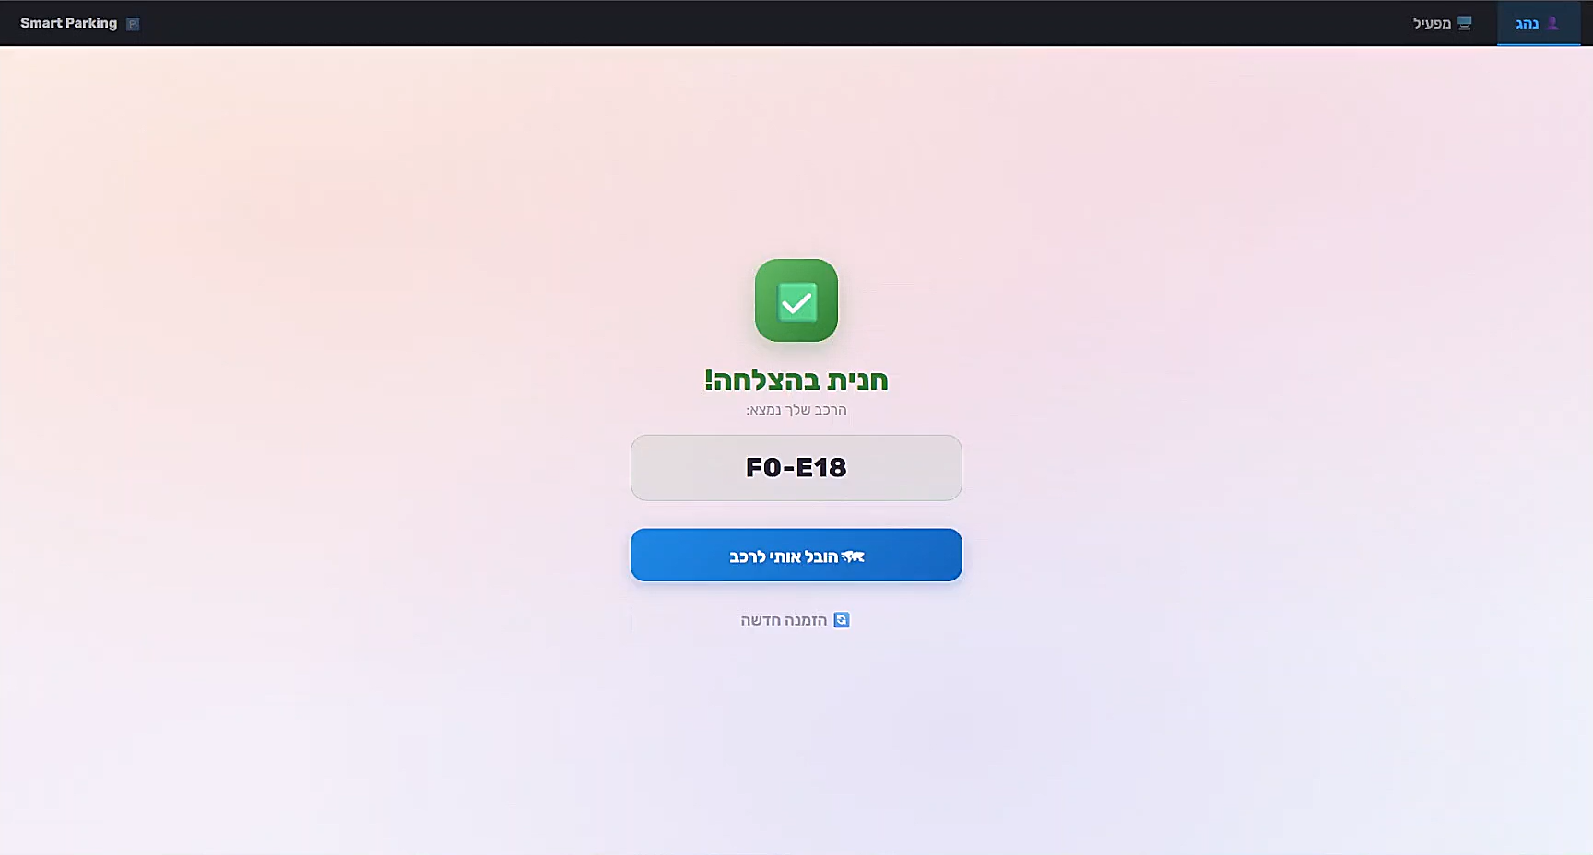
Video (Click to view the “play” button):
7 / 9
Note: Visitor starting point is either selected or automatically discovered if supported sensors exists in specific garage

Slide 8
General Notes
8 / 9
Our solution is a flexible software solution, built around a smart software and algorithmic layer for parking allocation and routing.
Each deployment includes a site-specific integration phase to connect with existing hardware, sensors, access systems, and operational workflows.
Contact:
Ido Harel - 0542429131
Gmail – idoharel123@gmail.com

