Slide 1
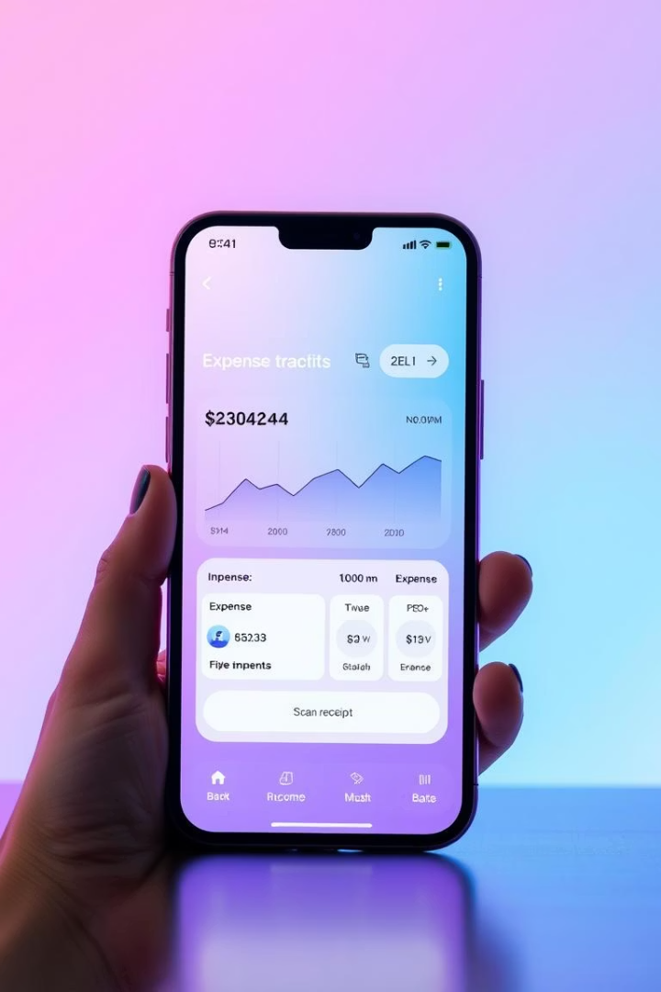

PaySync: Smart Expense Tracker
A comprehensive mobile application for managing personal finances efficiently. Track expenses, set budgets, and gain financial insights with PaySync's intuitive interface and robust features.
by jagadeesh ospari | AP22110011304

Slide 2





Project Overview
Cross-Platform App
Built with Flutter for Android and iOS devices.
Cloud Integration
Firebase authentication, storage, and real-time database.
Robust Backend
Spring Boot backend with RESTful APIs.
Secure Design
Encrypted data storage and biometric authentication.

Slide 3






Core Features
Analytics & Insights
Visual spending breakdowns and trends
Event-Based Grouping
Group expenses by events like trips
Transaction Management
Record expenses with receipts and location
PaySync offers comprehensive transaction management with receipt scanning, location tagging, and categorization. Users can group expenses under events like "Trip to Goa" and receive detailed analytics on spending patterns.

Slide 4





System Architecture
User Interface
Flutter-based frontend with Material Design components.
API Layer
RESTful services for data exchange and processing.
Data Storage
Firebase Firestore with offline capabilities.
Synchronization
Real-time data sync across multiple devices.

Slide 5
Security & Performance
Security Features
Performance Optimizations
Biometric authentication
Offline-first approach
Data encryption at rest
Lazy loading of resources
Secure HTTPS communication
Efficient state management
Firebase Authentication
Background sync service

Slide 6
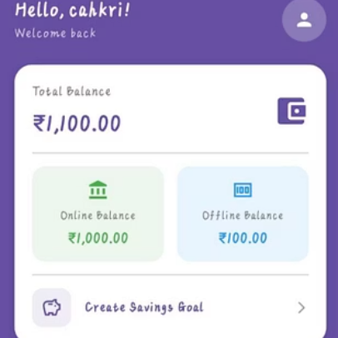
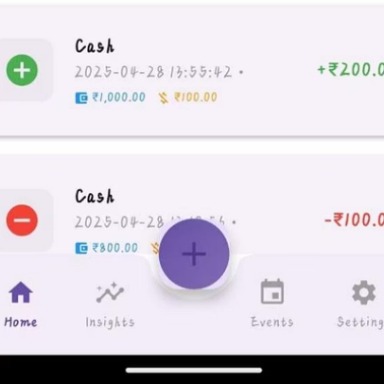
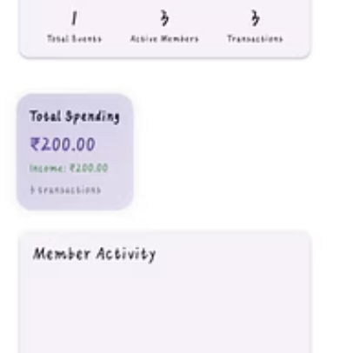
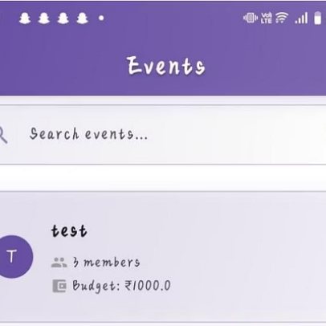
User Interface
PaySync features an intuitive interface with home dashboard, insights page, events tracking, and detailed transaction views. The design follows Material guidelines with both light and dark themes.

Slide 7
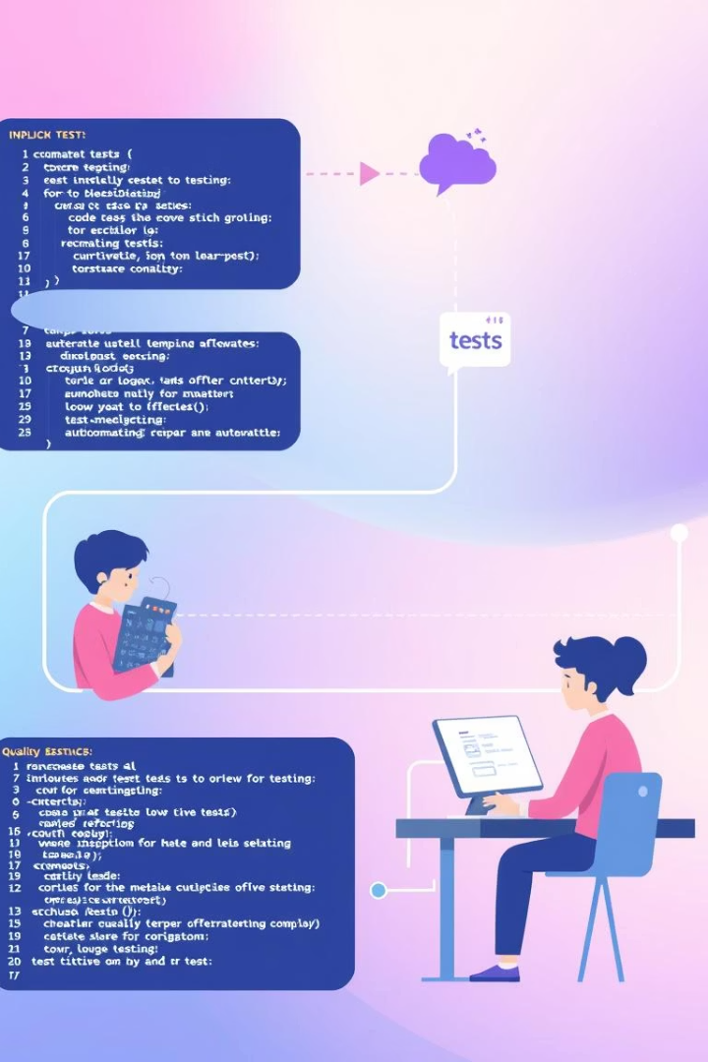
Testing Strategy
Unit Testing
Testing data models, services, and utility functions using Flutter Test Framework and JUnit.
Widget Testing
Validating UI components, forms, and screen interactions with automated tests.
Integration Testing
Verifying Firebase integration, API endpoints, and cross-platform compatibility.
Performance Testing
Evaluating load handling, memory usage, and offline functionality.

Slide 8

Future Roadmap
Integration Expansion
AI-Powered Insights
Direct connections with banking APIs and financial institutions for automated transaction import.
Collaborative Features
Advanced analytics with personalized financial recommendations based on spending patterns.
Expense sharing with friends and family members for group events and activities.

