Slide 1
CSSpeed
Team 10
Ethan Whitton and Joshua Wu

Slide 2

AGENDA
Team
Project Description
Design
Development
Demo
Results
Conclusion

Slide 3
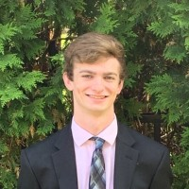
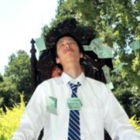
Team
Ethan Whitton
ITWS 2021
Joshua Wu
CSCI/ITWS 2022

Slide 4

INTRODUCTION
Having a hard time achieving your look with CSS?
Do you want to write CSS fast?
Want to have fun while practicing CSS?
Looking to grind l33tcode for CSS?
Are you bored and looking for a new pastime?

Slide 5

Introducing
CSSpeed

Slide 6


Project Description
GAMING
+
EDUCATION

Slide 7
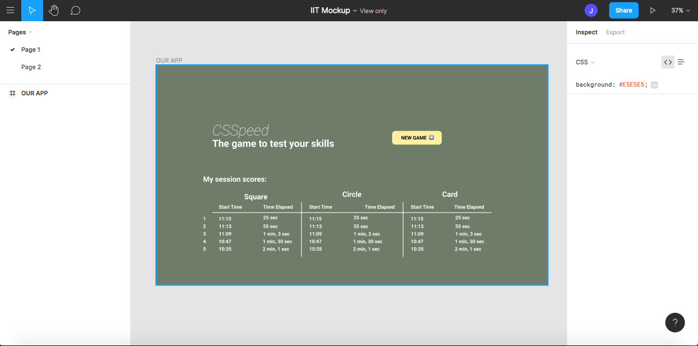
Landing page wireframe

Slide 8
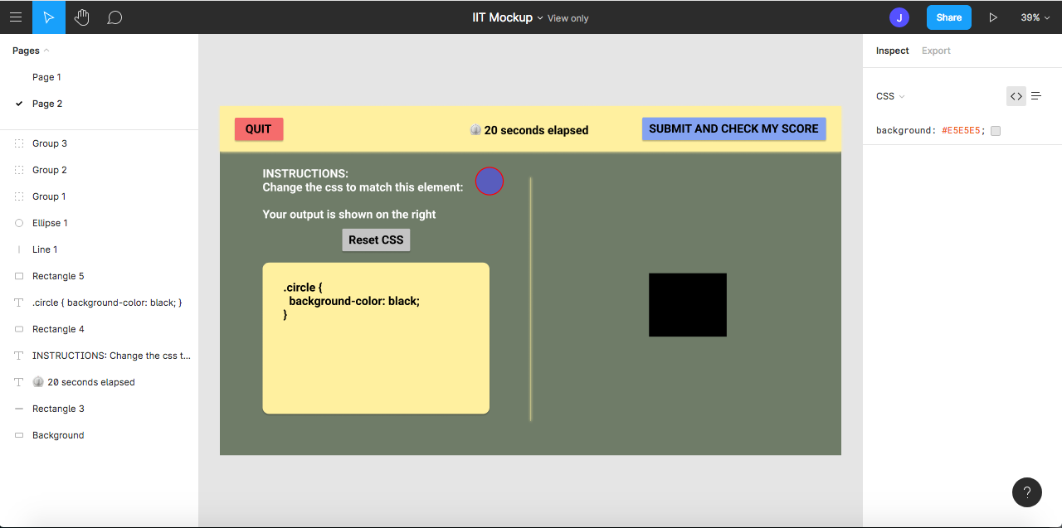
Play page wireframe

Slide 9
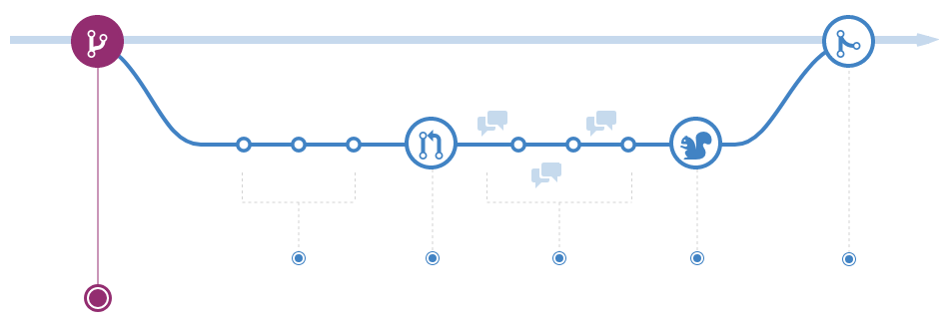
Development

Slide 10




Development

Slide 11

Deployment

Slide 12
Demo ~ LINK IN WEBEX CHAT

Slide 13

Results
Successfully developed game
Brushed up on our existing skill sets
Learned some new things about CSS
Practiced team work

Slide 14

Conclusions
Gamification is the future of education
Fulfilling experience
“That’s what games are, in the end. Teachers. Fun is just another word for learning.” ― Raph Koster

