Slide 1
Git

Slide 2

Uses of git
Git is a version control system.
Git helps you keep track of code changes.
Git is used to collaborate on code.

Slide 3

3 Uses

Slide 4

What git does

Slide 5
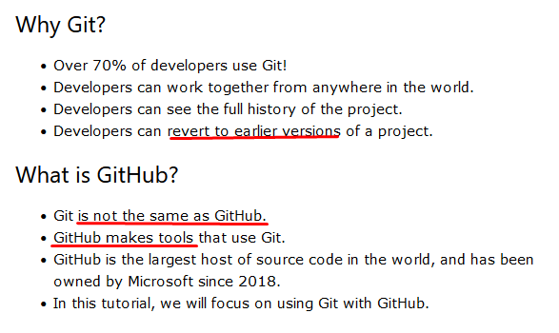
Differences between Git and GitHub

Slide 6

Version Checking

Slide 7

Configure Git

Slide 8


Creating folder

Slide 9
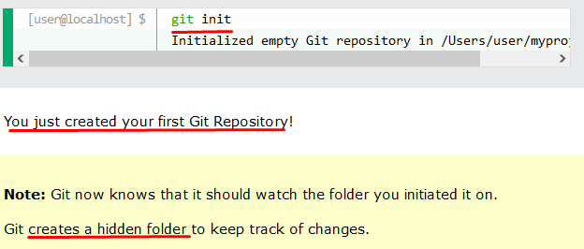
Initialize Git

Slide 10



Git Staging Environment

Slide 11



Git Commit

Slide 12

Git Commit without Stage

Slide 13

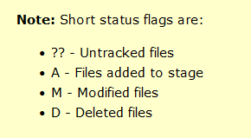
-- short

Slide 14

Git Commit Log

Slide 15
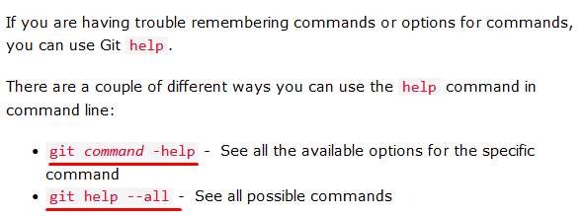
Git Help

Slide 16
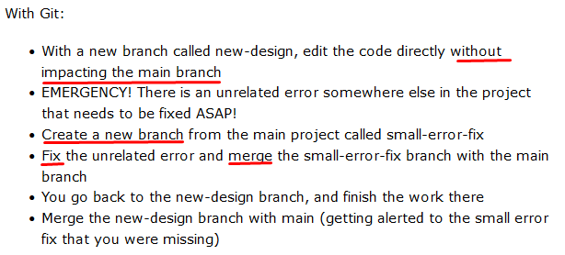
Working with Git Branches
In Git, a branch is a new / separate version of the main repository.

Slide 17



Create New Git Branch

Slide 18


Branch

Slide 19

Git Status

Slide 20

Switching between Branches

Slide 21
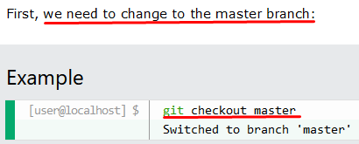

Merge Branches

Slide 22

Merge Conflict

Slide 23
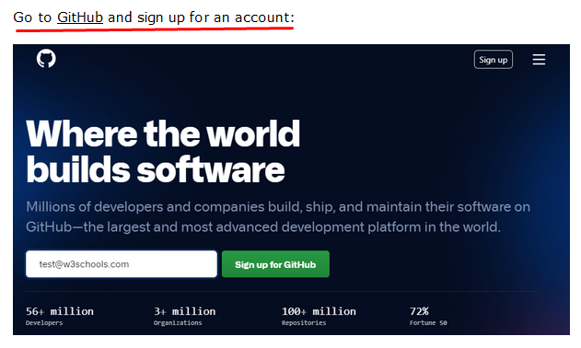
GitHub Account

Slide 24
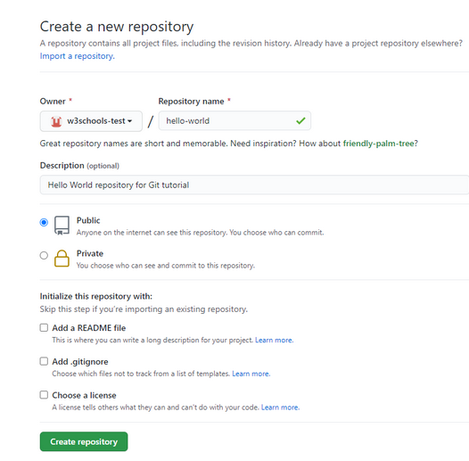
Create new repo

Slide 25


Push local repo to GitHub

Slide 26


Git Pull from GitHub

Slide 27

Push Changes to GitHub

Slide 28
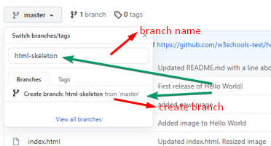
GitHub Branch

Slide 29


-a command

Slide 30



Switch to New Branch

Slide 31


Pull Request

Slide 32
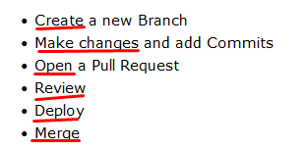
GitHub Flow

Slide 33

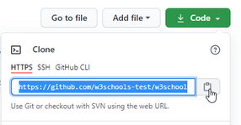

Clone a Fork

Slide 34



Git Ignore and .gitignore

Slide 35


Git Ignore and .gitignore
Now open the file using a text editor

Slide 36



SSH

Slide 37
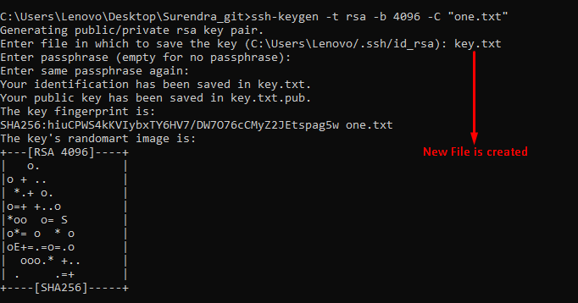
Key Generate

Slide 38
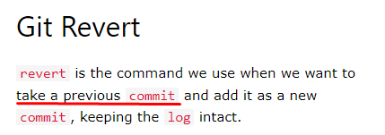


Git Revert

Slide 39




Git Revert

Slide 40





Git Reset

Slide 41
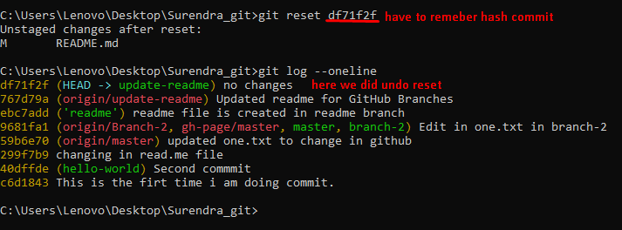
Git Undo Reset

Slide 42
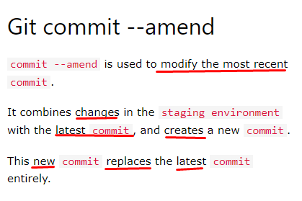
Git Amend

Slide 43


Git Amend (cont.)

