Slide 1


<Use Case Name here>
Model Governance Report as of < October 25th 2022>

Slide 2
Executive Report
Model Governance
In this report
Details about the model governance analysis done on the <use case name> .
This report is based on the framework of model governance published by <Qausal AI>
How Qausal AI can help
Qausal AI is building the first comprehensive model governance framework for managing models. Qausal’s model management platform provides a model inventory for all models, a simulation platform for what-if analysis, and monitoring of the outcomes. For more information, please visit https://www.qausal.ai/product.

Slide 3
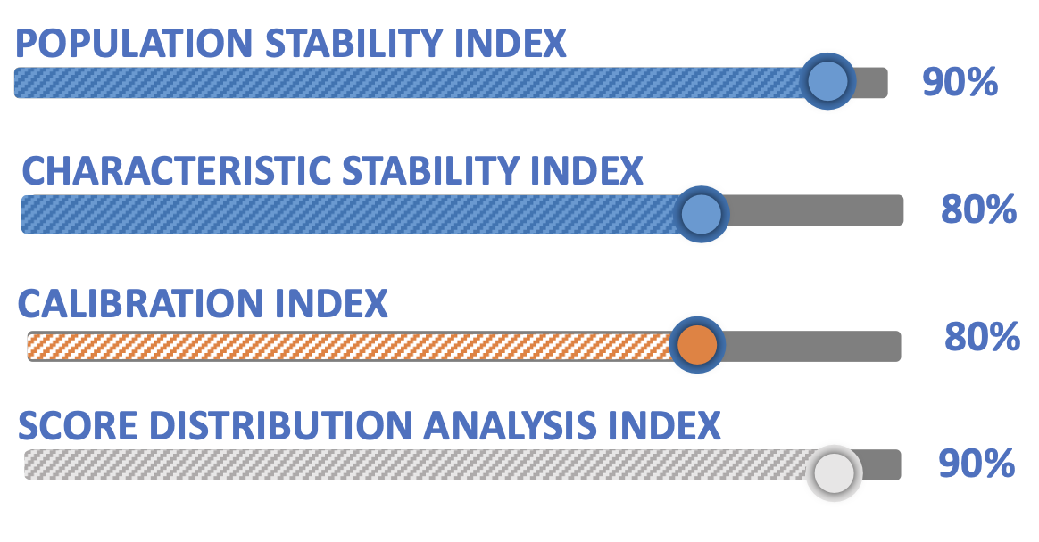
Use Case Summary
Wine is one of the most popular alcoholic drinks which has been used for thousands of years. Wine is produced by fermenting grapes. Relabeling cheaper wines to the popular and expensive brands and counterfeiting are also common frauds in the wine domain. Different modern approaches have been used … more
Recommendation
Governance Report Date
Retrain Model
10/26/2022
Model Details
Model Owner : <name > Model Developer : <names of developers > Model Approver : <names> Model User : <name >
Model Maintenance Team :
Model Approval Date: Last Model Validation Date: Last Model Monitoring Date:
IMAGE GENERATED DYNAMICALLY IN PYTHON

Slide 4
 | Metric | Value
1 | Model Risk Rating
2 | Model Area
3 | Use Case
4 | Model Category
5 | Model Dependencies
6 | Model Usage
7 | Model adjustments
8 | Model Owner
9 | Model Developer
10 | Model Approver
11 | Model User
12 | Model Maintenance
13 | Documentation & Code
14 | Current Model Status
15 | Implementation Platform
Model Management Details
Details on how the model has been managed.
ALL TABLES WITH SAME LOOK

Slide 5




Framework of Model Governance
Model Discrimination Analysis
Model Discrimination analysis refers to how well the model differentiates those at a higher risk of having an event from those at a lower risk.
System or Population Stability
How different is the current data being scored by the model as compared to the data from which the model was developed. Is the model stable over time?
Characteristic Stability
How different is the distribution of the current population for each explanatory variable in the model compared to the population used for model development? What impact does this have on model performance?
Model Calibration (Actual vs Expected)
Calibration refers to the accuracy of absolute risk estimates. Does the model deliver accurate point predictions? This might become significant for regulatory models of the future where systematic under or over predictions may have capital implications.
Areas of Model Governance analyzed to provide a comprehensive framework

Slide 6
Model Discrimination Analysis

Slide 7
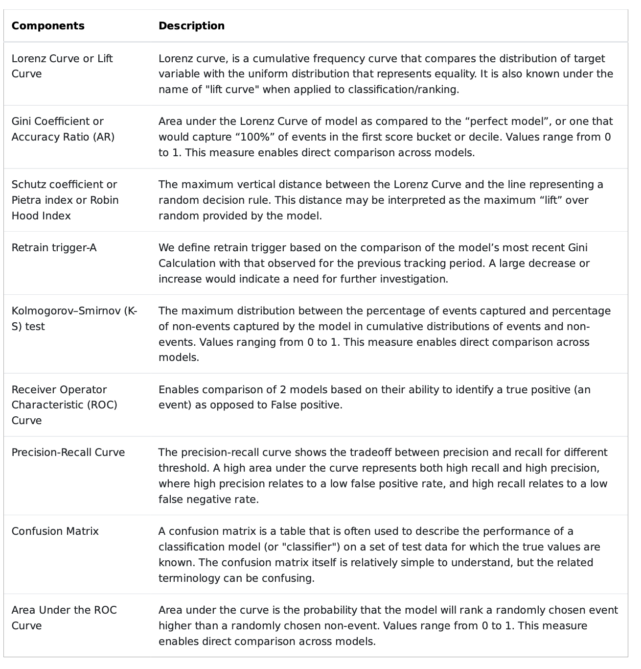
Components of Model Discrimination Analysis
Model Discrimination Analysis
Discrimination refers to how well the model differentiates those at higher risk of having an event from those at lower risk. Discrimination depends on the distribution of patient characteristics in the population in which the model is being used. A model could well discriminate patients with events from those without events in a heterogeneous population with widely different values of predictors included in the model (e.g., age, sex, laboratory values); however, the same model could fail to discriminate patients in a more homogenous population. An extreme example is a model including age as a predictor that may work well in a population with a flat age distribution between 20 and 90 years but fail in another population in which all patients are between the ages of 50 and 60 years.
ALL TABLES WITH LOOK AS IN SLIDE #4

Slide 8
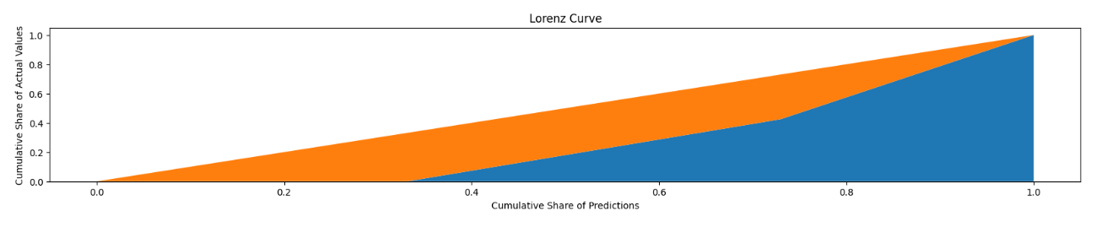
Lorenz Curve for <use case>
Details on Lorenz Curve
Lorenz curve, is a cumulative frequency curve that compares the distribution of a specific variable (e.g. income) with the uniform distribution that represents equality. It is also known under the name of "lift curve" when applied to classification/ranking. For a given range of predicted probability values, the lift represents a multiplicative increase in the positive class's rate (due to a given predictive model) over a random guess. It is a very common measure of inequality. We looked at the target variable and compared the model’s prediction with that of the actual results. As part of this analysis we found the Lorenz
IMAGE GENERATED DYNAMICALLY IN PYTHON

Slide 9
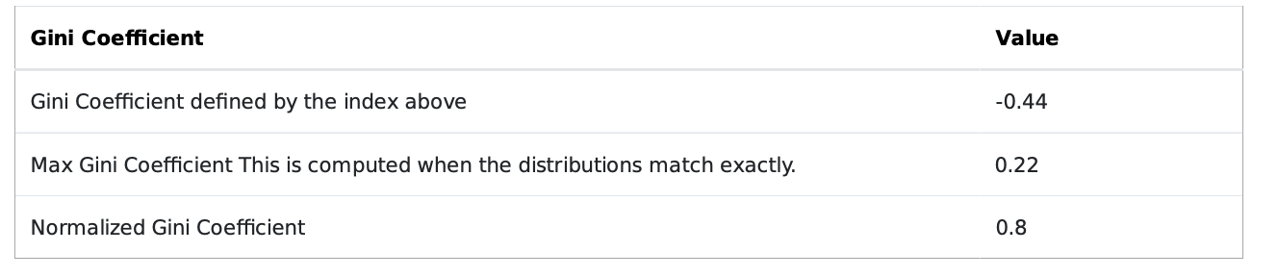
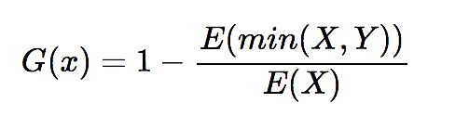
Gini Coefficient or Accuracy Ratio (AR) for <use case>
Details on Gini Coefficient or Accuracy Ratio (AR)
Gini index has an intuitive geometric interpretation: it can be defined as the ratio of the area that lies between the line of perfect equality and the Lorenz curve, over the total area under the line of equality.
The equation for Gini Coefficient is
ALL TABLES WITH LOOK AS IN SLIDE #4
where Y is an independent copy of X.
Retrain Trigger for <use case>
Retrain Trigger
We define retrain trigger based on the comparison of the model’s most recent Gini Calculation with that observed for the previous tracking period. A large decrease or increase would indicate a need for further investigation.
Gini Current:
Gini Last Model Run:
Difference between Ginis :
Note: If the difference between the last normalized Gini coefficient and current normalized Gini coefficient is > 50% we set Retrain Trigger to be “True”

Slide 10
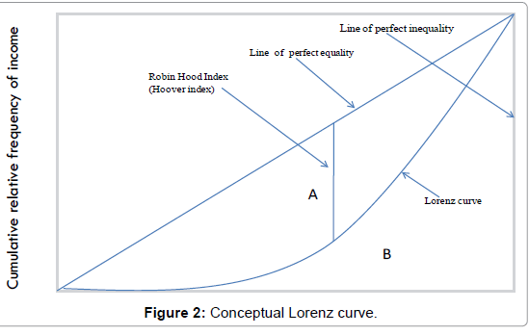
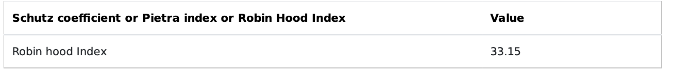
Schutz coefficient or Pietra index or Robin Hood Index
for <use case>
Details on Schutz coefficient or Pietra index or Robin Hood Index
Schutz Coefficient or Robin Hood index can be graphically represented as the maximum vertical distance between the Lorenz curve and the 45-degree line that represents perfect equality of values. The Robin Hood index is also known as the Hoover index
Higher values indicate more inequality between the prediction and actuals, indicating a likelihood of model deterioration.
IMAGE GENERATED DYNAMICALLY IN PYTHON

Slide 11
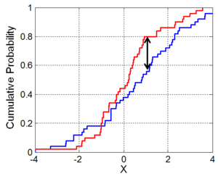

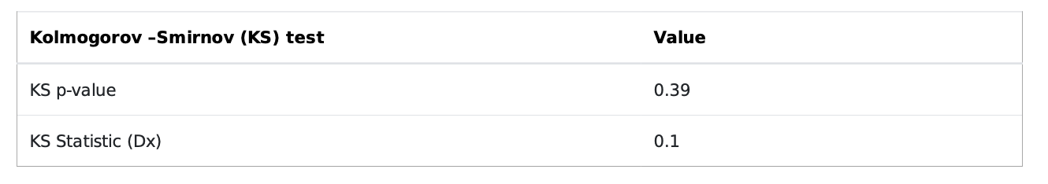
Kolmogorov–Smirnov (K-S) test for <use case>
Details on Kolmogorov–Smirnov (K-S) test
The Kolmogorov–Smirnov statistic quantifies a distance between the empirical distribution function of the sample and the cumulative distribution function of the reference distribution (associated with null hypothesis), or between the empirical distribution functions of two samples. This performs a test of the distribution G(x) of an observed random variable against a given distribution F(x). Under the null hypothesis the two distributions are identical, G(x)=F(x). The alternative hypothesis can be either ‘two-sided’ (default), ‘less’ or ‘greater’. The KS test is only valid for continuous distributions.
Where Dx is the KS Statistic Fexp (x) is the function of expected values of x Fobs (x) is the function of expected values of x
IMAGE GENERATED DYNAMICALLY IN PYTHON

Slide 12
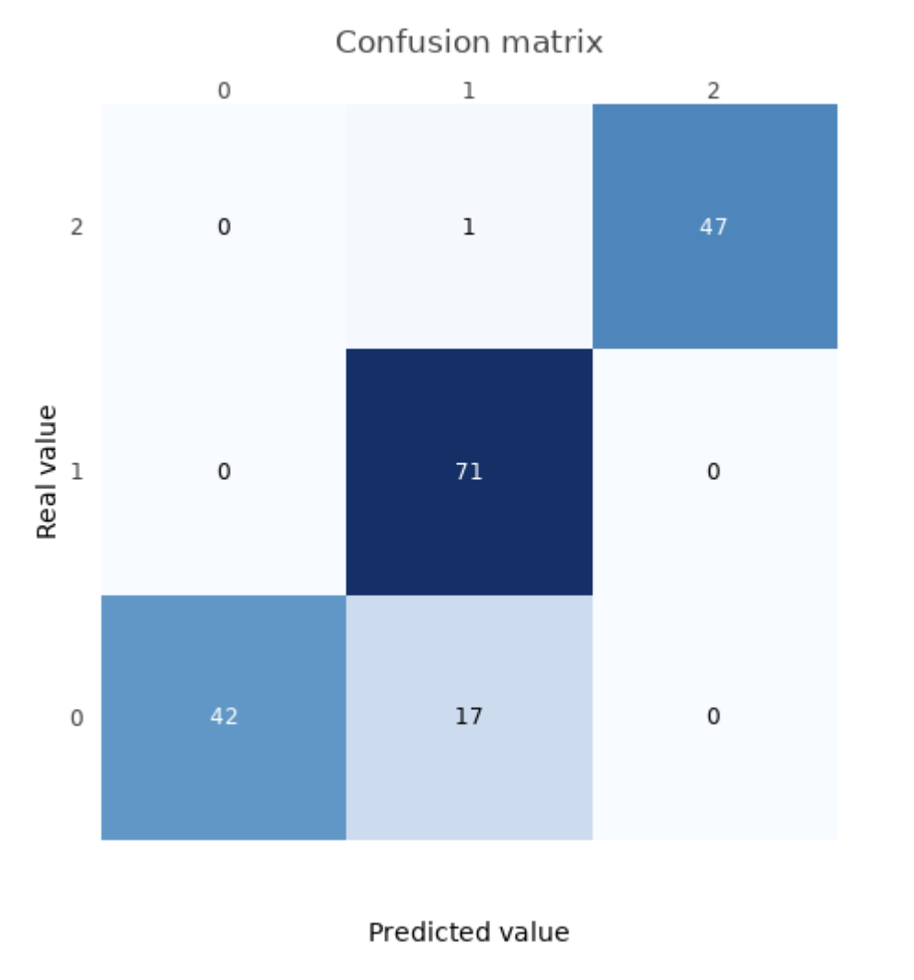
Confusion Matrix for <use case>
Details on Confusion Matrix
A confusion matrix is a table that is often used to describe the performance of a classification model (or "classifier") on a set of test data for which the true values are known. The confusion matrix itself is relatively simple to understand, but the related terminology can be confusing.
IMAGE GENERATED DYNAMICALLY IN PYTHON

Slide 13
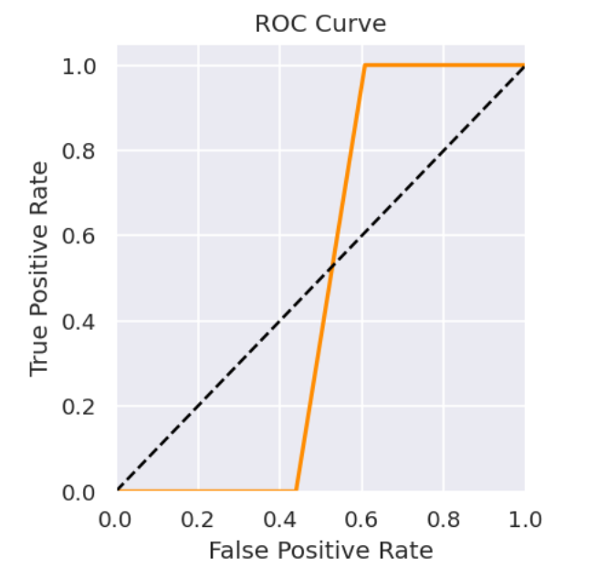
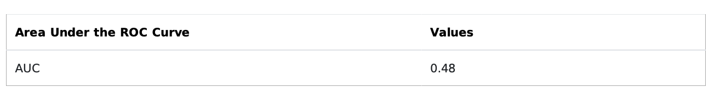
Receiver Operator Characteristic (ROC) Curve for <use case>
Details on Receiver Operator Characteristic (ROC) Curve
Enables comparison of 2 models based on their ability to identify a true positive (an event) as opposed to False positive.
IMAGE GENERATED DYNAMICALLY IN PYTHON
Area under the ROC Curve (AUC) for <use case>
Details on Area Under the ROC (AUC) Curve
Area under the curve is the probability that the model will rank a randomly chosen event higher than a randomly chosen non-event. Values range from 0 to 1. This measure enables direct comparison across models.

Slide 14
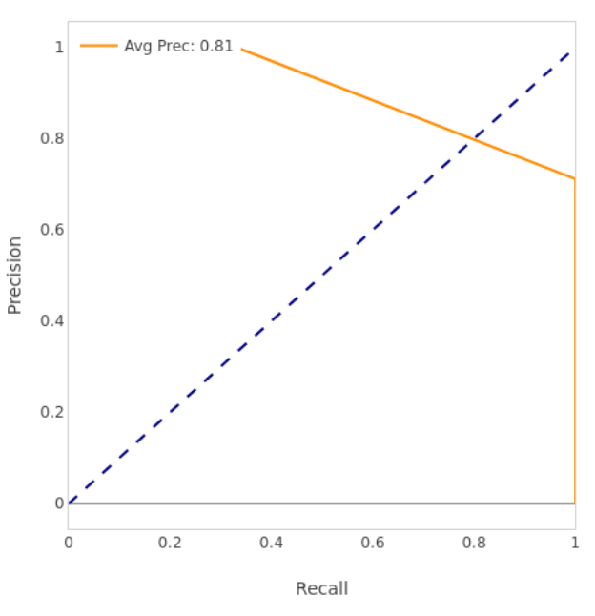
Precision Recall Curve (PR) Curve for <use case>
Details on Precision and Recall (PR) Curve
The precision-recall curve shows the tradeoff between precision and recall for different threshold. A high area under the curve represents both high recall and high precision, where high precision relates to a low false positive rate, and high recall relates to a low false negative rate.
IMAGE GENERATED DYNAMICALLY IN PYTHON

Slide 15
What is System or Population Stability?
How different is the current data being scored by the model as compared to the data from which the model was developed. Is the model stable over time?
System or Population Stability

Slide 16
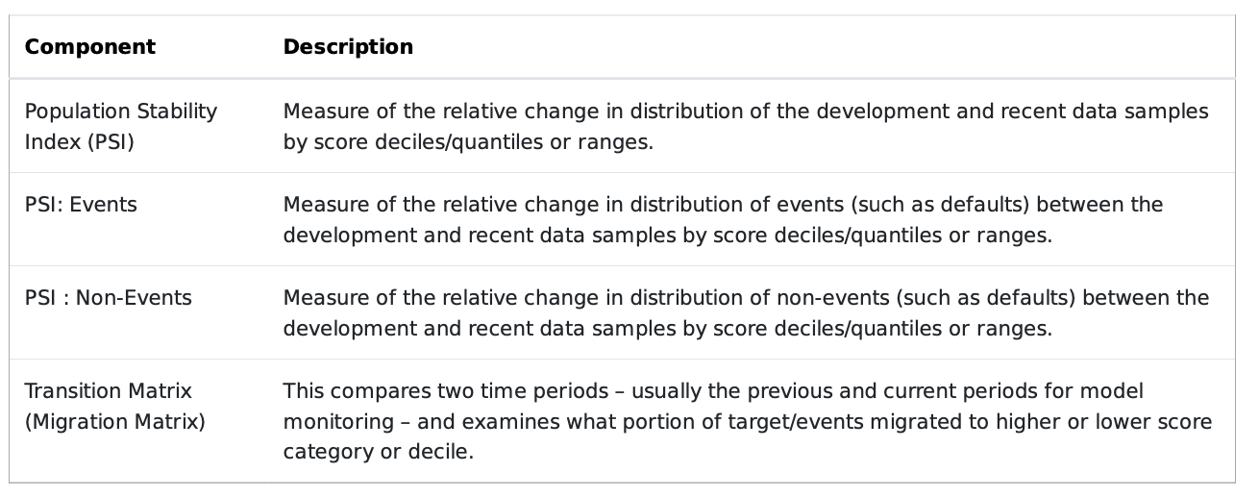
Components of System or Population Stability
System or Population Stability Analysis
System or population stability compares the data sample the model was developed on with a more recent data sample on which the model has been used. The discriminatory power of a model is based on information contained in the development dataset, and hence large variances from this may cause model performance to deteriorate or make the model unfit for purpose. The Population Stability Index (PSI) is the standard measure for system stability and is also recommended by most regulatory bodies. The PSI is also applicable to models that predict continuous outcomes. The transition matrix is critical to PD models and is in most cases a required submission to regulators. Thresholds for the degree of transition that is deemed acceptable are usually set internally by the institution.
ALL TABLES WITH LOOK AS IN SLIDE #4

Slide 17
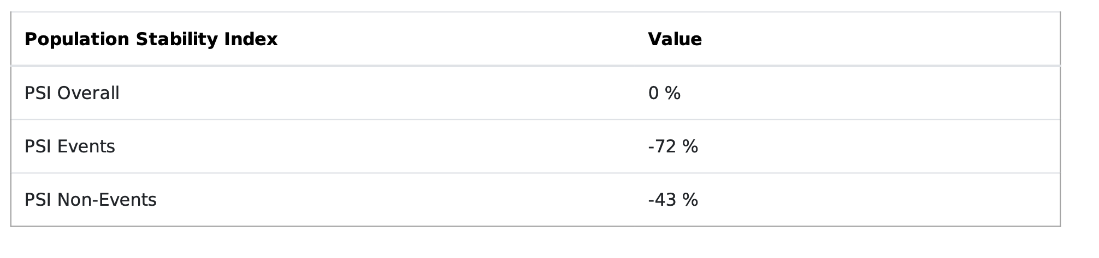
Population Stability Index (PSI)
Population Stability Index (PSI)
Population Stability Index (PSI) compares the distribution of a scoring variable (predicted probability) in scoring data set to a training data set that was used to develop the model. We answer the question ""How the current scoring is compared to the predicted probability from training data set ?". There are multiple uses of Population Stability Index (PSI). They are listed below -
1. Model might be influenced by economic changes. Suppose you built a risk model during economic recession (year 2008) and you are using the same model to score datasets in year 2016. There is a high chance that various attributes of the model are changed drastically over last 8 years. It means it does not make sense to use this model anymore if features of the model are changed significantly.
2. Change in product offerings due to internal policy changes. For example, one of your product are relaunched recently so attributes may behave differently as compared to attributes of your model.
3. PSI can detect if any data integration or programming issues to run the scoring code.
PSI = (% of records based on dependent variable in Scoring Dataset (A) - % of records based on dependent variable in Training Sample (B)) * In(A/ B)
ALL TABLES WITH LOOK AS IN SLIDE #4
References
Yurdakul, Bilal, "Statistical Properties of Population Stability Index" (2018). Dissertations. 3208. https://scholarworks.wmich.edu/dissertations/3208

Slide 18
What is Characteristic Stability?
How different is the distribution of the current population for each explanatory variable in the model compared to the population used for model development? What impact does this have on model performance?
Characteristic Stability

Slide 19
Population Stability Index (PSI)
Population Stability Index (PSI)
Population Stability Index (PSI) compares the distribution of a scoring variable (predicted probability) in scoring data set to a training data set that was used to develop the model. We answer the question ""How the current scoring is compared to the predicted probability from training data set ?". There are multiple uses of Population Stability Index (PSI). They are listed below -
1. Model might be influenced by economic changes. Suppose you built a risk model during economic recession (year 2008) and you are using the same model to score datasets in year 2016. There is a high chance that various attributes of the model are changed drastically over last 8 years. It means it does not make sense to use this model anymore if features of the model are changed significantly.
2. Change in product offerings due to internal policy changes. For example, one of your product are relaunched recently so attributes may behave differently as compared to attributes of your model.
3. PSI can detect if any data integration or programming issues to run the scoring code.
PSI = (% of records based on dependent variable in Scoring Dataset (A) - % of records based on dependent variable in Training Sample (B)) * In(A/ B)

Slide 20
Population Stability Index (PSI)
Population Stability Index (PSI)
Population Stability Index (PSI) compares the distribution of a scoring variable (predicted probability) in scoring data set to a training data set that was used to develop the model. We answer the question ""How the current scoring is compared to the predicted probability from training data set ?". There are multiple uses of Population Stability Index (PSI). They are listed below -
1. Model might be influenced by economic changes. Suppose you built a risk model during economic recession (year 2008) and you are using the same model to score datasets in year 2016. There is a high chance that various attributes of the model are changed drastically over last 8 years. It means it does not make sense to use this model anymore if features of the model are changed significantly.
2. Change in product offerings due to internal policy changes. For example, one of your product are relaunched recently so attributes may behave differently as compared to attributes of your model.
3. PSI can detect if any data integration or programming issues to run the scoring code.
PSI = (% of records based on dependent variable in Scoring Dataset (A) - % of records based on dependent variable in Training Sample (B)) * In(A/ B)

