Slide 1
Introduction
Background and Motivation
The National League of Cities (NLC) is an advocacy organization that represents American cities, towns, and villages.
The NLC’s research department publishes annual analysis of mayor’s State of the City speeches to get a sense of emerging policy trends.
In order to analyze these speeches employees manually tag topics.
Data
Roughly 150 speeches per year from 2016 to 2019 in word and pdf formats
About 120 topics, 10 major topics per year, and 5-30 topics per speech
Goal: Use Natural Language Processing (NLP) techniques to analyze mayors’ speeches from cities around the United States to identify local policy trends.

Slide 2


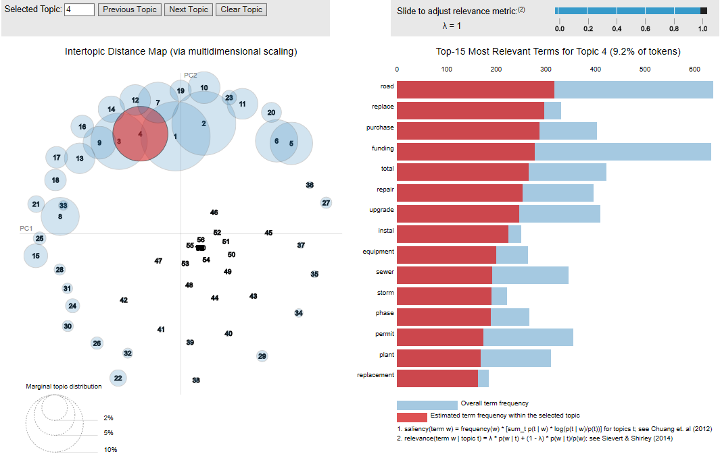
Speeches
LDA Model
Topics
LDA
This Photo by Unknown Author is licensed under CC BY-NC-ND

Slide 3
Results
Final Parameters:
Number of Topics =100
Passes = 200
Iterations = 400
Coherence Score = 53% (check this)
PyLDAVis

Slide 4
Coherent Topics
Library, early, playground, recreation, retail, vacant, approve, developer, late, law, basketball, site, locate, multi, play
Wordsprepare, marijuana, permanent, unit, abuse, experience_homelessness, single, poor, delivery, conflict, substance, option, ice, board, wage_job
Parks and Recreation
Substance Abuse
Road, replace, purchase, funding, total, repair, upgrade, install, equipment, sewer, storm, phase, permit, plant, replacement
Vision, energy, policy, room, neighbor, conversation, barrier, sustainable, real, justice, engage, voice, pathway, suffer, healthy
Infrastructure
Environment/ Sustainability

Slide 5
Less Coherent Topics
park_trail, notify, scatter, rock, restart, remove_barrier, religion, reinveste, rebuilding, racism, race_gender, poster, simple_question, governing, gas_station
rainy ,rainy_day, gasoline, pedestrian_safety, consumption, significant_progress, remove_barrier, rebuilding, streamlined, simple_question, set_bar, scatter, rockrestart
Parks, Recreation, Gender, Racial Equity, Sustainability
Pedestrian safety, gasoline, consumption and sustainability
committee, vision, effective, efficient, platform, selflessness, website, order, constituent, councilor, achieve, high_quality, brief, sure, efficient_effective
population, present, word, reason, maintain, run, history, different, collection, bond, special, answer, embrace, enjoy, attend
Unclear
Unclear

Slide 6
Topics by Year
2016
Topic | Distribution
Family and education | 0.14826946
Unclear(population, present, history, run, collection, answer, enjoy) | 0.016919535
Seniors | 0.023466531
Business | 0.029407484
Unclear (raise, friend, protect,door, mental) | 0.056234512
Education | 0.114815846
Infrastructure | 0.07890726
Homelessness | 0.026656741
Property tax | 0.012459487
Energy Conservation and Sustainability | 0.038814906
City Planning (Zone, Design, Inspection) | 0.014150485
Affordable Housing, Climate, Fuel, Carbon Emissions | 0.030257978
2019
Topic | Distribution
Family and education | 0.13446599
Unclear(population, present, history, run, answer, enjoy) | 0.015103648
Seniors | 0.030667298
Business | 0.032765217
Unclear (raise, friend, protect, door, mental) | 0.053238507
Education | 0.08474294
Infrastructure | 0.11006908
Pedestrian | 0.010068973
Homelessness | 0.018899236
Property tax | 0.013618809
Energy Conservation and Sustainability | 0.027214289
City Planning (Zone, Design, Inspection) | 0.015091527
Affordable Housing, Climate, Fuel, Carbon Emissions | 0.029035987

Slide 7
Topics by Region
Midwest
Topic | Distribution
Family and education | 0.14663307
Unclear(population, present, history, run, collection, answer, enjoy) | 0.011358672
Seniors | 0.02963802
Business | 0.025723208
Unclear (raise, friend, protect,door, mental) | 0.051641256
Education | 0.114815846
Infrastructure | 0.07890726
Homelessness | 0.026656741
Property tax | 0.012459487
Energy Conservation and Sustainability | 0.038814906
City Planning (Zone, Design, Inspection) | 0.014150485
Affordable Housing, Climate, Fuel, Carbon Emissions | 0.030257978
Northeast
Topic | Distribution
Family and education | 0.14826946
Unclear(population, present, history, run, collection, answer, enjoy) | 0.016919535
Seniors | 0.023466531
Business | 0.029407484
Unclear (raise, friend, protect,door, mental) | 0.056234512
Education | 0.114815846
Infrastructure | 0.07890726
Homelessness | 0.026656741
Property tax | 0.012459487
Energy Conservation and Sustainability | 0.038814906
City Planning (Zone, Design, Inspection) | 0.014150485
Affordable Housing, Climate, Fuel, Carbon Emissions | 0.030257978

Slide 8
Conclusion
We were able to create a topic model that can aide the NLC staff in the process of analyzing topics in mayor's speeches. However, this model stills needs quite a bit of fine tuning in order to provide more coherent and representative topics.
Cristina and Taisha will be using this model and the associated web application as a foundation for continued text analysis within the NLC organization.

