Slide 1
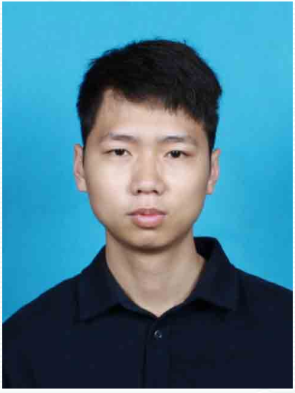
Guocai Liang
Resume
Phone 13356567960 | Email tobyrunninglc@gmail.com | GitHub 123qwe55aa
Education
Website tobyleons.xyz | Jiangmen, Guangdong
Dalian Polytechnic University
Expected Jun 2026
Inorganic Nonmetallic Materials Engineering Bachelor
• Core courses: Advanced Mathematics, University Physics, Glass Industry Furnace Design, Fundamentals of Inorganic Materials Science, Fundamentals of Mechanical Design, and more
Work and Campus Experience
Shenzhen Energy Environment | InfoSec Assistant | Shenzhen
Jan 2026 - Mar 2026
• SOC monitoring: Monitored security events in the Security Operations Center (SOC), recorded and triaged security alerts, and supported initial incident response. • Security maintenance: Assisted with daily network security maintenance, including real-time information security monitoring and ledger management. • Documentation: Organized security incident records, maintained cybersecurity ledgers, and consolidated related data for reporting.
Meituan | Delivery Rider | Shenzhen
Aug 2025 - Sep 2025
• Order fulfillment: Delivered restaurant orders in the assigned area, checked order details, and ensured accurate, on-time delivery.
• Route planning: Used GPS and navigation tools to plan routes, improving efficiency and reducing delays.
• Customer communication: Resolved issues during delivery and maintained clear communication with customers.
Hello Inc. | Customer Service Representative | Shenzhen
Aug 2024 - Sep 2024
• Complaint handling: Responded quickly to customer inquiries and complaints, driving issues to closure and protecting the customer experience.
• Relationship management: Built trust through patient communication and improved customer satisfaction.
• Issue logging: Documented common issues and resolutions to support future service improvements.
e-Gongda Club | Video Photography and Project Operations
2021
• Video photography: Served as the club video photographer, responsible for event footage and asset organization.
• Project operations: Helped run a dorm snack box project by supporting restocking, records, and daily operations.
Projects
• Hermes MCP Adapter — MCP · Messaging · Deployment: Built an AI-agent MCP tool layer with 9 custom tools, Telegram/iMessage routing, and production deployment using systemd and Nginx.
• CodeIsland — SSH Relay · Swift · SQLite: Built an SSH relay and Claude Code remote-session monitor with live terminal capture, JSON/SQLite histories, retrospective analysis, and subprocess lifecycle control.
• RecapLoL — FastAPI · React · Riot API: Combined Riot API server and ranked monitoring with Telegram alerts, match analytics, OP.GG references, and AI-generated coaching reports.
• geekgeekrun-mcp — Puppeteer · MCP: Added an MCP interface to GeekGeekRun’s BOSS Zhipin workflow so AI agents can search jobs, initiate chats, and automate application research.
• Projects Community — Next.js · SQLite · Drizzle: Built a local-first gamified research workspace with Vercel AI SDK, AI Realizer, community maps, and structured decision workflows.
Skills
• Language: IELTS 6.0; professional working proficiency in English; native/bilingual in Mandarin and Cantonese.
• Professional skills: Basic materials testing, quality awareness, technical writing, project coordination, and execution.
• Data skills: Data analysis and information organization; able to use digital tools to improve efficiency.
• Certifications and licenses: Driver's license; IELTS 6.0.
• Links: GitHub: github.com/123qwe55aa; website: tobyleons.xyz.
Summary
Background in customer service, project execution, data analysis, and materials engineering. Able to maintain careful, steady execution in fast-paced frontline and service roles, with a strong focus on communication, feedback, and issue closure. Well suited to service operations, project support, and quality or materials-related roles.

