Slide 1
Presentation
3

Slide 2
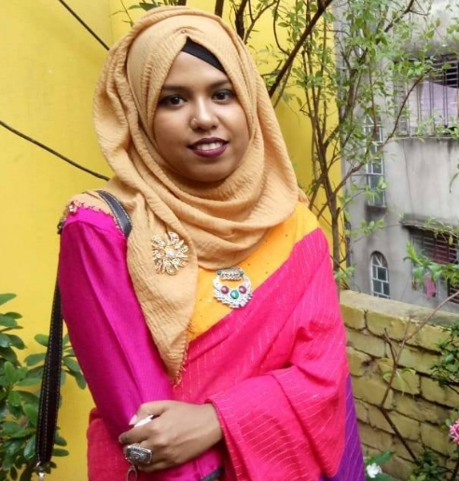
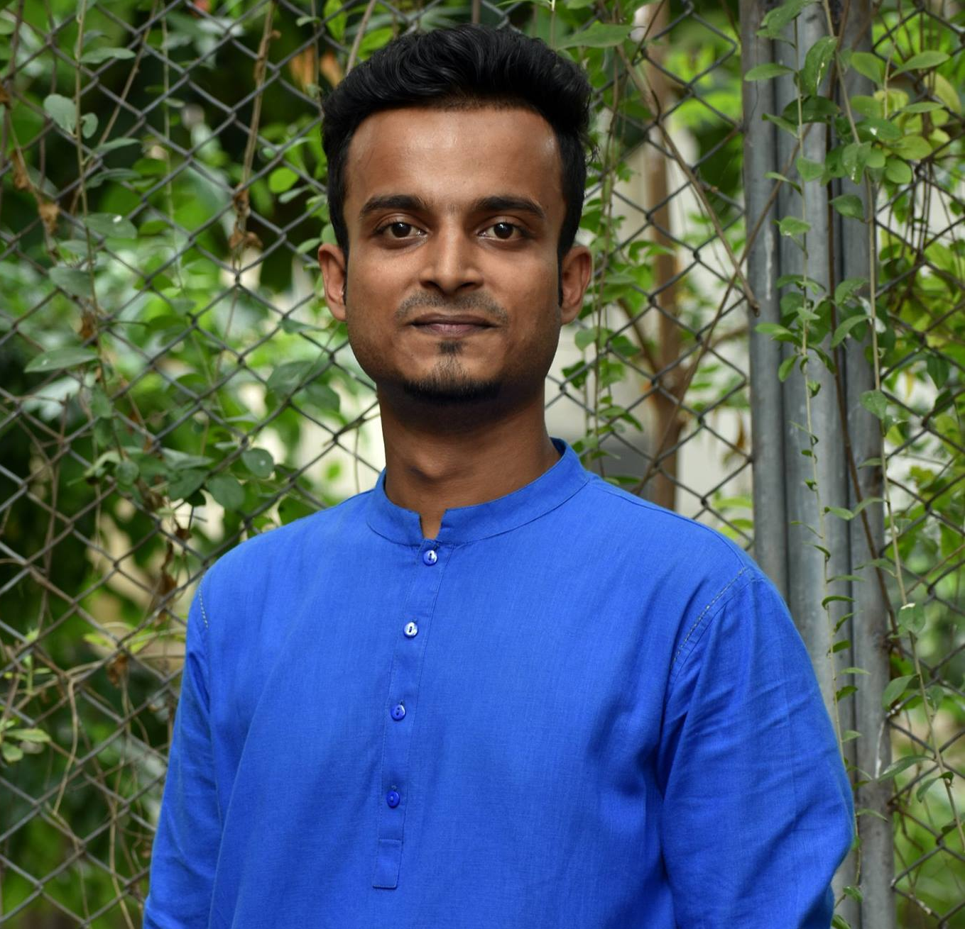

Group Name: Tierce
Nafisa Lubaba Rafisa
CSE 063 07432
Naimul Islam
CSE 063 07444
Rezwana Karim
CSE 063 07453

Slide 3
DFD
(Data Flow Diagram)

Slide 4
?
What is DFD?

Slide 5
Activity List ( User management):
Confirm users registration.
Record log-in information.

Slide 6
Activity List (Subjects):
Upload learning materials.
Record the test reports.
Feedback of the tests.

Slide 7
Activity List (Administration):
Keep user details.
Record feedback reports.
Insert/delete/update subject information.

Slide 8
Decomposition of DFD:
Context level | Level-0 | Level-1
Fun learn | 1.0 User management | 1.1 Confirm registration
 |  | 1.2 Log-in
 |  | 1.3 View subjects
 | 2.0 Subjects | 2.1 Upload learning materials
 |  | 2.2 Test reports
 |  | 2.3 Feedback
 | 3.0 Administration | 3.1 User detail
 |  | 3.2 Feedback report
 |  | 3.3 Insert/delete/update subject information

Slide 9
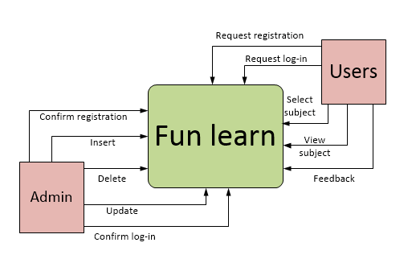
Context level:

Slide 10
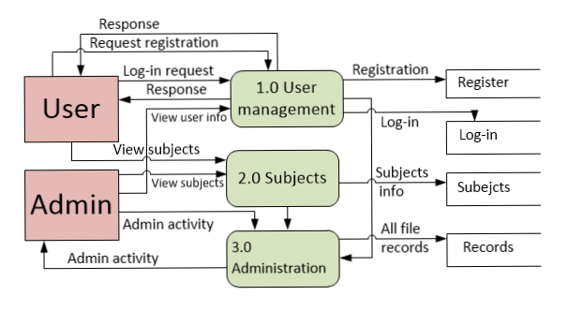
Level-0:

Slide 11
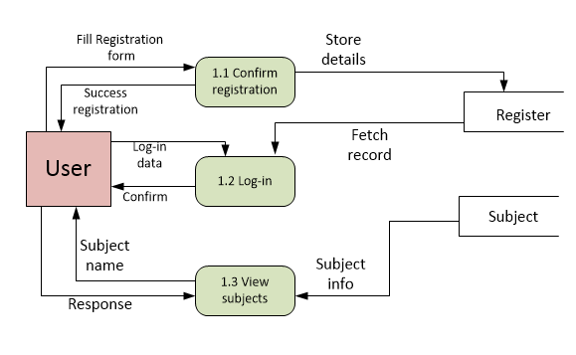
DFD Level-1:

Slide 12
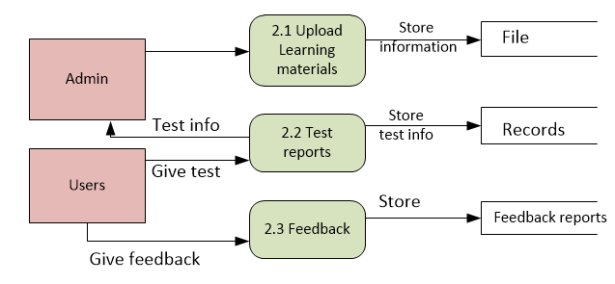
DFD Level-1:

Slide 13
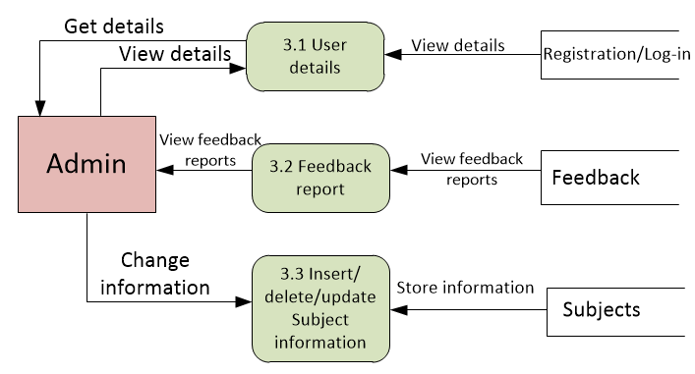
DFD Level-1:

Slide 14
Thank You

