Slide 1

Presentation-1
Project
proposal

Slide 2
Group- Tierce
Nafisa Lubaba Rafisa (CSE 63 07432)
Naimul Islam (CSE 63 07444)
Rezwana Karim (CSE 63 07453)

Slide 3
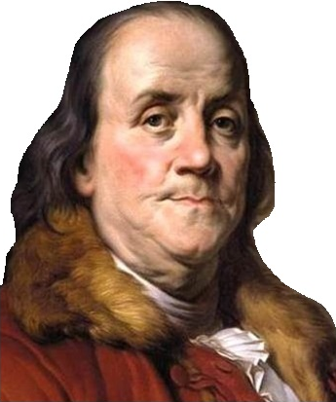
Tell me and I forget, teach me and I may remember, involve me and I learn.
Benjamin Franklin

Slide 4
A blackboard or whiteboard, chalk or marker, books, pens etc. are not enough to teach todays kids. They are more connected with mobile phones, laptop, video games etc. than their textbooks. They could not say what is written in their notebook but they can say which video is newly updated in YouTube. We may not keep them away from the technologies but we can use their connection with technologies in their study. As Benjamin Franklin said to involve to learn, we have to involve the kids with the subjects they have to study.
So we thought of making an app which will help the student from play to primary level complete their study with much fun. Where they will have all of the subjects as per their syllabus but in a interesting way. And when they will find things interesting they will get involved and they can learn things.
And it will be also easy for the parents to teach their children’s.

Slide 5
Fun learn
N

Slide 6
Motivation:
Learn with fun.
Learn while playing.
Making study interesting.
Making students involved with study

Slide 7
Features
Easy login
Strong user interface
Multi-language
Video based content
Testing knowledge
Offline mode

Slide 8
Technical feasibility:
H/W:
Laptop
S/W:
Windows
Asp.net

Slide 9
Economical feasibility:
No cost of data gathering.
Less cost.
Technical cost (if needed).

Slide 10
Operational feasibility:
Users will be students of play to primary level.
Using will be easy and simple.

Slide 11
Project scheduling:
Activity | Description | Precedence | Time(in/week)
1 | Information gathering | None | 1 week
2 | Project initiation | 1 | 1 week
3 | Theme design | 2 | 2 weeks
4 | Database design | 2,3 | 2 weeks
5 | Detailed design | 2,3,4 | 1 week
6 | Testing(round 1) | 5 | 1 week
7 | Design review | 6 | 1 week
8 | Coding | 7 | 3 weeks
9 | Testing (Round 2) | 8 | 1 week
10 | Software release | 9 | 1 week

Slide 12
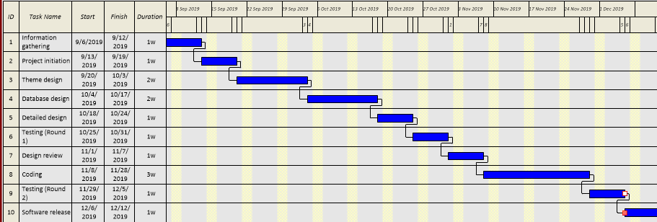
Gantt chart:

Slide 13
Risk analysis:
Because the syllabus of textbooks changes we have to be aware of the updates.
Registration process will be easy and simple.
There will be a backup of this project.

Slide 14
Conclusion:
We want to do this project so that students of play to primary level can learn their lessons easily. We want to keep them away from the extra burden of today’s educational war. We don’t if we will be successful or not but we will try our best.

Slide 15
Thank you

