Slide 1
Anomalies detection in crop health and creating a custom flight path.
Git hub URL: https://github.com/123sashank321/Anamolies_Detection_in_Crops
Sites.google : https://sites.google.com/view/anamolies-detection-in-crops/home
Professor: T Senthil Kumar(CSE)

Slide 2
Problem Statement
Current methods for monitoring crop health and managing agricultural spraying are often in efficient and labor-intensive, leading to suboptimal crop yields and increased pesticide use. There is a need for an advanced system that combines machine learning and drone technology to detect anomalies in crop health early and automate the creation of precise, customized flight paths for treatment. This will address issues of inefficiency, high operational costs, and environmental impact in modern agriculture.

Slide 3
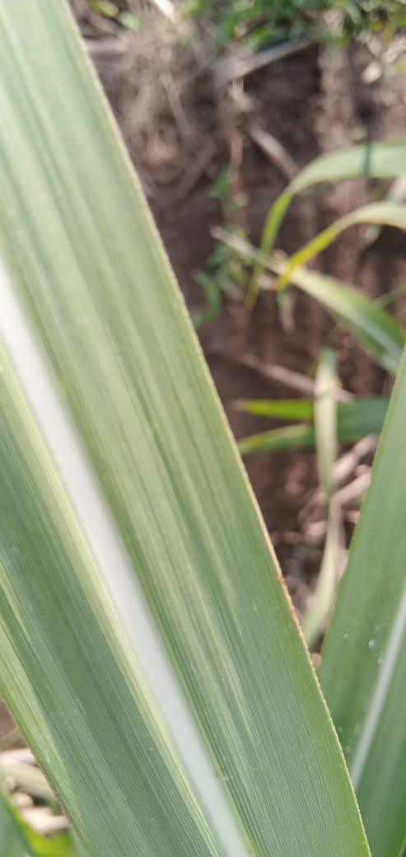
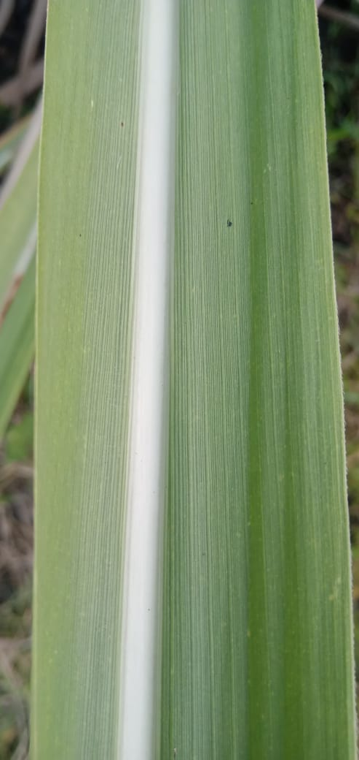
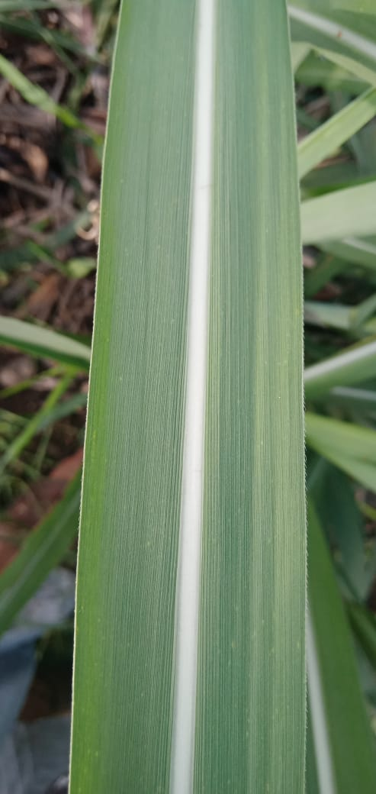
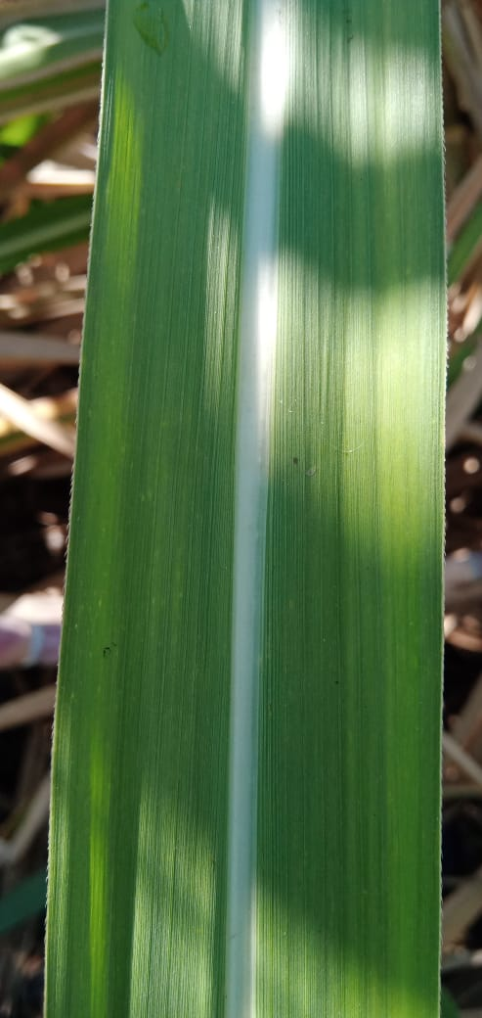
H
E
A
L
T
H
Y

Slide 4
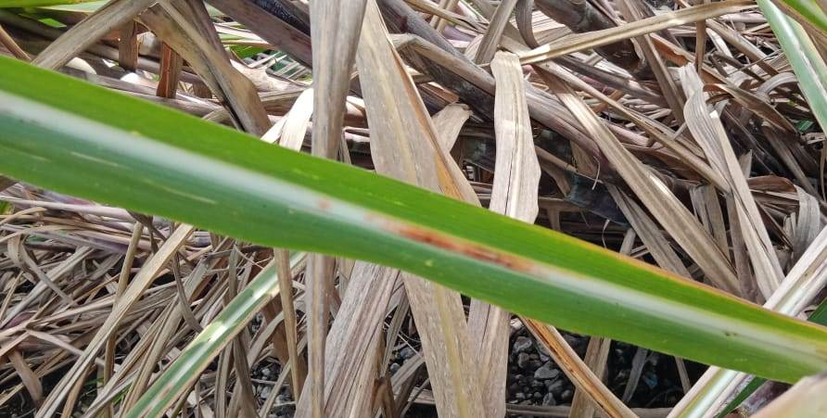
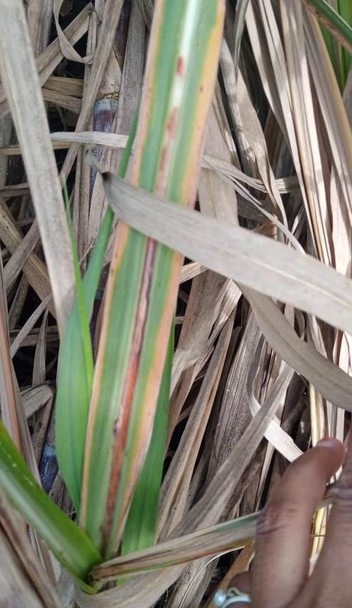
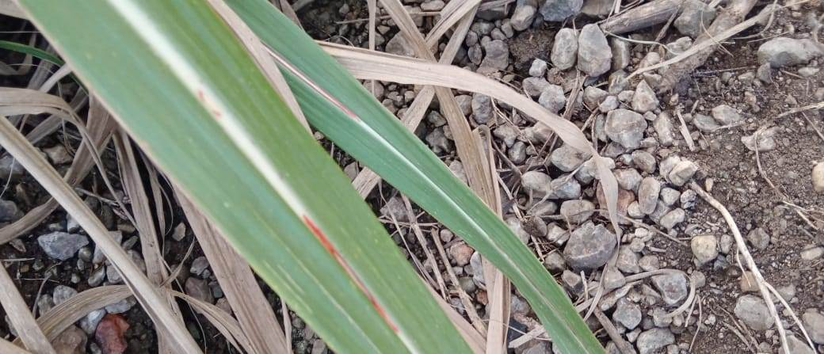
R
E
D
R
O
T

Slide 5
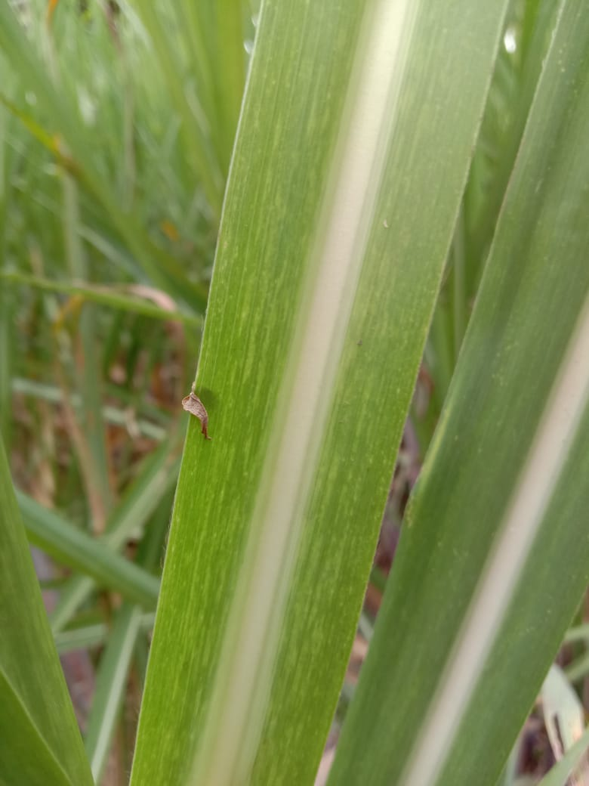
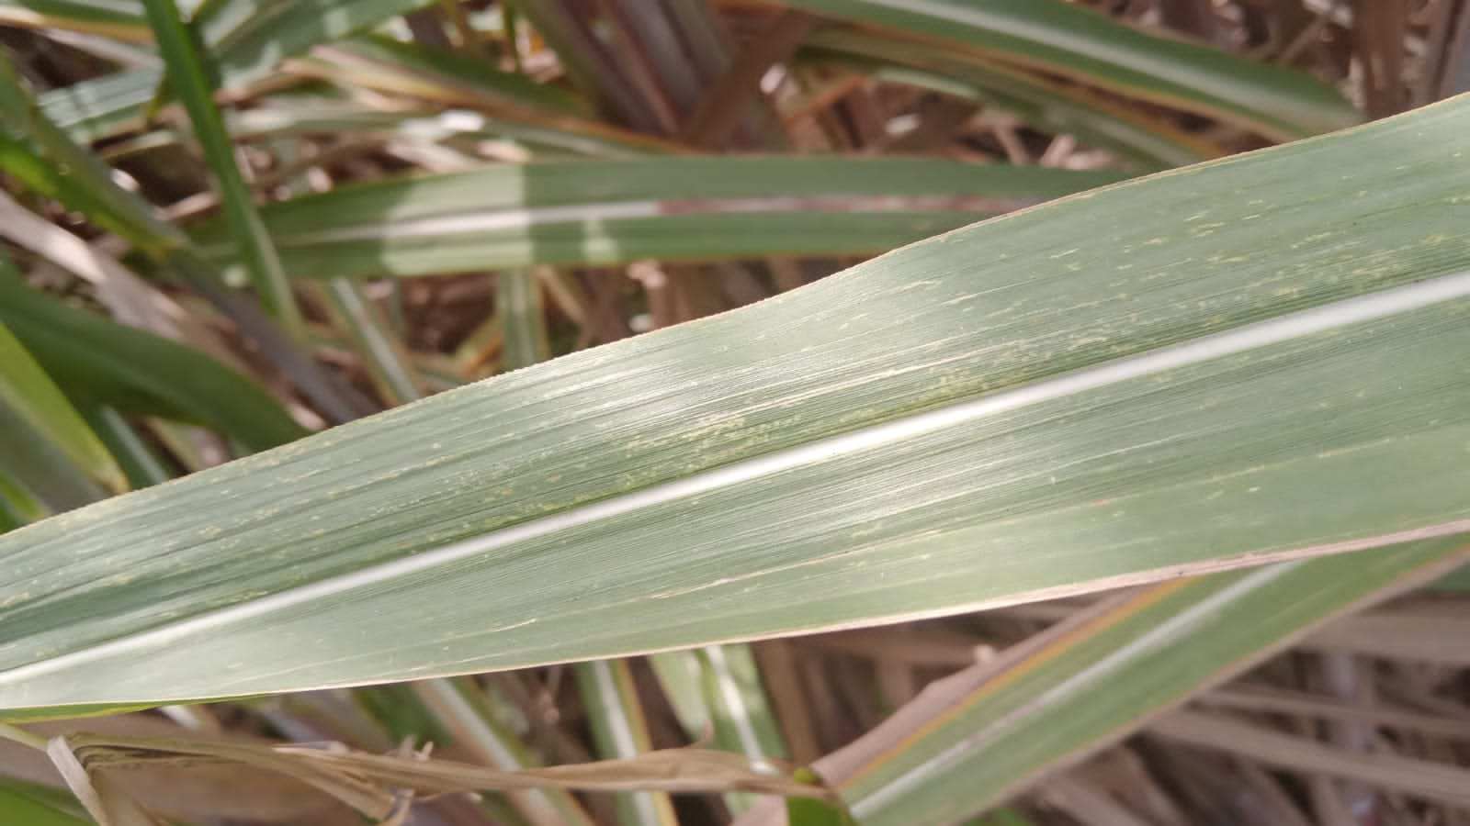
mosaic

Slide 6
What is Computer Vision
Computer vision is a field of artificial intelligence (AI) that focuses on enabling computers and systems to interpret and understand visual data from the world around them. The goal of computer vision is to replicate the complex process of human vision and allow machines to analyze, process, and make decisions based on images or video. It combines techniques from image processing, machine learning, deep learning, and pattern recognition to solve various visual recognition tasks.
Advantages of Computer Vision:
  Automation: Reduces human intervention in repetitive tasks.
  Accuracy: Increases precision and consistency in inspections.
  Real-Time Processing: Analyzes visual data instantly for timely decisions.
  Data Extraction: Identifies and interprets objects, faces, and gestures.
  Enhanced Safety: Improves safety in applications like autonomous vehicles and industrial monitoring.
  Versatile Applications: Applicable in healthcare, agriculture, retail, and security.
  Cost Efficiency: Lowers costs associated with manual monitoring and inspections.
  Scalability: Handles large volumes of visual data efficiently.

Slide 7
Deep learning with computer vision
Deep learning is a subset of machine learning that focuses on using artificial neural networks to model and solve complex patterns or tasks. These networks are called "deep" because they consist of multiple layers, each made up of interconnected nodes (also known as neurons).
Computer vision is a field of artificial intelligence that enables computers to interpret and understand visual information from the world, such as images and videos.
Hence when we use a multi layered neural network with visual data it becomes deep learning with computer vision.

Slide 8
Literature survey on RCNN model
1. UAV Sensing-Based Litchi Segmentation Using Modified Mask- RCNN for Precision Agriculture (IEEE Xplore Full-Text PDF:)
  This paper talks about counting litchi using a UAV by flying over the litchi trees.
  Drone used: DJI Phantom 4
  Dataset: 10000 images
  No. of Annotations: 31000
  Data-split: 70:20:10 = Train : Valid : Test

Slide 9
Literature survey on RCNN model
2. Soybean Disease Detection and Segmentation Based on Mask-RCNN Algorithm (https://rb.gy/0mtd97)
  This paper talks about identifying soybean disease and segmentation of the images. the selected soybean disease detection and segmentation was done based on the Mask R-CNN algorithm with the backbone ResNet50.
  No of epochs: 80
  Learning rate: 0.001

Slide 10
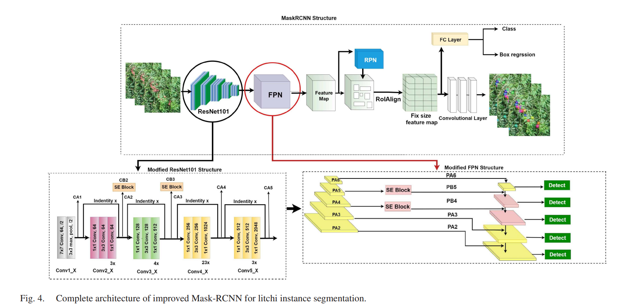

Slide 11
Masked RCNN
Mask R-CNN is an advanced deep learning model designed for object detection and instance segmentation. It extends Faster R-CNN by adding a branch for predicting segmentation masks on each Region of Interest (RoI), in addition to the classification and bounding box regression tasks performed by Faster R-CNN.
Key Features of Mask R-CNN:
Object Detection: Like Faster R-CNN, Mask R-CNN detects objects in an image by generating bounding boxes around them and classifying each detected object.
Instance Segmentation: In addition to detecting objects, Mask R-CNN adds a pixel-level mask for each object, allowing it to not only locate the object but also segment it out of the image. This is called "instance segmentation," where each object in the image is individually identified with a pixel-wise mask.

Slide 12
Architecture of Mask R-CNN:
Mask R-CNN follows a two-stage process:
Region Proposal Network (RPN):
  This is the same as in Faster R-CNN. The RPN scans the input image and proposes candidate regions (bounding boxes) where objects are likely to be located.
RoI Align (Region of Interest Alignment):
  In Faster R-CNN, RoIPool is used to map the proposed regions to a fixed size for further processing. Mask R-CNN introduces RoIAlign, which ensures that the regions are aligned more accurately without any quantization error during the pooling process. This significantly improves segmentation mask quality.
Three Outputs:
  Classification: Determines the class of the object detected within each proposed region.
  Bounding Box Regression: Refines the bounding box for more accurate localization of the object.
  Mask Prediction: A third branch predicts a binary mask for each RoI, indicating the exact pixels occupied by the object within the bounding box.

Slide 13
Algorithm for Mask R-CNN
Input: An image where objects need to be detected and segmented.
Feature Extraction: A CNN (e.g., ResNet or FPN) extracts feature maps from the image.
Region Proposal Network (RPN): Proposes candidate regions (bounding boxes) where objects might be located.
RoIAlign: Aligns the proposed regions more precisely to the original image, preserving spatial accuracy.
Object Detection:
  Classification Head: Classifies each region to identify the object.
  Bounding Box Head: Refines the bounding box coordinates for better localization.
Mask Prediction: A parallel branch predicts a binary mask (pixel-level) for each object in the region.
Final Outputs:
  Class labels (e.g., cat, car).
  Refined bounding boxes.
  Segmentation masks.
Loss Functions:
  Classification Loss: Cross-entropy loss for object identification.
  Bounding Box Loss: Smooth L1 loss for box refinement.
  Mask Loss: Binary cross-entropy loss for mask accuracy.

Slide 14
Why Mask R-CNN for anomaly detection in sugarcane crops?
Pixel-level Precision: Offers detailed segmentation of anomalous areas, enabling accurate identification of disease or pest-affected regions.
Dual Detection and Segmentation: Detects anomalies and provides exact masks, useful for identifying both the presence and spread of crop issues.
Handles Multiple Anomalies: Can detect and segment various types of crop anomalies (diseases, pests) simultaneously.
Works in Complex Environments: Effectively identifies anomalies even in fields with complex backgrounds, reducing false positives.
Higher Accuracy: RoIAlign ensures precise region alignment, improving detection of small or subtle crop issues.
Adaptability: Can be trained to detect a wide range of anomalies, making it versatile for sugarcane crop monitoring.

Slide 15
Hyperparameter Table
Hyperparameter | Description | Suggested Value
Learning Rate | Step size for updating weights | 0.001 to 0.0001
Batch Size | Number of images processed in one iteration | 2 to 8
Epochs | Number of complete passes through the dataset | 50 to 100
Backbone | Pre-trained model for feature extraction | ResNet50, ResNet101
Image Size | Input dimensions of images | 512x512 or 1024x1024
Anchor Scales | Sizes of anchor boxes for RPN | [32, 64, 128, 256, 512]
Anchor Ratios | Aspect ratios of anchor boxes | [0.5, 1, 2]
Mask Pooling Size | Output size of masks | 28x28
Dropout Rate | Fraction of neurons to drop during training | 0.5 (if applicable)
Data Augmentation | Techniques used to augment the dataset | Horizontal flip, rotation, scaling, etc.
Optimizer | Algorithm for updating weights | Adam or SGD
Warm-up Epochs | Initial epochs with a smaller learning rate | 5 to 10

Slide 16
Hyperparameter tunning
Grid Search: Explore a predefined set of hyperparameter values. This can be exhaustive and time-consuming.
Random Search: Sample a subset of hyperparameter combinations randomly. It’s often more efficient than grid search.
Bayesian Optimization: Use probabilistic models to find the best hyperparameters based on previous trials.
Hyperband: Combines random search with early stopping to allocate resources to promising configurations.

Slide 17
Performance metrics
Mean Average Precision (mAP): Overall performance metric across different classes and IoU thresholds, commonly evaluated at 0.5:0.95.
Intersection over Union (IoU): Measures the overlap between predicted and ground truth masks, with higher values indicating better localization.
Precision: The ratio of true positive detections to total predicted positives:
Recall: The ratio of true positive detections to total actual positives:
F1 Score: Combines precision and recall into a single metric

Slide 18
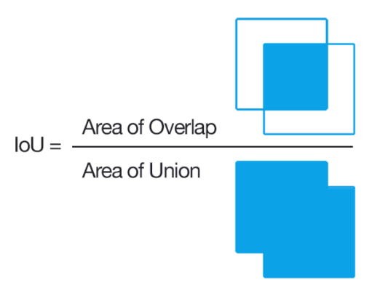


Formula for the metrics
Precision = TP / TP + FP
Recall = TP / TP + FN

Slide 19
Thank You

