Slide 1
Anomalies detection in crop health and creating a custom flight path

Slide 2
Anomalies detection in crop health and creating a custom flight path.
CB.EN.U4AEE21034
Erukala Sashank
CB.EN.U4AEE21046
Vishwa K
CB.EN.U4AEE21057
Magesvar V R
Git hub URL: https://github.com/123sashank321/Anamolies_Detection_in_Crops
Sites.google : https://sites.google.com/view/anamolies-detection-in-crops/home
Professor : Dr. T Senthil Kumar(CSE)
Collaborator : Mr. Akash (Sky –X)
Professor : S Thangeswari

Slide 3
Agenda
Introduction
Problem Statement
Literature Survey
Dataset description
Block Diagram
Methodologies
Conclusion
Future Enhancement

Slide 4
Introduction
Develop an Deep Learning algorithm to detect anomalies in crop health using sensor and imaging data.
Automate the creation of custom flight paths for agricultural spraying drones.

Slide 5
Problem Statement
Current methods for monitoring crop health and managing agricultural spraying are often inefficient and labor-intensive, leading to suboptimal crop yields and increased pesticide use. There is a need for an advanced system that combines machine learning and drone technology to detect anomalies in crop health early and automate the creation of precise, customized flight paths for treatment. This will address issues of inefficiency, high operational costs, and environmental impact in modern agriculture.

Slide 6
Literature Survey
Mendoza-Bernal, J., González-Vidal, A., & Skarmeta, A. F. (2024). A Convolutional Neural Network approach for image-based anomaly detection in smart agriculture. Expert Systems With Applications, 247, 123210. https://doi.org/10.1016/j.eswa.2024.123210
Narmilan, A., Gonzalez, F., Salgadoe, A., & Powell, K. (2022). Detection of White Leaf Disease in Sugarcane Using Machine Learning Techniques over UAV Multispectral Images. Drones, 6(9), 230. https://doi.org/10.3390/drones6090230
Attri, I., Awasthi, L. K., Sharma, T. P., & Rathee, P. (2023). A review of deep learning techniques used in agriculture. Ecological Informatics, 77, 102217. https://doi.org/10.1016/j.ecoinf.2023.102217

Slide 7
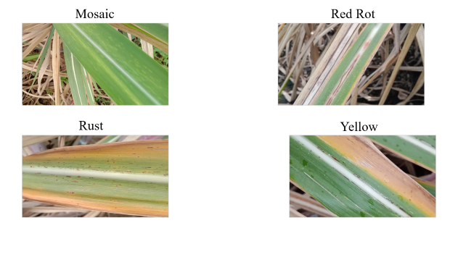

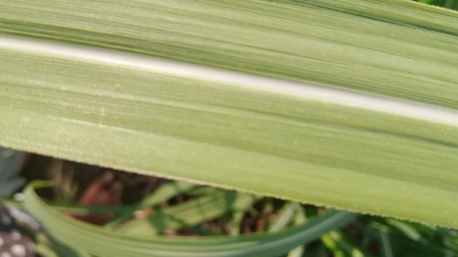
Information about Data Set
Dataset for our project is mainly based on sugarcane crops.
Our Dataset consists of images categorized into folders of
  Healthy
  Unhealthy

Slide 8
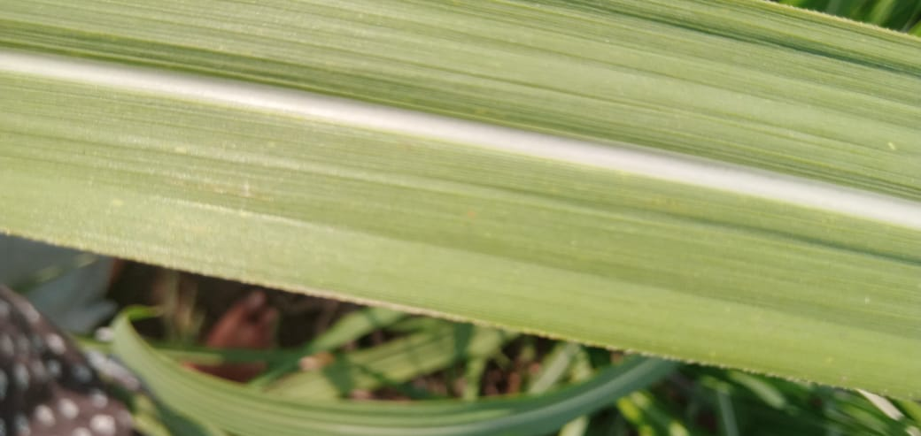

Slide 9
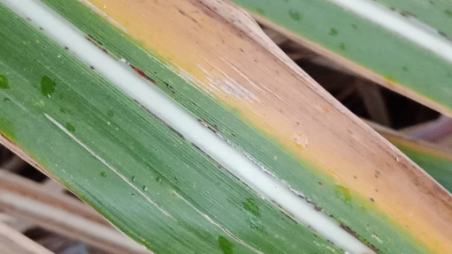
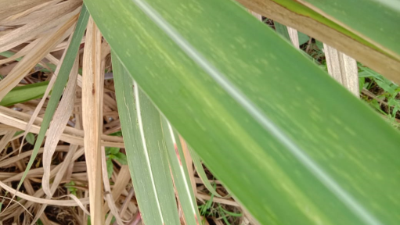
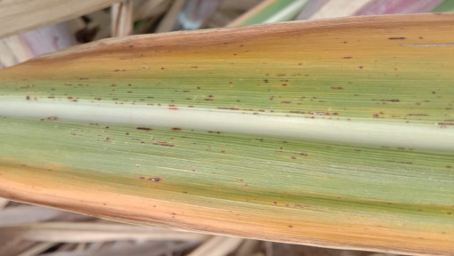
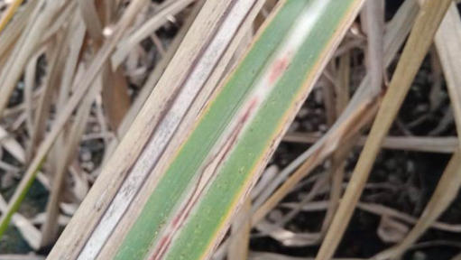
Mosaic
Red Rot
Rust
Yellow

Slide 10
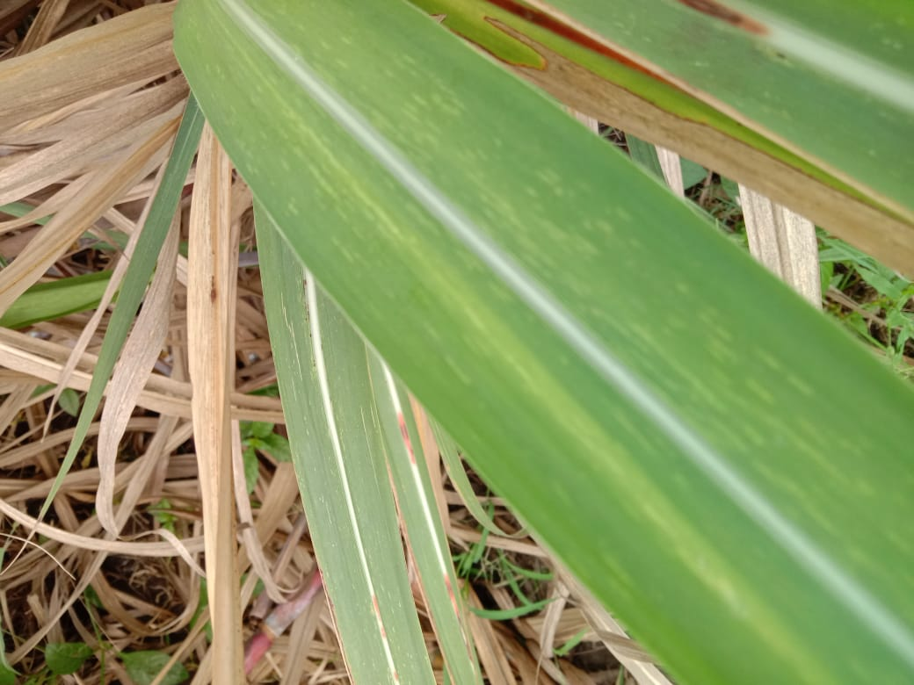

Slide 11
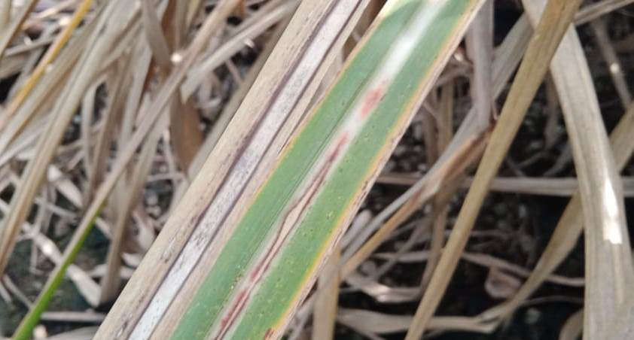

Slide 12
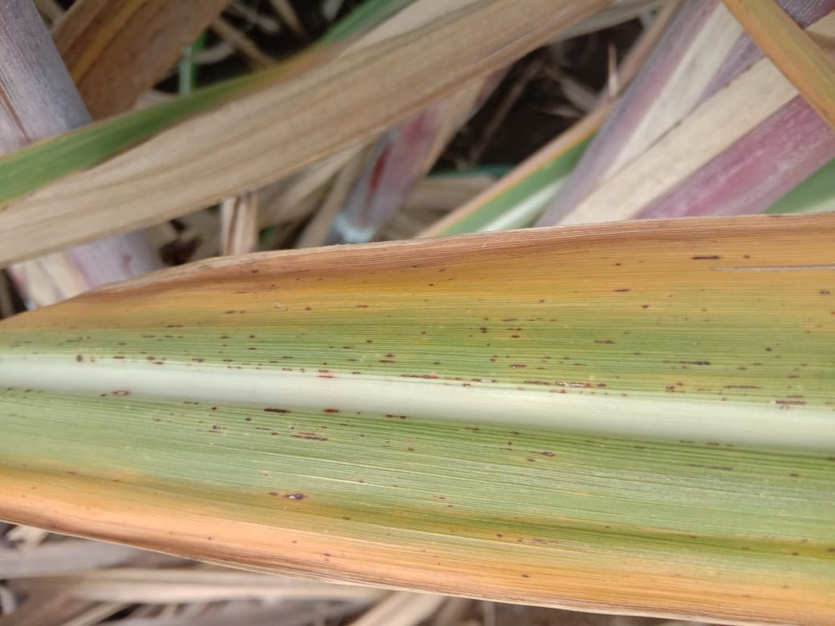

Slide 13
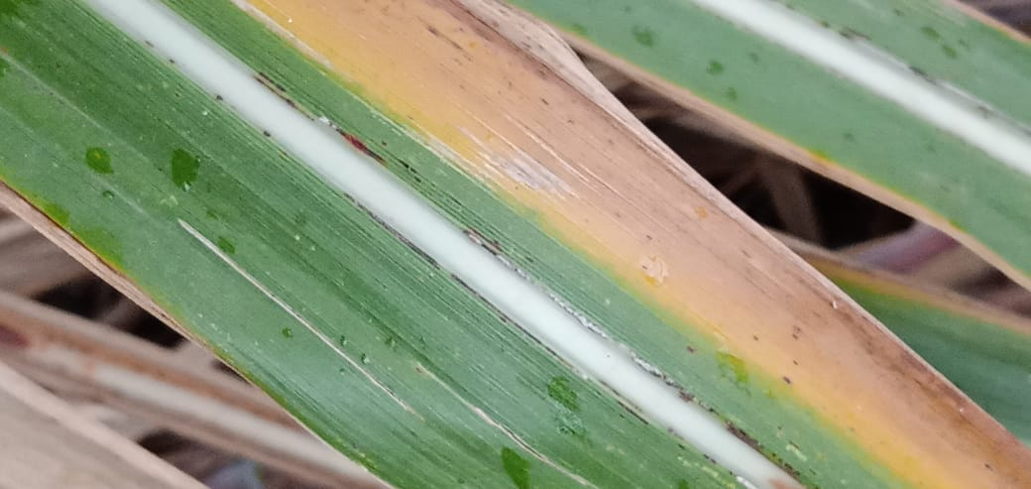

Slide 14
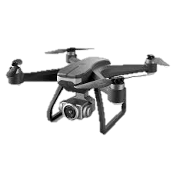
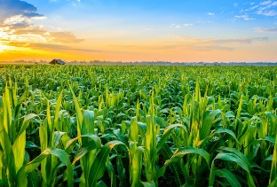

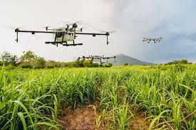


Block Diagram
Deep Learning Models
Global Coordinates of Anomaly
Reach the Coordinates
Send Coordinates to Drone Flight controller
Path Planning algorithms to reach those coordinates

Slide 15
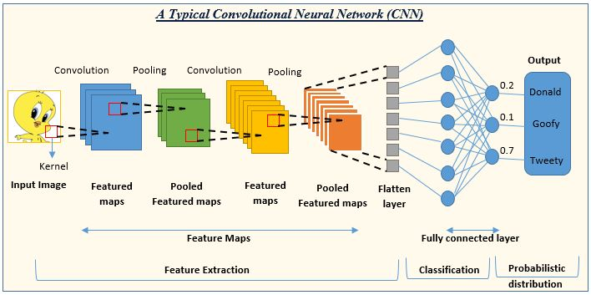
CNN Architecture
Source : https://www.analyticsvidhya.com/blog/2022/01/convolutional-neural-network-an-overview/

Slide 16
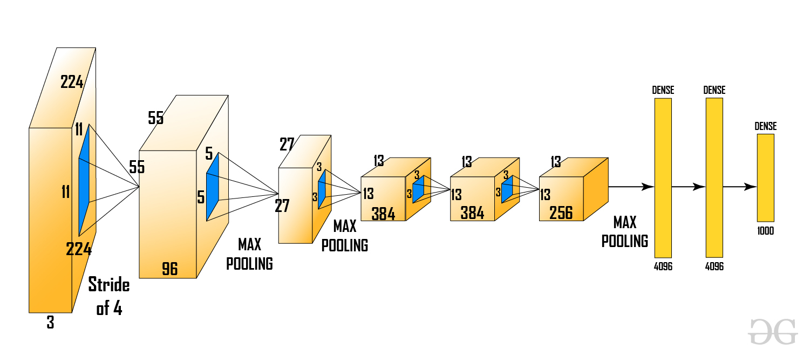
Block Diagram - RCNN
Source : https://www.geeksforgeeks.org/r-cnn-region-based-cnns/

Slide 17
Contributions
Roll.No | Name | Contribution | Uniqueness in Contribution
CB.EN.U4AEE21034 | Erukala Sashank | Equal | YOLO V8
CB.EN.U4AEE21046 | Vishwa K | Equal | Fast R - CNN
CB.EN.U4AEE21057 | Magesvar V R | Equal | CNN

Slide 18
Research Questions
Can your product estimate the area of the field?
What height should the Drone fly and how it is related to the crop?
Can Drone capturing mechanism damage the crop?
What is the novelty of the output?

Slide 19
Statistical Reference
Up to 40% of global crop yields are lost annually due to pests, diseases, and nutrient deficiencies.
Early detection of crop issues can improve yield by up to 20% through timely intervention.
Precision agriculture technologies can reduce pesticide use by 10-30%, minimizing environmental impact.
Automated systems can lower labor costs by 15-25% while improving treatment accuracy.

Slide 20
Social Relevance
Food Security: Enhances crop yield and quality, contributing to a more reliable food supply.
Sustainable Agriculture: Reduces pesticide use and promotes eco-friendly farming practices.
Economic Impact: Lowers operational costs for farmers and increases agricultural productivity.
Labor Efficiency: Automates routine tasks, freeing up labor for more skilled agricultural work.

Slide 21
Problem Statement
Current methods for monitoring crop health and managing agricultural spraying are often inefficient and labor-intensive, leading to suboptimal crop yields and increased pesticide use. There is a need for an advanced system that combines machine learning and drone technology to detect anomalies in crop health early and automate the creation of precise, customized flight paths for treatment. This will address issues of inefficiency, high operational costs, and environmental impact in modern agriculture.

Slide 22
Pros and Cons of using different approach
Data Mining
Machine Learning
Deep learning
Explainable AI
Federated Learning
Transfer Learning
Generative AI
Agent AI

Slide 23
Data Mining
Advantages:
Pattern Discovery: Efficiently identifies hidden patterns and correlations in large datasets, which is crucial for understanding crop health trends.
Data-Driven Decisions: Helps in making informed decisions based on historical data and trends, leading to optimized spraying schedules and routes.
Cost-Effective: Generally less computationally intensive than more advanced ML techniques, making it accessible for initial stages of analysis.
Limitations:
Limited Predictive Power: May not be as effective in predicting future anomalies or changes in crop health compared to ML or DL methods.
Static Analysis: Lacks the adaptability and learning capabilities of machine learning models, making it less effective for dynamic and evolving agricultural environments.
Dependency on Quality of Data: Highly dependent on the quality and completeness of the data available, which can be a limiting factor in rural or underdeveloped areas.

Slide 24
Machine Learning
Advantages:
Predictive Modeling: Capable of building predictive models that can anticipate crop health issues before they become severe, allowing for proactive measures.
Adaptability: Can adapt to new data and improve over time, providing increasingly accurate predictions and recommendations.
Versatility: Applicable to various types of data (e.g., soil, weather, crop images), enabling a holistic approach to anomaly detection and flight path planning.
Limitations:
Data Requirements: Requires substantial amounts of labeled data to train accurate models, which can be challenging to gather in agricultural settings.
Complexity: Implementing and maintaining ML models can be complex and may require specialized knowledge and resources.
Overfitting Risk: ML models may overfit to training data, reducing their effectiveness on new, unseen data if not properly managed.

Slide 25
Deep Learning
Advantages:
High Accuracy: Capable of achieving high levels of accuracy in anomaly detection due to its ability to model complex patterns in large datasets.
Automation: Can automate feature extraction, reducing the need for manual intervention and allowing for the discovery of subtle patterns.
Scalability: Effective in handling large-scale data from diverse sources, such as satellite imagery, drone footage, and IoT sensor data.
Limitations:
Resource Intensive: Requires significant computational resources and large labeled datasets for training, which may not be feasible in all settings.
Interpretability: Deep learning models are often seen as "black boxes," making it difficult to understand and interpret their decisions.
Deployment Complexity: Implementing and maintaining DL models in real-world agricultural environments can be challenging and costly.

Slide 26
Explainable AI
Advantages:
Transparency: Provides clear insights into how decisions are made, increasing trust and acceptance among stakeholders.
Regulatory Compliance: Helps in meeting regulatory requirements by providing explanations for automated decisions.
Improved Model Understanding: Enhances the ability to debug and improve models by understanding their decision-making processes.
Limitations:
Complexity: Developing explainable models can be more complex and may require trade-offs between accuracy and interpretability.
Performance Trade-offs: Explainable models may not always achieve the same level of performance as less interpretable models.
Limited Tools: The field of explainable AI is still evolving, with limited tools and frameworks available compared to traditional ML/DL.

Slide 27
Federated Learning
Advantages:
Data Privacy: Enables the use of distributed data without requiring it to be centralized, preserving privacy and security.
Collaboration: Facilitates collaboration among different organizations or farms, leading to more robust and diverse models.
Scalability: Can scale across multiple devices and locations, making it suitable for large-scale agricultural deployments.
Limitations:
Communication Overhead: Requires efficient communication protocols to handle the exchange of model updates, which can be challenging in remote areas.
Heterogeneity: Managing heterogeneous data and models from different sources can be complex and may affect model performance.
Limited Control: Reduces control over individual data, which may impact the ability to fine-tune and optimize models for specific use cases.

Slide 28
Transfer Learning
Advantages:
Reduced Training Time: Leverages pre-trained models to reduce the amount of training data and time required to develop accurate models.
Enhanced Performance: Can improve performance by transferring knowledge from related tasks or domains.
Resource Efficiency: Minimizes the need for extensive computational resources and large datasets, making it accessible for smaller farms.
Limitations:
Domain Adaptation: May require significant adaptation to fit the specific context of crop health monitoring and anomaly detection.
Data Mismatch: Differences between the source and target domains can impact the effectiveness of transfer learning.
Limited Applicability: Not all pre-trained models may be suitable for agricultural applications, requiring careful selection and customization.

Slide 29
Generative AI
Advantages:
Data Augmentation: Can generate synthetic data to augment training datasets, improving model robustness and performance.
Scenario Simulation: Allows for the simulation of various scenarios and conditions, aiding in the development of robust models.
Innovative Solutions: Enables the exploration of innovative solutions and techniques for anomaly detection and flight path planning.
Limitations:
Complexity: Developing and training generative models can be complex and resource-intensive.
Quality Control: Ensuring the quality and realism of generated data can be challenging, impacting model performance.
Ethical Considerations: Raises ethical concerns around data generation and potential misuse.

Slide 30
Agent AI
Advantages:
Autonomous Decision-Making: Enables the development of autonomous agents that can make real-time decisions, reducing the need for human intervention.
Scalability: Can scale across large agricultural fields, managing multiple tasks simultaneously.
Adaptability: Agents can adapt to changing conditions and continuously learn from their environment.
Limitations:
Complex Development: Developing intelligent agents requires advanced knowledge and resources, which may not be readily available.
Integration Challenges: Integrating agent AI with existing systems and processes can be challenging.
Maintenance: Requires ongoing maintenance and updates to ensure optimal performance and adaptability.

Slide 31
Types of Machine Learning
Supervised Learning
Unsupervised Learning
Reinforcement Learning
Deep Learning

Slide 32
Computer Vision Algorithms
Convolutional Neural Networks (CNNs) (1980)
Application: Image recognition, classification
Region-Based Convolutional Neural Networks (R-CNNs) (2014)
Application: Object detection
YOLO (You Only Look Once) (2016)
Application: Real-time object detection
SSD (Single Shot Detector) (1991)
Application: Real-time object detection
Mask R-CNN (2017)
Application: Object instance segmentation

Slide 33
Computer Vision Algorithms
Generative Adversarial Networks (GANs) (2014)
Application: Image generation, style transfer
Optical Character Recognition (OCR) (1993)
Application: Text detection and recognition
SIFT (Scale-Invariant Feature Transform) (1999)
Application: Image matching and object recognition
Eigenfaces and Fisherfaces
Application: Face recognition
DeepFace (2015)
Application: Face verification and recognition

Slide 34
Analytical Questions
Easy:
How often do the ML algorithm's anomaly detections need to be validated by manual checks?
What types of crop health anomalies can the drone's spraying system address effectively?
Medium:
How does the accuracy of anomaly detection vary with different sensor types or data inputs?
What is the effect of different spray dosage levels on crop health outcomes?
Hard:
How can the ML algorithm be optimized to improve anomaly detection in varying environmental conditions (different weather, lighting)?
What are the trade-offs between system complexity and accuracy in the automated flight path generation for the drone?

Slide 35
Prediction Questions
Easy:
What is the predicted improvement in anomaly detection accuracy with the use of the ML algorithm compared to manual inspection?
How likely is the drone’s automated spraying system to reduce pesticide usage compared to traditional methods?
Medium:
How might changes in sensor data quality affect the accuracy of anomaly detection predictions?
What are the expected changes in crop yield when using the ML-driven automated system compared to conventional methods?
Hard:
How will variations in environmental factors (e.g., weather conditions, crop types) impact the predictive performance of the ML algorithm for anomaly detection?
What are the long-term predictions for cost savings and environmental benefits with widespread adoption of this ML and drone system in agriculture?

Slide 36
Difference between Image Processing and Computer Vision
 | Computer Vision | Image Processing
Goals | Extracting insights from images and videos. | Manipulating visual aspects of images.
Input/Output | Input can be both image and video. Output can be an interpretation, which is often non-visual. | Input and output are both images.
Scope | More comprehensive. | Low-level operations that affect pixels within an image.
Methods | Complex algorithms and techniques. | More straightforward operations.
Common Applications | Autonomous vehicles, robotics, augmented reality, etc. | Image editing software (like Photoshop), medical imaging enhancements, etc.

Slide 37
Deep Learning Architecture
CNN- Convolution Neural Network
CNNs are highly effective in handling image data, which is crucial for analyzing visual information from crops.
They automatically detect and learn important features (e.g., color, texture, and shape) from images, making them ideal for identifying anomalies like disease spots, pest infestations, and nutrient deficiencies.
CNNs can capture spatial hierarchies in images, which helps in understanding the context and relative positioning of different features within the crop images.

Slide 38
Deep Learning Architecture
RNN- Recurrent Neural Network
RNNs are designed to handle sequential data and can capture temporal dependencies, which is useful if you're analyzing time-series data (e.g., monitoring crop health over different growth stages).
They can keep track of historical data, which helps in understanding how past conditions affect current crop health, leading to more accurate anomaly detection.
RNNs can adapt to varying lengths of input sequences, making them versatile for different types of temporal data in agricultural monitoring.

Slide 39
Deep Learning Architecture
Fast R-CNN (Region based convolutional neural network)
It is useful for detecting and classifying objects within an image, such as identifying specific regions of crops that show signs of anomalies.
Faster R-CNN allows for end-to-end training, which simplifies the model training process and enhances the overall detection performance.
It uses region proposals to focus on relevant parts of the image, reducing computational load and increasing detection accuracy for smaller anomalies.

