Slide 1

Anomalies detection in crop health and creating a custom flight path.
CB.EN.U4AEE21034
Erukala Sashank
Case Study Review-2
Git hub URL: https://github.com/123sashank321/Anamolies_Detection_in_Crops
Sites.google : https://sites.google.com/view/anamolies-detection-in-crops/home
Professor : Dr. T Senthil Kumar(CSE)
Collaborator : Mr. Akash (Sky –X)
Professor : S Thangeswari

Slide 2
Contents
Introduction
Problem Statement
Literature Survey
YOLO Architecture and its Features
Block Diagram/Methodology
Why YOLO-V8 ?
Computer Vision Based Approach
Hyper Parameter Table
Hyper Parameter Tuning
Setup Planned
Formula for performance Metrics

Slide 3
Introduction
In agriculture, timely detection of crop health issues like diseases, pests, and nutrient deficiencies is crucial for maximizing yield and ensuring food security. Traditional methods of monitoring, which rely on manual inspection, are slow, labor-intensive, and often miss early signs of problems. As farms grow larger, effective monitoring becomes increasingly challenging.
This project addresses these issues by combining drone technology and Deep learning to automate crop health monitoring. Drones capture large-scale, high-resolution imagery, while algorithms detect anomalies early, enabling targeted intervention. This approach reduces resource waste, minimizes environmental impact, and enhances productivity, making it a vital tool for modern precision farming.

Slide 4
Problem Statement
Current methods for monitoring crop health and managing agricultural spraying are often inefficient and labor-intensive, leading to suboptimal crop yields and increased pesticide use. There is a need for an advanced system that combines machine learning and drone technology to detect anomalies in crop health early and automate the creation of precise, customized flight paths for treatment. This will address issues of inefficiency, high operational costs, and environmental impact in modern agriculture.

Slide 5
Literature Survey
Title | Methodology | Purpose | Result
A Convolutional Neural Network approach for image-based anomaly detection in smart agriculture | Convolutional neural networks (CNN) for identifying anomalies in agricultural images. | It aims to address issues like class imbalance, lack of model generalization, and insufficient variety of training images by leveraging data augmentation techniques and Gaussian noise addition. | The methodology improved accuracy for both the Deep Weeds dataset (98%) and the Agriculture-Vision dataset (95.3%) using CNNs.
A lightweight SSV2-YOLO based model for detection of sugarcane aphids in unstructured natural environments | a lightweight SSV2-YOLO model based on YOLOv5s for SCA detection by reconstructing the backbone network with Stem and ShuffleNet V2 and adjusting the neck network width. | Existing pest detection algorithms struggle with small, high-density pests in natural environments due to computational constraints and image challenges. This calls for more efficient and accurate methods. | Compared with the YOLOv5s, SSV2-YOLO significantly reduced model complexity , parameter number (by 95.1%), model size (by 92.5%), increased detection speed (GPU by 31.6% and CPU by 81.8%) and improved accuracy (by 2.5%).
Smart Agriculture Drone for Crop Spraying Using Image-Processing and Machine Learning Techniques: Experimental Validation | a smart agriculture drone integrated with Internet of Things technologies that use machine learning techniques such as TensorFlow Lite with an EfficientDetLite1 model | To identify objects from a custom dataset trained on three crop classes, namely, pineapple, papaya, and cabbage species, achieving an inference time of 91 ms. | As a result, the drone maintained a speed of 7.5 m/s, synchronized with an image-processing time of 91 ms. This alignment allowed for effective image capture and processing, ensuring precise and timely spraying.

Slide 6
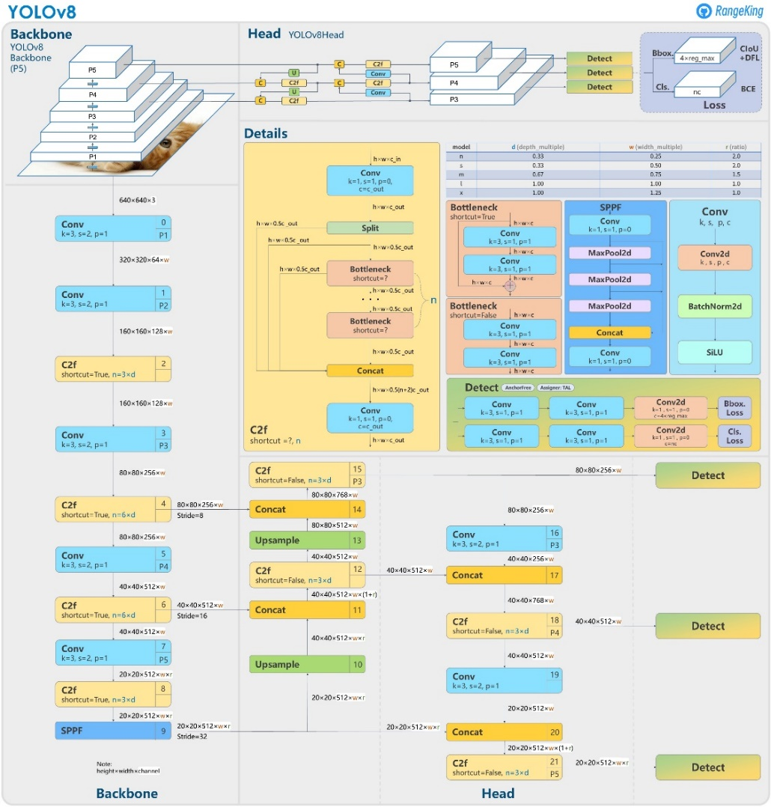
YOLO Architecture & its Features
Improved Back Bone
Neck (FPN+PAN)
Anchor Free detection
Dynamic Head
Scaled Architecture
Advanced Loss Function
Advanced NMS techniques
Source : [1]

Slide 7

YOLO Architecture & its Features
Source : [1]

Slide 8
YOLO Architecture & its Features
Source : [1]

Slide 9
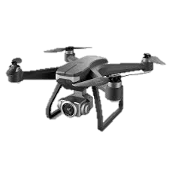
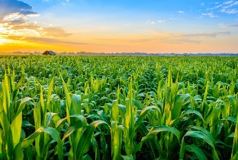
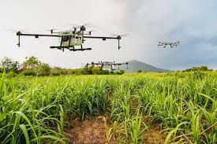
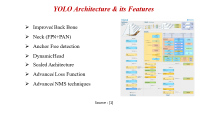
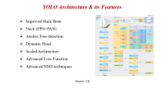
Block Diagram/Methodology
Global Coordinates of Anomaly
Deep Learning Model
Reach the Coordinates
Send Coordinates to Drone Flight controller
Path Planning algorithms to reach those coordinates

Slide 10
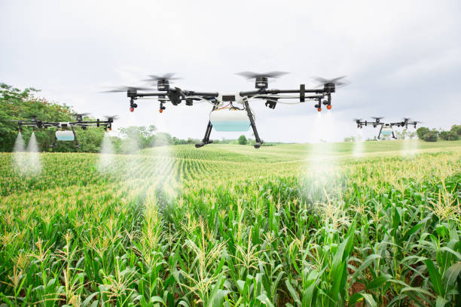
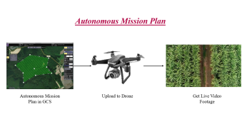
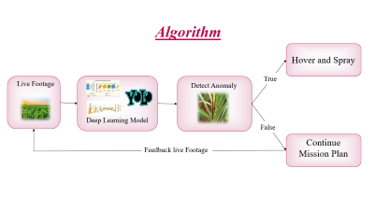
Block Diagram/Methodology
Autonomous Mission Plan
Output
AI and Algorithm

Slide 11
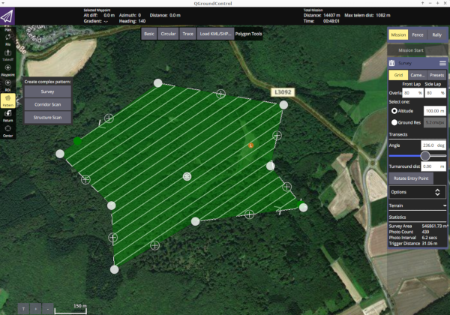
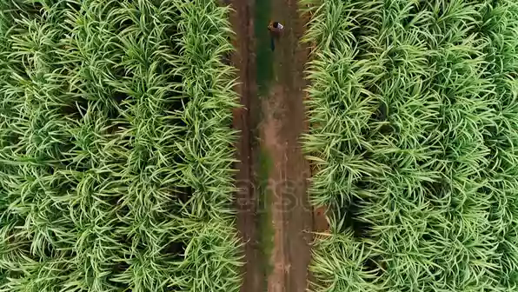
Autonomous Mission Plan
Autonomous Mission Plan in GCS
Upload to Drone
Get Live Video Footage

Slide 12
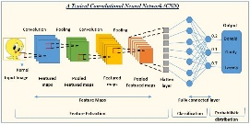

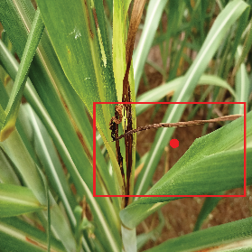
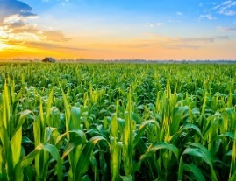
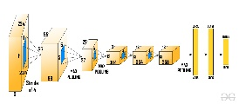
Algorithm
Hover and Spray
True
Live Footage
Detect Anomaly
Deep Learning Model
False
Continue Mission Plan
Feedback live Footage

Slide 13
Why YOLO-V8 Architecture
YOLO v8 is highly suitable for this application, with recent advancements further improving its efficacy:
Real-time processing: Crucial for on-the-fly drone path adjustments
Enhanced small object detection: Ideal for subtle anomalies
Multi-task learning: Combining detection and segmentation
Enables on-drone processing
Additionally, comparing to YOLOv5s, the SSV2-YOLO variant demonstrates significant improvements:
Smaller model size: 92.5% reduction, vital for drone deployment
Increased detection speed: 31.6% faster on GPU, 81.8% on CPU
Improved accuracy: 2.5% increase in detection precision

Slide 14
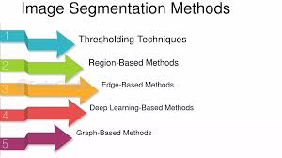
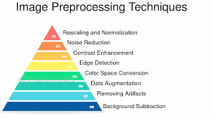
Computer Vision based Approach
Anomaly Detection:
Autoencoders for unsupervised anomaly detection
One-Class SVM or Isolation Forest for detecting novel anomalies
Image Enhancement:
Histogram equalization for improved contrast
Adaptive thresholding for dealing with varying lighting conditions
Spectral Analysis:
Principal Component Analysis (PCA) for multispectral image analysis
Spectral unmixing techniques for hyperspectral data
Texture Analysis:
Gray Level Co-occurrence Matrix (GLCM) for texture feature extraction
Gabor filters for capturing spatial frequency information
Shape Analysis:
Contour analysis for leaf shape characterization
Hu Moments for rotation-invariant shape description

Slide 15
Hyper Parameter Table
Hyperparameter | Description | Typical Range
Learning Rate | Controls the step size during optimization | 1e-5 to 1e-2
Batch Size | Number of training examples used in one iteration | 8 to 128
Number of Epochs | Number of complete passes through the training dataset | 50 to 300
Image Size | Input image dimensions | 320 to 1280
Optimizer | Algorithm to update network weights | Adam, SGD
Momentum (for SGD) | Accelerates gradient descent | 0.9 to 0.99
Augmentation Strength | Intensity of data augmentation | 0 to 1
Warmup Epochs | Number of epochs for learning rate warmup | 0 to 5
Box Loss Weight | Weight for bounding box regression loss | 0.02 to 0.1
Class Loss Weight | Weight for classification loss | 0.2 to 1.0

Slide 16
Hyper Parameter Tuning
Hyperparameter Tuning Strategy
Start with default values provided by the YOLO v8 implementation.
Perform a coarse grid search on key parameters (learning rate, batch size, image size).
Use Bayesian optimization or random search for fine-tuning.
Monitor training and validation curves to identify overfitting or underfitting.
Adjust data augmentation based on model performance and dataset size.
Fine-tune loss weights if certain aspects (localization, classification) are underperforming.
Experiment with different optimizers and learning rate schedules.
Consider model ensemble or test-time augmentation for final performance boost.

Slide 17
Setup Planned
Gather a diverse dataset of crop images, including various anomalies.
Train and optimize the YOLO v8 model for your specific use case.
Implement the system on suitable hardware for drone deployment.
Conduct thorough testing and validation in real-world conditions.

Slide 18
Formulas for Performance Metrics
Accuracy = (TP + TN) / (TP + TN + FP + FN)
Precision = TP / (TP + FP)
Recall = TP / (TP + FN)
F1 Score = 2 * (Precision * Recall) / (Precision + Recall)

Slide 19
References
https://github.com/ultralytics/ultralytics/issues/189
Singh, E.; Pratap, A.; Mehta, U.; Azid, S.I. Smart Agriculture Drone for Crop Spraying Using Image-Processing and Machine Learning Techniques: Experimental Validation. IoT 2024, 5, 250–270. https://doi.org/10.3390/iot5020013
A lightweight SSV2-YOLO based model for detection of sugarcane aphids in unstructured natural environments https://doi.org/10.1016/j.compag.2023.107961
Jacob Solawetz, Francesco. (Sep 4, 2024). What is YOLOv8? A Complete Guide.. Roboflow Blog: https://blog.roboflow.com/what-is-yolov8/
https://doi.org/10.1186/s40537-021-00434-w

Slide 20
Thank You

