Slide 1



Anomaly Detection
Presented by: Sourour Hammoud
23 August, 2025

Slide 2
Plan:
What is Anomaly Detection?
Methods of Anomaly Detection
Libraries Used to Build Anomaly Detection Application
Dataset Description
Python Coding Strategy
2

Slide 3

What is Anomaly Detection
Anomaly detection is the identification of rare events, items, or observations which are suspicious because they differ significantly from standard behaviors or patterns. Anomalies in data are also called standard deviations, outliers, noise, novelties, and exceptions [1].
3

Slide 4
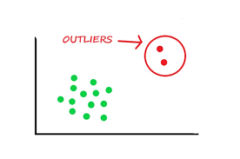
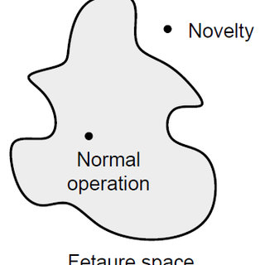

Outliers Detection:
The training data contains outliers which are defined as observations that are far from the others. Outlier detection estimators thus try to fit the regions where the training data is the most concentrated, ignoring the deviant observations [2].
Novelty Detection:
The training data is not polluted by outliers and we are interested in detecting whether a new observation is an outlier. In this context an outlier is also called a novelty [2].
Outlier detection and novelty detection are both used for anomaly detection, where one is interested in detecting abnormal or unusual observations [2].
4

Slide 5

Methods of Anomaly Detection
Isolation Forest:
The Isolation Forest ‘isolates’ observations by randomly selecting a feature and then randomly selecting a split value between the maximum and minimum values of the selected feature [3].
Local outlier Factor(LOF):
It measures the local deviation of the density of a given sample with respect to its neighbors. It is local in that the anomaly score depends on how isolated the object is with respect to the surrounding neighborhood [4].
One Class SVM:
Unsupervised Outlier Detection.
Estimate the support of a high-dimensional distribution [5].
5

Slide 6
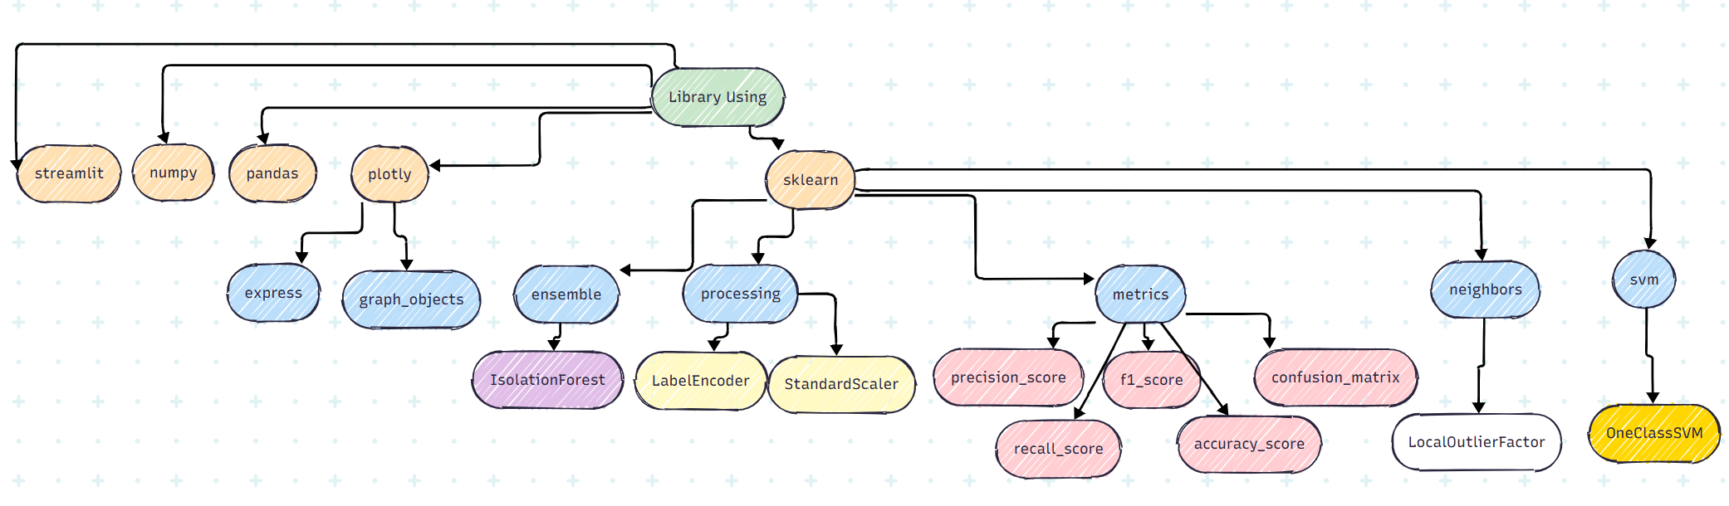
Libraries Used to Build Anomaly Detection Application
6

Slide 7




Dataset Description:
Cybersecurity intrusion data
Card Transdata
Occupancy
The Cybersecurity Intrusion Detection Dataset is created to identify cyberattacks using network traffic and user behavior, with details on its structure, key features, analysis methods, and applications in machine learning [7].
According to the Data Breach Index, more than 5 million records are being stolen on a daily basis, a concerning statistic that shows - fraud is still very common both for Card-Present and Card-not Present type of payments [6].
binary classification (room occupancy) from Temperature, Humidity, Light and CO2. occupancy was obtained from time stamped pictures that were taken every minute [8].
7

Slide 8
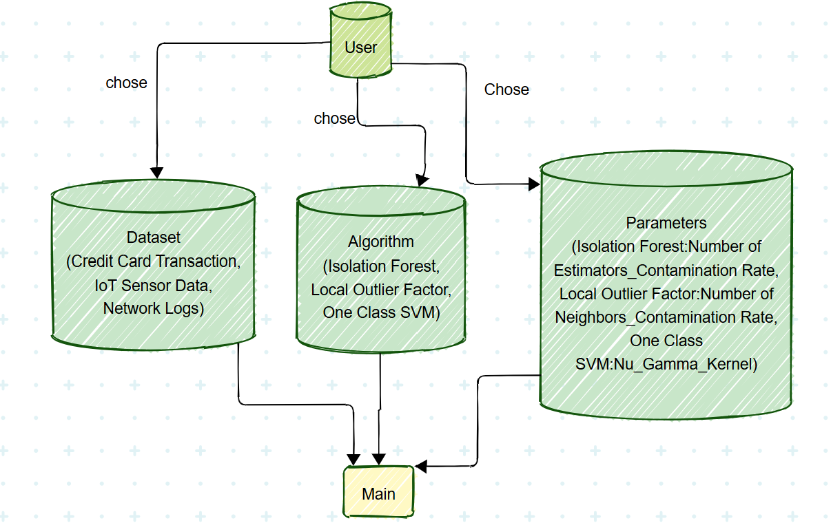
Python Coding Strategy
8

Slide 9
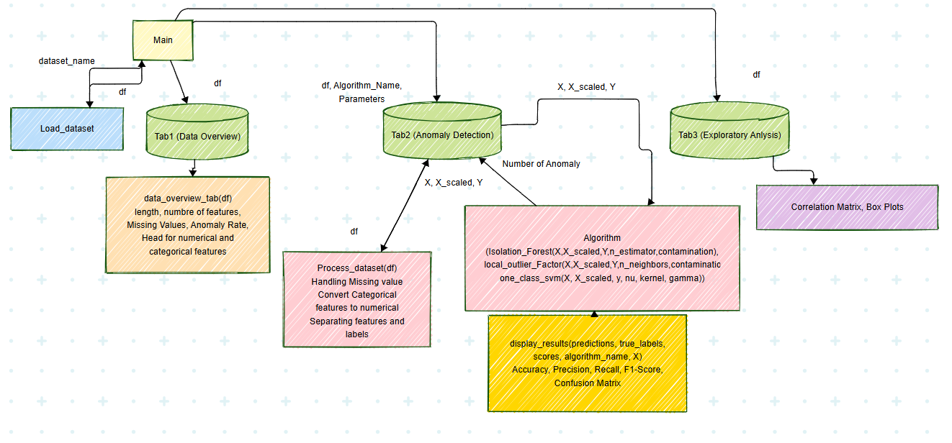
Python Coding Strategy
9

Slide 10
Reference:
https://www.vmware.com/topics/anomaly-detection [1]
https://scikit-learn.org/stable/modules/outlier_detection.html [2]
https://scikit-learn.org/stable/modules/generated/sklearn.ensemble.IsolationForest.html#sklearn.ensemble.IsolationForest [3]
https://scikit-learn.org/stable/modules/generated/sklearn.neighbors.LocalOutlierFactor.html#sklearn.neighbors.LocalOutlierFactor [4]
https://scikit-learn.org/stable/modules/generated/sklearn.svm.OneClassSVM.html#sklearn.svm.OneClassSVM [5]
https://www.kaggle.com/datasets/dhanushnarayananr/credit-card-fraud [6]
https://www.kaggle.com/datasets/dnkumars/cybersecurity-intrusion-detection-dataset [7]
https://www.kaggle.com/datasets/kukuroo3/room-occupancy-detection-data-iot-sensor [8]
10

Slide 11
Thank you

