Slide 1



Anomaly Detection
Presented by: Sourour Hammoud
23 August, 2025

Slide 2
Plan:
What is Anomaly Detection?
Methods of Anomaly Detection
Libraries Used to Build Anomaly Detection Application
Dataset Description
Python Coding Strategy
2

Slide 3

What is Anomaly Detection
Anomaly detection is the identification of rare events, items, or observations which are suspicious because they differ significantly from standard behaviors or patterns. Anomalies in data are also called standard deviations, outliers, noise, novelties, and exceptions [1].
3
Notes:
Anomaly detection is the process of finding data points, events, or patterns that do not follow the expected normal behavior. it means spotting things that look unusual or different compared to the majority of the data. In banking → detecting a fraudulent transaction.
In networks → detecting cyberattacks or intrusions.
Exmple: A credit card used in two countries within 5 minutes

Slide 4
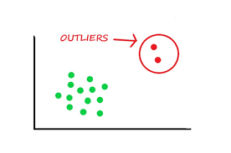
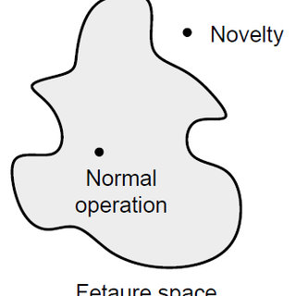

Outliers Detection:
The training data contains outliers which are defined as observations that are far from the others. Outlier detection estimators thus try to fit the regions where the training data is the most concentrated, ignoring the deviant observations [2].
Novelty Detection:
The training data is not polluted by outliers and we are interested in detecting whether a new observation is an outlier. In this context an outlier is also called a novelty [2].
Outlier detection and novelty detection are both used for anomaly detection, where one is interested in detecting abnormal or unusual observations [2].
4
Notes:
Outliers detection: finding data points that are very different( unusual or externe) compared to that the rest of the data. Use case: errors in data collection rare or meaningful anomalies(fraud).
Novelty detection: learns what is normal and then checks if new data deviates from it

Slide 5

Methods of Anomaly Detection
Isolation Forest:
The Isolation Forest ‘isolates’ observations by randomly selecting a feature and then randomly selecting a split value between the maximum and minimum values of the selected feature [3].
Local outlier Factor(LOF):
It measures the local deviation of the density of a given sample with respect to its neighbors. It is local in that the anomaly score depends on how isolated the object is with respect to the surrounding neighborhood [4].
One Class SVM:
Unsupervised Outlier Detection.
Estimate the support of a high-dimensional distribution [5].
5
Notes:
Isolation Forest: works by. Anomalies are easier to isolate, while normal points require more splits. Works will in high dimension
Local outlier detection: detects anomalies by comparing local density of each point with its neighbors.
One class svm:learns a decision boundary around the data using support vector machine. Good for complex boundary but can be sensitive to parameters choices(kernel, nu, gamma)

Slide 6
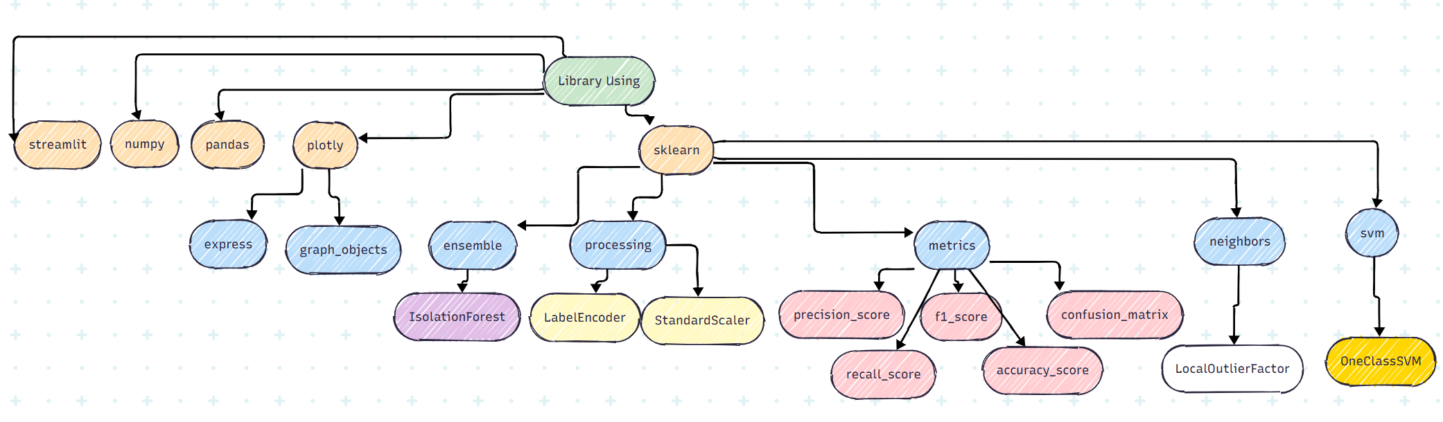
Libraries Used to Build Anomaly Detection Application
6
Notes:
streamlit → To build the web application interface.
numpy → For mathematical operations (arrays, matrices).
pandas → For data manipulation and cleaning (tables, CSV files).
plotly → For data visualization (interactive plots). Plotly is a Python library used for data visualization.
sklearn (scikit-learn) → For machine learning and anomaly detection algorithms.
express → Easy, high-level plotting (quick charts).
graph_objects → More detailed, customizable plotting.
ensemble → IsolationForest
A popular anomaly detection algorithm that isolates outliers.
processing → LabelEncoder, StandardScaler
LabelEncoder → Converts categorical values (like “yes/no”) into numbers.
StandardScaler → Normalizes data (mean=0, std=1).
metrics → precision_score, recall_score, f1_score, accuracy_score, confusion_matrix
Used to evaluate model performance.
Example: precision = how many predicted anomalies are actually true anomalies.
neighbors → LocalOutlierFactor (LOF)
Detects anomalies based on local density differences.
svm → OneClassSVM
A support vector machine version for anomaly detection.
Confusion matrix: table that compares the true labels with the predicted labels. Precision score: Out of all the points the model said are anomalies, how many are actually anomalies = TP/TP+FP
Recall score or sensitive: Out of all the real anomalies, how many did the model actually find TP/TP+FN
F1 score:A balance between precision and recall. =2*precision*recall/precision+recall. Useful when you want a balance (not just high precision or high recall).
Accuracy score: Out of all predictions, how many were correct =TP+TN/Total
In anomaly detection, accuracy can be misleading (if anomalies are rare, the model may just predict “normal” always and still get high accuracy).
Matplotlib

Slide 7




Dataset Description:
Cybersecurity intrusion data
Card Transdata
Occupancy
The Cybersecurity Intrusion Detection Dataset is created to identify cyberattacks using network traffic and user behavior, with details on its structure, key features, analysis methods, and applications in machine learning [7].
According to the Data Breach Index, more than 5 million records are being stolen on a daily basis, a concerning statistic that shows - fraud is still very common both for Card-Present and Card-not Present type of payments [6].
binary classification (room occupancy) from Temperature, Humidity, Light and CO2. occupancy was obtained from time stamped pictures that were taken every minute [8].
7

Slide 8
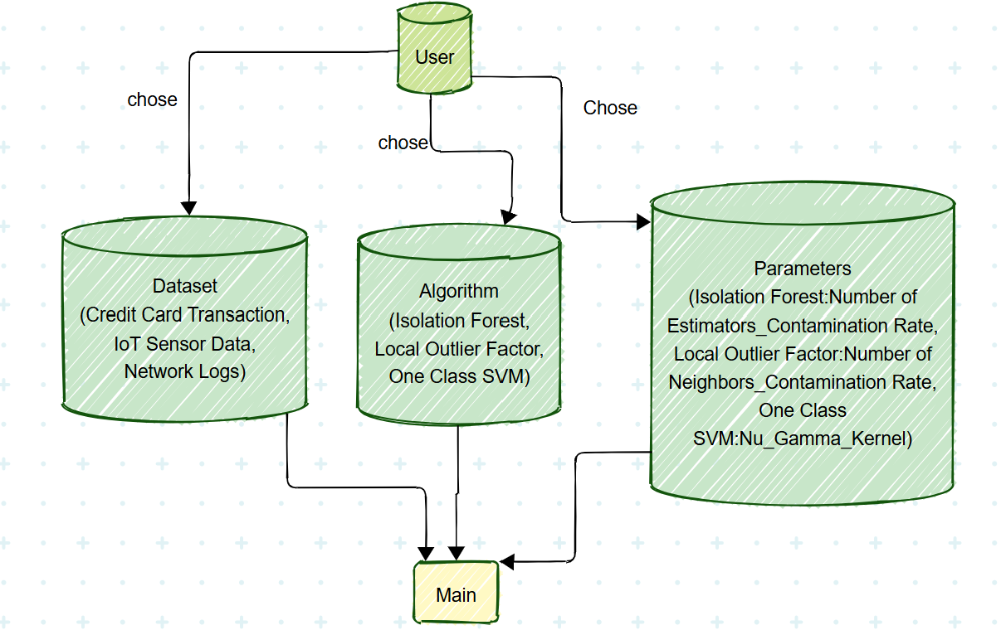
Python Coding Strategy
8

Slide 9
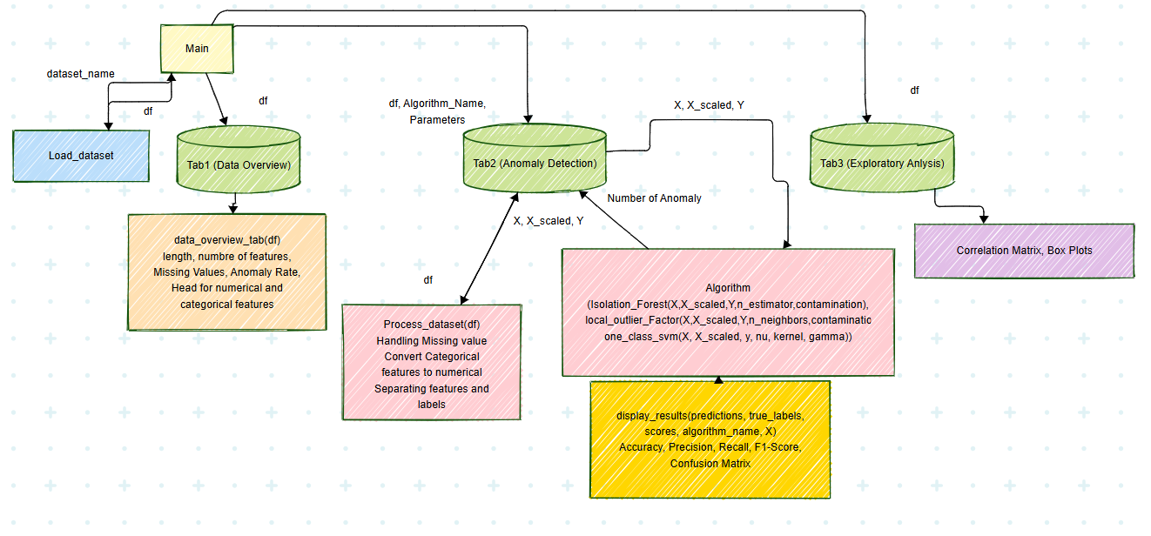
Python Coding Strategy
9

Slide 10
Reference:
https://www.vmware.com/topics/anomaly-detection [1]
https://scikit-learn.org/stable/modules/outlier_detection.html [2]
https://scikit-learn.org/stable/modules/generated/sklearn.ensemble.IsolationForest.html#sklearn.ensemble.IsolationForest [3]
https://scikit-learn.org/stable/modules/generated/sklearn.neighbors.LocalOutlierFactor.html#sklearn.neighbors.LocalOutlierFactor [4]
https://scikit-learn.org/stable/modules/generated/sklearn.svm.OneClassSVM.html#sklearn.svm.OneClassSVM [5]
https://www.kaggle.com/datasets/dhanushnarayananr/credit-card-fraud [6]
https://www.kaggle.com/datasets/dnkumars/cybersecurity-intrusion-detection-dataset [7]
https://www.kaggle.com/datasets/kukuroo3/room-occupancy-detection-data-iot-sensor [8]
10

Slide 11
Thank you

