Slide 1
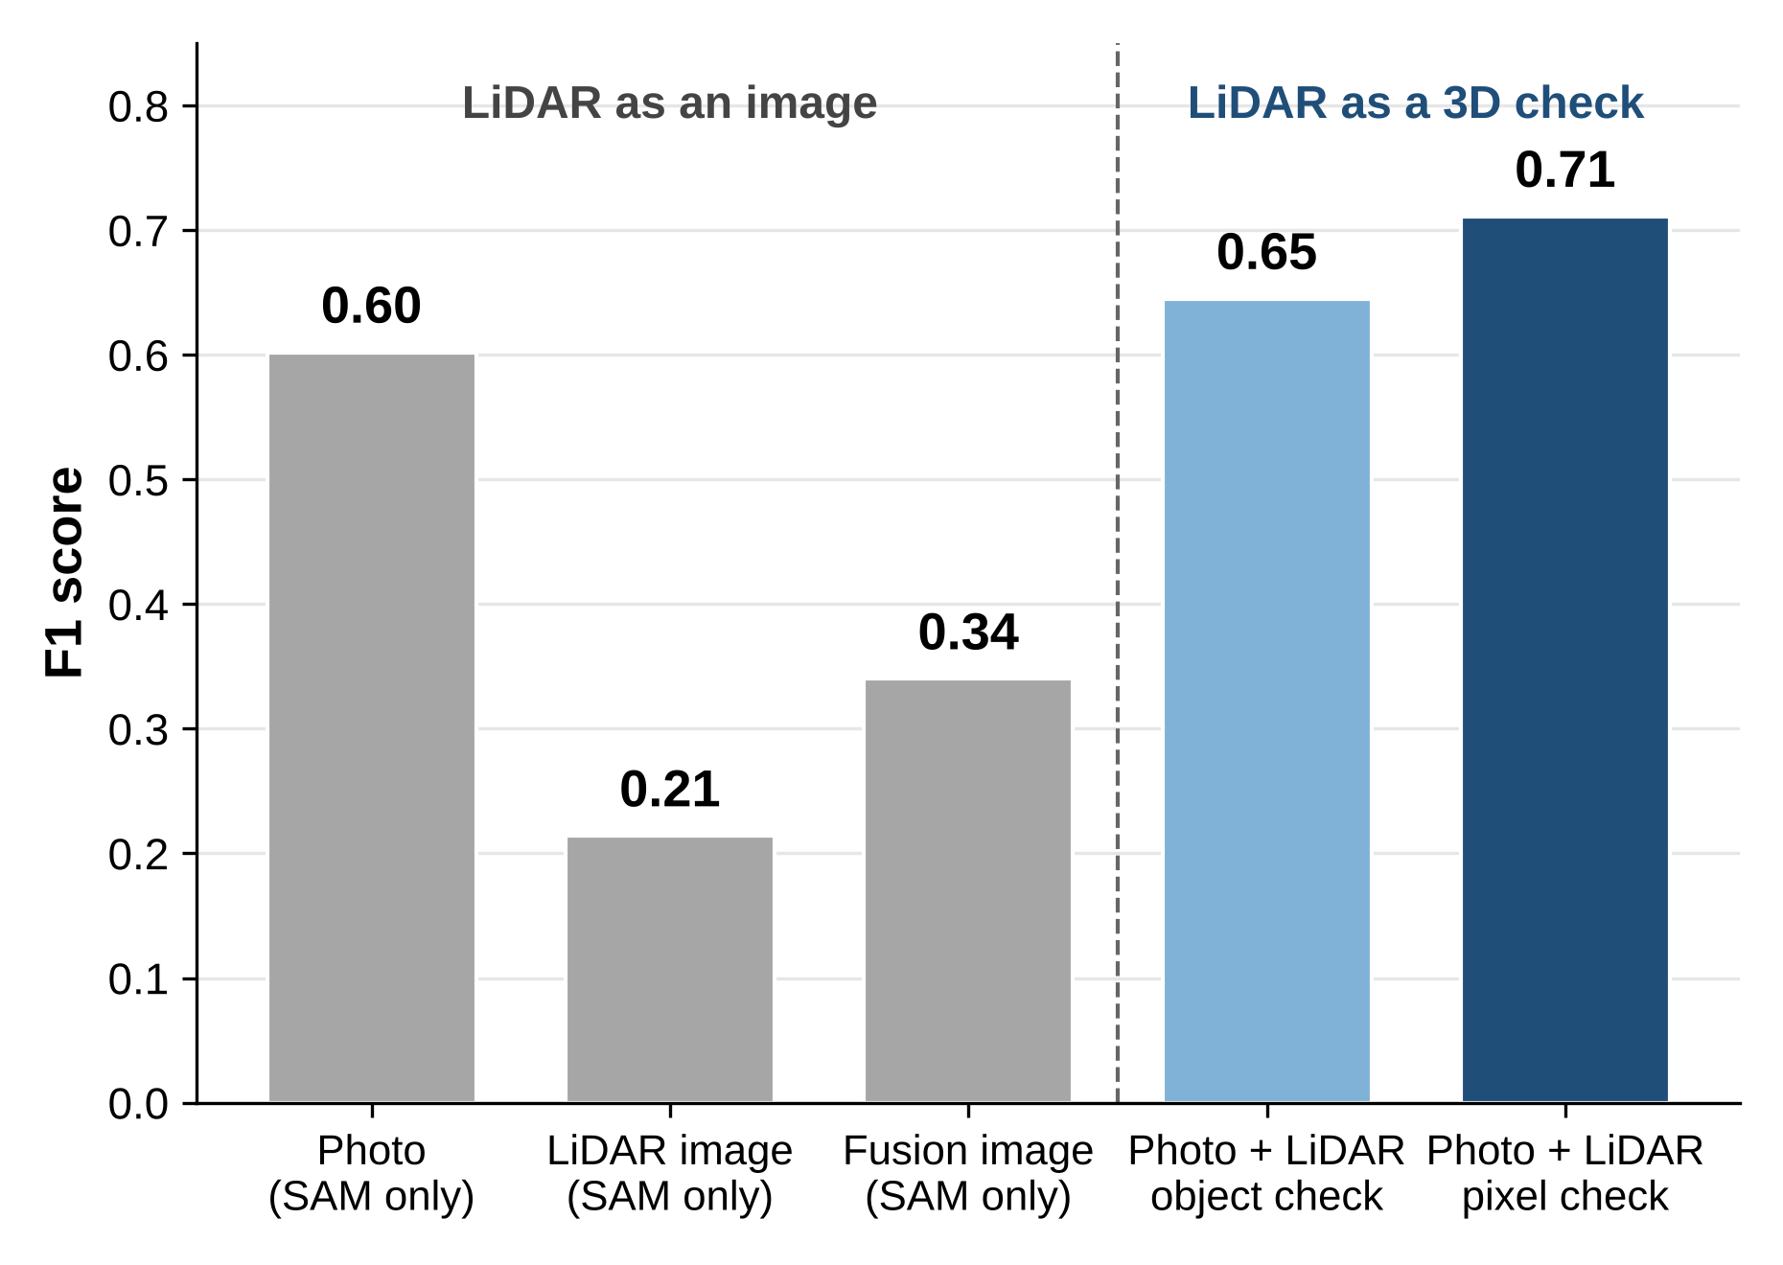
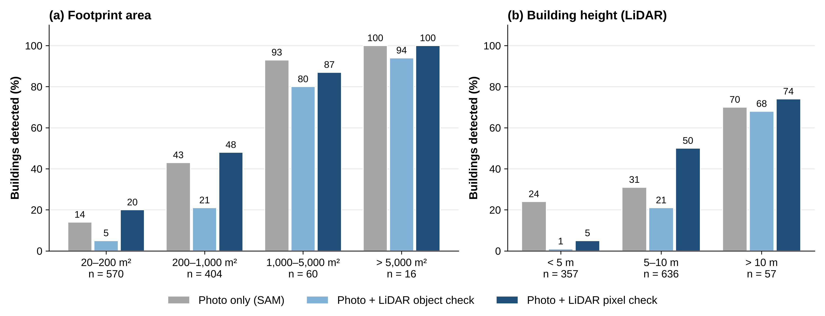
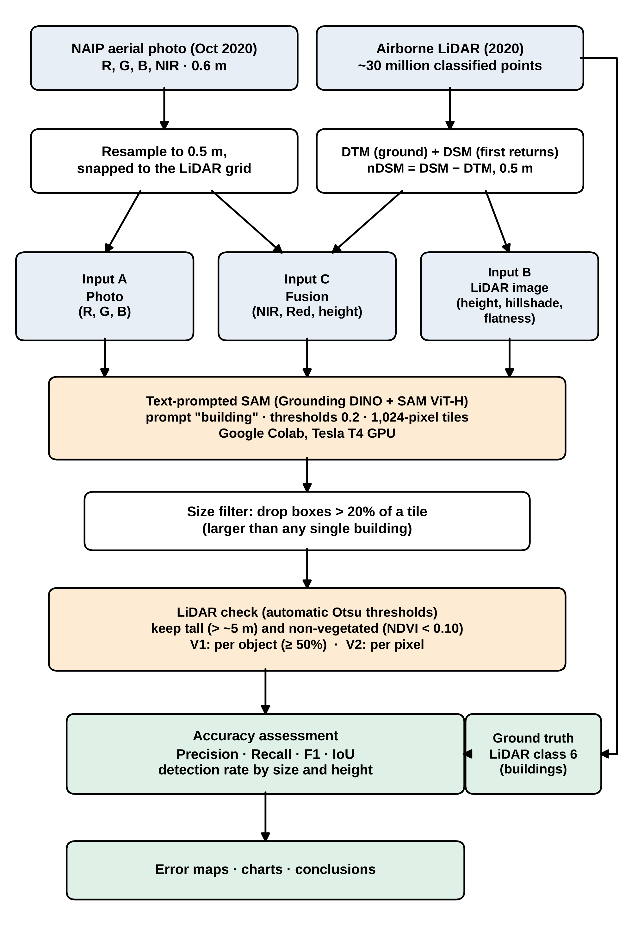
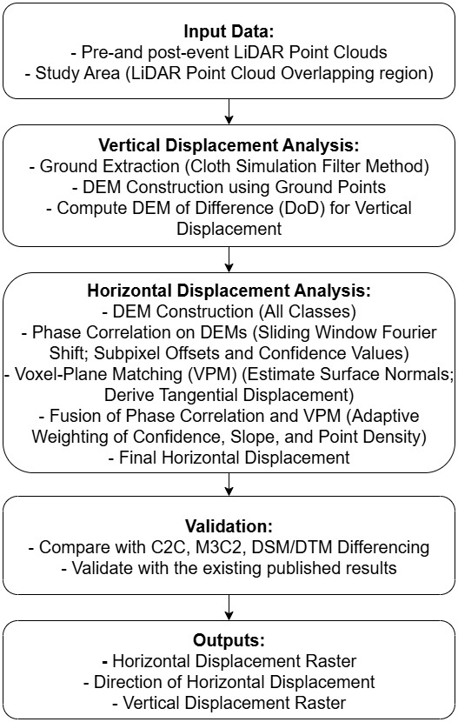
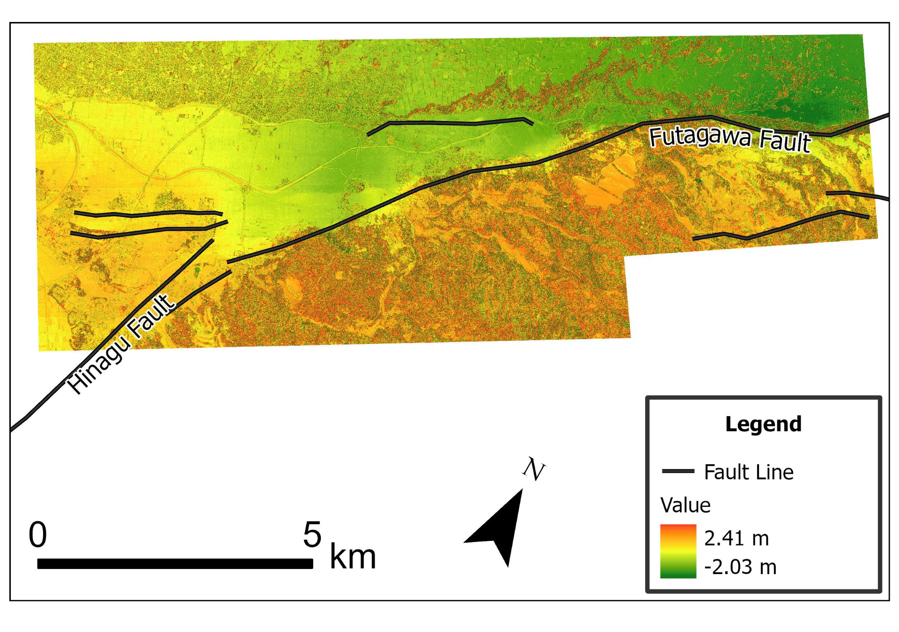
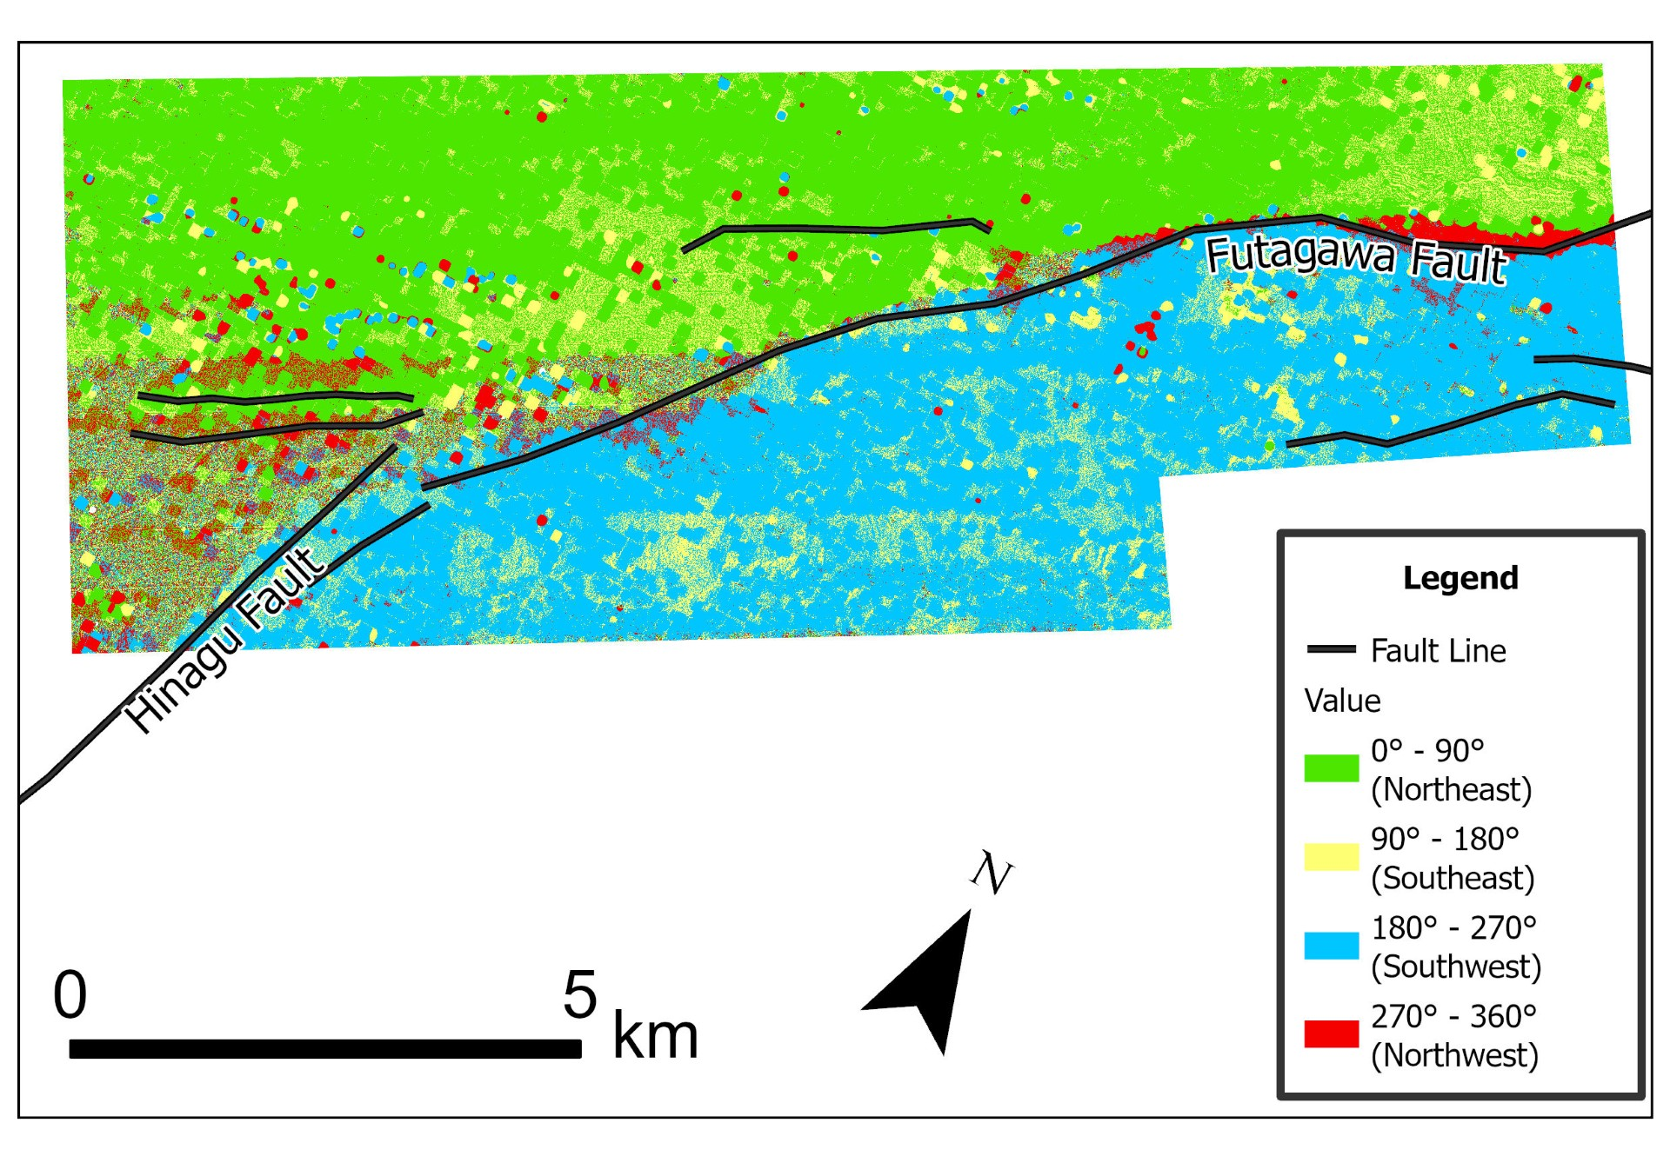
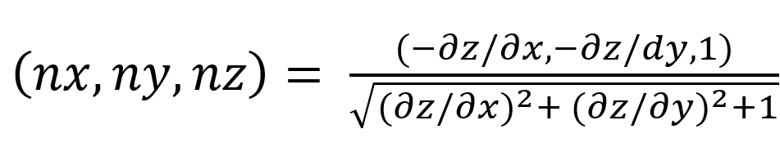
Can AI See Buildings Better with LiDAR? Testing Text-Prompted Segment Anything (SAM) on the UNT Campus
Sudipta Poudel
Department of Geography and the Environment, University of North Texas (UNT), Denton, TX 76203
1. Introduction
3. Methods (cont.)
Building footprints are core data for campus planning, digital twins and emergency response. New foundation models can map them without any training data: Grounding DINO finds objects from a text prompt and the Segment Anything Model (SAM) cuts out their exact outlines (together, “Text SAM”).
But both models learned from ordinary photos, and aerial photos hide roofs under trees and make flat roofs look like parking lots. Airborne LiDAR measures height directly. Can a photo-trained AI use it?
Research questions
1. How well does Text SAM find buildings in an aerial photo?
2. Does LiDAR help when given to SAM as an image, alone or fused with the photo?
3. Can LiDAR help instead as a 3D check on SAM’s detections?
4. Which buildings does SAM miss?
Hypothesis: adding LiDAR height information improves building detection.
6. LiDAR check (no ground truth used): automatic Otsu thresholds keep pixels taller than ≈ 5 m with NDVI < 0.10. V1 keeps a SAM object if ≥ 50% of it passes; V2 keeps only the passing pixels.
7. Accuracy, pixel by pixel against the ground truth:
Precision = TP / (TP + FP) Recall = TP / (TP + FN)
F1 = 2 · P · R / (P + R) IoU = TP / (TP + FP + FN)
A building (≥ 20 m², n = 1,050) counts as found if ≥ 50% of its footprint is detected.
4. Results
Fed in as images, LiDAR did not help. Used as a 3D check, it did.
• Photo only: F1 0.60, precision 0.56.
• LiDAR image: very precise (0.97) but found only 12% of building area.
• Photo + LiDAR check: precision 0.82 (V1); F1 up to 0.71 (V2).
• Large buildings (> 1,000 m²): 87–100% found; small (< 200 m²): 14–20%.
2. Study Area and Data
Core of the UNT main campus, Denton, Texas (1.49 × 1.76 km): academic buildings, dormitories, parking lots and small houses under mature trees. All layers on one 0.5 m grid, NAD83(2011) / UTM zone 14N.
• Airborne LiDAR, 2020: ≈ 30 million classified points (≈ 11.5 pts/m²); the building class (6) is the ground truth.
• NAIP aerial photo, 11 Oct 2020: R, G, B, near-infrared, 0.6 m (TxGIO).
• Model: Grounding DINO (Swin-B) + SAM ViT-H, prompt “building”.
Figure 3. F1 score by approach.
Insert Figure 1 here
(the three SAM inputs side by side: A photo, B LiDAR image, C fusion — export from ArcGIS)
Delete this box → Insert → Pictures
Insert Figure 4 here
fig_error_maps_final.png
(Google Drive → GIS_Day_SAM/results)
Delete this box → Insert → Pictures
Figure 1. Study area and the three SAM inputs: (A) photo, (B) LiDAR image, (C) fusion.
Figure 4. Correct (green), false alarm (vermillion) and missed (blue) buildings: (a) photo only, (b) photo + LiDAR pixel check.
3. Methods
1. Height models (ArcGIS Pro): DTM from ground points, DSM from first returns, nDSM = DSM − DTM (0.5 m).
2. Ground truth: LiDAR building points (class 6) → 1/0 mask.
3. Three 8-bit inputs, same grid: A Photo (R, G, B); B LiDAR image (height, hillshade, flatness); C Fusion (near-infrared, red, height).
4. Text SAM (Google Colab, T4 GPU): prompt “building”, thresholds 0.2, 1,024-pixel tiles; identical settings for A, B and C.
5. Size filter: drop boxes larger than 20% of a tile (bigger than any building).
Figure 5. Share of buildings detected, by footprint area and LiDAR height.
5. Conclusions
• Text SAM finds UNT buildings in an aerial photo with moderate accuracy (F1 0.60).
• A photo-trained AI cannot read LiDAR images (F1 0.21–0.34) without retraining.
• As a 3D check, LiDAR removes false alarms: precision 0.56 → 0.82, F1 0.60 → 0.71.
• Small, low buildings under trees remain the main challenge.
Take-home: AI can’t see LiDAR yet, but LiDAR can check AI.
Acknowledgments
Thanks to [advisor’s name] and the UNT LiDAR course for the 2020 point cloud; NAIP imagery from the Texas Geographic Information Office (TxGIO).
References
Kirillov, A., et al. (2023). Segment Anything. Proc. IEEE/CVF ICCV, 4015–4026.
Liu, S., et al. (2023). Grounding DINO: Marrying DINO with grounded pre-training for open-set object detection. arXiv:2303.05499.
Otsu, N. (1979). A threshold selection method from gray-level histograms. IEEE Trans. SMC, 9(1), 62–66.
Wu, Q., & Osco, L. P. (2023). samgeo: A Python package for segmenting geospatial data with SAM. JOSS, 8(89), 5663.
Figure 2. Data processing flowchart.

