Slide 1
Computerising phonological and morphological analysis of early Slavonic texts
JOSEPH WINSLOW
HANNE ECKHOFF
28 AUGUST 2025

Slide 2
Project aims and plan for this talk
  Computerising phonological and morphological analysis of early Slavonic texts using existing treebank data and a Late Common Slavonic computerised inflectional morphology
  TOROT/PROIEL early Slavonic treebank data as the point of departure
  Resources are shaped by prioritised levels of linguistic analysis
  What is missing from existing resources?
  Resource design
  Demonstration of online resource

Slide 3
Computer-aided phonological investigation
  Late Common Slavonic reconstructions as a form of ‘phonological annotation’
  Using TOROT data to help produce these Late Common Slavonic reconstructions
  Enabling holisitic and exhaustive investigations into the phonological systems underlying texts

Slide 4
TOROT/PROIEL treebanks: data structure and texts
  Origin: “Pragmatic Resources in Old Indo-European Languages”, Oslo 2008–2012
  Parallel treebank of early Indo-European translations of the Gospels
  Multilayered analysis: lemmatisation, detailed POS and morphology tags, enhanced dependency syntax, token alignment with source text, information status analysis with anaphoric links, further bespoke tagging (semantics, derivational morphology, rhetorical relations …)
  Expansion to more OCS and large collection of OES and Middle Russian texts in TOROT Treebank
  Texts: Largely existing editions, digitised by ourselves or others. Priority: closeness to manuscript, but some simplification (e.g. stripping off diacritics)

Slide 5
TOROT/PROIEL treebanks
Annotation type | Manual with syntax | Automatic lemmatisation and morphology only (to some extent post-corrected)
(O)CS | 242,813 word tokens | 53,079 word tokens
OES/Middle Russian | 259,284 word tokens | 266 word tokens

Slide 6
Errors
A 500k corpus inevitably has (human) errors
A substantial share of the data has been double-checked (“reviewed”), but errors still remain
Many rounds of large-scale consistency checks
Errors are being corrected continuously, empirical studies bring errors to light
… but the type of error detected depends on the type of study

Slide 7
High level
Low level
Syntax
Textology
Phonology
Orthography
Morphology
Semantics
“”Pragmatics””
Palaeography
Lexicography

Slide 8
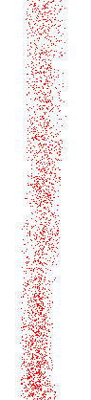
Threshold of
Sloppiness
High level
Low level
Syntax
Textology
Phonology
Orthography
Morphology
Semantics
“”Pragmatics””
Palaeography
Lexicography

Slide 9

manuscripts.ru
Threshold of
Sloppiness
High level
Low level
Syntax
Textology
Phonology
Orthography
Morphology
Semantics
“”Pragmatics””
Palaeography
Lexicography

Slide 10
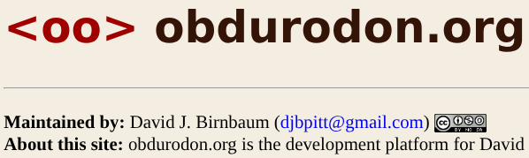
manuscripts.ru
Threshold of
Sloppiness
Birnbaum
High level
Low level
Syntax
Textology
Phonology
Orthography
Morphology
Semantics
“”Pragmatics””
Palaeography
Lexicography

Slide 11
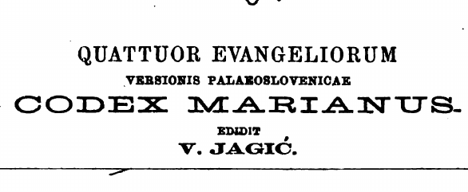
Print editions
manuscripts.ru
Threshold of
Sloppiness
Birnbaum
High level
Low level
Syntax
Textology
Phonology
Orthography
Morphology
Semantics
“”Pragmatics””
Palaeography
Lexicography

Slide 12

Print editions
manuscripts.ru
Threshold of
Sloppiness
Birnbaum
High level
Low level
Syntax
Textology
Phonology
Orthography
Morphology
Semantics
“”Pragmatics””
Palaeography
Lexicography

Slide 13


Print editions
manuscripts.ru
Threshold of
Sloppiness
TOROT
OCS
TOROT
Old Rus.
Birnbaum
High level
Low level
Syntax
Textology
Phonology
Orthography
Morphology
Semantics
“”Pragmatics””
Palaeography
Lexicography

Slide 14
Anything trained on TOROT/PROIEL data
Print editions
manuscripts.ru
Threshold of
Sloppiness
TOROT
OCS
TOROT
Old Rus.
Birnbaum
High level
Low level
Syntax
Textology
Phonology
Orthography
Morphology
Semantics
“”Pragmatics””
Palaeography
Lexicography

Slide 15
How can we use TOROT data to aid phonological investigations?

Slide 16
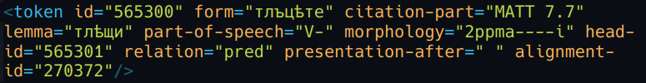
Sample TOROT token annotations

Slide 17
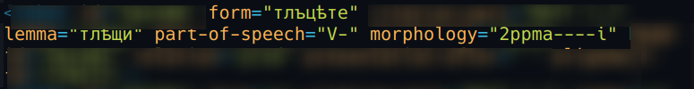
Sample TOROT token annotations
Tells us how we should inflect it
Uniquely identifies lemma

Slide 18
But we also need…
LCS lemma reconstruction
Categorisation into inflection-classes
Computerised LCS inflectional-morphology
Mechanism for handling post-LCS morphological innovations

Slide 19
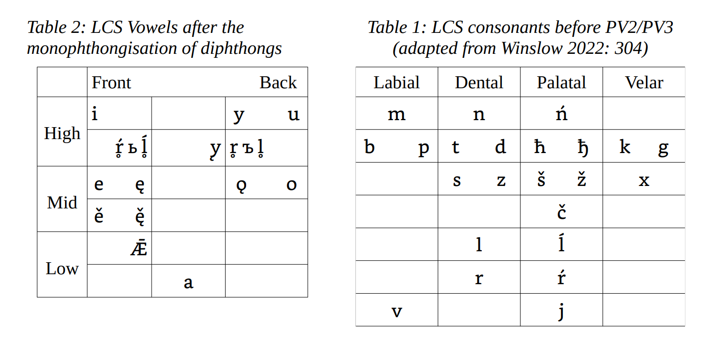





Plus /ḱ ǵ x́ f ü/ to represent sounds in foreign and (initially at least) unintegrated borrowings
Notes:
{Possibly skip}
{Then search for ǵü or jeǵüpьt in the interface to show the hesitation between keeping the <ü> letter, or writing <u> or <i> or <ю>}

Slide 20
LCS lemma and inflection-class annotations
TOROT lemma form | TOROT PoS | LCS lemma | Inflection class
оусъхнѫти | V- | usъxnǫti | 21
дрѣво | Nb | dervo | nt_S
(For most words this is all we need)
Notes:
{Mention it’s more complicated than that but if people are interested they can ask}
{Say the last column is used to determine how many characters to chop off the lemma-form before adding endings}

Slide 21
Computerised inflectional morphology

Slide 22
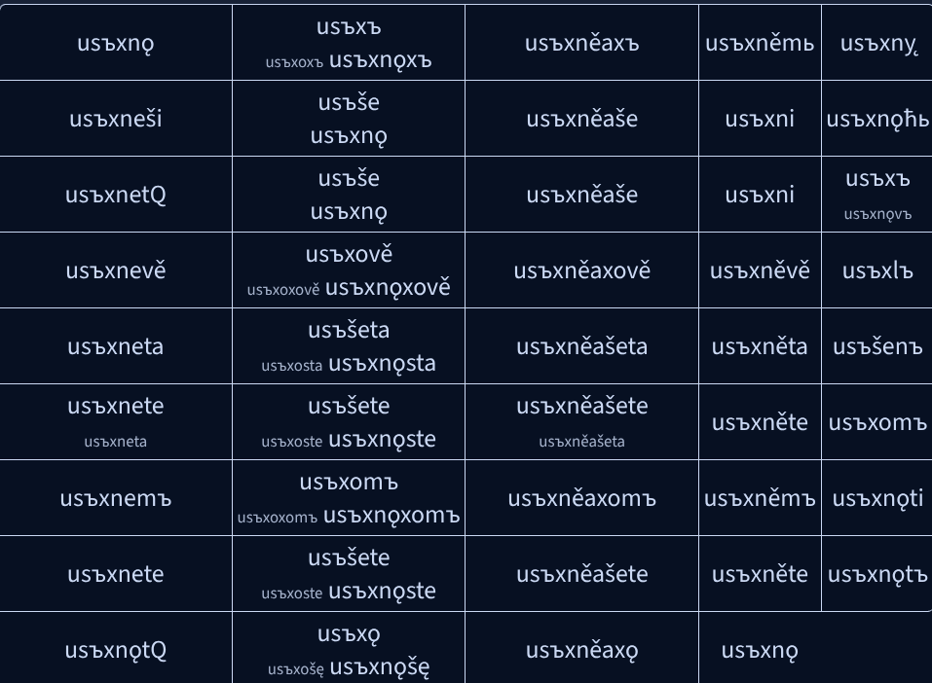

Slide 23
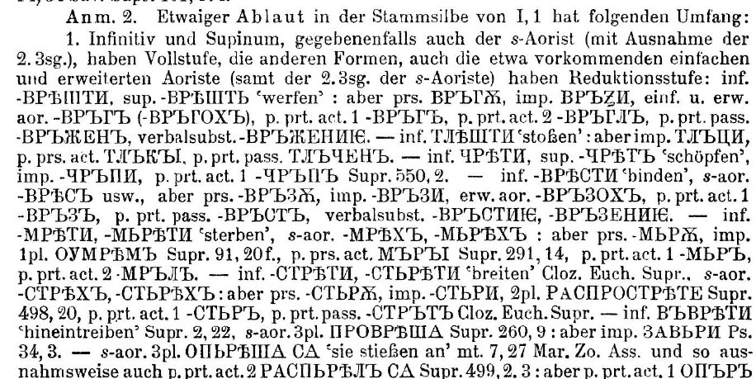
Computerised Inflectional Morphology
this is what helped me decide what ablaut-grades to use for the various class 1 sonorant-stemmed verbs
  Based mostly on Diels’ Altkirchenslavische Grammatik (1963)
  Supplemented by Olander’s Proto-Slavic Inflectional Morphology (2015) to help decide what the “original” LCS inflectional-endings were

Slide 24
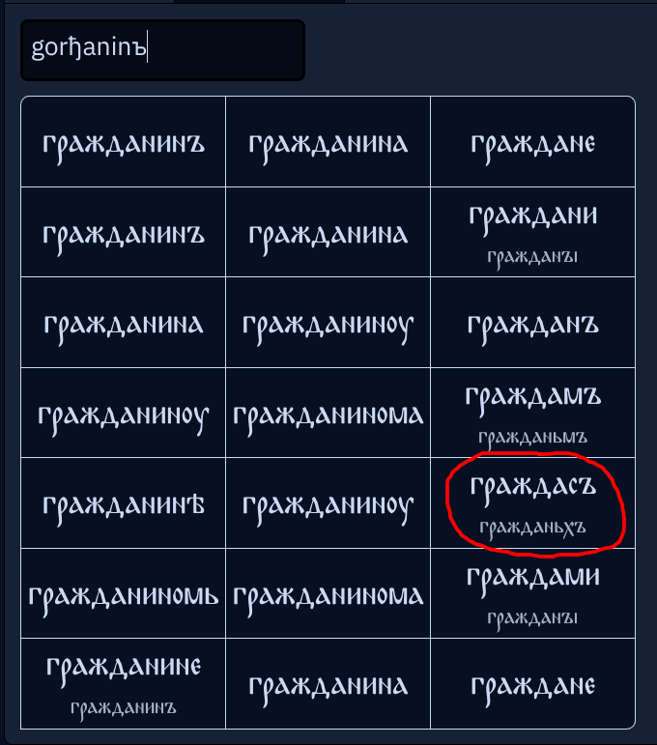
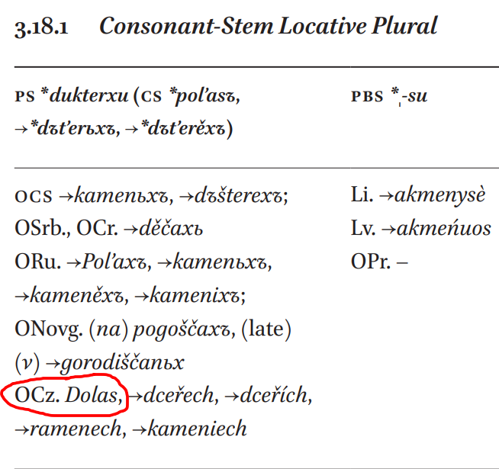
Computerised Inflectional Morphology
  Old Czech loc. pl. ‘dolas’ compels me to use the un-RUKI’d consonant-stem *-sъ ending attached directly to the stem for my “masc_anin” nouns like *gorђǢninъ…

Slide 25
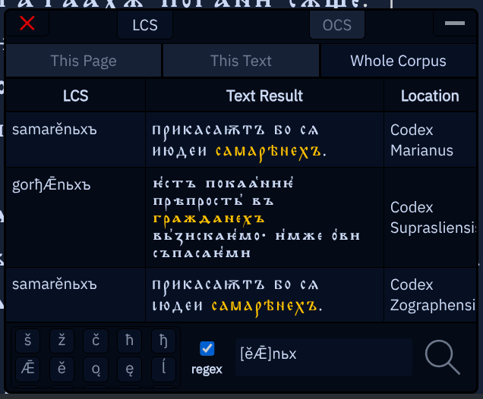
Computerised Inflectional Morphology
  …even though no such forms appear in our OCS texts, all having been replaced by the i-stem *ьxъ ending

Slide 26
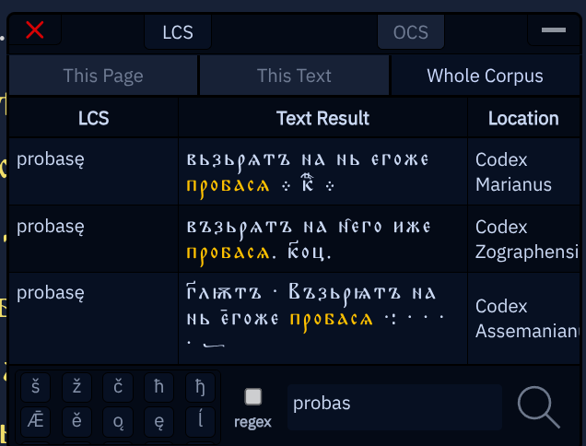
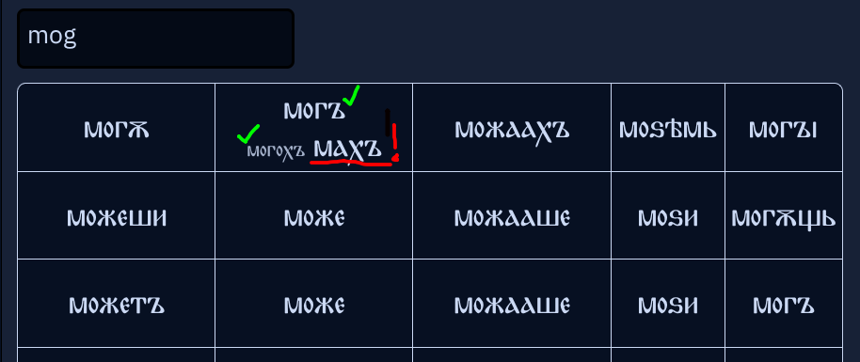
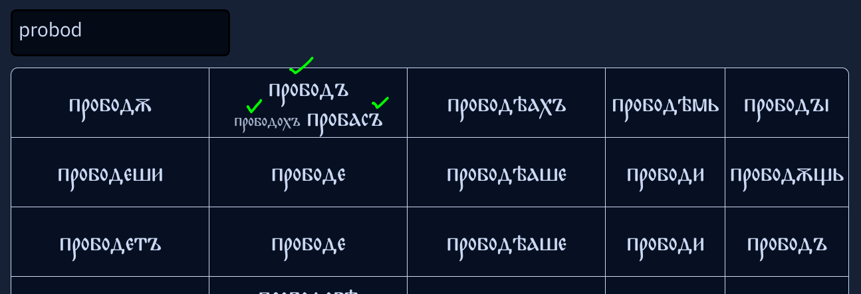
Computerised Inflectional Morphology
  Can over-generalise: lengthened-grade S-aorists like пробасѧ from class 1 *pro-bod- mean that my grammar predicts **махъ as the S-aorist of мощи (*mog-ti)

Slide 27
Detecting innovated morphology
Forms are inspected by the Autoreconstructor for most of the morphological deviances which occur in canonical OCS
The internal inflection-tables store up to three sets of endings for each class: 1.) the base, or correct endings; 2.) post-LCS innovated endings; 3.) alternative but still “correct” LCS endings
Notes:
{Possibly search for “ošę” in Marianus and then Zographensis to demonstrate the extent of the spread of extended S-aorists in the latter}

Slide 28
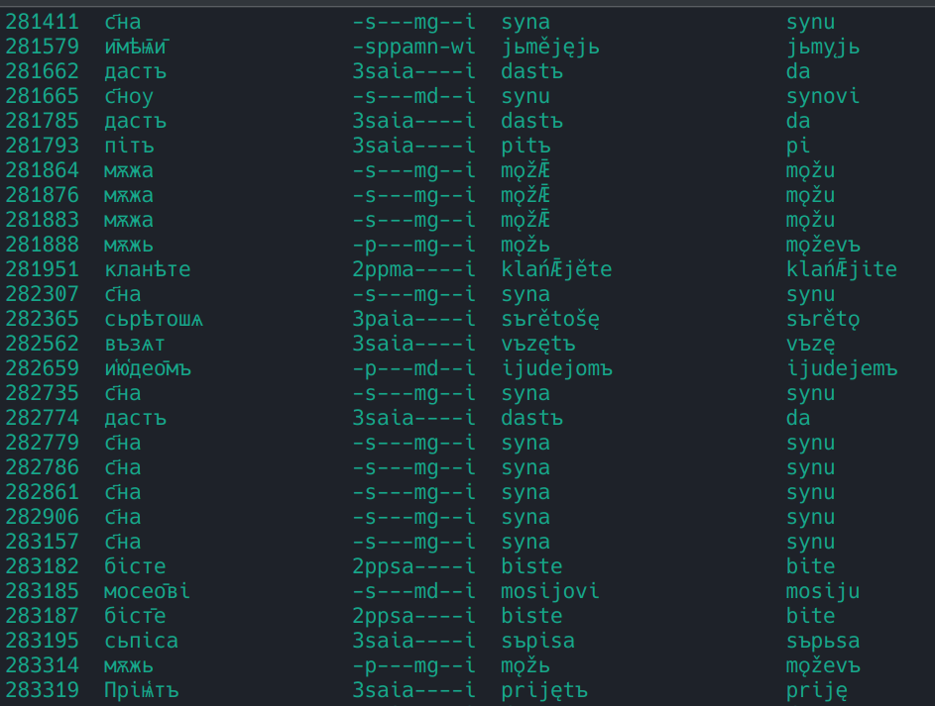
Notes:
{Run “select tokno, chu_word_torot, morph_tag, autoreconstructed_lcs, autoreconstructed_morph_replace from corpus where autoreconstructed_morph_replace IS NOT NULL and pv2_3_exists IS NULL;” in sqlite3 cmdline and scroll around pointing stuff out as well if it feels right}
3.) Automatic conversion of OCS into Old Russian - do Psal., or search for *meržǢ on Zogr. and follow the link to pg. 2 of John 21 and convert that as a demonstration of wholly automatic tagging + autoreconstruction + conversion to OR. (Search for the regex “^a|[ęǢ]” on that page to make the words pulsate green, then run the russifyOCS() function a few times over to show the stochastic nature of the front-nasal spellings, then search for the same regex on the first page of Uspenskij Sbornik and point out how similar the fake OR is to the real)

Slide 29
TOROT gives us a lot more than we might expect:
fine-grained and archaising lemmatisation - tries to follow the best historical dictionaries (SNSP for OCS, Sreznevskij for Old Rus.)
morphology-tags determined mostly by FORM rather than MEANING - e.g. animate genitive-accusatives marked as genitive regardless of syntactic role
Non-normalised Unicode text, based on standard print editions or the Helsinki ASCII-encoded corpus

Slide 30
BUT…
Suprasliensis (from syntacticus.org)

Slide 31
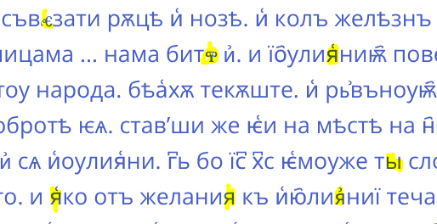
BUT…
Suprasliensis (from syntacticus.org)
significant problems with character-encoding inconsistencies went unnoticed for years and have not yet been fully cleaned up (Latin characters; unjustifiable use of Ru. <я, ы>; random bits of Glagolitic)

Slide 32
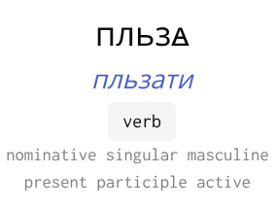
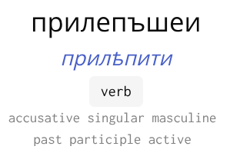
BUT…
Suprasliensis (from syntacticus.org)
significant problems with character-encoding inconsistencies went unnoticed for years and have not yet been fully cleaned up (Latin characters; unjustifiable use of Ru. <я, ы>; random bits of Glagolitic)
annotators sometimes confuse similar-looking lemma-forms because it isn’t a huge deal for syntacticians
The expected PRAP of class 5.2 ablauting пльзати is плѣжѧ; this is from class 3.1 пльзѣти
This is actually PAP *prilьpъšьjь from class 2.1 прильнѫти

Slide 33
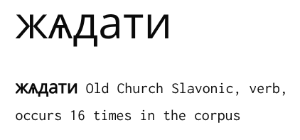
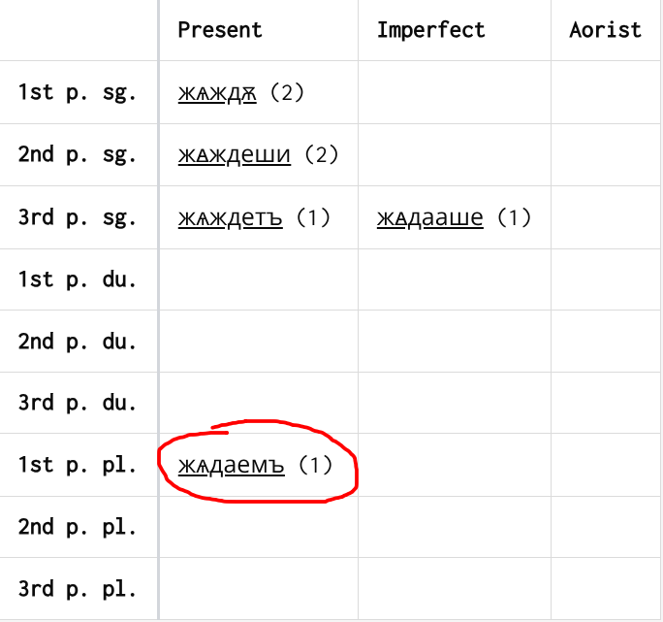
BUT…
lemmatisation sometimes not fine-grained enough

Slide 34
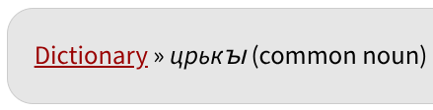

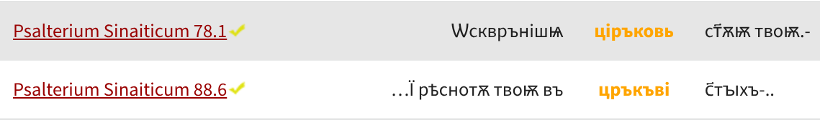
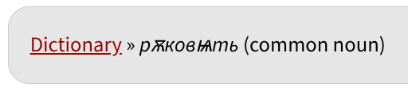
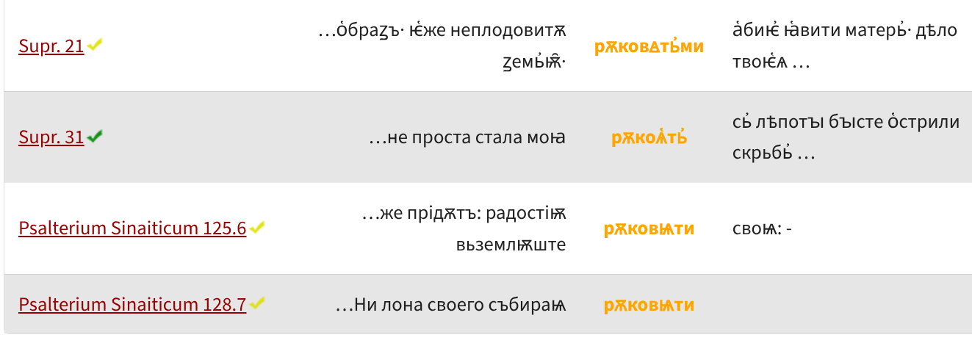
BUT…
Doublets going back to pre-LCS phonological divergence are often not separated
Both from Gmc. *kirika, but the first two borrowed as LCS *kirъky and the second as *kŕ̥ky
< *rǫkojętь
< *rǫkovętь

Slide 35
Making the Autoreconstructor work forces us to notice all these issues and improve TOROT:

Slide 36
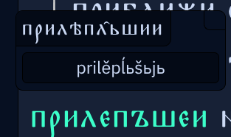
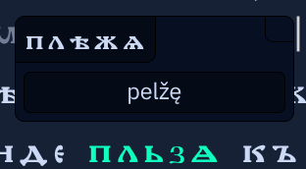
We can instantly see annotation/lemmatisation mistakes
“Normalised” OCS forms trivially generatable from the LCS reconstructions
Mismatch between the two forms is obvious and not explainable by morphological innovation or sound-change
Notes:
{Mention the Syntacticus slide and say how those types of problems are}

Slide 37
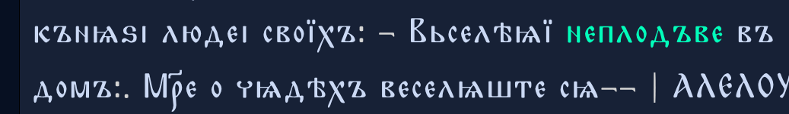
We can instantly see annotation/lemmatisation mistakes
Notes:
{Mention the Syntacticus slide and say how those types of problems are}

Slide 38
Aspectual pairs съвѧжѫ / съвѧзаѭ can be differentiated

Slide 39
  The grammar responsible for producing inflected LCS forms that match the attested OCS forms acts like an extreme form of accountability: the correctness of the grammar is literally just the percentage of forms it correctly reconstructs (assuming all morphology tags are correct): ⱁⱅⱏ ⱂⰾⱁⰴⱏ ⰿⱁⰻⱈⱏ ⱂⱁⰸⱀⰰⰲⰰⰵⱎⰻ ⰿⱔ
  We have to be AT LEAST as rigorous as the dictionaries in lemmatisation, sometimes more so:
Notes:
{Show the Gorazd integration by searching for съпьсати съписати and point out the wrongness of lemmatisation }

Slide 40
Anything trained on TOROT/PROIEL data
Print editions
manuscripts.ru
Threshold of
Sloppiness
TOROT
OCS
TOROT
Old Rus.
Birnbaum
High level
Low level
Syntax
Textology
Phonology
Orthography
Morphology
Semantics
“”Pragmatics””
Palaeography
Lexicography

Slide 41
Anything trained on TOROT/PROIEL data
Print editions
manuscripts.ru
Threshold of
Sloppiness
TOROT
OCS
TOROT
Old Rus.
Birnbaum
High level
Low level
Syntax
Textology
Phonology
Orthography
Morphology
Semantics
“”Pragmatics””
Palaeography
Lexicography

Slide 42
Contact us: hanne.eckhoff@mod-langs.ox.ac.uk joseph.winslow@trinity.ox.ac.uk
Data: https://torottreebank.github.io/ https://github.com/syntacticus/syntacticus-treebank-data

Slide 43
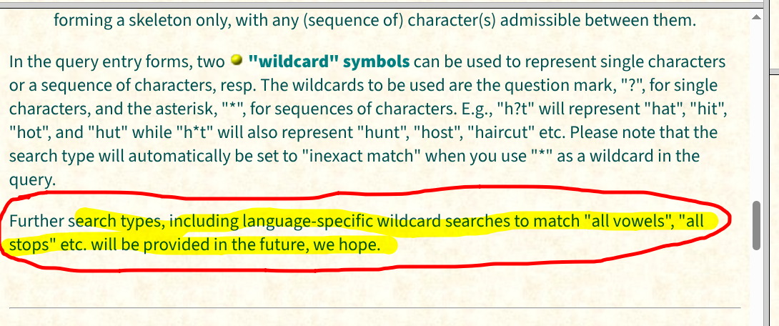
TITUS
This is only possible with my LCS index (since we can’t know for sure the sound-value or classification of any individual letter in any individual text)

Slide 44
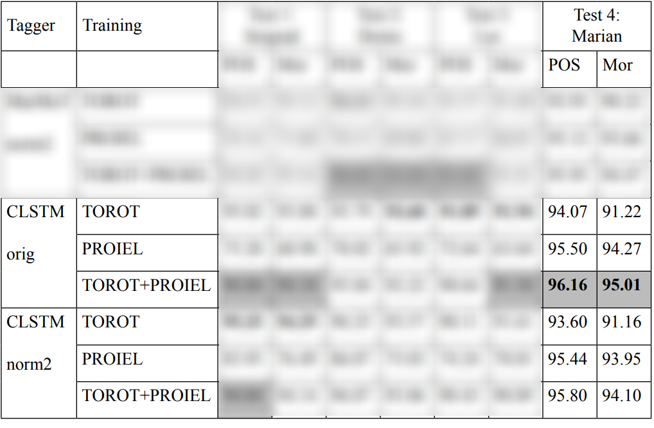
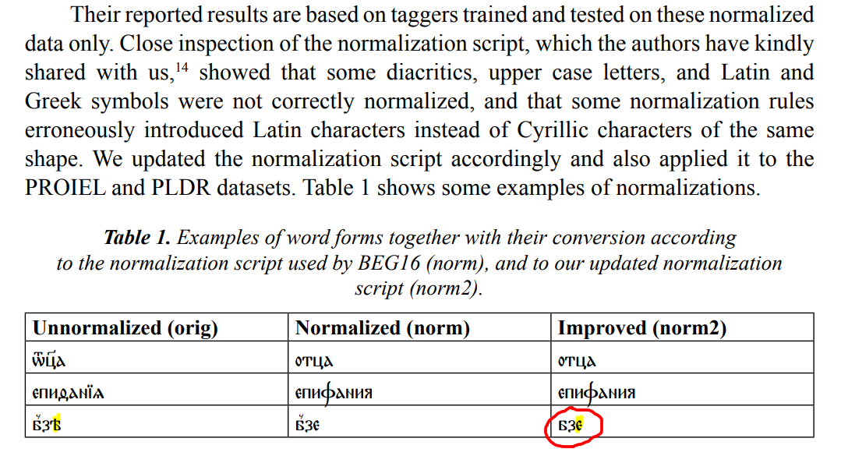
(Scherrer, Mocken & Rabus 2018)
Worse results on Marianus with a dodgy normalisation than without

Slide 45
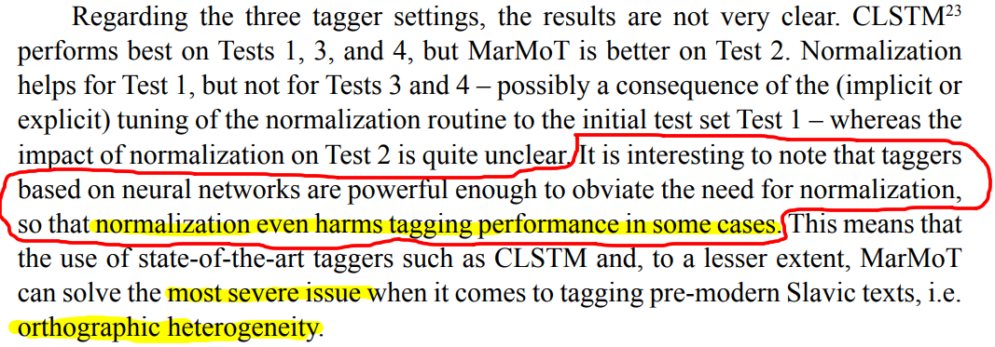
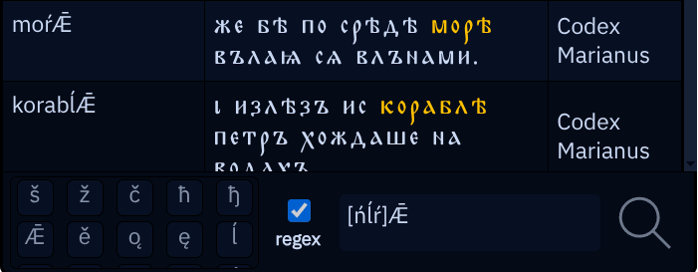
No wonder; you’ve applied a modern Russian normalisation to Glagolitic OCS
(Scherrer, Mocken & Rabus 2018)
Orthographic heterogeneity IS the data we should be EXPLAINING, not an “issue” to be got rid of
These two jo-stem gen.sg. nouns are gonna get normalised to море and корабле - very helpful for the neural network (NOT)
Not at all evidence against the utility of targeted normalisation

