Slide 1

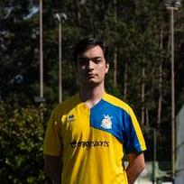
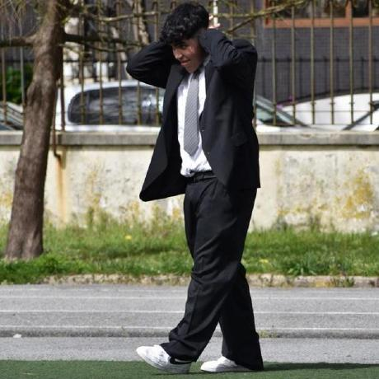


Logistics On Rails - SPRINT 1
G052
LAPR3 2025/2026
Francisco Vasconcelos (1240934) | Gabriel Inácio (1240935) | Gonçalo Azevedo (1240936) | Maria Pinto (1240892) | Paulo Ferreira (1240941)

Slide 2
Sprint planning – Sprint 1
Planned Start Date: 29 de setembro Real Start Date: 29 de setembro
Planned End Date: 26 de outubro Real End Date: 27 de outubro
SPRINT BACKLOG
Number of stories | 16
Number of bugs | 0
Number of tasks | 2
Number of Management Tasks (Scrum) | 14
Number of team members | Planned: 5 Actual: 5
Total planned estimation vs execution | Planned hours: 117 Executed hours: 84

Slide 3
Sprint 1 planning
Assigned User Stories (as stated in the project assignment) | Commited? Yes / No (according to team planning) | Todo | Doing | Testing | Done | Blocked
USBD01 | Yes |  |  |  | x
USBD02 | Yes |  |  |  | x
USBD03 | Yes |  |  |  | x
USBD04 | Yes |  |  |  | x
USBD09 | Yes |  |  |  | x
USBD014 | Yes |  |  |  | x
USBD015 | Yes |  |  |  | x
USBD020 | Yes |  |  |  | x

Slide 4
Sprint 1 planning
Assigned User Stories (as stated in the project assignment) | Commited? Yes / No (according to team planning) | Todo | Doing | Testing | Done | Blocked
USEI01 | Yes |  |  |  | x
USEI02 | Yes |  |  |  | x
USEI03 | Yes |  |  |  | x
USEI04 | Yes |  |  |  | x
USEI05 | Yes |  |  |  | x

Slide 5
Sprint 1 planning
Assigned User Stories (as stated in the project assignment) | Commited? Yes / No (according to team planning) | Todo | Doing | Testing | Done | Blocked
USLP01 | Yes |  |  |  | x
USLP02 | Yes |  |  |  | x
USLP03 | Yes |  |  |  | x

Slide 6
Work assigned by team member

Slide 7
Work assigned by type (componente)

Slide 8
Issues / Assumptions / unanswered questions
Description | Responsible | Date / sprint | Related issue / item in Git
USLP03 – given that the acceptance criteria was unclear, and no concrete answer was given in the client forum, it was assumed that this user story was supposed to be developed in Oracle Live SQL, as a simple script instead of a java program. | Maria & Gonçalo | Sprint 1 | USLP03 - As a Traffic Dispatcher, I want to calculate the estimated travel time between two stations, with a direct connection between them, and a selected locomotive

Slide 9
Daily Meetings
Date (of the meeting) | Place / duration | Francisco Vasconcelos | Gabriel Inácio | Gonçalo Azevedo | Maria Pinto | Paulo Ferreira
30/09/2025 | Online / 10 min | x | x | x | x | x
04/10/2025 | Online / 12 min | x | x | x | x | x
06/10/2025 | Online / 10 min | x | x | x | x | x
08/10/2025 | Online / 10 min | x | x | x | x | x
10/10/2025 | Online / 11 min | x | x | x | x | x
13/10/2025 | Online / 11 min | x | x | x | x | x
15/10/2025 | Online / 11 min | x | x | x | x | x

Slide 10
Daily Meetings
Date (of the meeting) | Place / duration | Francisco Vasconcelos | Gabriel Inácio | Gonçalo Azevedo | Maria Pinto | Paulo Ferreira
17/10/2025 | Online / 14 min | x | x | x | x | x
20/10/2025 | Online / 14 min | x | x | x | x | x
21/10/2025 | Online / 9 min | x | x | x | x | x
22/10/2025 | Online / 13 min | x | x | x | x | x
23/10/2025 | Online / 11 min | x | x | x | x | x
24/10/2025 | Online / 11 min | x | x | x | x | x
25/10/2025 | Online / 15 min | x | x | x | x | x

Slide 11
LLM performance assessment (use ChatGPT or Copilot)
Source file (attach the file you have used):
Input (write down the prompt you used to ask for the performance assessment) :
“Based on the file containing every member's updates throughout the sprint, write an individual LLM performance assessment for every member and a global one for the whole team, in order to evaluate everyone's personal and teamwork.”

Slide 12
LLM performance assessment - Output
Output file (attach the complete file extracted from the A.I. tool):
Output (write one line per team member):
Francisco showed high autonomy and technical fluency, especially in backend service orchestration.
Gabriel’s performance was marked by deep attention to data consistency and modularity.
Gonçalo excelled in system modeling and test coverage.
Maria’s leadership in documentation and alignment was essential.
Paulo’s contributions were steady and detail-oriented.
Team Members’ Opinion about the A.I. output:
Francisco: "Cool that it noticed my backend work."
Gabriel: "Glad it saw how much I care about clean data."
Gonçalo: "Nice to see my modeling and tests mentioned."
Maria: "Happy it valued the docs and team alignment."
Paulo: "Good to know my detailed work stood out."

Slide 13
Sprint Retrospective Date: 27/10/2025
What went well?
Team Coordination and Communication
Progressive Completion of Key Modules
Effective Use of SCRUM
Strong modular development and task ownership
Early and consistent use of Visual Paradigm for modeling
What went wrong?
Glossary Delays
Data Inconsistencies
Ambiguities in Requirements
Lack of Answers in the Forum
Late Complexity in Returns & Inspection
What we learned?
Importance of Early Glossary Alignment
FEFO/FIFO Logic Requires Rigorous Validation
Test-Driven Development Enhances Stability
Collaboration Across Roles Is Key
Clear Task Status Tracking ccelerates Sprint Momentum

Slide 14
Sprint Retrospective Date: 27/10/2025
Action items:
Expand automated tests for dispatch, picking, and return modules to catch logic flaws earlier and improve confidence in integration.
Ensure glossary, diagrams, and SQL scripts are fully synchronized across modules and reflect the latest implementation logic.
Proactively review upcoming user stories with the team and instructors to avoid mid-sprint blockers due to unclear specifications.
Refine task estimation and distribution to balance workload and avoid bottlenecks, especially in modules with overlapping dependencies.
While each member has shown strong ownership of their modules, some delays suggest that a deeper understanding of how different components interact could improve overall cohesion.

Slide 15

Overall Project performance:
Comments: We are happy with everything we developed this Sprint, and we are focused on continuing the great work in the next Sprint.
LLM evaluation: “The team operated with high synergy and technical maturity. Their sprint output reflects a well-structured, glossary-aligned, and thoroughly tested system. The balance between individual ownership and collaborative refinement was exemplary.”
How do you grade your performance (0-5): 5
How do you grade your results (0-5): 5

Slide 16


