Slide 1
Module 1:
Task and Data Splitting
Module 2:
Feature Processing and Calculation
Module 3:
Advantage Correction and Updating
（MetaAdvantageHead）
Context Vector
Support Set
Task Context Encoder
States, Advantages, and Reward Statistics
Advantage Correction Head
Correction Term
Policy Updating Module
Greenhouse Control Task Fragment
Corrected Advantage
Current Observation State
Recurrent PPO Module（Base ）
Meta-Loss Calculation Module
+
Clipping Normalization
Query Set
Raw Advantage

Slide 2
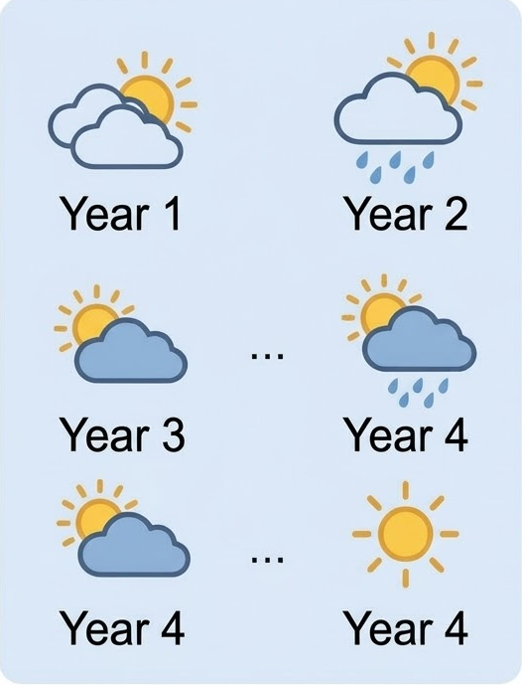

Weather-conditioned Task Distribution
Support Set
Agri-MetaRL Agent
Recurrent
Actor-Critic
Meta-Adaptation
Greenhouse
State
(Observation)
Reward
Actions

