Slide 1
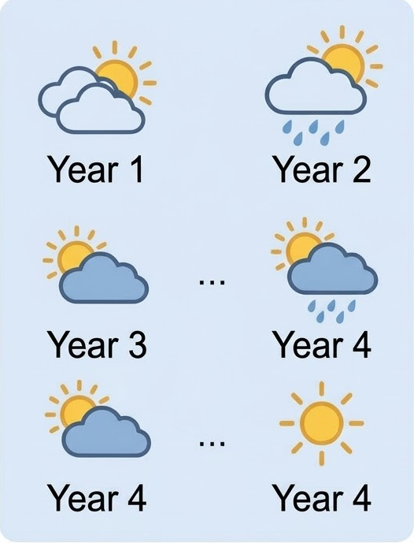
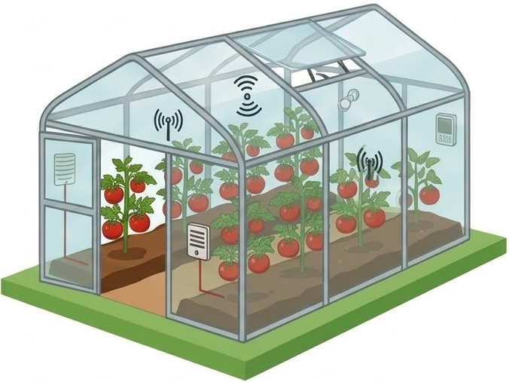
Weather-conditioned Task Distribution
Support Set
Agri-MetaRL Agent
Recurrent
Actor-Critic
Meta-Adaptation
Greenhouse
State
(Observation)
Reward
Actions

