Slide 1
Internet of things
PUBLIC TRANSPORTATION OPTIMIZATION
Team members
SI NO | NAME | REGISTER NUMBER | E-MAIL ID
1 | G. Balakathirvel | 951321205009 | balakathirvel46@gmail.com
2 | P. Muthukumar | 951321205031 | muthubalan6344@gmail.com
3 | R Muthu magesh | 951321205032 | digitalmagesh9@gmail.com
4 | A.Sahaya michael arun | 951321205304 | michaelarun39@gmail.com

Slide 2
Introduction of IoT
Data on the number of public transport users, collected with IoT sensors, allows routes to be optimized or new ones to be designed. These sensors can be in the vehicle or also in the security cameras. If we talk about IoT applied to logistics, sensorized trucks and vans help to know where the goods are at all times. Also, this use of IoT optimizes the number of vehicles on the road or the routes they follow, in order to save fuel and maintenance costs. Other useful data that sensors can collect to make decisions include speed, temperature, number of driving hours…By collecting all this information, not only does the company become better organized. It also improves communication with its customers, since it can send them, for example, precise information about the time of arrival at the destination. Smart cities use this data to enhance the quality of life for their citizens, and there’s no better example than when you apply a “smart city” mind set to public transportation systems. By optimizing your public transport systems you can help citizens get where they’re going more quickly by reducing congestion on roadways and intelligently allocating and routing buses to areas with more travellers. That means locals, visitors and workers spend less time in transit and more time enjoying your city, successfully completing errands or getting to and from work

Slide 3
Smart transportation
According to the US Department of Transportation, “Intelligent Transportation Systems (ITS) apply a variety of technologies to monitor, evaluate, and manage transportation systems to enhance efficiency and safety.” Putting visions of science fiction style transportation aside for the moment, this definition can be simplified into the following concepts for what makes up smart transportation: management, efficiency, and safety. In other words, smart transportation uses new and emerging technologies to make moving around a city more convenient, more cost effective (for both the city and the individual), and safer. Primarily the proliferation of IoT devices and 5G communication technology. The former provides for inexpensive sensors and controllers that can be imbedded into nearly any physical machine to be controlled and managed remotely. The latter provides the high speed communications needed for managing and controlling transportation systems in real time with minimal latency. Smart transportation is not just a theory for the future; it is being implemented today in several cities with their successes and failures being used to improve systems in new locations. Some of the cities that are implementing new transportation technologies may surprise you at first. Of course, global hubs like New York City have embraced smart transportation for their ever increasingly intelligent city. However, the rural state of Wyoming is also a leading tested for connected vehicles. This is because the cowboy state is a major freight corridor — autonomous transportation of goods across the country can drastically improve supply chain efficiency and reduce the need for long-haul drivers forced to balance tight timelines with their human need for rest.

Slide 4
Benefits
Smart Transportation is safer: By combining machine learning with IoT and 5G, autonomous transportation systems (both in vehicles and in stationary infrastructure such as intersections) have proven to reduce the “human factor” in accidents. Computers don’t get distracted or fatigued or emotional.
Smart Transportation is better managed: Data collection is an important key to responsible public management of infrastructure. Smart transportation not only provides detailed data points for every aspect of the transportation system, but allows administrators to better monitor operations, track maintenance needs, and identify key sources of problems that need to be fixed.
Smart Transportation is cost effective: Because smart transportation makes better use of the resources available, it can cut down costs thanks to preventative maintenance, lower energy consumption, and fewer resources used towards accidents. Cost savings can also be gained by riders when inexpensive public transit is efficient enough to compete with private vehicle ownership.

Slide 5
Design thinking
Design Thinking has been successfully used in the Transportation Industry by institutions such as Ford, Lincoln and Madrid’s EMT system. Transportation is a critical aspect of modern society, and design thinking has proven to be an effective tool for improving it. One example of the use of design thinking in transportation is the redesign of bus stops in Minneapolis, Minnesota. The city used a design thinking approach to involve residents in the process of improving bus stops. The project resulted in more user-friendly and accessible bus stops that better meet the needs of the community.

Slide 6
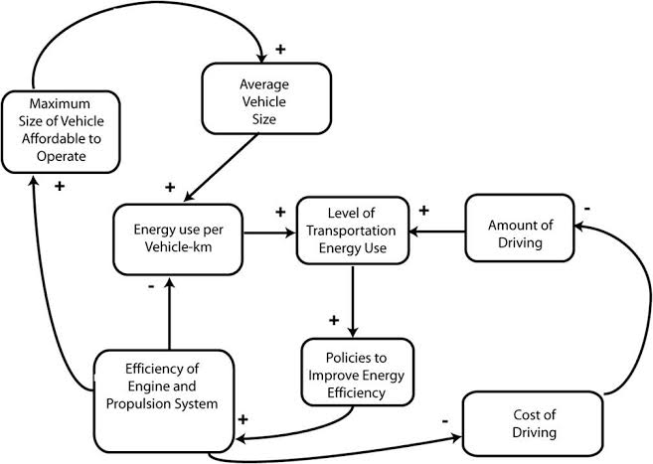
Block diagram

Slide 7
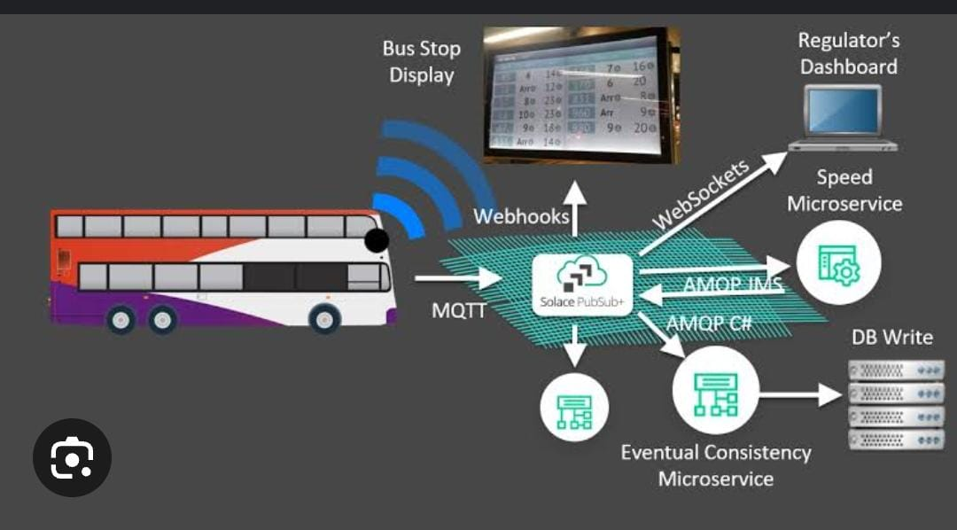

Slide 8
Scaling and Deployment
Network Expansion : Plan for scaling the system to cover a larger public transportation network.
Full deployment : Deploy the optimized system across the entire public transportation network.

Slide 9
Maintenance and Monitoring
Maintenance Schedule: Establish a maintenance schedule to ensure the ongoing functionality of sensors, communication equipment, and software. Real-time Monitoring: Implement real-time monitoring of the entire system to detect anomalies or performance degradation.Set up alerting mechanisms to notify administrators of issues

Slide 10
User Training and Documentation
User Training:
Provide training to transportation authority staff and end-users on how to use the system effectively.
Documentation:
Prepare comprehensive user documentation, including guidelines, FAQs, and tutorials for both administrators and passengers.

Slide 11
Security and Compliance
Data Security: - Ensure robust data security practices, including encryption, secure storage, and access controls to protect user data and sensitive information. Regulatory Compliance: - Ensure compliance with relevant data privacy and transportation regulations.

Slide 12
Conclusion
In conclusion, the IoT-driven public transportation optimization project is a pivotal step towards improving urban mobility. Leveraging IoT sensors, advanced analytics, and real-time data processing, it enhances route efficiency and passenger satisfaction. Scalability ensures adaptability to evolving urban demands, while stringent security measures safeguard sensitive information. Continuous improvement, driven by user feedback, guarantees that the system evolves to meet changing needs. Ultimately, this initiative not only represents a technological milestone but also a commitment to greener, more accessible, and sustainable urban transportation. It promises a future of more efficient, user-focused, and eco-friendly public transit, benefiting cities and communities worldwide..

Slide 13
Thank you

